Slide 1
Beyond Algorithms:
How AI is Transforming Utility Regulation
Araceli Castaneda,
Director of Leadership Studies
Public Utility Research Center
https://warrington.ufl.edu/public-utility-research-center/
OOCUR Conference, April 27 – May 1, 2026

Slide 2
Some Known Uses of AI
Google as a search engine
  Information driven – documents, images, websites, etc.
Netflix
  Makes recommendations to viewer
  Creation of actual TV series
Amazon as a shopping platform
  Wide selection
  Great customization and convenience
Notes:
Hypothetical

Slide 3
What is also changing?
AI is changing how you do things
But it’s also changing us, and how we relate to others…
Notes:
Hypothetical

Slide 4
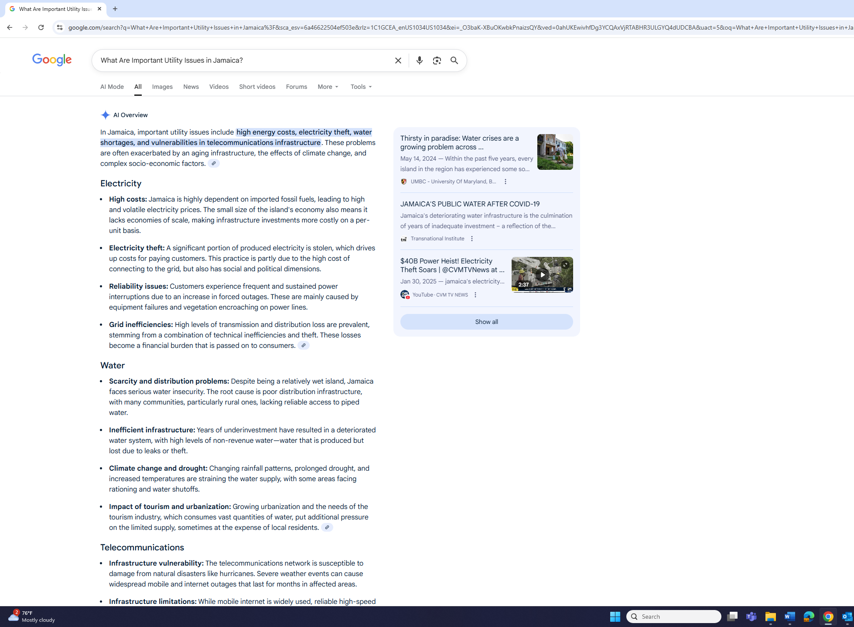
What’s AI saying about you?
Notes:
Hypothetical

Slide 5
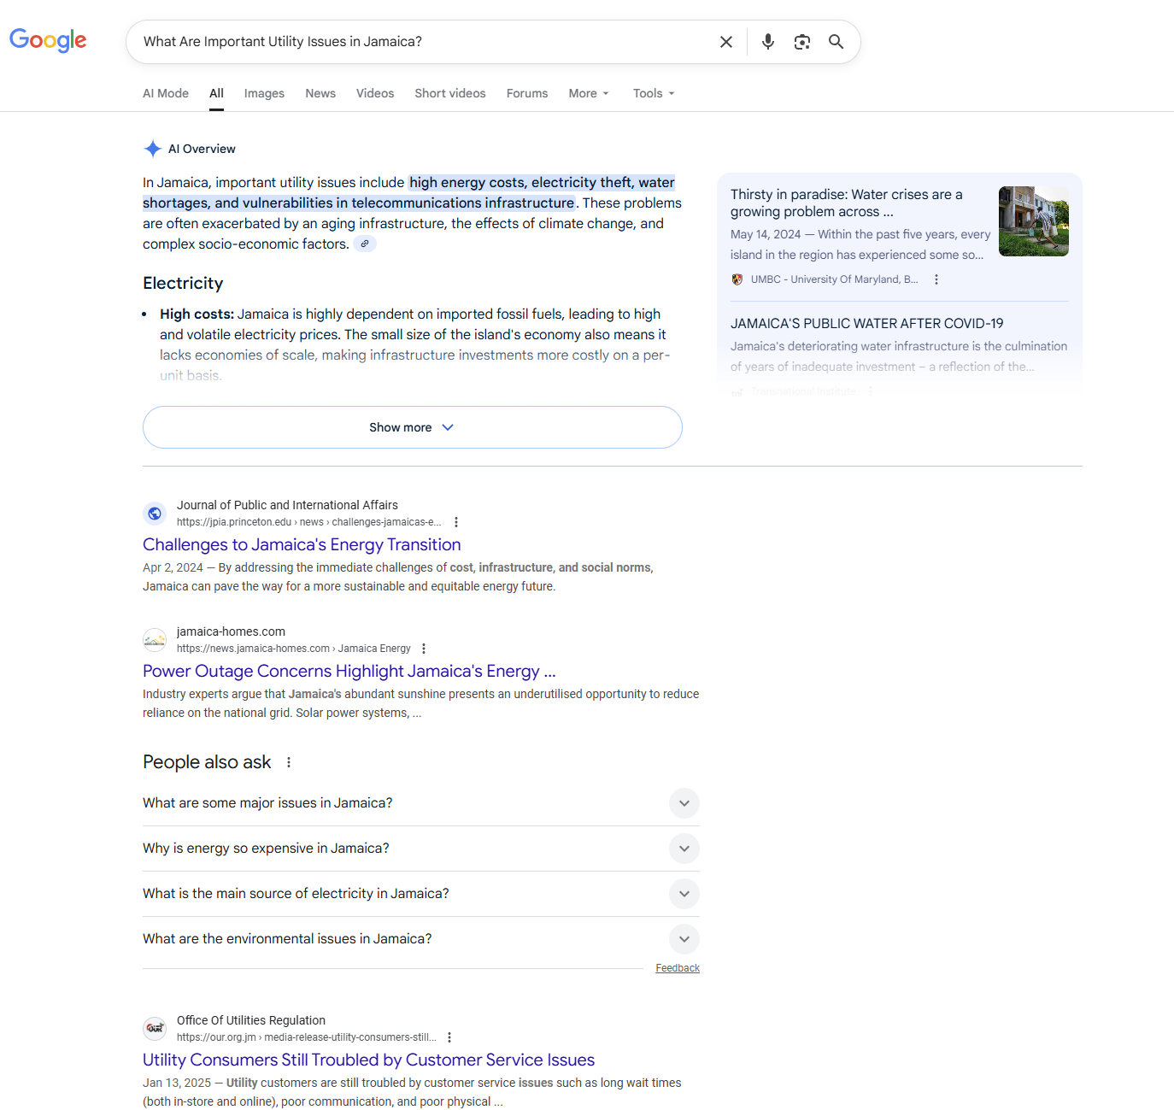
Goodbye Clicks, Hello AI: Zero-Click Search Redefines Marketing | Bain & Company
Notes:
Hypothetical

Slide 6
Bain and Company on Redefining Marketing https://www.bain.com/insights/goodbye-clicks-hello-ai-zero-click-search-redefines-marketing/
80% of people now rely on AI generated content when using search engines
40% of them don’t click any further (“Zero Click” searches)
And 60% of them end their searches with just one click
  Google is speaking on your behalf…

Slide 7
Where to use AI and not?
MIT Source: The GenAI Divide: State of AI in Business https://www.artificialintelligence-news.com/wp-content/uploads/2025/08/ai_report_2025.pdf
Create Highly Targeted AI Assists
Remove drudgery, free up time, automate repeatable tasks, amplify existing workflows
Your "AI assist perimeter" for low-judgment work like summaries, first-pass research, formatting, repurposing, tagging, scheduling, and drafting
Protect Your Human-Crafted Core
Maintain your human-crafted, artisanal core
  Uniquely you and unscalable
  Relationships, in-person experiences…
  and tasks requiring heart, humor, or humanity
Your "no AI core" for strategic elements like source of truth content, your voice, client interactions

Slide 8
95% of AI projects fail
MIT Source: The GenAI Divide: State of AI in Business https://www.artificialintelligence-news.com/wp-content/uploads/2025/08/ai_report_2025.pdf
95% of AI Projects Fail*
  150 executives
  350 employees
  300 individual AI projects
  *Learning gap is to blame
  Do you want to be a leader or a follower?

Slide 9
Skills to Learn in the World of AI: Leadership
Amazon Web Services CEO: Soft skills—critical thinking, emotional intelligence, and adaptability—are most important
  https://www.cnbc.com/2025/08/13/amazon-aws-ceo-the-most-important-skill-you-need-to-succeed-in-ai-age.html
Airbnb CEO: Students need to learn how to solve problems and provide leadership. Human strengths are the true differentiator: Adaptability, judgment, resilience
  https://www.harvardbusiness.org/insight/climbing-the-high-summits-why-every-leader-must-master-human-skills-to-get-the-most-out-of-ai/
McKinsey: Work is more deeply human than ever before, given the scope of change and uncertainty
  https://www.mckinsey.com/capabilities/strategy-and-corporate-finance/our-insights/building-leaders-in-the-age-of-ai
  Leadership skills vs technical skills in the age of AI

Slide 10
Your thoughts as an organization
How are you going to communicate when your stakeholders use Google for their answers, and don’t come to your website directly?
Where do you want to be an AI leader? Where do you want to play safe?
How are you going to develop those people skills in an AI context to be successful?

Slide 11
Debriefing
What’s one idea from your group discussion you’d like to share?

Slide 12
We often hear “We are in the age of AI”
At PURC, we like to say that
“We are in the age of people using AI”

Slide 13
Moving into the unknown
(The Three Juxtapositions)
Next practice, not best practice
Why, not what
Leadership, not leading

Slide 14
Free PURC Resources For You
Basics of Artificial Intelligence for Utility Regulation Module 1: https://youtu.be/sWgsAOVTW38
Basics of Artificial Intelligence for Utility Regulation Module 2: https://youtu.be/i_QunTBih-s
ChatPURC: chatpurc.warrington.ufl.edu

Slide 15
Thank you! araceli.castaneda@warrington.ufl.edu
Araceli Castaneda,
Director of Leadership Studies
Public Utility Research Center
https://warrington.ufl.edu/public-utility-research-center/

