Slide 1
Suriname’s Regulatory Framework for a Prosperous and Sustainable Future
Presented at the OOCUR General Conference 2026
Juan Accord – Legal Specialist

Slide 2
Overview of presentation
The Energy Transition Context
The Pre-Reform Regulatory Framework
From Monopoly to Market – Legal Evolution and the Rise of Renewable Energy and Distributed Generation
Ongoing Reforms and the Future Legal Framework

Slide 3
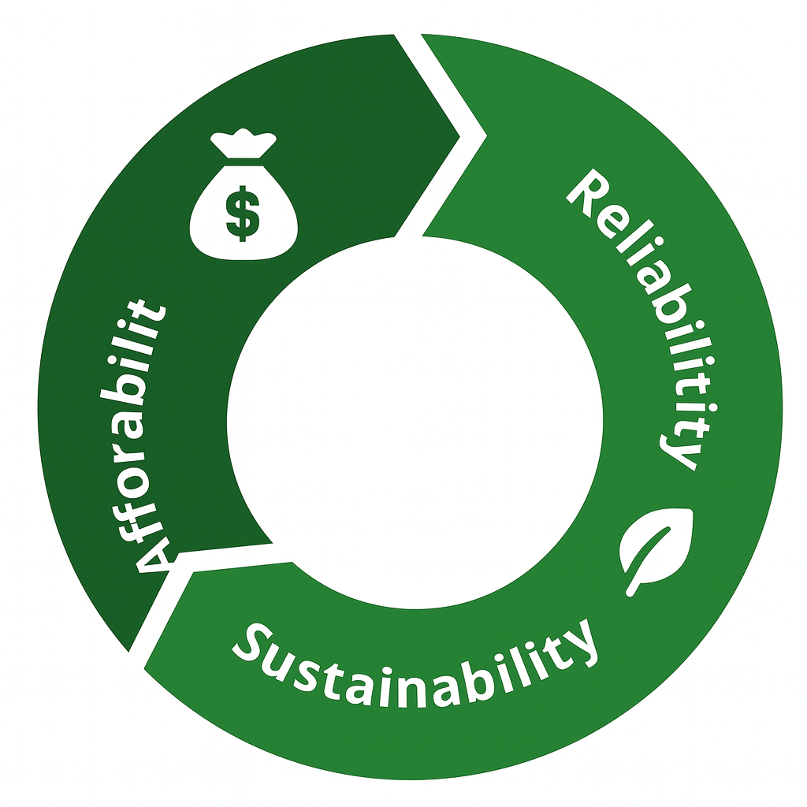
1. Energy Transition context
Suriname is modernizing its electricity sector to align affordability, reliability, and sustainability.
The Energy Authority Suriname (EAS) plays a central role in implementing the Electricity Act 2016, ensuring the legal framework supports a renewable energy future.

Slide 4
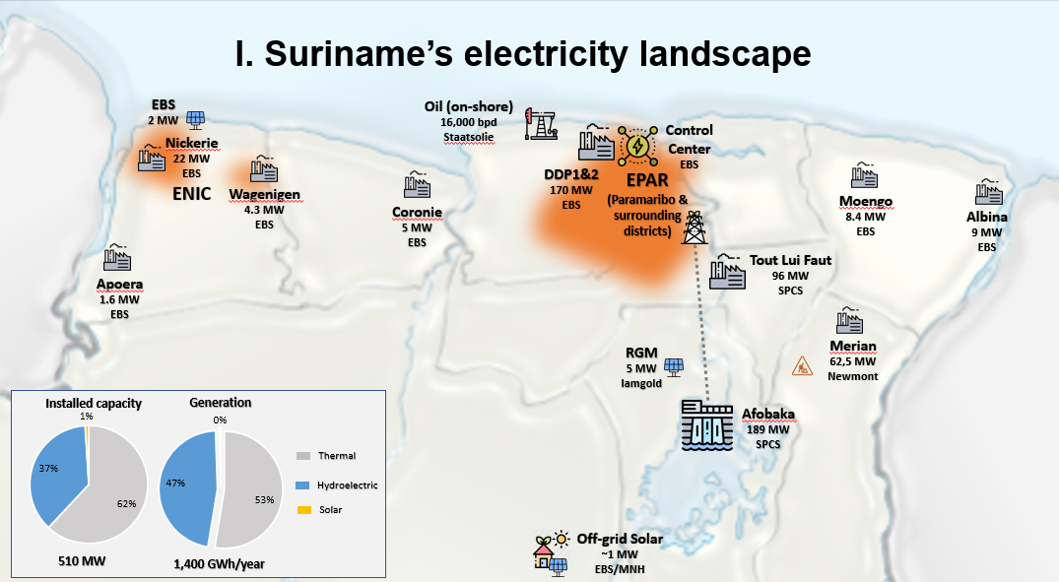

Slide 5
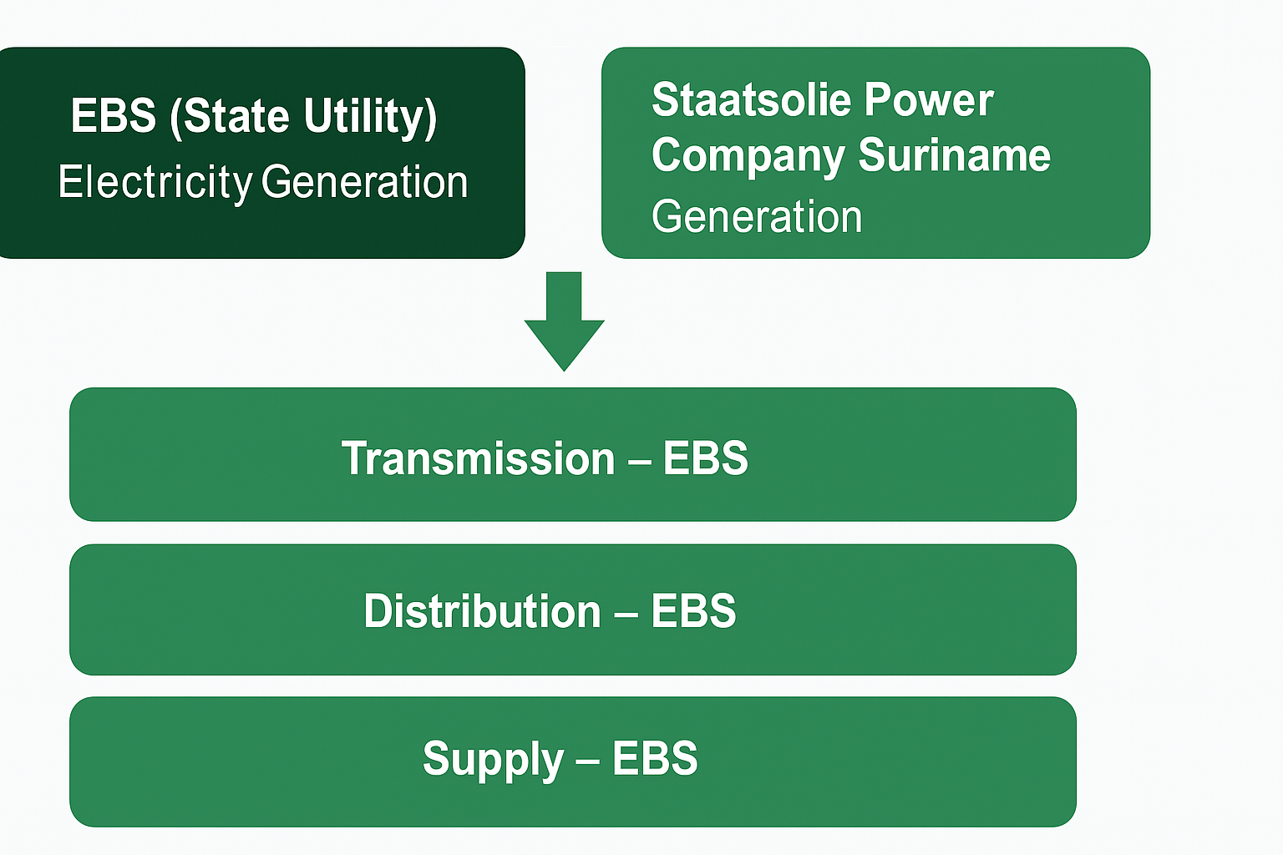
2. Before 2016: Pre-Reform Landscape

Slide 6
Pre-Reform Landscape
No dedicated Electricity Law.
EBS held a legal and operational monopoly.
Tariffs politically determined.
No regulation or renewable-energy provisions.

Slide 7


Slide 8
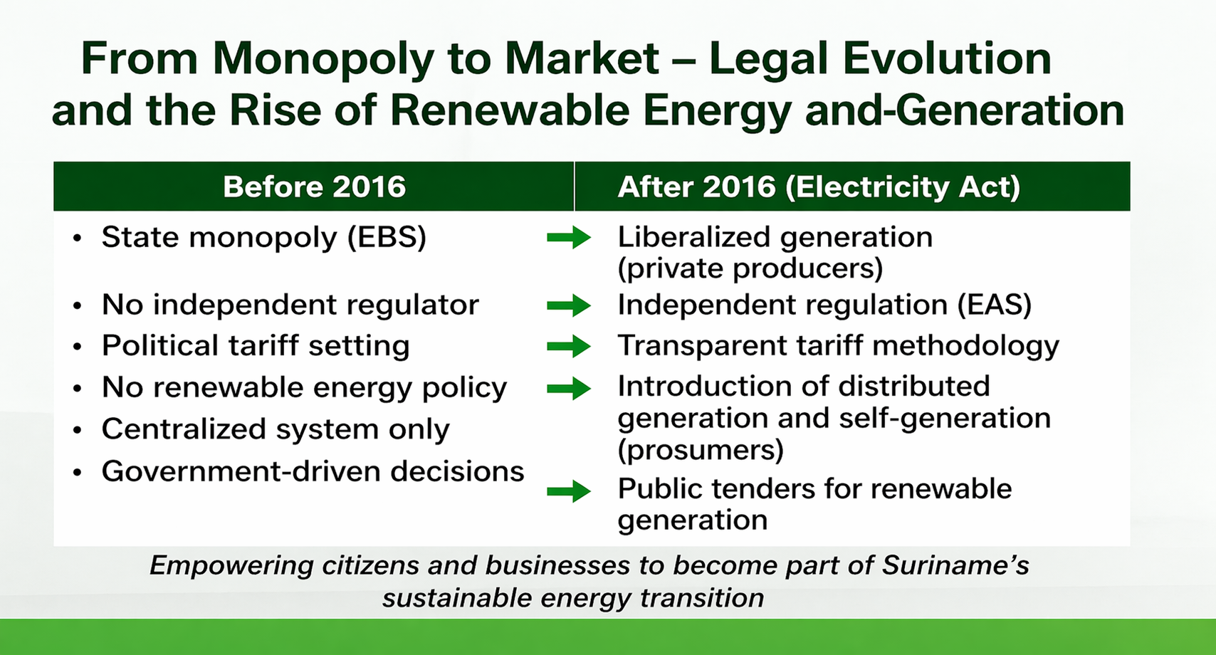

Slide 9
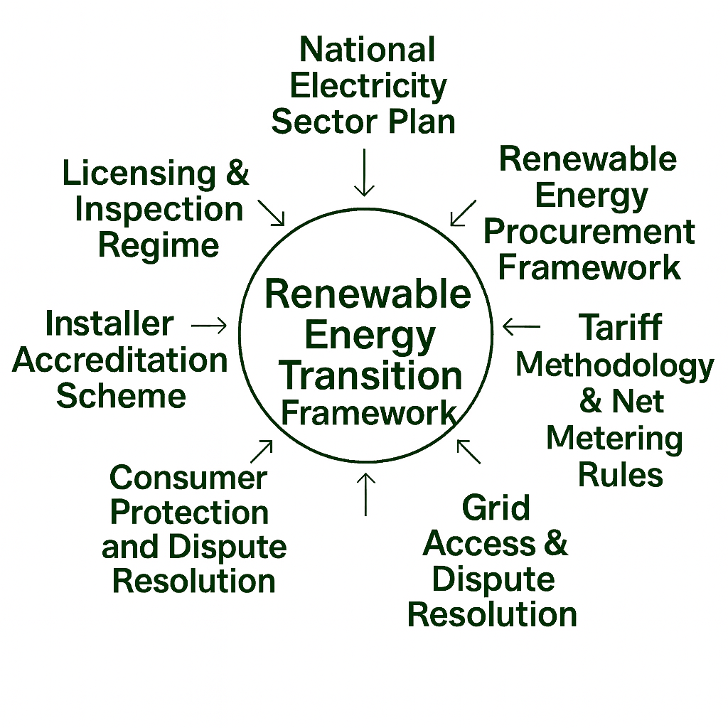
SME’s Legal Instruments for the Renewable Transition

Slide 10
Ongoing Reforms and the Future Legal Framework

Slide 11
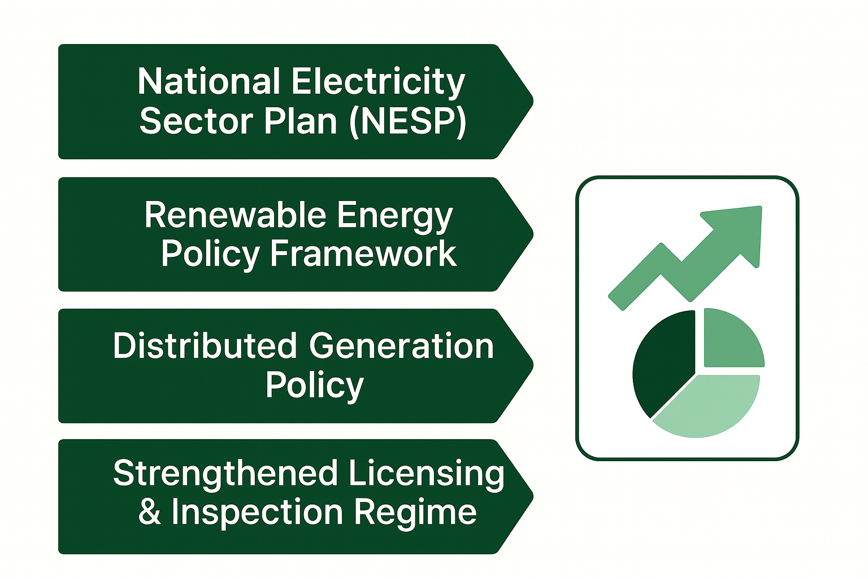
Ongoing Reforms and Future Legal Framework

Slide 12
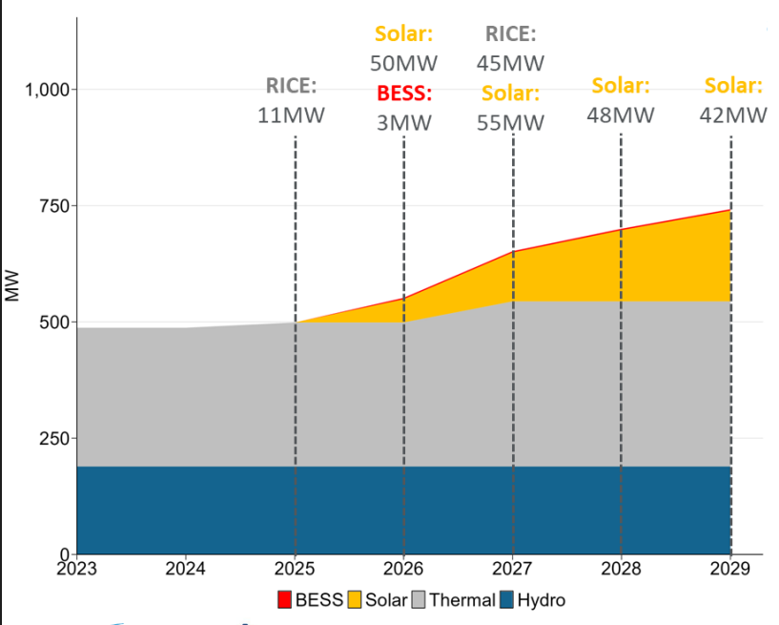
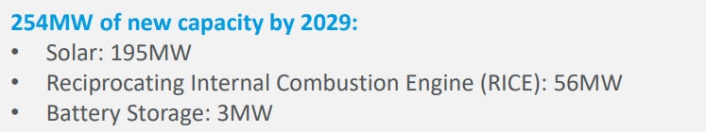
EPAR’s expansion plan for 2025-2029

Slide 13

“The law is not just a framework — it is the foundation of Suriname’s energy transition.”
Questions?

