Slide 1
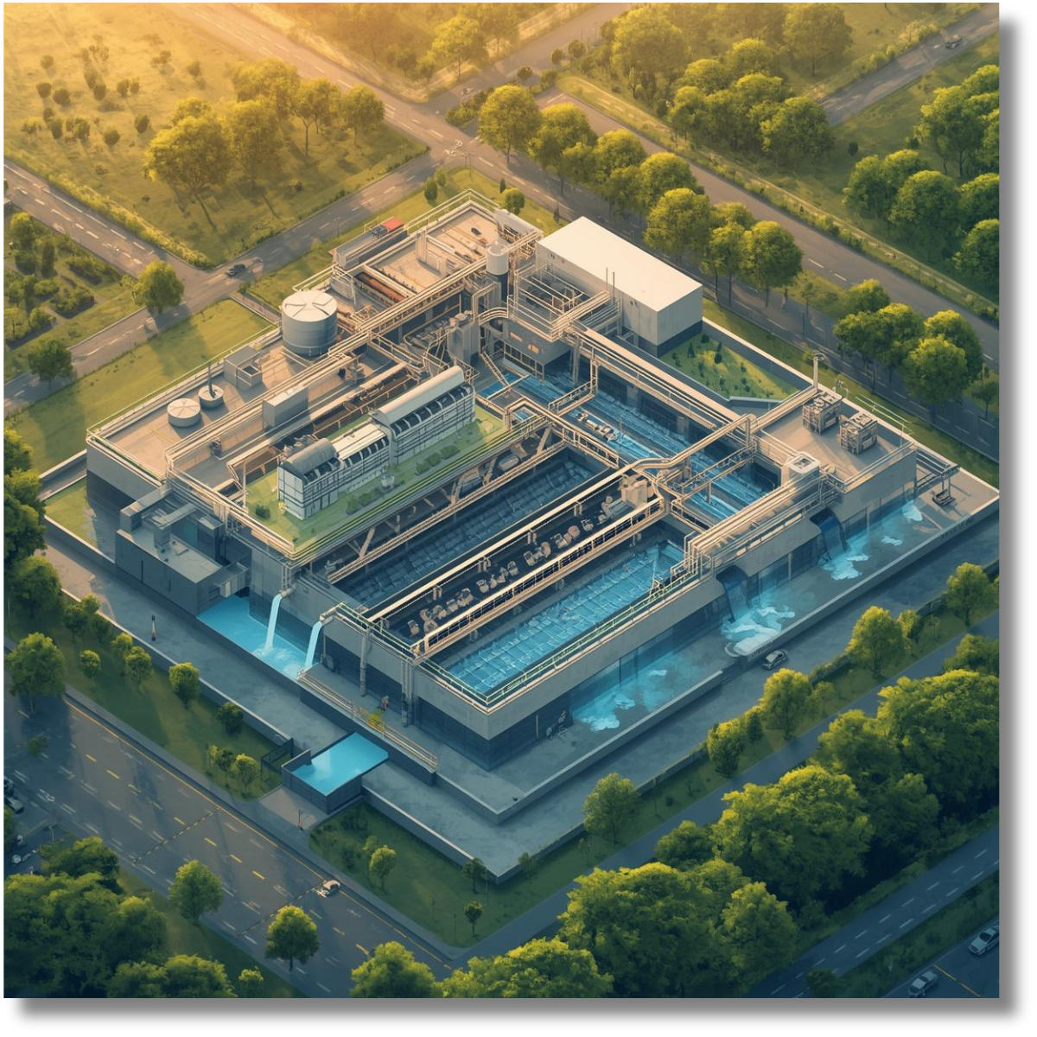
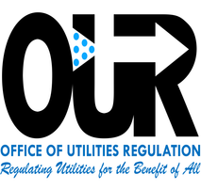
Shifting the Culture: A Coordinated Approach to Increasing Water Supply
Sashana Miller
April 27-May 1, 2026
Office Of Utilities Regulation

Slide 2




Introduction
In 2024, approximately 2.2B people lacked safely managed drinking water.
Water systems are under strain from pollution, water stress, and weak governance.
Only 56% of domestic wastewater is safely treated, water stress remains critical in several regions, freshwater ecosystems are declining, and transboundary cooperation is limited
Between 2015 and 2024, the share of the population using safely managed drinking water rose from 68% to 74%.
At the current rate the world will not achieve sustainable water management until at least 2049.
About 10% of the global population now lives under high or critical water stress
https://unstats.un.org/sdgs/report/2025/The-Sustainable-Development-Goals-Report-2025.pdf

Slide 3

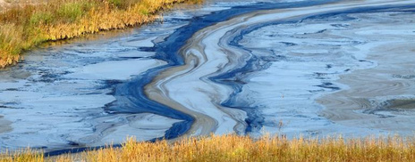
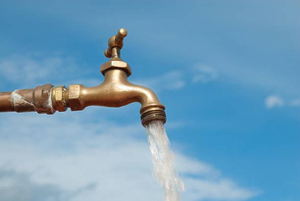
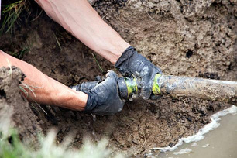
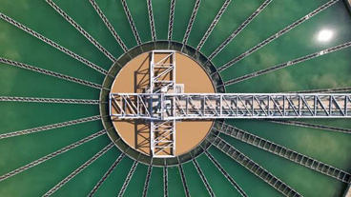
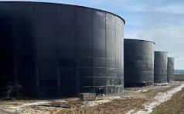
Water Supply Challenges in the Caribbean
Climate
Increased
Non-Revenue
Limited and Aging
Poor National Water Storage
Variability (droughts)
Pollution
Demand
Water
Infrastructure
Systems

Slide 4

Uniting Stakeholders for Sustainable Water Supply
A coordinated approach that integrates multiple stakeholders to enhance efficiency, optimise resources, and ensure long-term sustainability.
Strategic Planning + Collaboration = Impact
🏛
Government
Implements policies prioritizing infrastructure investments, regulatory frameworks, and public awareness campaigns.
🌐
International Agencies
Provide vital funding and technical expertise enabling large-scale water access and infrastructure resilience.
⚡
Emerging Technologies
Advanced project management and smart tech improve efficiency, reduce losses, and accelerate project delivery.

Slide 5
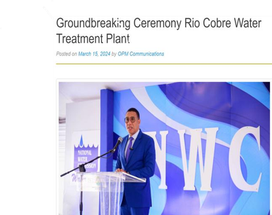
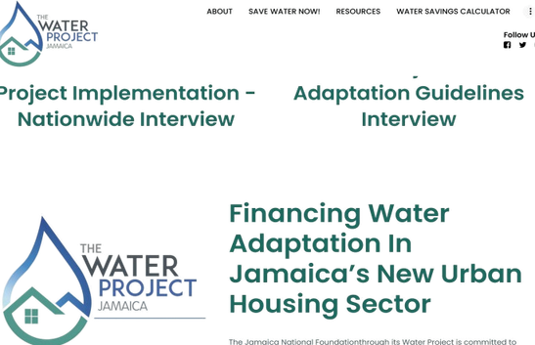
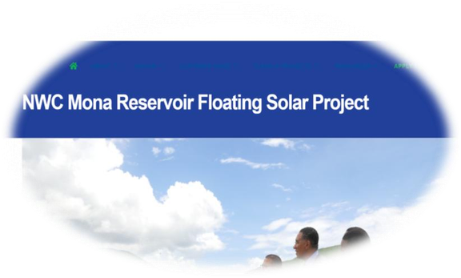
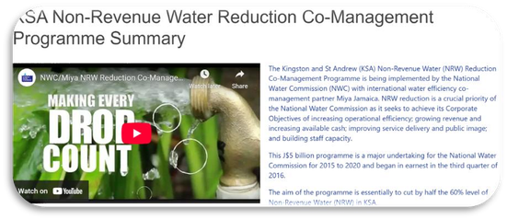
Jamaica’s Journey Towards Water Supply Resilience
Rainwater Harvesting (RWH) Planning Guideline

Slide 6
Jamaica’s Journey Towards Water Supply Resilience
Rainwater Harvesting (RWH) Planning Guideline was approved by Cabinet in October 2023.
Government of Jamaica – National Drought Mitigation Programme (NDMP)
National Water Resources Master Plan for Jamaica
Managed Artificial Recharge (MAR) Facility – Innswood, St Catherine.

Slide 7

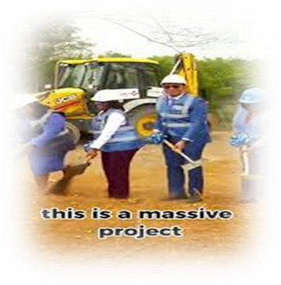
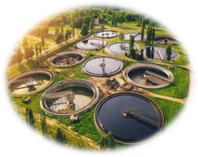
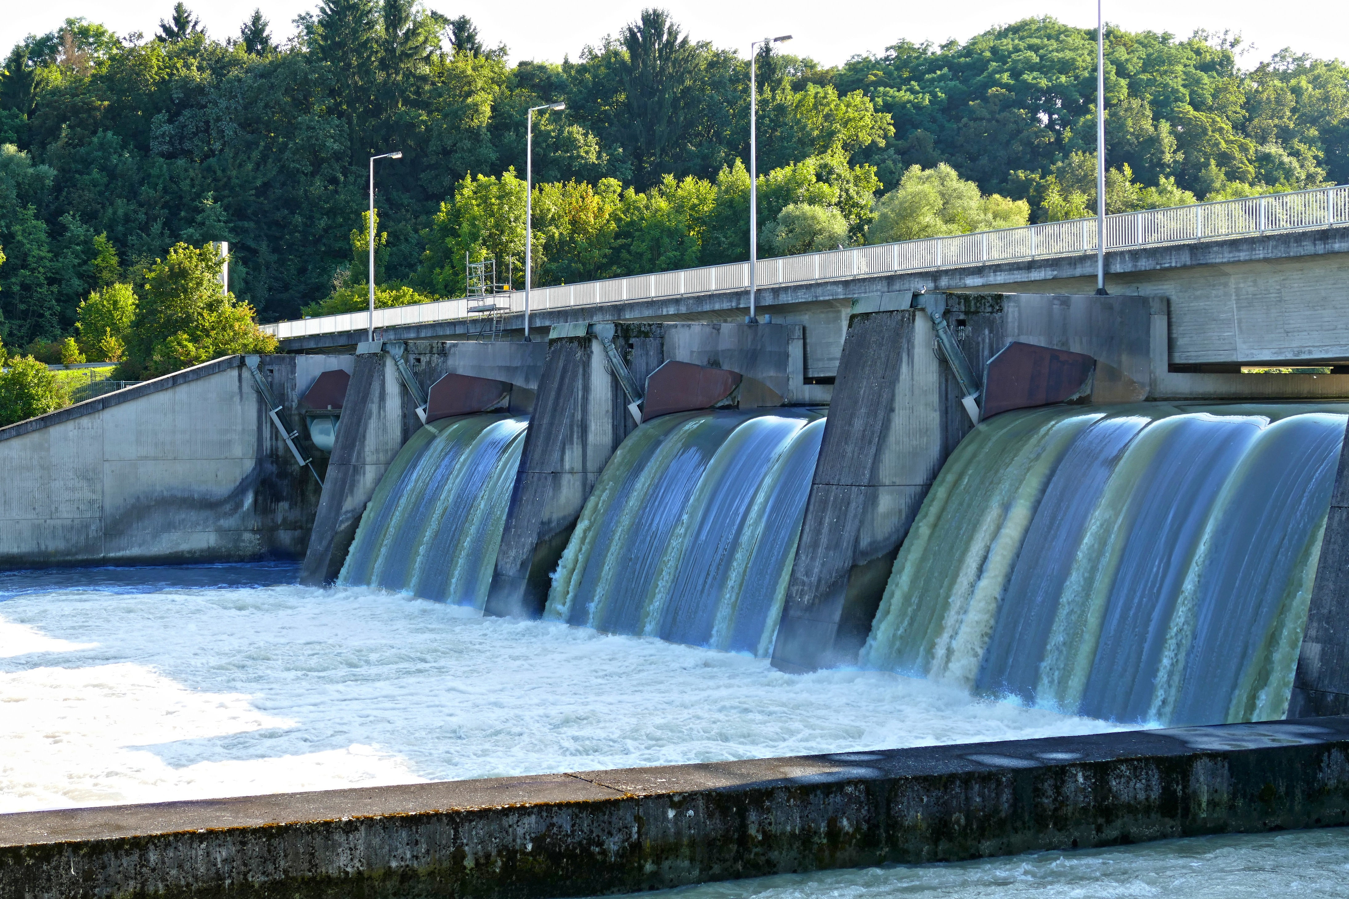
A New Approach: The Reuse of Treated Effluent from the Soapberry Wastewater Treatment Plant

Slide 8
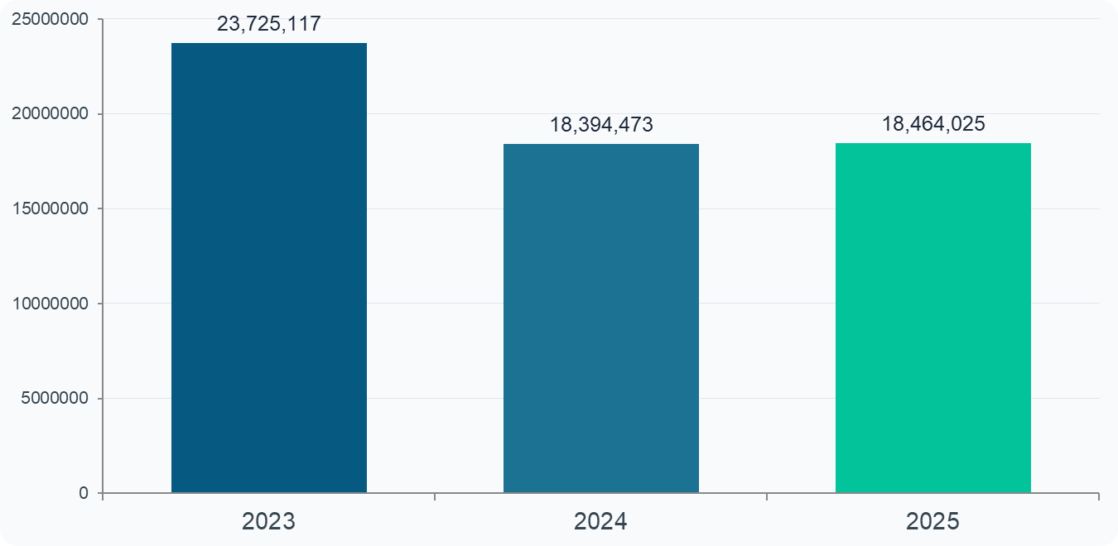
Wastewater Reuse
SOAPBERRY WASTEWATER TREATMENT PLANT
Plant Overview
Treatment Process Flow
RAW SEWAGE
INFLOW
OXIDATION
PONDS
ALGAE
TREATMENT
POLISHING
LAGOONS
EFFLUENT
DISCHARGE
📍 Location
St. Catherine, Jamaica (200 acres)
🏭 Operator
WOMC (Wastewater Operation & Mgmt Co.) . Managed by Central Wastewater Treatment Company
👥 Owner
NWC (85.2%) | Ashtrom Ltd (14.8%)
🔬 Regulator
Office of Utilities Regulation (OUR)
Current Utilization (Cubic Meter)
💧 Capacity
75,000 m³/day — ~30M m³/year
🏙️ Serves
~256,000 people across KMA (Through the NWC’s Network)
✅ Commissioned
February / March 2008
🔄 Operating
24/7 — zero downtime since launch

Slide 9
Wastewater Reuse
😟 The Perception Barrier
🔄 The Mindset Shift Required
✅ How to Drive Change
Yuck Factor
"Waste" to dispose of
▶
A resource to recover
📢 National Awareness Campaign
Many Jamaicans instinctively associate treated wastewater with sewage — regardless of treatment quality. This emotional rejection overrides scientific evidence.
Government-led messaging reframing treated water as a resource. Use trusted voices — churches, schools, community leaders.
Religious & Cultural Norms
Sewage = dangerous
▶
Treated effluent = safe
🏫 School & Youth Education
Deep-rooted beliefs around cleanliness and purity shape attitudes to water. 'Recycled sewage' carries a social stigma difficult to shift without deliberate engagement.
Embed water literacy in the national curriculum. Children become household advocates — as seen in Singapore and Australia.
Low Awareness
Someone else's problem
▶
Shared water stewardship
🔬 Radical Transparency
Most citizens are unaware that countries like Israel, Singapore and Namibia have safely reused wastewater for decades — including for drinking water.
OUR and NEPA publish real-time Soapberry effluent quality data publicly. Trust is built through evidence, not promises.
Mistrust of Institutions
Government will fix it
▶
Community participation
🌾 Visible Pilot Successes
Historical underinvestment in Jamaica's water infrastructure has eroded public trust in NWC and government assurances about water quality and safety.
Showcase working agricultural reuse on the Rio Cobre. Seeing treated water grow food breaks the 'yuck factor' faster than any brochure.
Singapore rebranded sewage as 'NEWater' — acceptance rose from 23% to 98% in 10 years through education.
Without public acceptance, even the best-engineered system will face rejection. Culture must change alongside infrastructure.

Slide 10
Wastewater Reuse
WASTEWATER REUSE: PATHWAYS & APPLICATIONS
🌾 Agricultural
Irrigation
💧 Aquifer
Recharge
🏭 Industrial
Processes
Treated effluent supplies nutrients and water for crop irrigation — the single largest global use, cutting freshwater demand by up to 30%.
Injecting treated water into depleted groundwater systems restores reserves and prevents saltwater intrusion in coastal areas.
Cooling towers, manufacturing, and construction can substitute treated reclaimed water for potable supply — reducing industrial freshwater draw.
🌿 Environmental
Flows
🏙️ Urban Non-
Potable Reuse
🚰 Indirect Potable
Reuse (IPR)
Restoring wetlands, rivers, and estuaries improves biodiversity and supports the ecosystem services that underpin freshwater cycles.
Toilet flushing, street cleaning, parks and golf course irrigation — reducing urban potable demand by 15–25%.
Highly treated effluent is blended into drinking water reservoirs after extended environmental buffer. Used in Singapore, Namibia, Israel.

Slide 11
Wastewater Reuse
GLOBAL LEADERS IN WASTEWATER REUSE — LESSONS FOR JAMAICA
🇮🇱 Israel
🇸🇬 Singapore
🇪🇸 Spain
90%
40%
17%
of wastewater reused
of water supply from NEWater
of treated water reused
World leader. ~87% used for agricultural irrigation via a national distribution network. The Dan Region Reclamation Project recharges aquifers with tertiary-treated effluent. Freed coastal aquifers from over-abstraction.
NEWater — ultra-purified reclaimed water — supplies industrial and indirect potable use. 5 NEWater plants treat 100% of Singapore's wastewater. Target: 55% of demand met by reuse by 2060.
Largest reuse volume in the EU. Murcia region irrigates 65,000 ha of agriculture with reclaimed water. Strict EU 2020 Reuse Regulation governs quality standards.
🇳🇦 Namibia
🇦🇺 Australia
🇯🇴 Jordan
Since 1968
30%+
100%
direct potable reuse
reuse across states
treated effluent reused
Windhoek's Goreangab Plant — world's first direct potable reuse facility — has operated for over 50 years. Blends treated reclaimed water directly into the city's drinking supply.
Perth's Water Corporation injects treated wastewater into the Gnangara aquifer system, replenishing 50% of Perth's groundwater. South Australia has mandatory reuse targets tied to urban planning.
With minimal freshwater, Jordan treats and reuses ALL wastewater — primarily for irrigating 30,000+ ha of crops. The As-Samra Treatment Plant is one of the largest in the Middle East.

Slide 12
Wastewater Reuse
AN INTEGRATED GOVERNANCE FRAMEWORK FOR JAMAICAN WASTEWATER REUSE
GOVERNMENT
& POLICY
CWTC/ SPV
PRIVATE
INVESTORS
Set national targets
Enact Water Reuse Rules and Laws
Allocate capital funding
Operate treatment plants
Deliver treated effluent
Expand infrastructure
Finance PPP expansion
Build distribution pipelines
Manage reuse facilities
WASTEWATER
REUSE
ECOSYSTEM
FARMERS &
INDUSTRY
OUR
REGULATOR
Set quality standards
Approve tariffs
Issue reuse licences
End-users of reclaimed water
Reduce freshwater abstraction
Pay affordable reuse tariff
NEPA &
WRA
Environmental compliance
Monitor discharge quality
Groundwater protection

Slide 13



CWTC/SOAPBERRY WWTP
  Lease Agreement
  2. WWPA
SPV GLOBAL SHAREHOLDER
LENDERS
INVESTOR 1
DEBT 1
Equity 30%
SPV
DEBT 70%
Your paragraph tex
SPV
INVESTOR 2
DEBT 2
  3. EPC CONTRACT
  4. O&M CONTRACT
OPERATOR
•CONTRACTOR
CONTRACTOR
Storage Construction and Piping Phase 3 years
Operating phase 22 years

Slide 14
Requirements of the SPV
●
The SPV is issued with a licence which expires on the 23rd anniversary of the commercial operations date.
●
The Licence may not be assigned or transferred, and the Licensee cannot transfer ownership without the written consent of the Minister.
●
The rates and fees to be charged for the water supplied must be in accordance with the WPA
and approved by the OUR.
●
The Licensee must maintain and keep in good repair all equipment and facilities used in carrying out the Licensed business.
●
The accounts and records of SPV should be sufficient to separate the activity of the licensed business from any other business operated by the Licensee. These accounts must be audited annually.

Slide 15
The Role of the Regulator
THE REGULATOR'S ROLE: OUR AS ENABLER OF WASTEWATER REUSE
Licensing
& Standards
Tariff
Framework
PPP
Oversight
Issue Reclaimed Water Use Licences to NWC or SPV
Establish tiered effluent quality standards by end-use (agriculture, industrial, recharge)
Adopt WHO / EU 2020 reuse water quality benchmarks
Mandate NEPA ‘s compliance for all reuse discharges
Set a suitable tariff rate lower than potable water tariffs to incentivize uptake
Allow for the recovery of wastewater reuse infrastructure costs
Establish a Reuse Factor (RF) similar to the existing PAM mechanism
Protect agricultural and small-farmer affordability
Review Soapberry’s PPP expansion agreement.
Set performance bond and service-level obligations for private operator
Ensure public interest protections in 20-year concession contract
Monitor and publish annual reuse performance data

Slide 16
Wastewater Reuse
SOAPBERRY: THE REUSE OPPORTUNITY IN NUMBERS
55,000
20M+
50,000
US$100M
m³/day
m³/year
hectares
expansion
Currently discharged
into Rio Cobre
Available for
agricultural reuse
Farmland that could
be irrigated
PPP investment to
double capacity
Recommended Reuse Pathways for Soapberry Effluent
🌾 South Coast Agriculture
🏭 Portmore Industrial Zone
💧 Liguanea Plain Aquifer
🌿 Kingston Harbour Restoration
Rio Cobre corridor farmlands — sugar, banana, vegetables. Minimal new pipeline infrastructure. Immediate uplift for food security.
Supply treated effluent for industrial cooling, construction, and manufacturing in the Kingston Metro corridor, reducing potable demand.
Managed Aquifer Recharge (MAR) into the over-stressed Liguanea aquifer — KSA's primary groundwater source — to offset saltwater intrusion.
Diverting treated effluent from Rio Cobre into managed wetland buffer zones reduces Kingston Harbour nutrient loading and improves marine ecology.

Slide 17
Wastewater Reuse
IMPLEMENTATION ROADMAP: WASTEWATER REUSE IN JAMAICA
Phase 1
Policy & Regulatory Foundation
2026 – 2027
Enact National Water Reuse Policy
OUR issues Reclaimed Water Licensing Framework
CWTC/ SPV /NWC conduct feasibility studies for 3 priority reuse pathways
Establish inter-agency taskforce (OUR, NEPA, WRA, NWC, MOA)
Phase 2
PPP Transaction & Pilot Projects
2027 – 2029
Complete Soapberry PPP market process — award 20-year concession
Launch agricultural pilot: 5,000 ha Rio Cobre corridor irrigation scheme
Begin Managed Aquifer Recharge (MAR) feasibility for Liguanea Plain
OUR sets initial reclaimed water tariff structure
Phase 3
Scale-Up & National Integration
2029 – 2033
Soapberry expansion complete: 150,000 m³/day capacity
Full agricultural reuse network operational: 20,000+ ha irrigated
Industrial reuse pipeline serving Portmore / Spanish Town corridor/KMA
National Water Accounts reflect reuse as a formal supply source
Notes:
Timeline subject to Cabinet approval, PPP process outcomes, and regulatory review. Phasing aligns with Jamaica's Vision 2030 water sector targets.

Slide 18
Wastewater Reuse
RECOMMENDATIONS & CALL TO ACTION
01
Enact a National Water Reuse Act
GOJ / Parliament
Jamaica needs a dedicated legal framework that classifies treated wastewater as a resource, not a waste. Government should table legislation by 2027.
02
OUR: Issue Reclaimed Water Licence Class
OUR
The Office of Utilities Regulation should establish a distinct licensing category for reclaimed water supply, with tiered quality standards and a below-potable tariff.
03
Fast-Track the Soapberry PPP
GOJ / NWC / DBJ
Government should complete the Soapberry divestment and expansion process in 2026, unlocking 75,000 m³/day of new capacity and private investment in reuse infrastructure.
04
Pilot Agricultural Reuse on the Rio Cobre
NWC / MOA
NWC and the Ministry of Agriculture should launch an immediate pilot supplying 5,000 ha of farmland with Soapberry treated effluent — demonstrating the model before full rollout.
05
Commission Liguanea Aquifer Recharge Study
WRA / NEPA
WRA and NEPA should commission a managed aquifer recharge feasibility study for the Liguanea Plain — Jamaica's most critical urban groundwater resource.

Slide 19
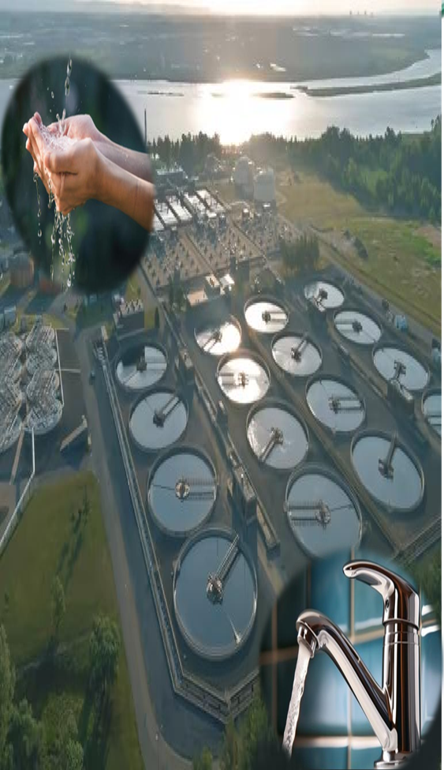
Conclusion
Jamaica has ~ 55,000 m³ of high-quality treated water leaving Soapberry every single day. Today it flows into a river. Tomorrow, it could grow our food, recharge our aquifers, and secure our cities.
"The water of the future
will not come from rain -
it will come from us."
EVERY DROP
COUNTS.
Wastewater reuse can augment Jamaica's water supply by up to 20%
Soapberry's 55,000 m³/day output is an untapped national asset
Israel, Singapore, Jordan & Australia show reuse is achievable at scale
The OUR must establish a clear licensing and tariff framework
A PPP model with private capital can deliver the Soapberry expansion
Collaboration across GOJ, OUR, NWC, NEPA, WRA, and farmers is essential
Key Takeaways

Slide 20
Conclusion
The water industry is at a crossroads where traditional methods are no longer sufficient to meet growing challenges. Innovation introduces the tools, technologies, and processes necessary to tackle these issues, while a mindset shift aligns industries, governments, and communities towards sustainable and equitable water use. Together, they are essential to creating a future in which water resources are efficiently managed, protected, and accessible to all.

