Slide 1
Navigating Caribbean Regulatory Challenges:
Opportunities, Innovations and Collaborations
Insights from Suriname’s Evolving Regulatory Framework
Energy Panel Discussion - Regulating DER: Challenges and Opportunities in the Caribbean
Wednesday, April 29th, 2026 | OOCUR 20th Annual Conference | Jamaica
Sorayadebie Jhagroe, MSc.
Notes:
Good morning everyone.
Thank you to the moderator for setting the stage so clearly, especially highlighting how DERs are transforming electricity systems globally.
In Suriname, we are experiencing that same transition to some extent:
from a centralized, utility-driven system to a more decentralized and participatory model.

Slide 2
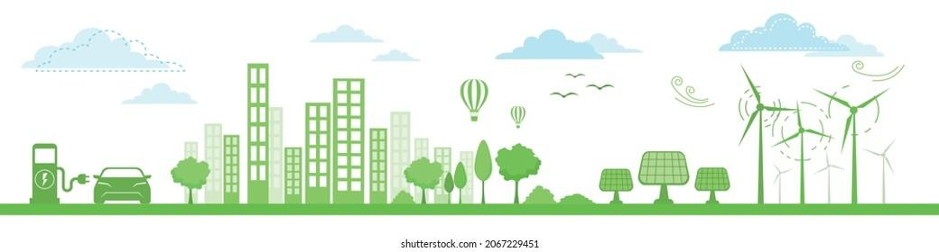
Table of Contents
EAS: Overview of Background, Framework & Responsibilities
Context of the Presentation
Suriname’s Evolving Framework with regard to DERs
Notes:
Today, I’ll briefly share:
Our regulatory starting point and especially how we have progressed and how DERs are emerging in our system, with more challenges than we thought
Also, this was not initially my topic, but I hope to be able to navigate as this year’s theme also notes.
I do have many slides for some info, especially towards the end with some smaller letters to give more of an overview. l’ll try to keep it brief within my 7 minutes given.

Slide 3
Background
&
Regulatory
Framework
Wednesday, April 29th, 2026 | OOCUR 20th Annual Conference | Jamaica
Sorayadebie Jhagroe, MSc.
Notes:
For the background & regulatory framework

Slide 4
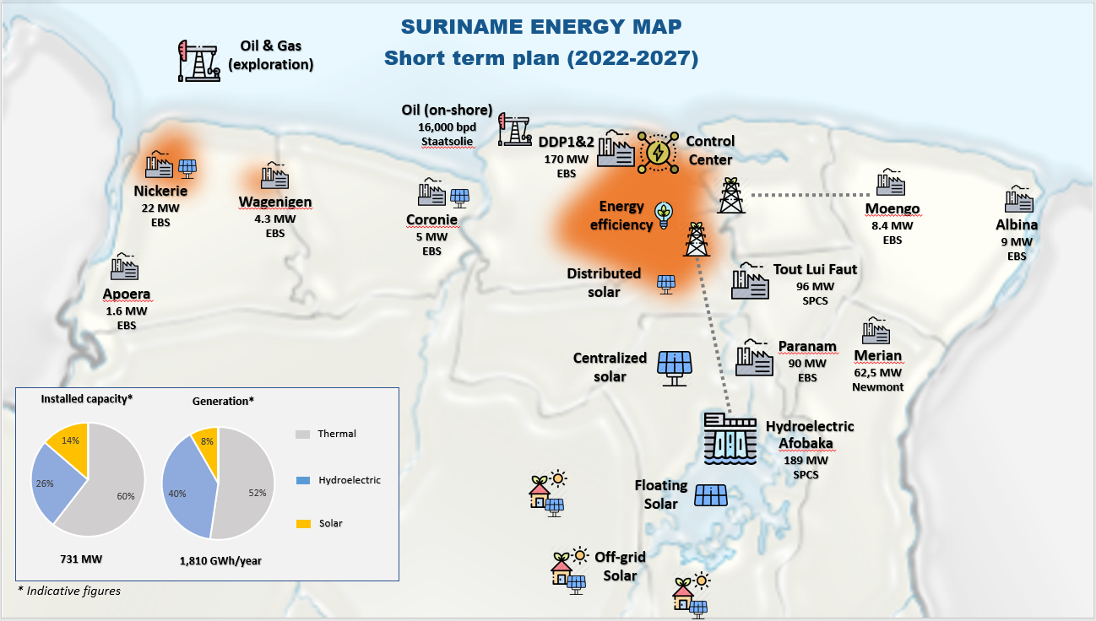
Notes:
This is an overview of the Suriname map with installed capacities. We already know that demand will be growing, and steadily in the coming years.
Suriname’s installed capacity reflects a centralized system, but demand is expected to grow by about 10% each year in the coming years.”
“At the same time, DERs will add supply AND they will fundamentally reshape how demand appears and is managed on the grid.”

Slide 5
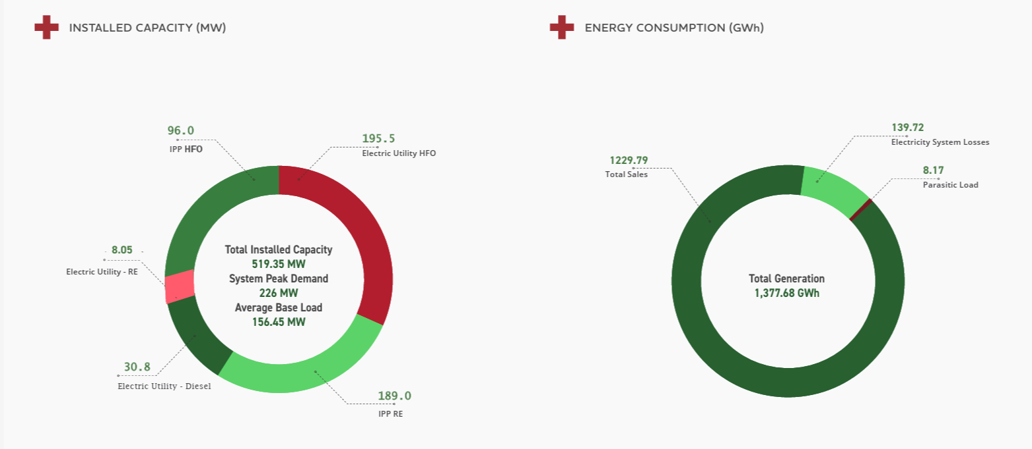
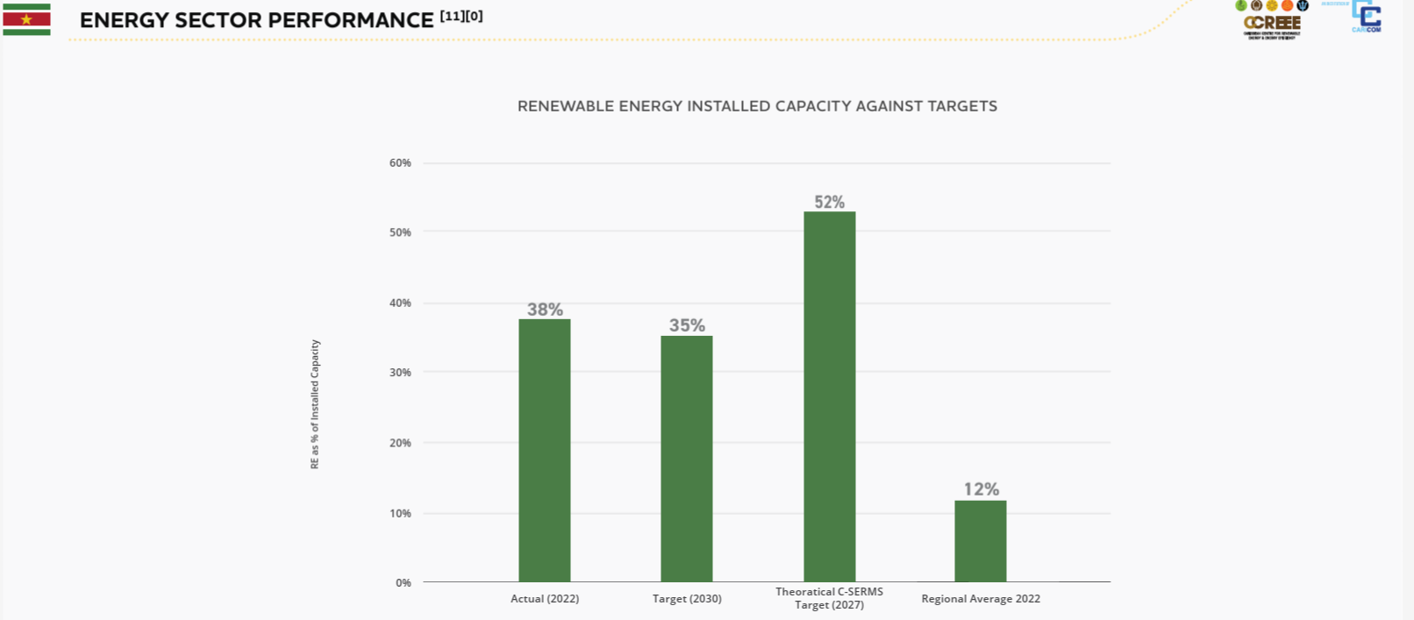
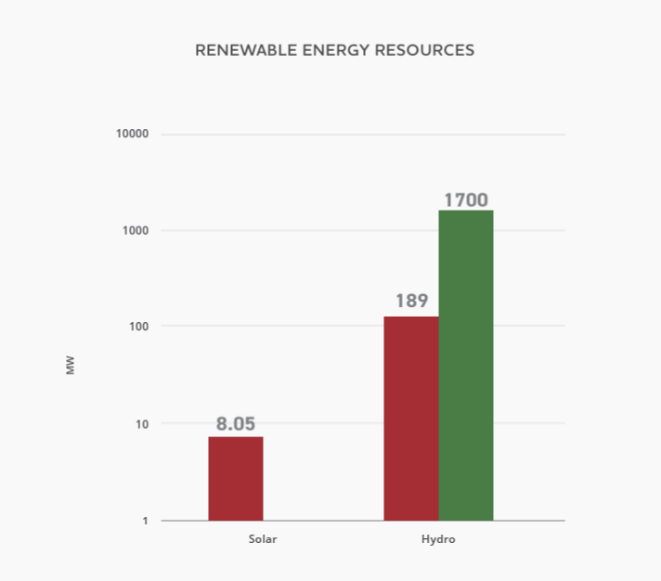
Energy Report Card – CCREEE
Notes:
This slide shows the gap between our current renewable capacity and our national targets, highlighting both progress and the scale of what still needs to be achieved.”
Closing this gap will in some way also be depend on DERs, making it essential that our regulatory framework enables, and not limits, their growth

Slide 6
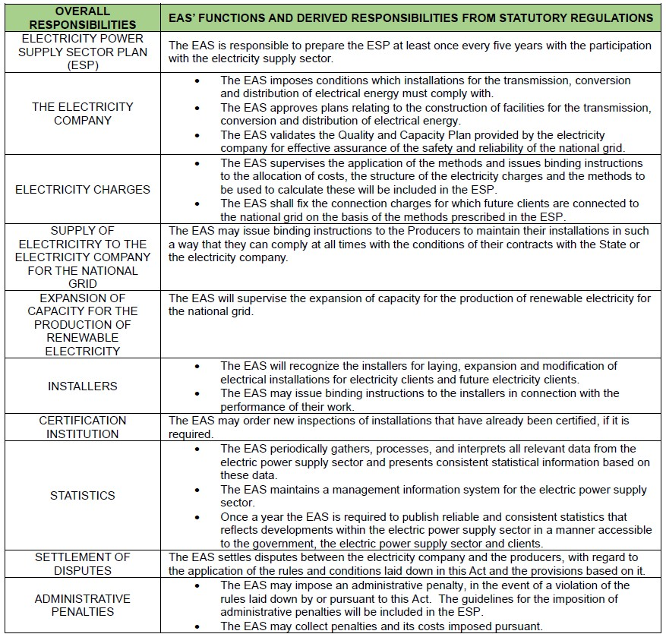
Overview of Background, Framework & Responsibilities
Independent regulator, EAS-Act established in 2016, operational since 2020
Mission: transparent, reliable, and sustainable energy governance
Board of Directors
(EAS-Act): 7 persons
Managing Director
Staff: 3 Technical (HoD ERT + 2 Specialists), 1 Administrative, 2 Ancillary, Vacant: Technical Regulation & Supervision
The Electricity Act defines the regulatory methodologies that govern the electricity sector
The ESP is intended to be guiding the sustainable development of the Power sector in Suriname in assuring a reliable supply of electricity.
Notes:
The EAS established under the Electricity Act of 2016 (BUT ONLY ACTUALLY OPERATIONAL SINCE 2020), is responsible for regulating the electricity sector, providing the foundation for integrating emerging solutions like DERs into the system. We are small, only 7 staff and ancillary staff, limited by the E – Act currently. So I asked myselfthe question yesterday: Where should I put DERs in for us at the EAS? It is clear that it is a cross-cutting aspect, based on legal and more regulated through economic as well as technical regulation.

Slide 7
Fundamental regulatory framework
Fundamental changes Electricity Sector of Suriname:
The Electricity Act 2016
The Act on establishment of the Energy Authority Suriname (EAS), article 3 & 4
The Electricity Sector Plan, article 8 & 9
The Electricity Company (organisation structure). article 10 & 12
IPP Process for non- RE sources, article 21
Self generation, art. 11 sec 3 & art. 13
Tariff setting, article 17 sec 5
Licensing framework, art. 21 sec 4
Reforms underway: tariff reform (IMF Program until 2024/5, renewable energy regulation, PPAs
New mechanism: auctions/tenders for renewable generation capacity
Objective: competitive prices, investor confidence, private sector participation
Notes:
Suriname’s electricity sector has been undergoing fundamental reform, since the start, guided by the Electricity Act 2016 and now the ESP, and this is only over the timespan of about 5 years.
For example for DERs:
The Electricity Act allows households and businesses to install small-scale renewable energy systems for their own consumption.
The Act states that these distributed generation customers will be able to receive compensation for electricity they feed into the National Grid,
and mandates that the commercial terms for compensation be established in the ESP.
Now these commercial terms which are currently in the ESP must be based ofcourse on the provisions in the Act, the tariff structure in the tariff methodology, and the flows of electricity to and from the distributed generation system.
The ESP also describes the commercial terms as FIT for selling electricity from distributed generation, but let me also mention that
practically the Electricity Act does not limit the amount of electricity that small scale systems can feed into the National Grid,
but limits the amount of electricity that is eligible for payment from EBS when it comes to for example solar PV.

Slide 8
Time-of-Use (TOU) pricing to encourage off-peak usage.
Capacity-based charges for fair network cost recovery.
Dynamic pricing tested under regulatory sandboxes.
Smart metering and demand-response integration.
Current FIT Mechanism: Suriname currently has a net billing system with a feed-in tariff (FIT) set at 115 percent of the energy rate applicable to the consumer, mandated by State Decree S.B. 2021 no. 88
Suriname’s Unique Starting Point
Nationally Determined Contribution (NDC)
Green Development Strategy (GDS)
The Electricity Sector Plan (ESP)
How ESP Connects to NDC & GDS
Key Transition Opportunities
Notes:
What we’re seeing in Suriname is not a fully mature DER ecosystem yet, but the early building blocks are clearly emerging.
At present, the country already has a net billing framework supported by a feed-in tariff of approximately 115% of the retail electricity rate, established under State Decree. That is a relatively generous incentive, and it plays an important role in stimulating early adoption of rooftop solar.
Looking ahead, mechanisms introduced through regulatory sandboxes or TOU could become increasingly relevant. These tools can help align customer behavior with system needs, especially as variable renewable generation grows.
That said, the effectiveness of these approaches will depend heavily on enabling infrastructure, particularly smart metering and improved system visibility, which are still developing. That may be more on the utility side.
So, in the case of Suriname, the key issue is not yet managing high DER penetration, but putting in place the right regulatory and technical foundations now to support DER growth in a balanced, fair, and sustainable way.

Slide 9
Challenges and opportunities
Challenges:
Methodology
Cost of service does not incentivize the electricity utility company to increase costs towards efficiency (as part of the energy transition which is more focused on O&G), which can potentially benefit both the utility and society
In the periodic calculations of the cost of electricity, the magnitude of variable costs (i.e. generation costs) in particular is a huge challenge, as they depend on the international barrel price for fuel oil (fuel plug purchase for thermal generation) and the official exchange rate for the US dollar
Information asymmetry
Verification of tariff calculations can not be executed properly – framework in progress
No regularly reporting, no properly information system in place – EIMS to be implemented
Notes:
While the opportunities are clear, structural challenges remain for us as the regulator.
The current cost-of-service model does not strongly incentivize efficiency or innovation as a primary goal, which is critical for integrating DERs.
Tariffs are also highly sensitive to fuel prices and exchange rates, creating volatility and uncertainty.
In addition, information asymmetry and limited data availability make verification and effective regulation more difficult—though the planned EIMS is a step in the right direction.

Slide 10
Suriname’s Evolving Regulatory Framework
Wednesday, April 29th, 2026 | OOCUR 20th Annual Conference | Jamaica
Sorayadebie Jhagroe, MSc.

Slide 11
Regulatory substance: Economic Regulation
The tariff methodology and subsidy scheme, introduced in 2021 by State Decrees complies with the E-Act 2016, building blocks ESP 2018 and now under the ESP’s Regulatory Plan; always high priority as the financial soundness of the Electricity Company is a prerequisite for the continuity and growth of the electricity supply sector: cost - of - service regulation
Volume 3: Regulatory Plan under Chapter 3 & 4: Methodology & Regulatory Accounting Rules
EAS uses the Excel based calculation tool, provided with data/information by the N.V. EBS’s to validate total cost of service, allocate cost between customer categories of and set tariffs.
The calculation of the electricity tariff consists of (1) base tariff, a consumption tariff and, where applicable, a labor factor: allows the electricity company to recover its efficient fixed costs (indirect costs) & (2) variable costs (direct costs) both related to the purchase, generation, transmission and supply of electricity, respectively, with an allowable profit margin
Gradual tariff adjustments aligned with IMF-supported subsidy reform has been completed
Notes:
In Suriname, the current tariff structure is based on a cost-of-service model.
It consists of a fixed base charge and a variable consumption charge, reflecting both fixed network costs and fuel-dependent generation costs.
Mechanisms to recover the cost of RE generation include, for example, a pass-through reflecting the cost of generation
and distributed generation customers pay their share of fixed costs as they still use the utility’s transmission and distribution system
when their system is not generating, or when needed.

Slide 12
Regulatory Accounting Rules
RAR: implements the standard for financial reporting for the purpose of determining and verifying the efficient costs for the electricity services provided by EBS.
  Enables transparent cost allocation of renewable integration.
  Supports cost-reflective tariffs and revenue adequacy.
  Identifies renewable-related cost drivers.
  Framework for incorporating distributed generation costs.
Status: review of latest comments draft RAR of EBS by consultant RCFA and agreement to be reached in October 2025 & final RAR to be delivered by the start of November 2025 > Over to execution phase currently
Notes:
The Regulatory Accounting Rules, or RAR, establish a framework for transparent cost reporting and support cost-reflective tariffs.
The RAR is important for DERs because it enables transparent tracking and allocation of costs related to distributed generation.
This supports fair tariffs and compensation mechanisms, which are essential for integrating DERs without distorting the system.
We do have our RAR ready in general, but need to be moving toward real execution, and explore how to do it.

Slide 13
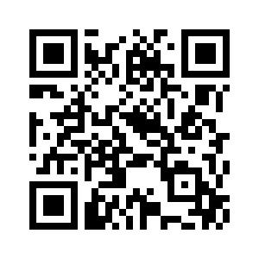
Electricity
Sector
Plan
https://eas.sr/electricity-sector-plan/
Notes:
Just to give you an overview in how, now that we have the ESP, the distributed energy resources are part of our regulatory plan.
You can access the ESP through the barcode, and read through more in depth if interested, as this is a very extensive technical document.

Slide 14
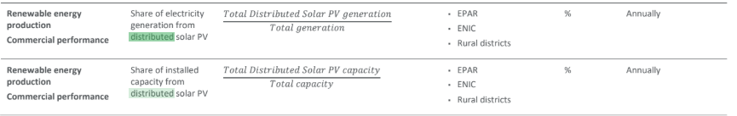
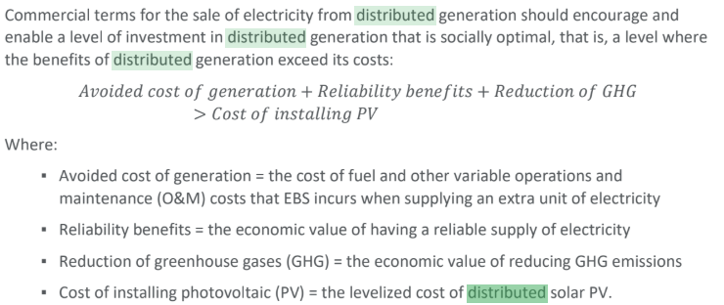
Notes:
This is one of the tables about the KPIs to be able to know the share of electricity generation or installed capacity from distributed solar PV.

Slide 15
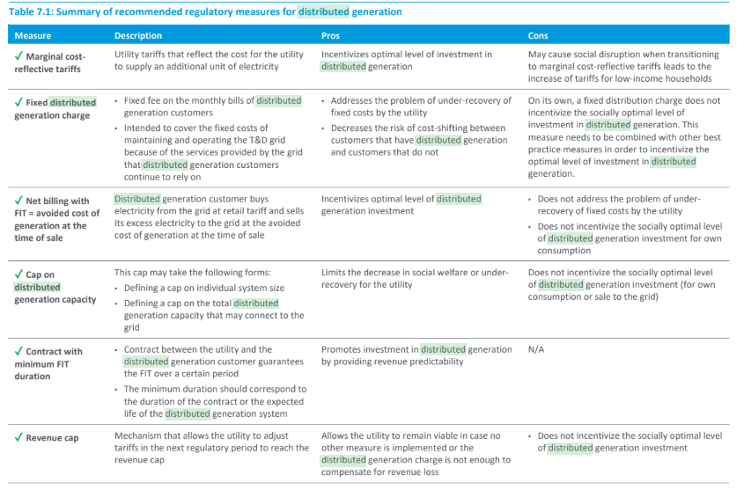
Notes:
This table summarizes the regulatory measures that should be implemented to achieve a socially optimal level of investment in distributed generation
or avoided to prevent under- or overinvestment in distributed generation and threats to EBS’s financial sustainability, which is a whole other dimension.
The recommended regulatory measures can be implemented to address each measure's shortfalls.
The table also explains the pros and cons of each measure from an economic perspective.
The ESP is currently in the stage of approval on governments side.

Slide 16
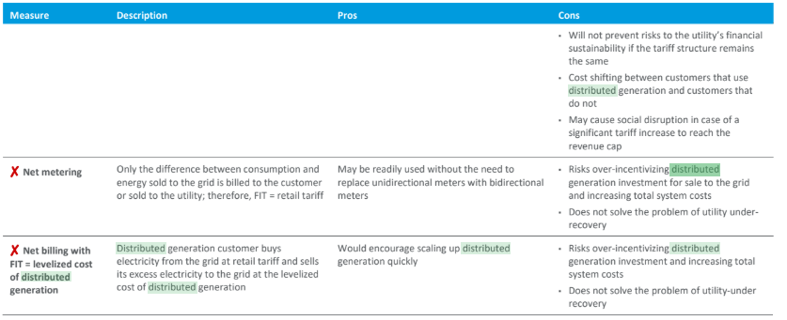
Notes:
The table continued, with the two last measures as how to deal with it, in general.

Slide 17
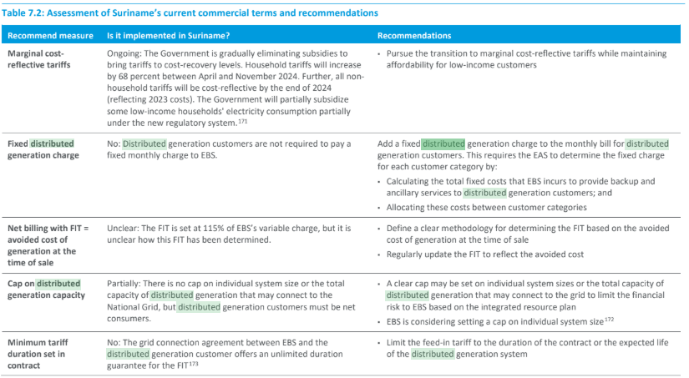
Notes:
We also got an overview on the fixed distributed generation charge, or the cap on distributed generation capacity. This is about the recommended measures.
And the second column here is about the implementation in Suriname as of 2025. You can see that for the first one it it not, and the second one partially.

Slide 18
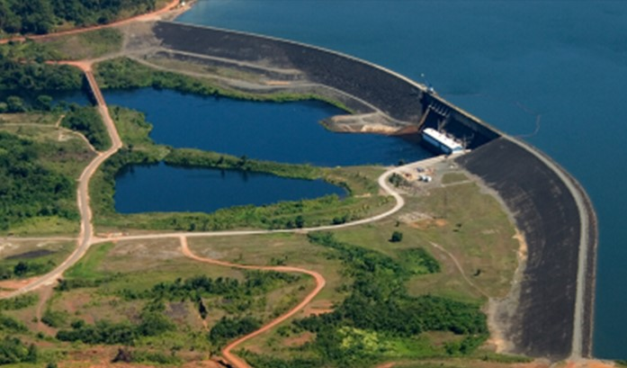
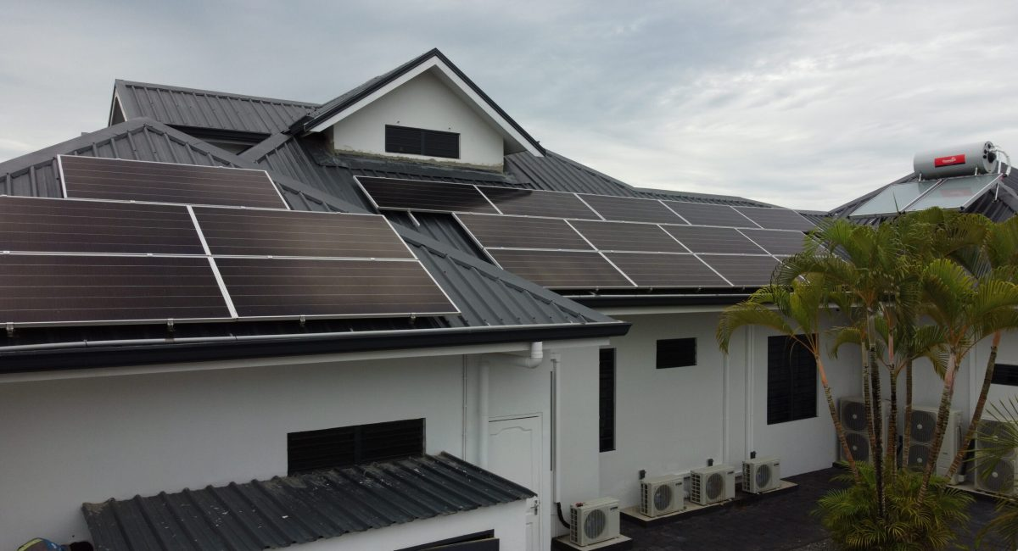
What’s Next? What could be considered for Suriname?
  1. Aligning incentives for DER participation
  Renewable Contribution Factor embedded in subsidy framework
  Reward prosumers and low-carbon behavior (e.g., rooftop solar users)
  Support fair participation as DER adoption expands
  Benchmarked against emerging DER incentive models
  DER link: ensures distributed generation is encouraged but not distorted
  2. Data & visibility for DER integration
  Energy Information Management System (EIMS) under development
  Enables tracking of distributed generation, consumption, and system impacts
  Supports forecasting of DER penetration and grid impacts
  Foundation for future DER aggregation and demand response
  DER link: solves the “visibility problem” of decentralized generation
  3. System flexibility for high DER penetration
  E-Mobility Strategy (EV integration planning) led by EAS and OGM
  Time-of-use tariffs for EV charging to manage peak demand
  Assessment of grid constraints under electrification and DER growth
  Exploration of Vehicle-to-Grid (V2G) as a distributed flexibility resource
  DER link: EVs become mobile DERs and flexibility assets
Notes:
So, back to DER on what we could consider moving forward:
Aligning incentives for DER participation: some measures to include to ensure distributed generation is encouraged
Data and visibility for DER integration: for Suriname through EIMS developments
System flexibility, but I’d say that this is maybe a more challenging technical factor

Slide 19





Thank You!
Renewable energy is not the energy of the future;
it is the foundation of the future we choose today!
Notes:
I have come to the end of my presentation, thank you very much for your attention.
Also the organizers for this challenging conference.
I’d say it seems like I managed to end in time, so you all probably not being in time for lunch is definitely not me. Thank you.

