Slide 1

OOCUR 20th Conference
AI in the Telecommunications and Broadcasting Sector: Challenges and Opportunities
April 2026
Notes:
Good afternoon everyone. Thank you Mavis Johnson-Collie for the Introduction.
Today, I’ll be sharing insights on what I’m sure by now is a very familiar topic to everyone here, AI
Specifically, what we will be looking at is AI in the Telecoms and broadcasting sector.

Slide 2
Overview
TRANSFORMATION & GROWTH
AI is transforming telecom and broadcasting globally, unlocking unprecedented potential.
Key Applications:
Autonomous Networks
Operational Efficiency
Resource Optimisation
Intelligent Chatbots & Hyper-personalization
← Enable innovation while ensuring fairness, inclusion, and consumer protection. →
CRITICAL RISK FACTORS
The deployment of AI across critical sectors introduces systemic social and technical challenges.
Key Risks
Data Privacy & Security
Bias & Inclusivity
Accountability
Transparency & Trust
Notes:
There are immense opportunities for transformation and growth with the telecommunications and broadcasting sectors as a result of AI adoption.
We will look at some key applications,, these summarizes the benefits of AI in the industry as experienced by both operators and regulators.
Also, there are some critical risk factors that that come with the adoption of AI, not just in the sector but these can apply globally.
Importantly, we’ll explore how regulators can support this transformation and minimize these risks by implementing some key principles in their regulatory practices.

Slide 3
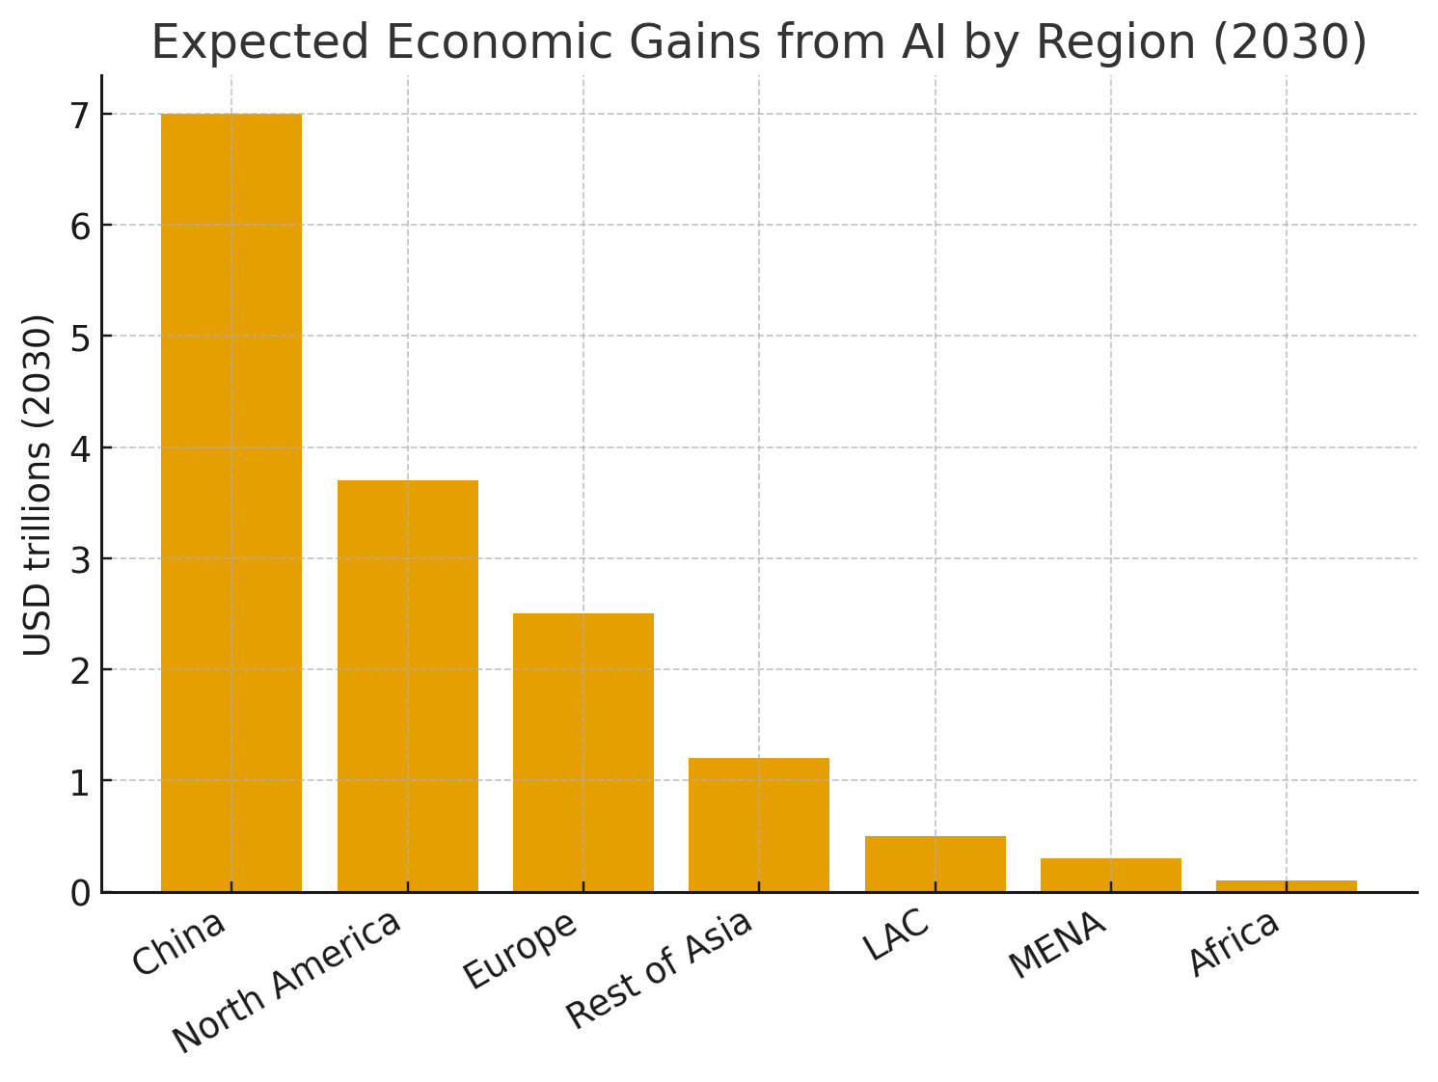
Global AI Economic Impact (ITU)
Source: ITU – Emerging Technology Trends: AI & Big Data for Development
Notes:
As we can see from this slide, AI’s impact is global, but most of the gains are concentrated outside the region — and that means there’s a real opportunity for our region and our operators to capture more of that value.

Slide 4
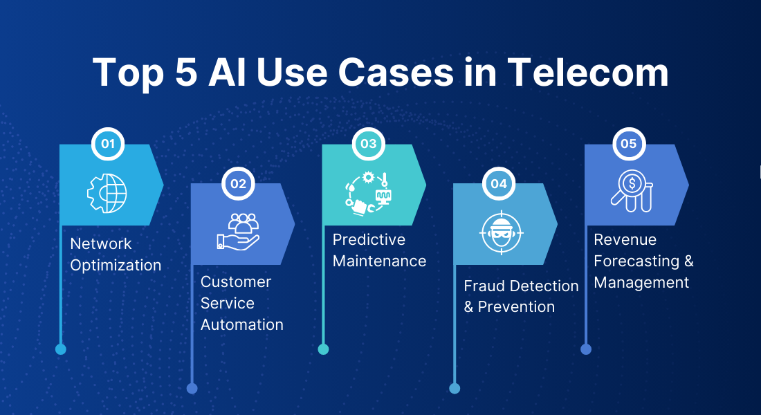
AI Benefits for Operators
Source: bacancytechnology.com
Notes:
So what are some of the benefits of AI in the telecoms industry?
Presented here are the top 5 use cases in telecoms. AI is transforming telecom in five key areas.
Starting with network optimization—this is especially critical for 5G and beyond. These networks are more complex, with higher data volumes and real-time demands, so manual management is no longer sufficient. AI enables real-time traffic analysis to predict congestion and prevent failures… improving performance and reliability.
Second, customer service automation—AI tools like chatbots and virtual assistants provide instant support, handle routine queries, and enhance customer experience while reducing operational costs.
Third, predictive maintenance—key in the Caribbean given dispersed and weather-exposed networks. AI flags faults early… reducing outages and improving resilience.
Fourth, fraud detection—AI identifies unusual patterns in real time… helping operators quickly detect and prevent fraudulent activity, protecting both revenue and customers.
And finally, revenue forecasting—AI analyzes usage patterns and market trends to improve demand prediction, optimize pricing, and support better business decisions.
Overall, what we are seeing is a shift from reactive to proactive operations… improving efficiency, reducing downtime, and delivering a better customer experience.”

Slide 5
AI Benefits for Broadcasters
AI-powered solutions enable broadcasters to:
Enhance Content Production
Automate editing, subtitles, and content generation to reduce time and cost
Personalise Viewer Experience
Deliver tailored recommendations (e.g., Netflix, YouTube) to boost engagement
Leverage Audience Insights
Analyse real-time data to predict trends and optimise programming
Optimise Content Delivery
Improve streaming quality and bandwidth allocation for seamless viewing
Increase Operational Efficiency
Automate workflows, metadata tagging, and compliance monitoring
Notes:
“AI is really changing broadcasting in a few key ways. It helps speed up content production by automating things like editing, subtitles, and even generating content. It also makes viewing more personal by recommending shows based on what people actually like. On the back end, it gives broadcasters better audience insights so they can spot trends and plan smarter.

Slide 6
Policy Outcomes of AI Benefits
Benefit | Policy Outcome
Network reliability & efficiency | Universal access and affordable, high-quality services
Personalised services | Enhanced consumer protection and user experience
Cyber-Security | Trusted digital ecosystem
Content delivery | Inclusion and cultural diversity
Notes:
This slide highlights the transition from technical AI capabilities to the specific policy outcomes w As regulators, our interest in AI isn't just about the "hype"—it’s about how these tools serve can help deliver real benefits to citizens. When we talk about AI improving network reliability, we are really talking about fewer outages, faster fault detection, and more resilient infrastructure overall. In practical terms, that means networks that can better withstand disruptions from things like natural disasters, congestion, or equipment failures. And we know this is critical for the Caribbean.

Slide 7
AI Benefits for Regulators
Risk Detection, Compliance & Cybersecurity
Spectrum Planning and Management
Consumer Insights
Evidence-Based Decisions
Notes:
AI also modernizes regulatory practices, enabling more precise and effective governance.
These are a few areas where AI is transforming regulatory oversight: it can analyze large volumes of data in real time to identify trends, detect anomalies, and anticipate market developments. This allows regulators to implement more targeted, evidence-based policies, monitor compliance more efficiently, and respond proactively to emerging issues.

Slide 8
Key Risks of AI Adoption
Risk | Description
Data Privacy & Security | Exposure of sensitive user data
Bias & Inclusivity | AI may reinforce digital divides
Accountability | Unclear fault attribution in AI errors
Transparency & Trust | Opaque “black box” models, deepfakes
Skills Gap | Limited local AI expertise and governance
Notes:
Of course there are also risks associated with increase AI adoption. We see these risks happening in the wider global adoption of AI, but it also applies to AI in telecom industry. Data Privacy & Security, ,Bias & Inclusivity, Accountability, Transparency & Trust, Skills Gap

Slide 9
Enablers for AI Innovation
Outcome-Based Regulation
  Focus on results over prescriptive rules. e.g., Regulatory Sandboxes)
Evidence-Driven Policy
  Utilize data sharing and research collaboration.
Collaboration & Regional Cooperation
  Establish shared resources and harmonised standards .E.g. CTU Caribbean AI Task Force (2025) & UNESCO AI Roadmap.
Capacity Building
  Develop training programs for regulators, operators, and academia.
Notes:
Which brings us to governance frameworks and how we can encourage innovation while minimising risk.
We are shifting toward outcome-based regulation, where instead of rigid rules, we focus on measurable results. Regulatory sandboxes are a key tool here, allowing us to test innovation safely before wider rollout.
We also need evidence-driven policy, grounded in real data and research, with strong collaboration between regulators, operators, and academia to understand AI’s real impact on networks and consumers.
At the same time, regional cooperation is critical. Through initiatives like the CTU Caribbean AI Task Force and UNESCO’s AI Roadmap, we can align approaches and share expertise across the region.
And finally, capacity building is essential—so regulators, industry, and academia all have the skills needed to keep pace with rapid AI development.

Slide 10
Thank you!

