Slide 1
The Universal Service Fund: a viable path to universal and meaningful connectivity
Presented by: Kane Dalkan
USF Project Manager
TATT
OOCUR 2025
Notes:
10
- Today I will presenting Trinidad and Tobago’s approach to Universal Service through the USF(Universal Service Fund)
- Connectivity(meaningful)

Slide 2
The role of regulation in Universal Service
    Market forces alone haven’t delivered full broadband access
    Regulation, Universal Service policies are a critical tool: Trinidad and Tobago uses the Universal Service Fund
Notes:
50
I will start with a problem that affects most regulators, and it is that if we leave things up to the free market,
not everyone will be served. Certain segments of the population will be left out.
Reg is a critical tool……….where market economics alone fall short.
Different approaches. Universal Service Fund(USF)
Financial contributions, funds are pooled.. target those that would be excluded digitally.

Slide 3
Our Legislative Foundation
The Universal Service Framework
Telecommunications Act,
Ch 47:31
Universal Service Regulations
Notes:
60
Usually USF needs to be supported by a strong legislative foundation. This pyramid highlights 3 legal components.
The Telecommunications Act, TATT Regulator. it authorizes TATT to “promote universal service” and to “establish mechanisms for funding such services.”
Universal Service Framework: more of a policy direction — what we are trying to achieve, and a bit about how
USF regulation: binding rules and procedures. Eligibility critieria for projects, reports, how much contributions should be.

Slide 4
How the fund works
Contributions to the USF
  0.5% gross revenues - Domestic telecommunications services or operation of domestic telecommunications network facilities by concessionaires
  1% gross revenues - International telecommunications services or operation of international telecommunications network facilities by concessionaires
  Percentage of the funds collected from concession and licence fees
Targeted funding for projects that bridge gaps in:
  Access (to services)
  Availability (of infrastructure)
  Affordability
Projects selected (must meet criteria as set out in regulations):
  Mandatory Universal Service Initiative (MUSI): to be implemented by all relevant concessionaires (Schedule III)
  Contractual Universal Service Initiative (CUSI):
    Selection by TATT – based on digital inclusion survey (last conducted in 2021)
    Solicitation process for project
Notes:
150
How fund works?
0.5% or 1% by telecom operators/concessionaries.
TATT option to contribute % of the funds from fees.
Gaps of digitaly excluded are 3 groups:
Accessibilty – barrier exists, Availability – (infra), Affordability – (financially disadvantaged)
MUSI – must be done, CUSI –tendering process, competitive bid between operators
How do we select projects?
-National survey (Breakdown communities -> ranked by gaps)
-Solicitation process, where anyone can suggest projects (criteria)

Slide 5
Universal Service Projects in Action
Meaningful Connectivity
    Delivered and Ongoing Projects:
    TTWiFi
    Subsidy on devices for PwDs
    Laptops for Students
    Broadband in St John’s Parish, Tobago
Notes:
20
List

Slide 6
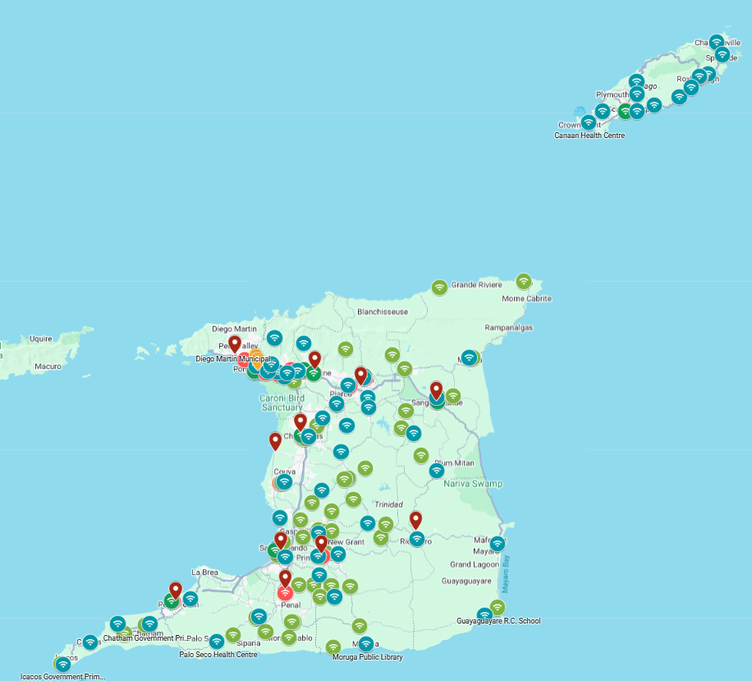
  Results (..so far):
  TTWiFi by the numbers (as of Sept 2025)
 | Transport Hubs | Libraries | Schools | Health Institutions | Total
Live | 12 | 23 | 77 | 115 | 227
Notes:
50
Sharing some of what we’ve done
227+ locations, well spread. Many site types -> elderly, student
Point out areas on the border – coastal, sparse, road access not good, Tobago also

Slide 7
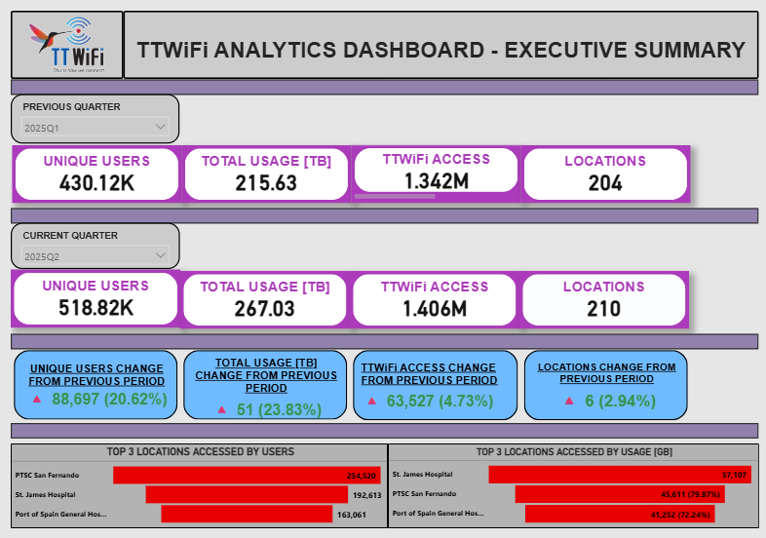
  Results (..so far):
  TTWiFi Metrics, April – June 2025
Notes:
60
Hitting the idea of meaningful connectivity. The first stage is getting service out there.
Further, Goal to enrich persons’ live.
Collection of metrics – strong M&E, QoQ shows increases of users.
This data can be split and sliced to drill down to use – entertainment education, govt services

Slide 8
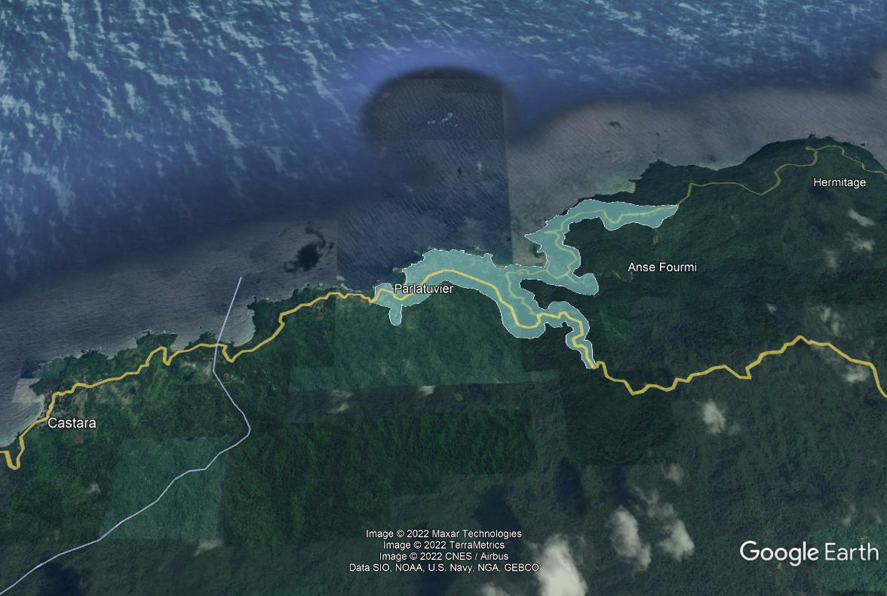
St John’s Parish Broadband Infrastructure Initiative
To improve the broadband Internet access infrastructure in the St John’s Parish, namely the villages of Parlatuvier, L’Anse Fourmi and Bloody Bay (approx. 285 households).
Fibre-to-the-home access network and offer competitive broadband (150 Mbps speeds plus) and subscription television broadcasting.
Bloody Bay
Notes:
30
50-60km of fiber, 250-300 households,
City of Scarborough, 150Mbps min
Fishing or coastal villages

Slide 9
  Results (cont’d)
  Upcoming projects:
    ICT Access Centres
    Broadband (in 10 more underserved areas)
Project | Reach | Outcomes
PwD device subsidy | 1800 beneficiaries | Improved accessibility
Broadband in St John’s Parish, Tobago | 91 subscribers | Network expansion by other ISPs
Laptops for Students | 1000 laptops distributed | Digital inclusion for students
Notes:
30
Some more summary of the results:

Slide 10
  Future Scoping - Innovation meets regulation
  As technology and services advance, there is always potential for underserved areas
  Evolving technology landscape
    Technology neutral legislation allows agility
    Example: Satellite broadband.
      TTWiFi at Matelot health centre, Forest Reserve Anglican Primary School currently active.
Notes:
30
Looking towards the future, as technology evolves -> gap may close, but potential underserved.
Technology neutral.

Slide 11
The Caribbean Landscape
    In the English-speaking Caribbean, seven countries have functioning Universal Service regions:
      Dominica, Grenada, Saint Kitts and Nevis, Saint Lucia, Saint Vincent and the Grenadines, Jamaica, and Trinidad and Tobago.
    Shared principles, varying implementation
Notes:
30
Zooming out to the Caribbean. TATT completed a review in 2024. 7 countries in English speaking Caribbean
We have identified that implementation varies although we have shared principles -> we can share lessons learnt, build off each other.

Slide 12
Key takeaways
  Not just connecting communities, but ensuring those connections are meaningful
    Connectivity as an enabler of inclusion, education, and productivity.
  Universal service funds are not just financial instruments — they are policy enablers of digital equity
  Consider Trinidad and Tobago, its universal service fund, and our successes in your approach to reaching Universal and Meaningful Connectivity
Notes:
30
Read

Slide 13
Thank You!
Telecommunications Authority of Trinidad and Tobago
Website: www.tatt.org.tt
email: info@tatt.org.tt
Tel: 1-868-675-8288

