Slide 1



NATIONAL WATER COMMISSION
“PPP JOURNEY & LESSONS LEARNT”
‘Navigating Caribbean Regulatory Challenges: Opportunities , Innovations & Collaborations’
Presenter: Lewis A. Lakeman
Assistant Vice President – Public Private Partnerships & Project Finance
Notes:
PUBLIC PRIVATE PARTNERSHIPS, PARTICULARLY IN THE Water Sector, are
extremely complex,
command a high demand of Resources and Technical Expertise are
more expensive transactions to execute, than the Traditional Government Procurements.
I WILL USE THIS OPPORTUNITY TO SHARE AND GIVE YOU AN INSIGHT ON THE NWC’S PPP JOURNEY AND
HOW WE HAVE BEEN NAVIGATING THE VARIOUS CHALLENGES , FOR THE SUCCESSFUL IMPLEMENATION OF THESE TYPE OF TRANSACTIONS.
AND I AM LEWIS LAKEMAN

Slide 2
Presentation
STRATEGIES FOR THE WAY FORWARD
NWC PSP AND PPP TRANSACTIONS
WATER HERITAGE, WATER SECTOR & NWC
LESSONS LEARNT / SUCCESS FACTORS
POTENTIAL (PPP PIPELINE) TRANSACTIONS
IMPLEMENTATION CHALLENGES
POLICY AND REGULATORY FRAMEWORK
Notes:
QUICK OVERVIEW OF THE PRESENTATION WILL INCLUDE :
A. HIGHLIGHTS OF THE REQUIRED POICY, REGULATORY, FRAMEWORKS WHICH GOVERNS PPP/PSP TRANSACTIONS.
B. HGHLIGHT OF KEY FACTORS THAT ASSISTED THE NWC WITH THE IMPLEMENTING PPP PROJECTS
C. POTENTIAL PPP PIPELINE TRANSACTIONS &
E. KEYS TAKE AWAY & LESSONS LEARNT

Slide 3
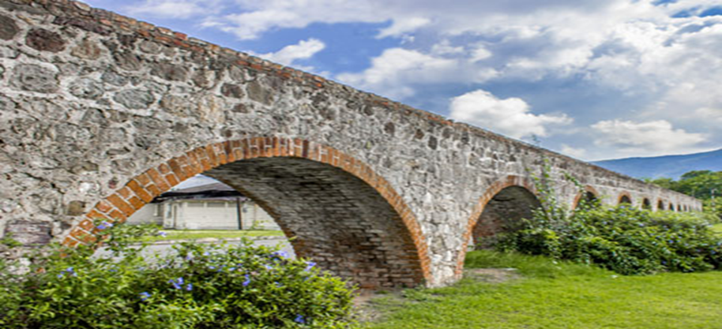
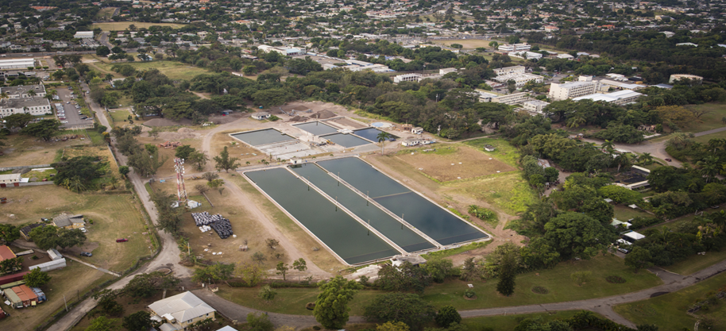
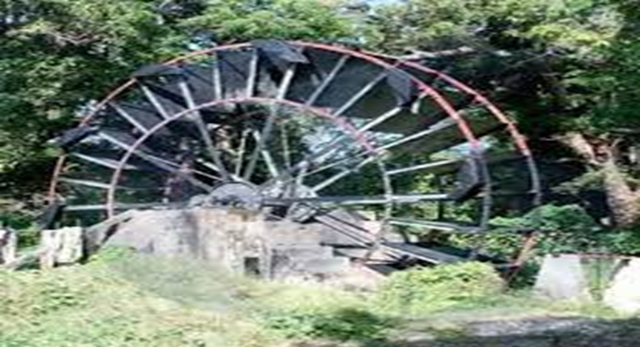
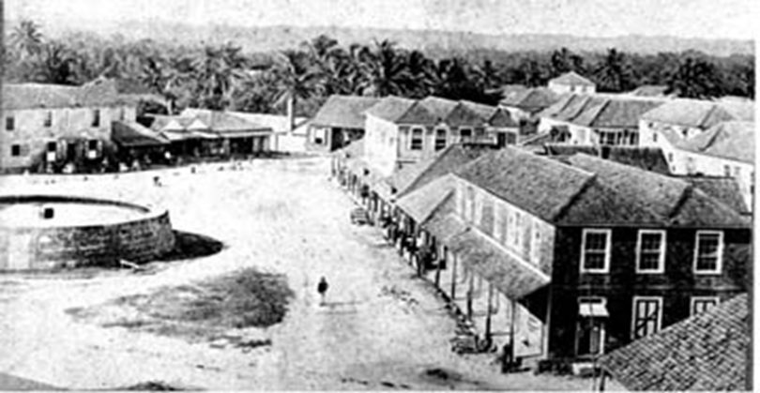
Jamaica water heritage
Kingston – Thomas & Rodger Elleston
Falmouth Water Works Company - 1799
1758 - House of Assembly passed a “Private Bill”
for Thomas Elleston to construct an 18th Century
“Open Aqueduct” - Hope River to Mona, Hope &
Papine Estate.
-------------------------------------------------------------
1766 - “RE personally funded” & constructed “Open
Conduit” - Hope River to Duke, King & Orange Streets.
Now site of NWC’s (SSF) 6.0 MGD Hope WTP.
1799 - Falmouth Water Works Company-“Private Venture”
“First Town in the Western Hemisphere”- Piped water supply system” with M/Brae River as source.
The “Persian Water Wheel”, a marvel of early
and great engineering feat at that time.
“Predated New York City’s” piped water supply
Provided town and visiting ships with Portable water
Notes:
INTERESTINGLY , JAMAICA WATER’S HERITAGE AND HISTORY, BEGAN IN THE MID TO LATE 18TH CENTURY WITH A COMBINATION OF :
PRIVATE CITIZENS LED, SOLELY PRIVATE VENTURE AND COLONIAL GOVERNMENT/PRIVATE SECTOR LED UNDERTAKINGS FOR THE
CITY OF KINGSTON - 1766
AND THE CONSTRUCTION OF THE FIRST PIPED WATER SUPPLY SCHEME IN THE WESTERN HEMISPHERE IN 1799, BY THE FALMOUTH WATER WORKS COMPANY WHICH WAS A PRIVATE COMPANY.
LET US FAST FORWARD TO 1980 WHEREIN, THE
1. GOVERNMENT of the day, HOUSE OF ASSESSBLEY, PASSED A PRIVATE BILL FOR, TOMAS ELLESTON TO CONSTRUCT AND OPERATE AN OPEN Aqueduct SYSTEM THAT IS STILL IN OPERATION TODAY BY THE NATIONAL WATER COMMISSION.
2. PRIVATE CITIZENS LED WATER SUPPLY SCHEMES, WHERE IN ROGER HOPE ELLESTION – DEVELOPEDTHE FIRST WATER SUPPLY FOR THE “TOWN OF KINGSTON” IN 1766 until 1777.
2. PRIVATE VENTURE THAT SAW THE CONSTRUCTION AND OPERATION OF THE FIRST PIPED WATER SUPPLY SCHEME IN THE WESTERN HEMISPHERE
“FALMOUTH WATER WORKS” IN 1799.
FASR FORWARD TO 1980
Wherein 1752 – The “House of Assembly” passed a “Private Bill” for Thomas Elleston to construct an 18th century “Open Aqueduct” that took water from the Hope River to Mona, Hope and Papine Slave Estates in Kingston and ST ANDREW.
SIMIARLY, WE SAW WHERE THE
FAST FORWARD TO 1980.

Slide 4
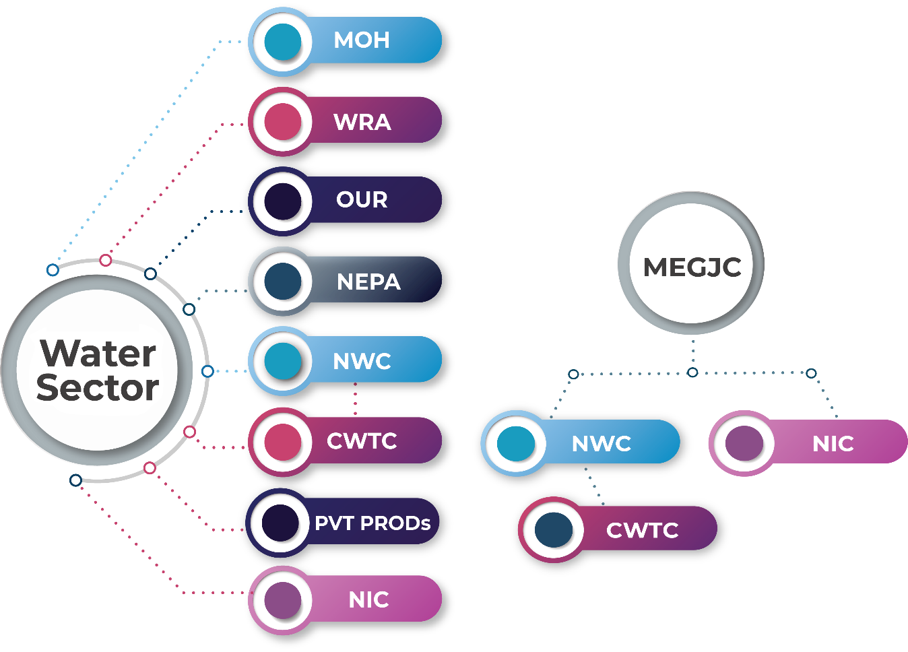
Overview of the national water sector & nwc
NWC established 1980 NWC Act. Merger of the KSA Water Commission and National Water Authority(NWA) the main, but not exclusive provider of potable water and sewage collection & treatment services in Jamaica.
Agency of Ministry of Water Environment & Climate Change (MWECC)
Governance: Nine (9) Board Member of Commissioners, Seven (7) Operational Regions with 2,200 Team members.
Asset Value : US$350.M, Customer Base : 550,000
- Potable Water: 75% of the population with piped water
- Operates over 1,000 water supply facilities
- 11,000 km of water mains
- Sewerage coverage 25% islandwide
- Operate some 68 WWTPs, 100 Pump Stations and
- In-excess of 500 km of collector& trunk sewers.
Coverage : USA = 85%, NUSA = 15%
MWECC
“MATURE SECTOR - ECO-SYSTEM”
Well developed and highly regulated sector
“FIRST POINT OF CONTACT”: Collaboration with Private Sector Investors. Technical support, advice and guidance.
“UTILITY OF LAST RESORT” OR “SERVICE OF LAST PROVIDER” (SoLP) : Assume operational control of delinquent & bankrupt “Privately operated Utilities”
Notes:
THE NATIONAL WATER COMMISSION (FULLY GOVERNMENT/STATE-OWNED WATER UTILITY) WAS ESTABLIHSED (1980),
AS THE PRINCIPAL WATER UTILITY PROVIDING WASTEWATER AND WATER SUPPLY SERVICES TO OVER 75% OF THE
POPULATION.
- DOMINATE PLAYER IN THE WATER SECTOR,
WE ALSO COMPETE AND COLLABORATE WITH OTHER
PRIVATELY OPERATED WATER AND ENERGY UTILITIES TO PROVIDE WATER, WASTEWATER & ENERGY SERVICES.
FIRST POINT OF CONTACT”: Collaboration with Private Sector Investors. PROVIDING Technical support, advice and guidance( EVEN IF THE NWC WILL NOT BE APART OF THE INVESTMENT}
UTILITY OF LAST RESORT” OR “SERVICE OF LAST PROVIDER” (SoLP) : Assume operational control of delinquent & bankrupt “Privately operated Utilities”

Slide 5

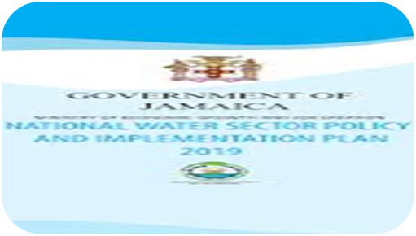
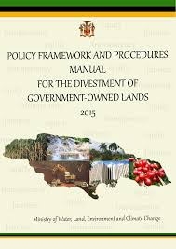
POLICIES, PROCEDURES & REGULATIONs
United Nations Sustainable Development Goal (SDG) SDG # 6, 8 & 9.
Vision 2030 Jamaica - National Development Plan
Jamaica Water Sector Policy (2019), National Water Commission Act - 1980,
Policy Framework & Procedures Manual for Privatization of Government Assets (2012) & (updated 2017)
National Energy Policy 2009 - 2030
National Renewable Energy Policy 2009 - 2030
Electricity Act (2015)
JPSCo. All-Island Electricity Licence - Gazette January 27, 2016, Expire - July 8, 2027
Office of Utilities Regulation Act (1995)
Natural Resources Conservation Wastewater and Sludge Regulations (2013)
Water Resources Act (1995)
Public Bodies Management and Accountability Act
Financial Administration and Audit Act (FAA)
Public Procurement Act (2015)
Climate Change Policy Framework for Jamaica (2015)
Notes:
NWC OPERATION AND ITS IMPLEMENTATION OF PPP PROJECTS, ARE GOVERNED BY OVER 15:
- LEGISLATIONS,
- POLICIES,
- PROCEDURES AND
- REGULATORY FRAMEWORK AND
THIS NUMBER IS STILL INCREASING. ….

Slide 6
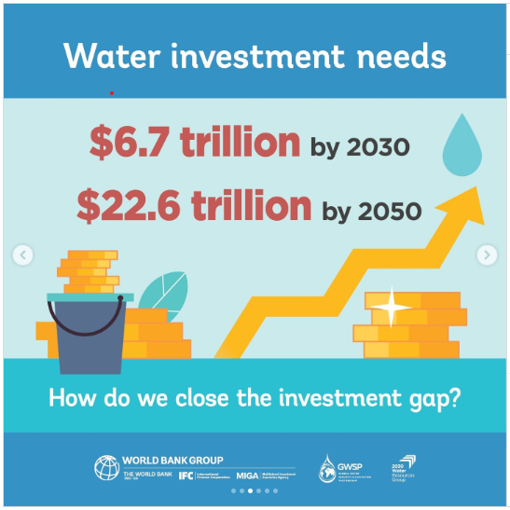
GLOBAL WATER & SANITATION INVESTMENT SDG NEEDS
Notes:
GLOBALLY, INFRASTRUCTURE NEEDS ARE EXTREMELY HIGH, PARTICULATY FOR THE WATER AND SANITATION SECTOR.
ACCORDING TO THE WORLD BANK …… SOME US$ 7 TRILLION
HOW DO WE PLAN TO CLOSE THE INVESTMENT GAP & PIVOT TO SATISFY THE GLOBAL WATER AND
SANITATION INVESTMENT FOR SDG NEEDS.

Slide 7
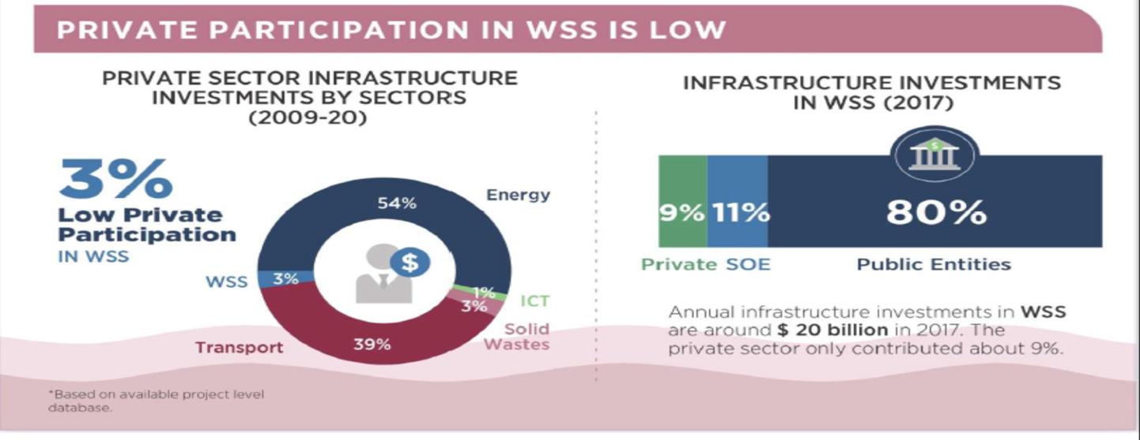
GLOBAL INVESTMENT IN WATER SUPPLY & SANITATION
Notes:
THE BANK FURTHER NOTED THAT :
INVESTMENT IN THE WATER SECTOR, WERE MOSTLY UNDERTAKEN, (APPROXIMATELY 91%), BY STATE OWNED ENTITIES.
THERE IS VERY LOW PRIVATE SECTOR PARTICIPATION REPRESENTING SOME 3% and 9% OF TOTAL INVESTMENT IN THE SECTOR.
THIS MAY DEMONSTRATE THAT THERE ARE OPPORTUNITIES, FOR “PPP & PSP” FINANCING MODALITY, IN THE WATER SECTOR.

Slide 8
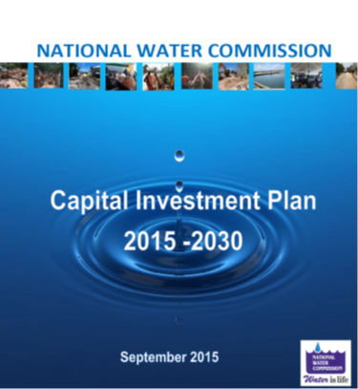
NATIONAL WATER COMMISSION capital investment plan
NWC intends to develop and implement a number of projects under its Capital Investment Plan (CIP) (2015 to 2030) targeted water sector targets aimed at :
  Increasing access to piped water by 2030 to at least 85% of population
  Increasing sewerage coverage by 2030 to at least 30% of population
  Improve its operational efficiencies e.g. NRW Reduction & Energy Efficiency
Jamaica will require US$5.0 B capital investment in water & sewerage systems to satisfy Vision 2030 Goals.
Notes:
CLOSER HOME,
THE NWC DEVELOPED ITS OWN 15 YEAR CAPITAL INVESTMENT PLAN AND IN
IN KEEPING WITH JAMAICA’S VISION 2030 WILL REQUIRE TOTAL INVESTMENT OF US$5.0B.

Slide 9
NWC’S INVOLVEMENT WITH THE PRIVATE SECTOR
NWC has sought to focus more on its core activities/functions:
  Become more “manager of operators, less manager of operations”
  NWC outsourced some of its operations that are guided by:
VALUE FOR MONEY
BANKABILITY
AFFORDABILITY
MARKETABILITY
VIABILITY/
FEASIBILITY
FISCALLY
COMPLIANCE
Notes:
NWC’S INVESTMENT DECISIONS AND COLLABORATION WITH THE PRIVATE SECTOR IS GUIDED BY :

Slide 10


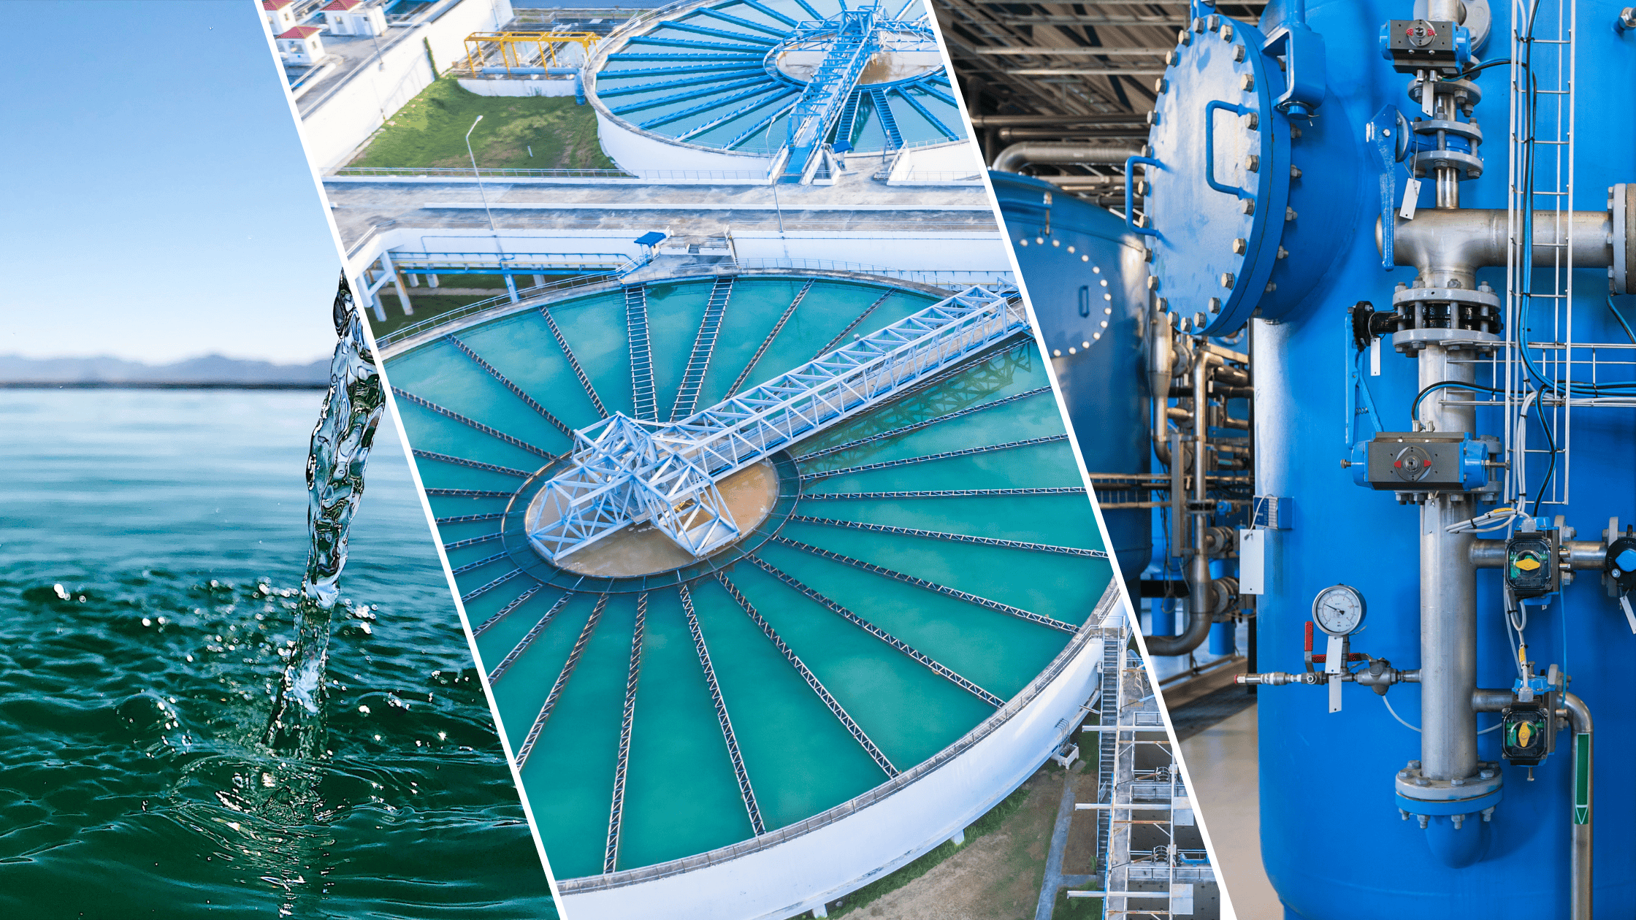

Nwc’s involvement with the private sector provides
Access to Finance - When NWC is unable to access loan finance due to National Debt/Fiscal constraints & NWC’s Balance Sheet health. - Cash flow generated is sufficient to cover obligations.
Exposure, Development New Water Technology & T/Expertise
- Enhanced public services, infrastructure via improved operational efficiency
- Reduces cost & improves service quality for consumers;
Innovation Efficiency - Water & Wastewater & NRW Reduction*
- Capture efficiencies via innovations in Project Development, Designs, Construction & Financing.
- New technology to enhance, improve efficient & reliable system”.
- “If Incentivized” PSP reduce COS via quickly & timely response to Utility’s demands”.
Extracting “Long-Term Value-for-Money” via Risk Allocation
- “By removing the GoJ/NWC’s influence in some areas, some risks can be better managed & mitigated by the private sector”- - “Through appropriate Risk Transfer” PS over the life of the project design, construction to O & M. - Private sector is “efficient at reducing & manage costs”, if Agreement is properly managed.
Notes:
ADDITIONALLY, PPP /PRIVATE SECTOR PARTICIPATION PROVIDES NWC ACCES :
HAVE BEEN LEVERAGING PRIVATE SECTOR PARTICIPATION IN THE AREAS OF THEIR CAPACITY TO PROVIDE ACCESS TO :
ACCESS to Finance
Exposure & Development of New Technology & Expertise
Innovation and Efficiency ( NOT PRECRIPTIVE ENCOURGAE INNOVATION)
ENHANCED OPERATIONAL EFFICIENCY (NRW)
Extracting “Long-Term Value-for-Money” : OVER THE LIFE OF THE PROJECT DESIGN, CONSTRUCTION 0&M.

Slide 11
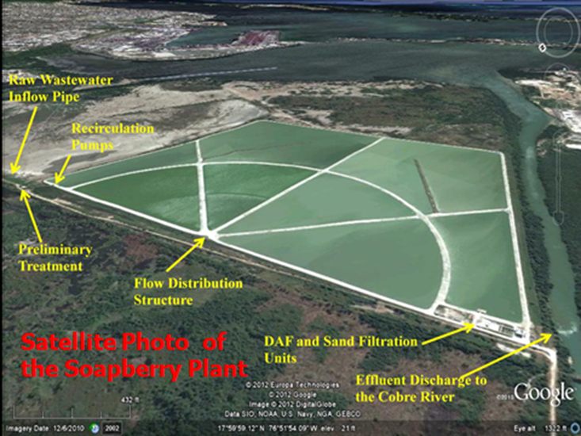
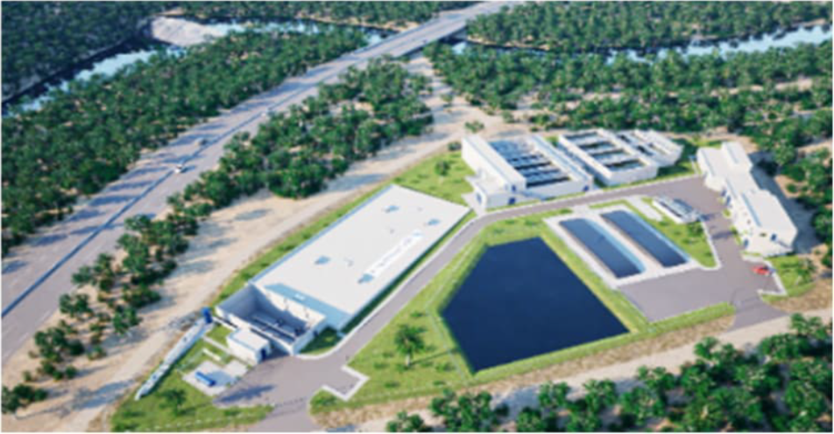
Nwc’s Ppp and psp partnership transactions
CWTC/SOAPBERRY WwTP PHASE # 1
SPV: Central Wastewater Treatment Company
Capacity : 75,000M³/Day
COD : 2007
Duration: 20-year PPP (DBFO)
Project Cost: USD$40.0M Loan US: $20.0M
Equity Partners: UDC, NWC, NHT & ABS *
*(NWC = 85% & ABS = 15%)
Status: O&M Agreement. Licence-March 2027
RIO COBRE WATER LIMITED (RCWL)
(Government Paid Public Private Partnership)
SPV: Rio Cobre Water Company Limited.
Capacity: 15IMGD
Financial Close: December 2022
Duration: 25year “Government Paid” PPP - DBFOM
Project Sum : US$ 92.0 M
Equity Partners: Eppley, Pan Jamaica Group & VCGP
Status: Construction. Two(2) years, ends May 2027
COMMERCIAL AND FINANCIAL US$200.0M
Notes:
THE NWC HAVE SUCCESSFULLY CONCLUDED AND PARTICIPATED IN PPP/PSP TRANSACTION PROJECTS OF US$ 2111M UP TO COMMERICAL/FINANCE CLOSE. ,
THEY INCLUDED A COMBINATION OF
WASTEWATER TREATMENT PLANT CONSTRUCTION
- WATER TREATMENT PLANTS
AND OUTSIDE OF THE PPP POLICES WHICH WAS ESTABLISHED ON 2012/20117
WESTERN WWTP/ GREENWICH WWTPS ( OLD AND DATED )
SATISFY THE MANLEY MEADOWS AND INNER CITY HOUSING DEVELOPMENT PROJECTS.

Slide 12
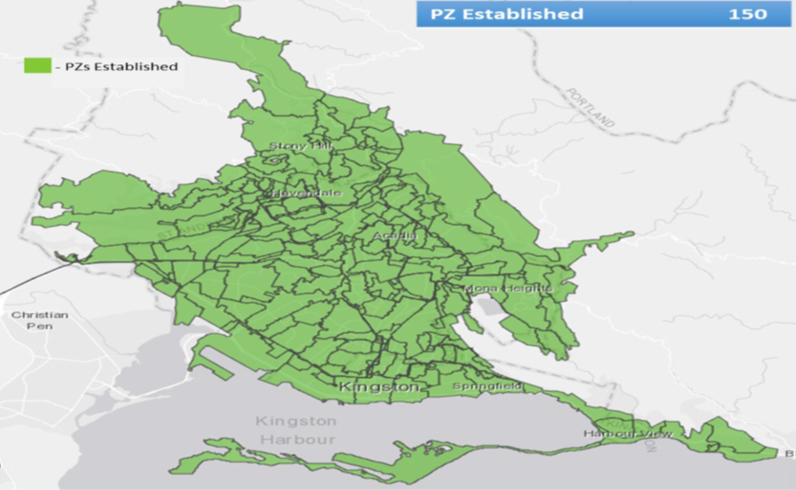
Nwc’s public private sector partnerships transactions
KSA NRW REDUCTION PROGRAMME
(Co-Management Performance Base Contract)
SPV: MIYA Jamaica Limited
Structure: Co-Management Performance Based
Target : 65% to 40 %
Duration : Six Years (2015 - 2021)
Contract Sum : US$55.0 M
Status: Completed.
PORT MORE NRW REDUCTION
(Co-Management Performance Base Contract)
SPV: MIYA Jamaica Limited
Structure: Co-Management & Performance Based
Target : 70% to 30 %
Duration : Five Years (2021 – 2026)
Contract Sum : US$16.0 M
Status: Contract to be concluded April 2026
Notes:
THE NWC COMPLETED CO-MANAGEMENT PERFORMANCE BASE CONTRACTS FOR KINGSTON AND PORTMORE NON-REVUNE WATER REDUCTION
NON-REVENUENE WATER LOSSES REDUCTION AND WATER SUPPLY EFFIIECNY PROGRAMME VIA Co-Management and Performance Based Contracts in excess of US$80.0 M.

Slide 13

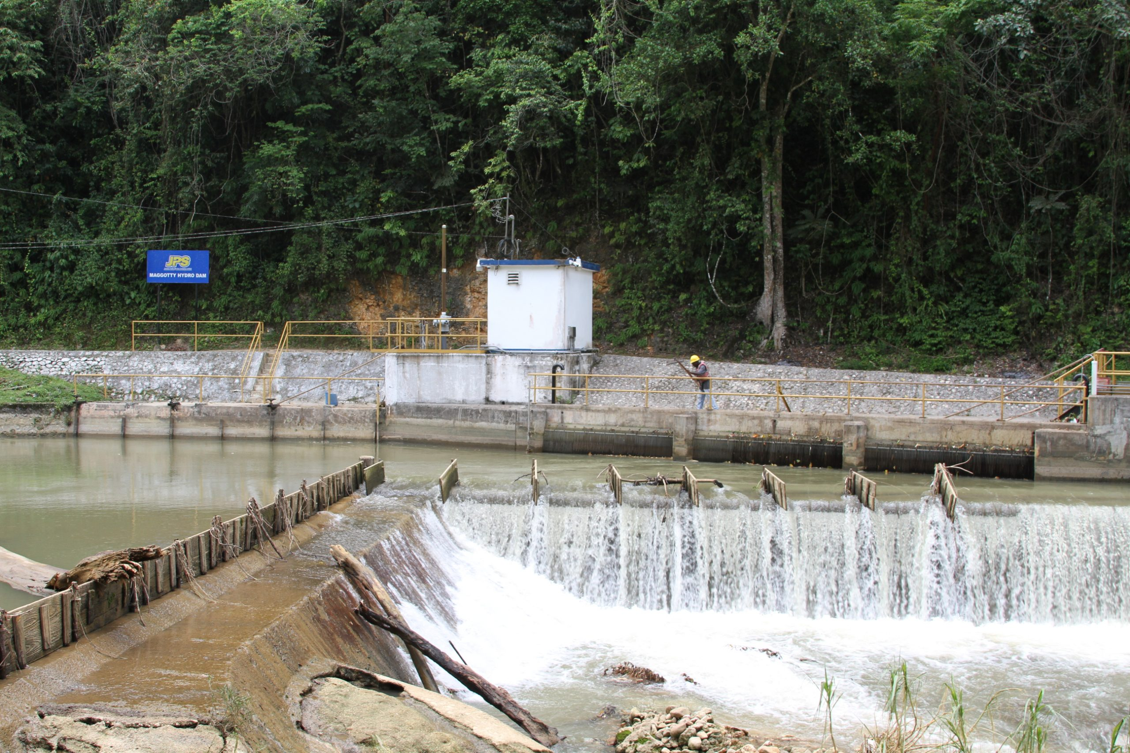

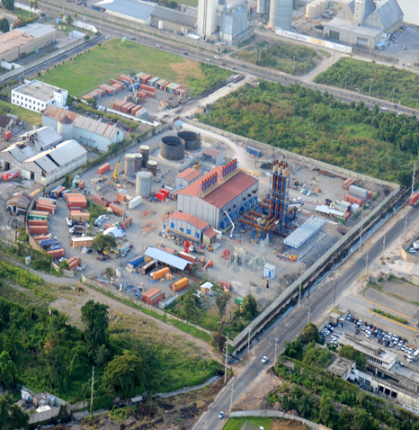
Nwc’s public private SECTOR partnership transactions
CONSTANT SPRING HYDRO POWER PLANT
(Modernization and Recommissioning)
“JPSCo., utilizes water from the NWC's Hermitage Dam & NWC Raw Water Line / Penstock, Wag Water & Boar Rivers to generate electricity”
Operators : NWC/JPSCo.
Recommissioned: December 2009
Capacity : I MW , Impact : 1,600 households.
Transaction Structure: JPS/NWC Land Lease Agreement
Project Cost : US$1.0M
WEST KINGSTON POWER PARTNERS
(NWC plans to “Generate” & “Wheel Power” to JPS)
(WKPP DBFO 66MW Power Facility)
Transaction Structure:
- NWC’s retired Western WwTP Land Lease to WKPP
- WKPP DBFOM 66MW Power Facility Power to JPSCo.
- Agreement have "Provisions” to be “upscaled” for
Generation and Wheeling. December 2010.
Notes:
JOINT VENTURE JV ARRANGEMENTS WITH OUR NATIONAL POWER SUPPLIER JPSCo AND INDEPENDENT POWER PROVIDERS
WHEREIN IN THE NWC WAS ABLE TO LEVERAGE ITS ASSETS, TOPROVIDE/FACILITATE PROVISION WATER AND ENERGY SERVCIES
HYDRO POWER ARRANGEMENT WITH JPSC0.
(LAND LEASE AND USE OF NWC’S WATER INFRASTRUCTURE AND FACILITIES)
AND OUTSIDE OF THE PPP POLICES WHICH WAS ESTABLISHED ON 2012/20117
WESTERN WWTP/ GREENWICH WWTPS ( OLD AND DATED )
SATISFY THE MANLEY MEADOWS AND INNER CITY HOUSING DEVELOPMENT PROJECTS.

Slide 14
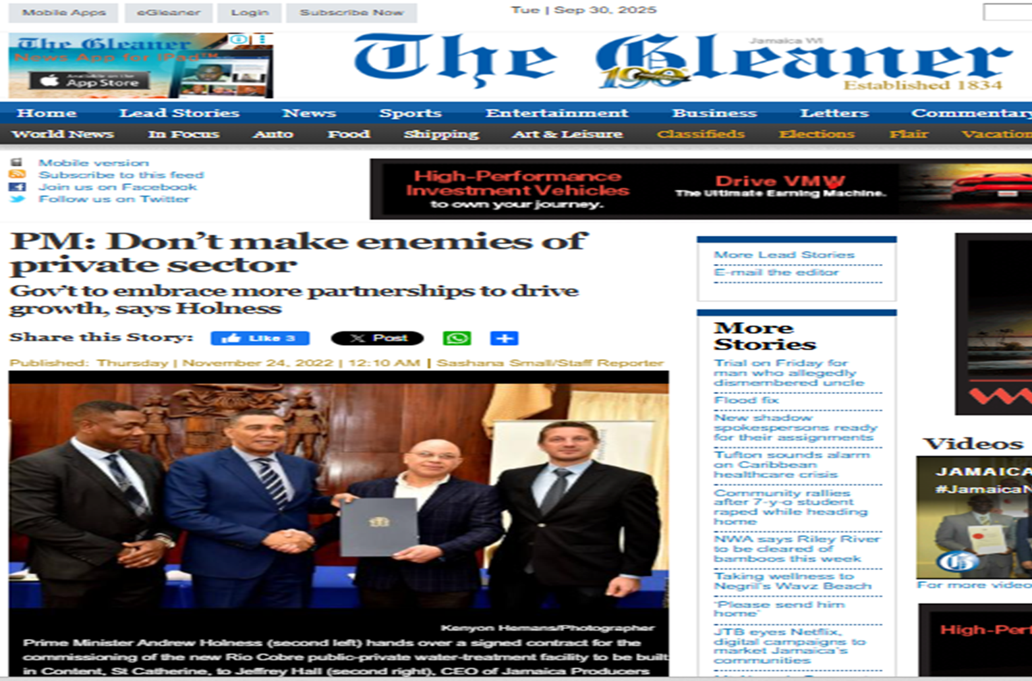
-
“Perception IS very Diverse” “Privatisation/sale of assets” or “PPP”
CHALLENGES IN IMPLEMENTING PPP TRANSACTIONS
“PPPs NOT SUITED FOR EVERY TYPE OF INFRASTRUCTURE INVESTMENT”
“NOT ALL RISKS WITHIN CONTROL OF NWC”
RAW WATER QUALITY AVAILABILITY - RISK
Parameter /Characteristic
(Quality, Availability & Yield)
A
INTEGRITY OF CONVEYANCE NETWORK
Trade Waste Effluent - Quality, Rate, Storm Water Intrusion
High Non - Revenue Water
Notes:
Challenges in navigating the IMPLEMENTATION OF PPP PROJECTS.
PPP is all about managing risks. And appropriate allocation of assume
WHILST WE HAVE AN INCREASED IN PPP TRANSACTIONS.
THE NWC HAVE TO NAVIGATE THE NEGATIVE PUBLIC AND STAFF PERCEPTIONS AND RESISTENCE TO PSP, AS HIGHLIGHTED BY OUR PRIME MINISTER IN 2022.
THE PRIVATE SECTOR WILL BE ALWAYS HERE AND THEY BRING VALUE THAT THE PUBLIC SECTOR CAN LEVERAGE, IF PROPERLY MANAGED
--------------------------------------------------------------------------------------------------------------------------------------------------------------------
NWC Tender for the invitation of PSP in the O&M of its Major Water and Wastewater Treatment Plant “had to be differed” – Fear of Job Lost ( Education is required)

Slide 15
CHALLENGES IN IMPLEMENTING PPP TRANSACTION
FINANCIAL
CAPACITY & CREDITWORTHNESS
“INVESTORS HIGH DEMANDS/UNREALISTIC GUARANTEES /SECURITIES/BONDS/RING FENCE PAYMENT REGRIME ”
- Utility struggles to cover O&M, Cap Ex. Investment & Debt Service
- Adequacy of tariff to make project affordable for cost recovery
Difficulty in structuring financially viable projects, securing investment,
& managing tariffs to balance affordability with cost recovery
LIMITED MARKET PLAYERS & COMPETITION IN THE SECTOR
“ LIMITED MARKET PLAYERS AND MARKET COMPETITION”
- Investors have a preference for Direct Contracting (DC) Procurement
DC Procurement is challenging to manage than Competitive Process
OUR mimics this role: Ensure Reasonable Price, QoS and Prevent Price
Spiraling
ACCESS TO CENTRALIZED SEWERAGE NETWORK
“LOW ACCESS/CONNECTIVITY TO CENTRALIZED SEWERAGE SYSTEMS”
- Small & fragmented water supply schemes
- “Economies of scales and commercial feasibility impaired”
- Transaction will have to be structured as “packaged of systems:”
Notes:
A. THE FINANCIAL CAPACITY & CREDITWORTHNESS OF NWC, AS A RESULT
“INVESTORS MAKE EXTREMELY HIGH DEMANDS / UNREALISTIC GUARANTEES REQUIREMENTS / SECURITIES / BONDS INCLUDING RING FENCE PAYMENT REGRIME WITH A VIEW TO ENSURE TARIFF PAYMENTS AND RECOVERY OF INVESTMENT.
B. LIMITED MARKET PLAYERS & COMPETITION IN THE WATER AND WASTEWATER SECTOR
- GLOBALLY, IN SOME INSTANCES AND SUB-SECTORS IE. NRW REDUCTION, WE NOTED THERE ARE ONLY 3 OR 4 Players ( AND NOT ALL OF THEM PARTICIPATE IN THE COMPETIVE TENDER PROCESS).
- The OUR tends to Minic this “Competitive Role” , to ensure “reasonable pricing” and “prevent price spiraling”.
C. ON THE WASTEWATER TREATMENT SIDE OF THE BUSINESS ACCESS TO CENTRALIZED SEWERAGE NETWORK IS LOW
- IT IS LESS THAN 25%
- THE GAP HAS TO DO WITH LIMITED SEWERING AND POSSIBLE SOLUTION BE “PACKAGING TO SECURE THE ECONOMIES OF SCALE” FOR THE TRANSACTION

Slide 16
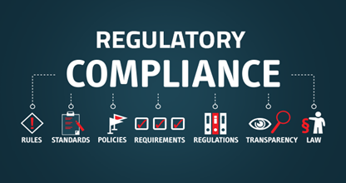

NAVIGATING THE CHALLENGES
SUCESSS FACTORS/ LESSONS LEARNT
ECONOMIC & ENVIRONMENTAL REGULATORY AUTHORITIES
1. Early & constant engagement of the Regulators key stages.
2. Provide an additional layer of due diligence and key advice
3. Engender trust for the Investor & bring “integrity to the process”
EXISTENCE OF JAMAICA “PPP POLICY & FRAMEWORK”
1. Jamaica’s Water, Energy & Climate Change Policies encourages PSP
2. Gives Investor “Confidence” in the PPP Process” as “Rule Based Process”
3. Otherwise claims/issues resolve through the Contract & Agreement
4. Jamaica is “Common Law” - No PPP Laws in Jamaica / Mostly seen
Civil Law Countries. PPP are prescriptive & codified in Law.
Notes:
The Private Sector and Investors are attracted by :
EXISTENCE OF JAMAICA POLICES WHICH ENCORAGES PSP PARTICIPATION.
POLICIES gives Investors the “Confidence in the Local PPP Process” & “Rules of the Game”.

Slide 17


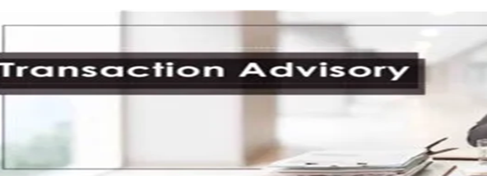
NAVIGATING THE CHALLENGES
SUCESSS FACTORS/ LESSONS LEARNT
SOUND BUSINESS CASE REPORT & MARKET SOUNDING
1.Well researched BCR Project Feasibility & Identify Risks early
2. Guide the NWC’ Structuring & Negotiation of the transaction
3. Gauge Financiers & Investors interests in the project early.
EXPERIENCED INDEPENDENT ADVISORS
1. Bring international perspectives PPP Transaction Structuring
2. Sound/balanced understanding of the local & environment
business conditions
3. MDA quickly developed the capacity/competence “Depth &
Breath” to match the IA’s expertise.
4. Importance of MDAs “taking ownership” of the transaction

Slide 18
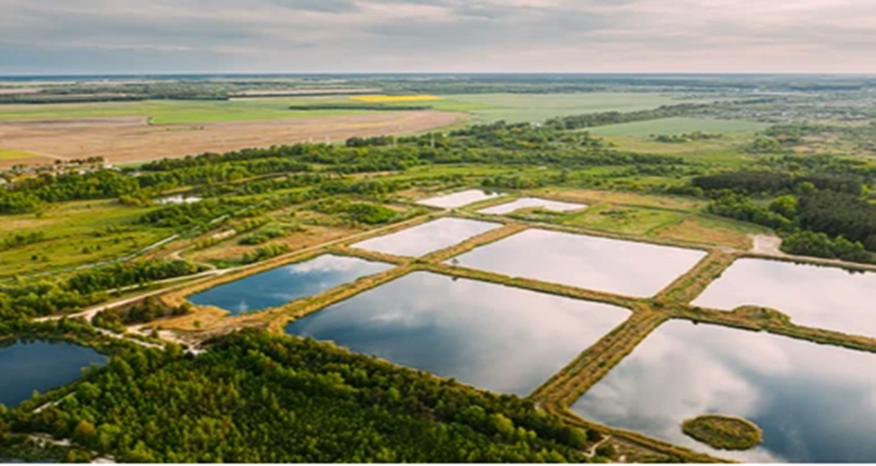
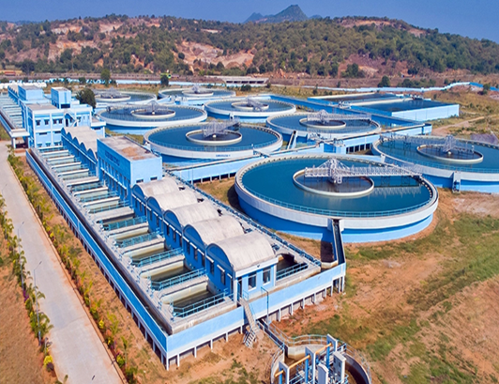
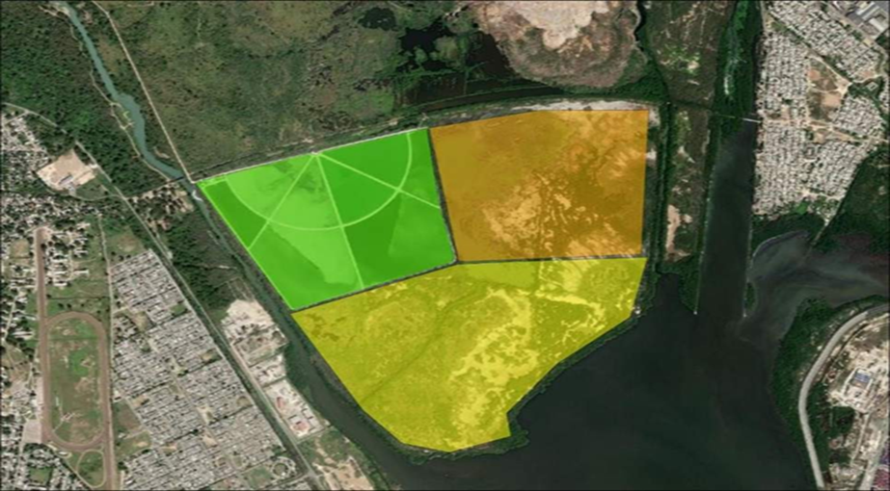
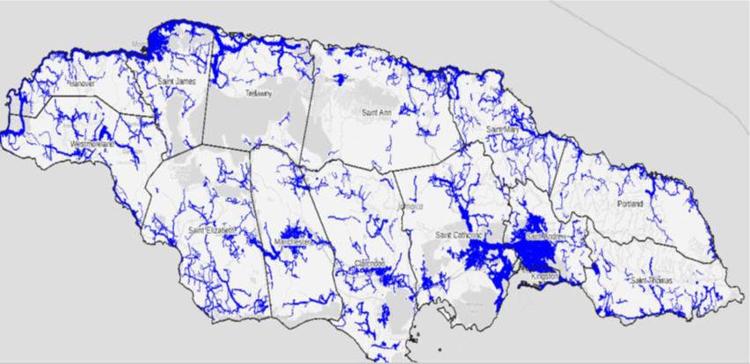

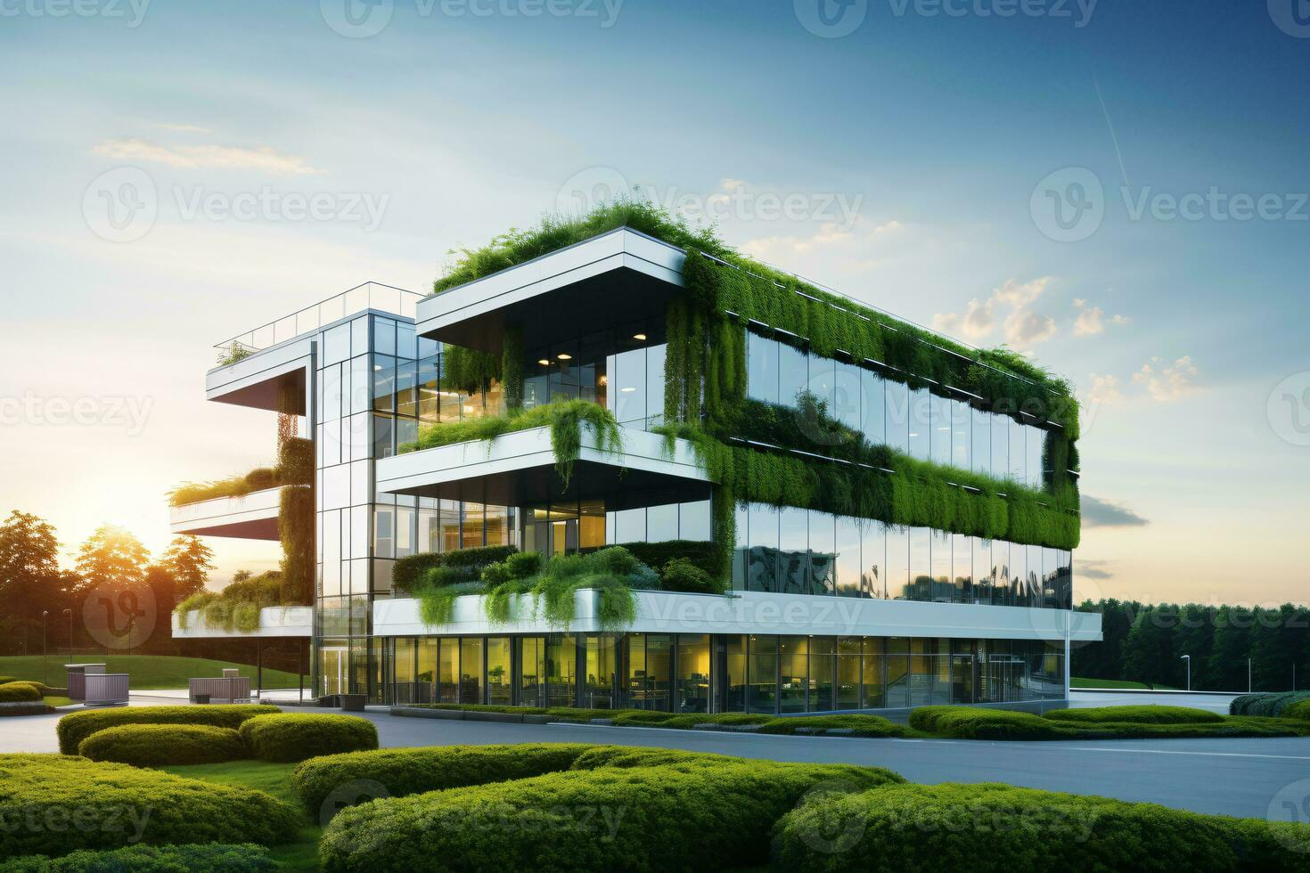
NWC’s PIPELINE OF PROJECTS/TRANSACTIONS
WASTEWATER PLANTS
(KSA, Falmouth, Negril, Spanish Town}
Impact : 500,000 persons
Budget: US$700.0M
Status : Master Plan
WATER PRODUCTION CAPACITY “Strategic WTPs Islandwide”
“ KMA & Western Resilience WSS Programme”
Capacity : 50MGD, Impact: 1.1M
Budget: US$1.2B
Status: Project Identification
CWTC - WwTP PHASE # II (Divest Shares WwTP Expansion
Capacity: 37,500M³/Day
Budget : US$165M
Status: SOA & BCR completed
ISLANDWIDE NRW REDUCTION
(Co-Management & Performance Based Contract)
Duration : 11 Years - Three(3) Phases
Budget : US$450.0 M
Status : Procurement underway.
SOLAR POWER FARM
“NWC plans to “Generate” & “Wheel Power” to JPSCo.”
Capacity: 70 MW,
Budget: US$81.0M
Status: Project Preparation
CORPORATE & REGIONAL OFFICES
“ Centralization” of corporate functions via monetization of its Real Estate holdings”
“Green Eco-friendly “LEED” Rated Building”
Capacity : 90,000ft² , Budget: US$30.0 M
Status: Project Concept & Identification
PORTFOLIO UNDER MANAGEMENT US$900.0M
Notes:
NWC PIPELINE OF PPP PORTFOLIO IS US$900M

Slide 19
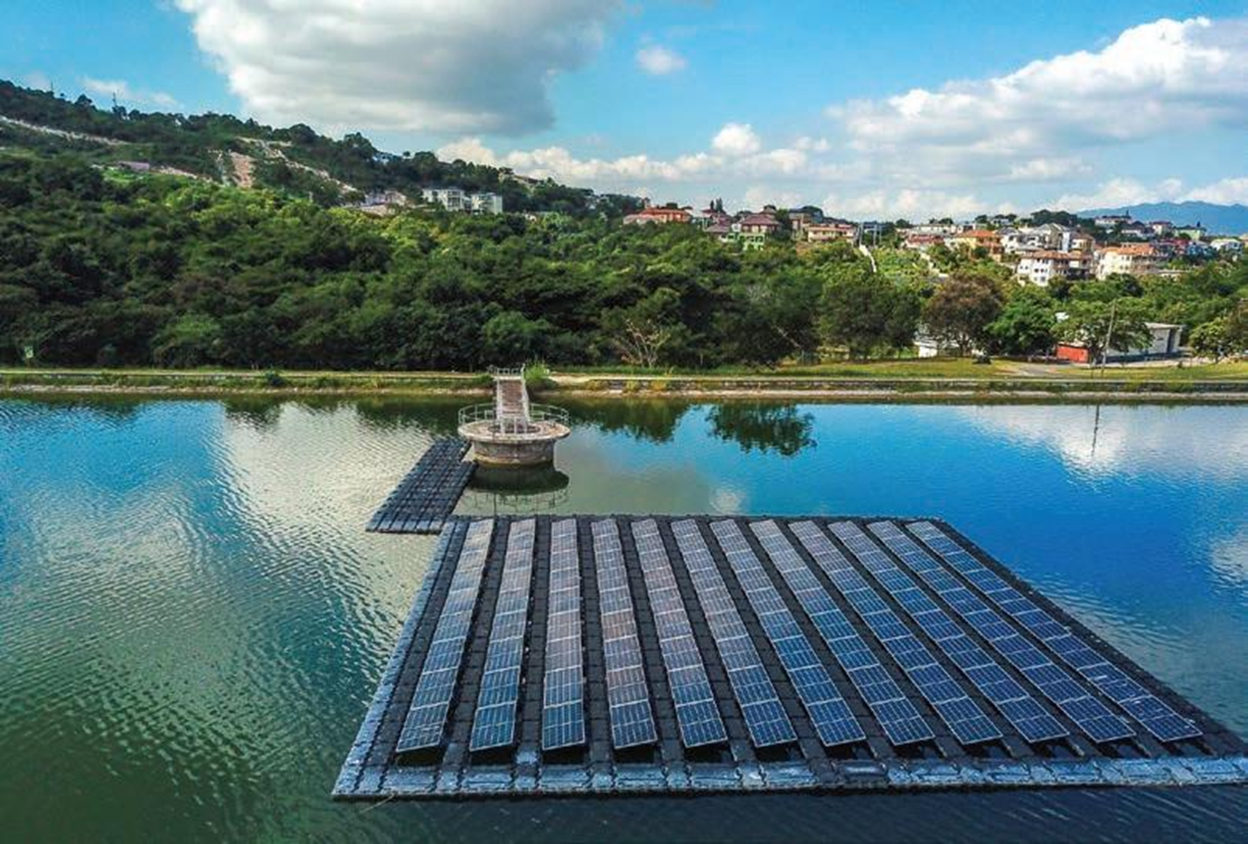
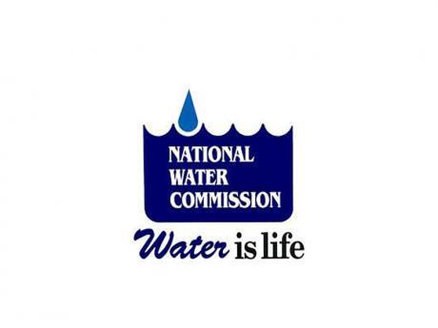
THANK YOU !
Lewis A. Lakeman
Assistant Vice President –
Public Private Partnerships & Project Finance
National Water Commission
lewis.lakeman@nwc.com.jm

Slide 20
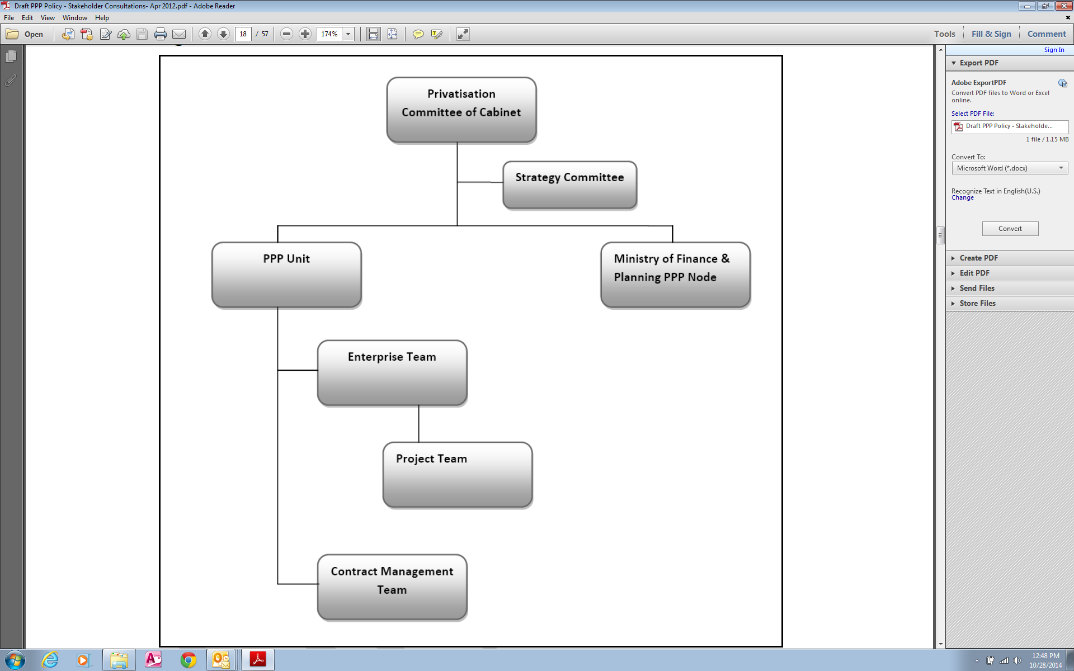
GOJ’s PPP INSTITUTIONAL FRAMEWORK
DBJ Privatization Secretariat
Fiscal Management
MoF, DBJ, AGC, NWC
NWC - Project Development
NWC - Operations
Notes:
The Ministry of Finance and Development Bank of Jamaica, plays a key role in the GOJ PPP INSTITUTIONAL FRAMEWORK
WHEREIN, THE BANK, ACT AS “TRANSACTION MANAGER” THROUGH A “CABINET APPROVED PPP/PRIVATISATION ENTERPRIZED/PROJECT TEAM” THAT LEADS THE DESIGNATED AGENCY ( I.E. NWC/ SOLID WASTE AURTHORITY JUSTICE COUR SYSTEM ETC. )GOJ’S PPP TRANSACTION.

