Slide 1
Distributed Energy Resources
Lessons from Europe for the Caribbean
OOCUR Conference – 29 April 2026

Slide 2







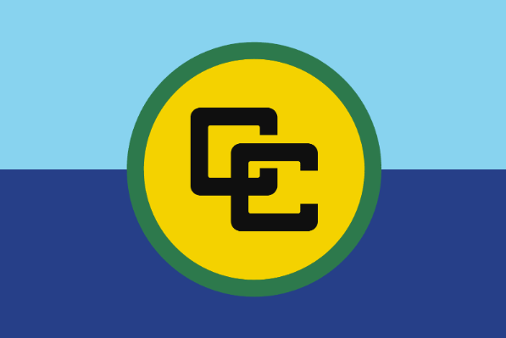
Distributed Energy Resources (DERs) can play a key role in The Caribbean
  Small decentralized energy technologies. Mainly:
    Rooftop solar
    Behind-the-meter batteries
    Small generators
    Microgrids
Today’s focus
  Lower consumer bills
  Alternative in case of supply interruptions
  Lower Co2 and local pollution
  56% of all installed solar capacity is rooftop solar (>170GW)
  Rooftop solar increasingly accompanied of behind-the-meter batteries
  Less room for utility-scale solar
  More sunlight hours lower unit cost
  Hurricanes higher value of security of supply

Slide 3



Lessons form the European experience with DERs: The Promotion Phase
There have been two phases in the European Experience: Promotion and Maturity
Promotion
  Tools for promoting rooftop solar:
    Net metering
      Surplus electricity reduces 1:1 the amount of electricity consumed in the invoice
      High-powered incentive: self-consumed energy reduces both generation and network costs
    Surplus electricity can be sold at hourly market price
      Smaller incentive than net metering
      Self-consumed energy pays fixed network costs (but not variable network costs)
Lessons
  Promotion needs to consider that most grid costs are still present
    Net metering was progressively abandoned
  Need to ensure people don’t feel solar is unduly punished
    Controversy over network costs paid (“Sun tax” in Spain)
  Poorer people may benefit less
    PV and batteries have high upfront costs and are more suited to bigger homes
Takeaways
  Promotion needs to be carefully designed
    Possible to incentivise early and simple to kick-start the sector
    But consider progressive reduction of subsidies since the beginning
    Be careful if your tariffs are fully variable because self-consumption means no payment for network costs
  To spread the benefits, consider
    Community solar
    Public-building solar
    Shared storage

Slide 4


The Maturity Phase of Distributed energy resources can arrive sooner in The Caribbean
Main challenges in the Maturity Phase
1
Cannibalisation
2
3
Network congestion
Resilience
  High solar penetration means the value of additional solar can be null
  The network can’t accommodate additional capacity
  The network can’t transport the excess solar supply in some areas to areas that need it.
  High solar penetration reduces the ability to control voltage
  If DER are not visible to the system operator, when DER grows significantly they can create problems to manage the system
Start planning early!
These issues are likely to be more prominent in smaller electricity systems like the Caribbean
1
Cannibalisation
2
3
Network congestion
Resilience
  Lower irradiation differences in smaller countries mean “solar cannibalisation” starts earlier
  Less meshed networks imply congestion starts earlier
  A less meshed network and demand/supply disconnections make voltage control harder

Slide 5
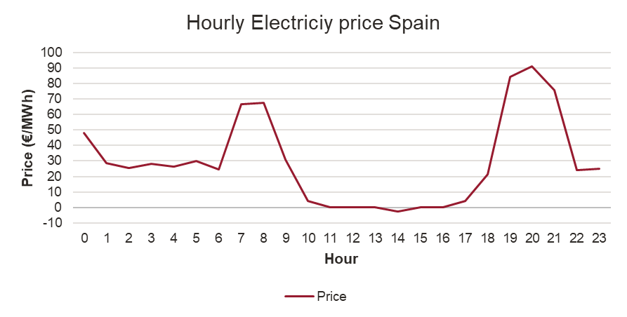
The European experience with Distributed energy resources: Maturity
1
Cannibalisation
Issue:
  When there is too much solar, the value of additional solar might be 0 or even negative if some plants have start up costs
Solutions:
  Give price signals so that people don’t overinvest in solar and invest in batteries: Time of Use pricing.
*Source: Entso-e

Slide 6
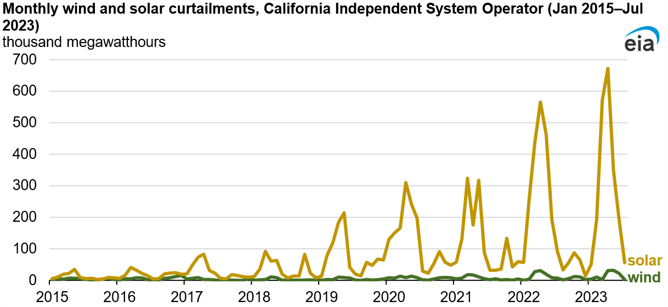
The European experience with Distributed energy resources: Maturity
2
Network congestion
Issue: Two types of congestion:
  No network access for new capacity
  Production of renewables has to be curtailed as it can’t be transported to where demand is located
Solutions:
  Forward-looking network planning
  Clear rules to allocate network capacity
  Batteries to store excess solar production and release it when there is no congestion
*Source: U.S. Energy Information Administration. Note that the curtailment shown can be due to network congestions or to negative prices

Slide 7
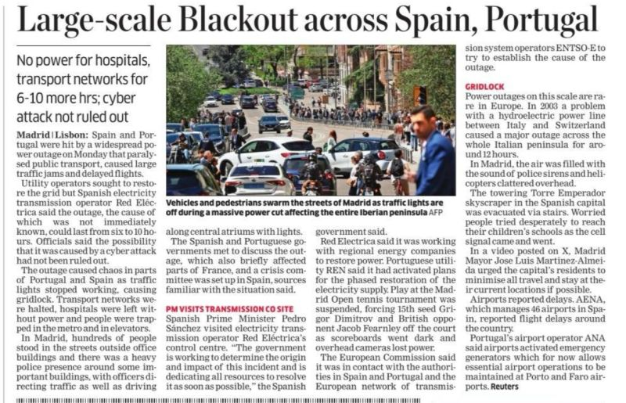
The European experience with Distributed energy resources: Maturity
3
Resilience
Issue:
  Higher solar penetration reduces the ability to control voltage
  Small DER can increase the challenges of system management if they are not visible to the system operator
Solutions:
  Smart inverters can provide voltage control – make sure sufficient new solar capacity has them (batteries normally have them)
  Ensure you have enough conventional (diesel or gas-fired) generation capacity ready to support the electric system
  Keep track of installed rooftop solar and its production

Slide 8





Conclusions
  Start promotion in a simple way — but consider network costs or plan for evolution
Plan networks to avoid congestions
Use price signals to balance investments in solar and batteries
Batteries contribute to solving all the issues at the maturity phase
Don’t forget fairness!

Slide 9


Thank you for listening – please get in touch if you have any questions!
Pablo González
    +34 913 43 23 53
  pablo.gonzalez@frontier-economics.com
  https://www.linkedin.com/in/pablo-gonzález-pinillos-850639a5/

