Slide 1



OOCUR 20th Annual Conference
Montego Bay, Jamaica
April 2026
Water governance, public policies and regulatory frameworks
Rita Amaral, Executive Director at LIS-Water

Slide 2
The global water challenge
The operating context of water services is changing fast…
Climate shocks
Hurricanes, droughts, flooding
Water stress
Scarcity, variability, higher production costs
Financial pressure
Limited fiscal space, aging assets, investment gaps
Rising expectations
Citizens, tourism, environmental standards

Slide 3
The global water challenge
Rethinking the governance
and regulatory systems of
water and sanitation sector is critical
Even mature systems (e.g. UK, Portugal) are being rethought.

Slide 4
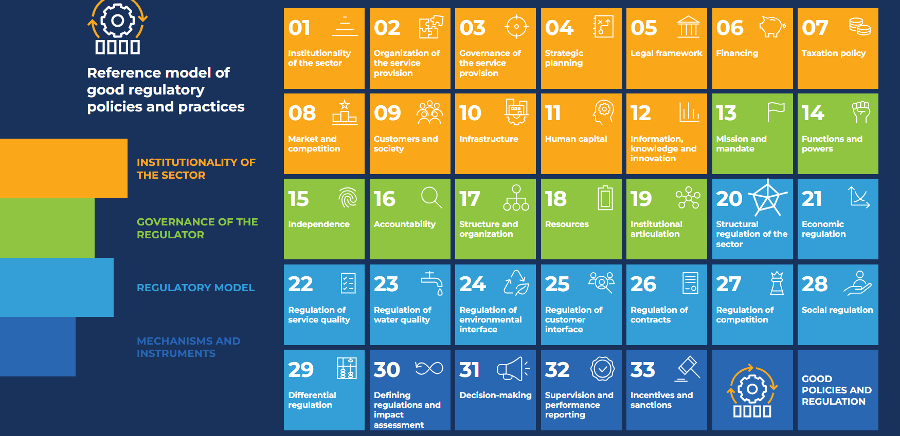
What needs to be rethought
Architecture of the sector

Slide 5
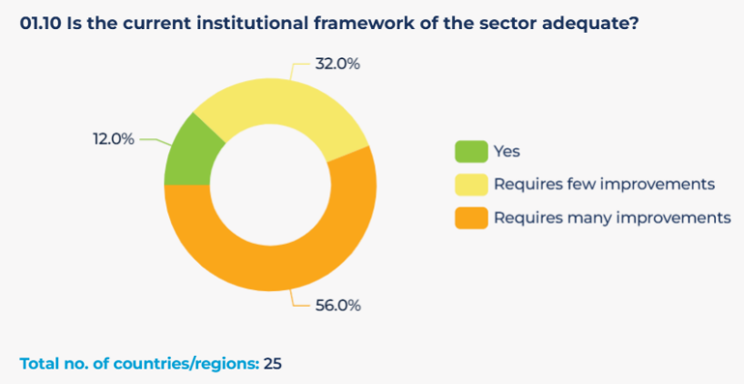

What benchmarking tell us
Lesson 1: How the sector is organized shapes results
88% of countries need reforms to make their institutional framework fit for purpose

Slide 6
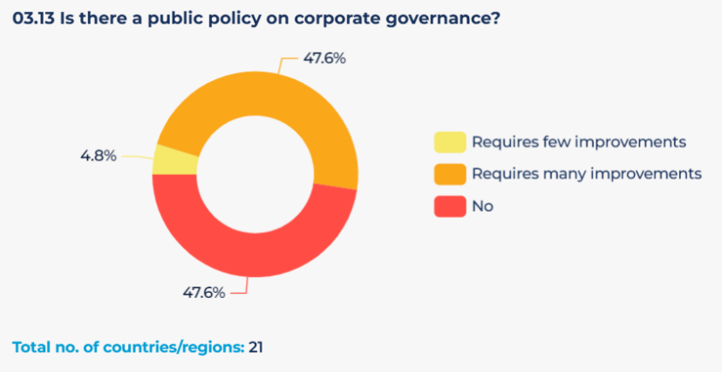
What benchmarking tell us
Lesson 2: Corporate governance of utilities matters
95% of countries lack a robust public policy on corporate governance

Slide 7
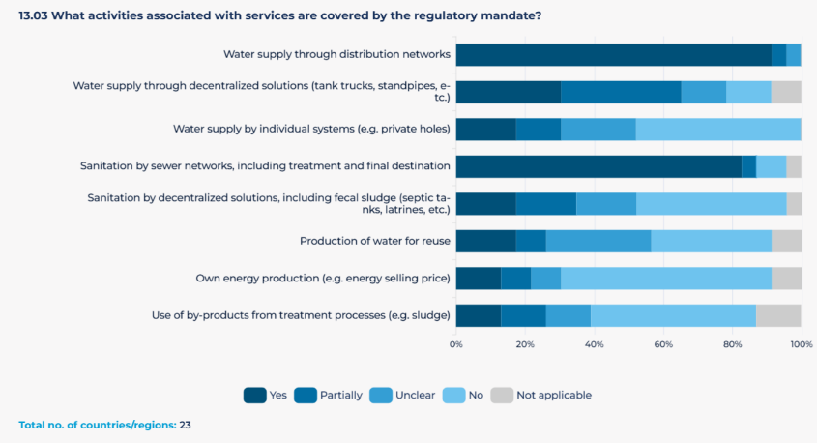
What benchmarking tell us
Lesson 3: Regulatory mandates should match service realities
Regulatory mandates remain focused on network services, leaving decentralized systems behind

Slide 8
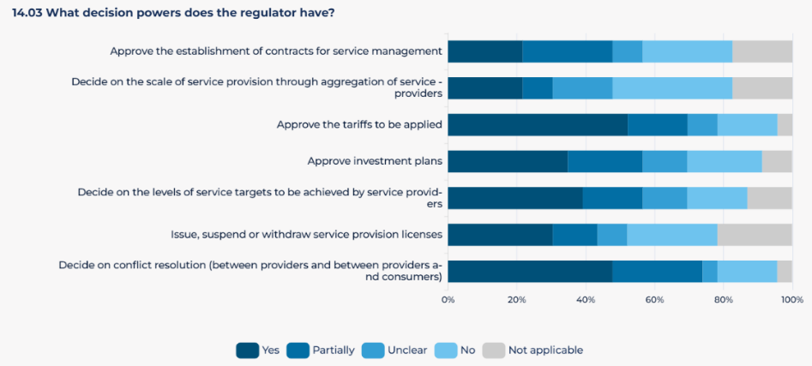
What benchmarking tell us
Lesson 4: Regulation needs decision powers to be effective
Formal mandates exist — but decision powers are frequently limited

Slide 9
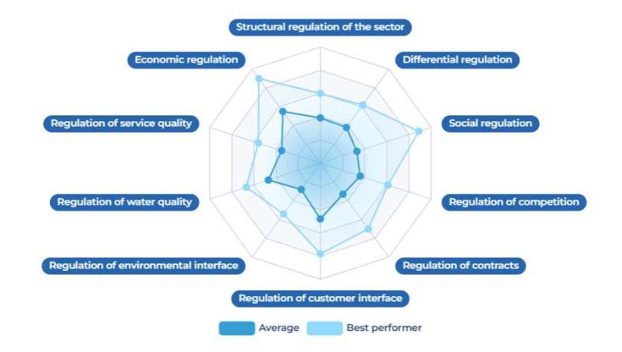
What benchmarking tell us
Lesson 5: Without capability, regulation remains paper-based
Implementation strength varies significantly across regulatory functions

Slide 10
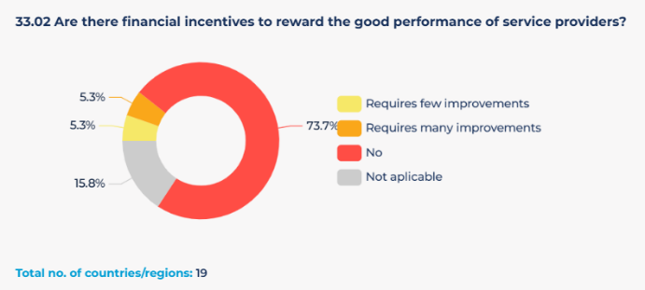
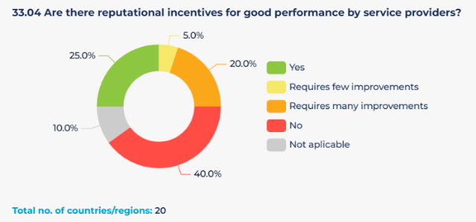
What benchmarking tell us
Lesson 6: Incentives shape sector behavior
Incentives remain the missing link in utility performance

Slide 11
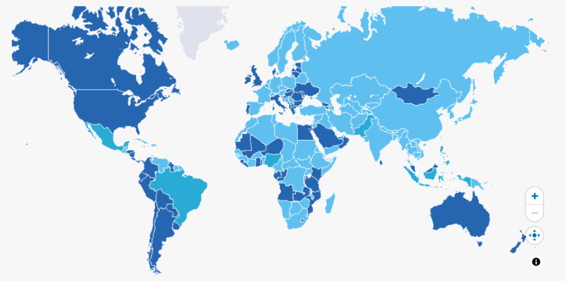

What benchmarking tell us
Lesson 7: The number of specialized regulators is growing, but their capacity and effectiveness still need significant strengthening
38% countries with specialized regulators
+210 regulators

Slide 12
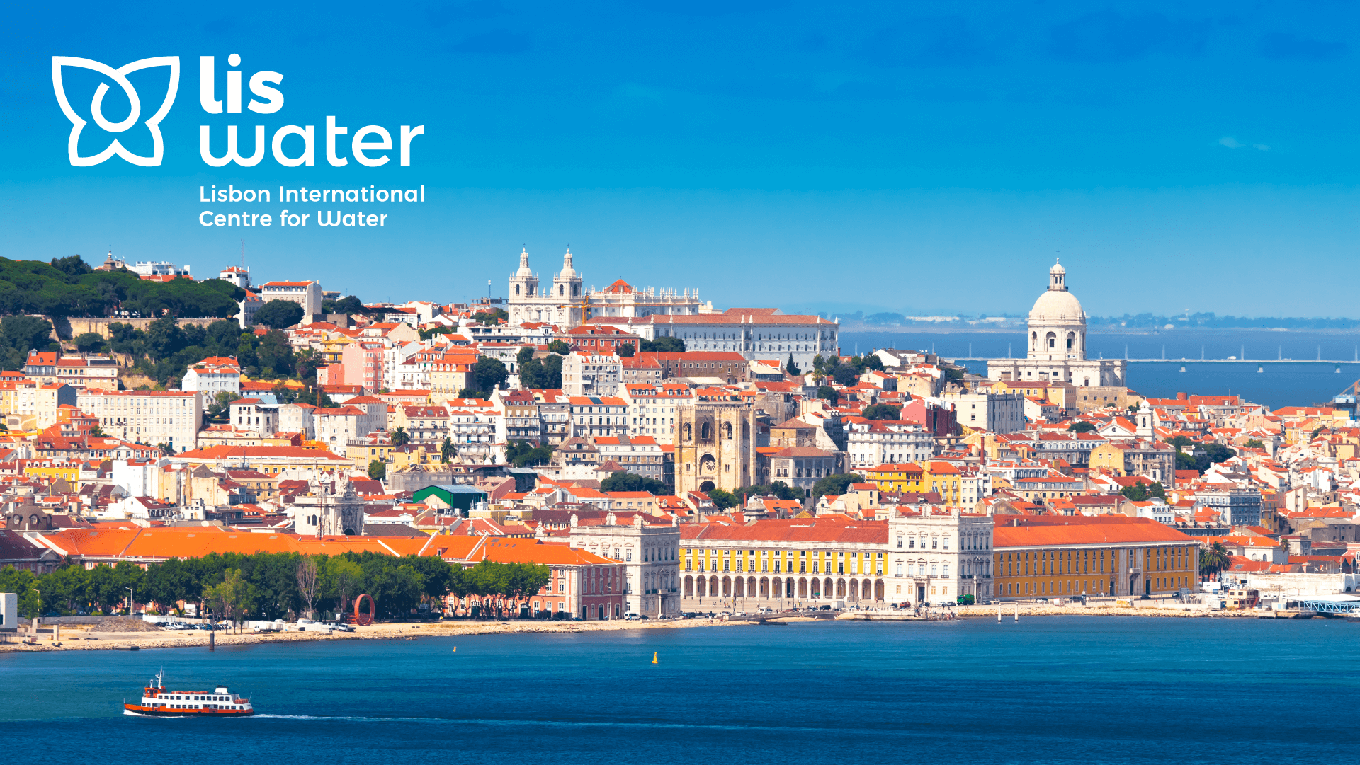
Helping countries build stronger
governance and regulatory systems

Slide 13
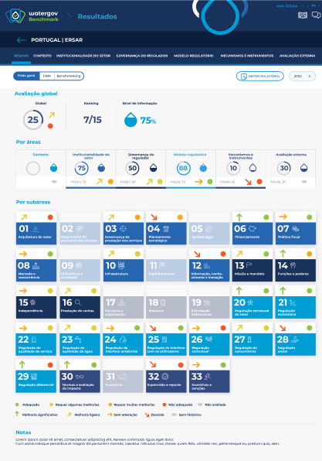



Turning governance into reform
We help countries make governance and regulation
measurable, actionable and monitorable.
Benchmark performance
Benchmark systems and identify gaps
Design
Shape governance and regulatory reforms
Deliver
Support implementation and institutional change
Build capability
Equip teams to lead reform
COUNTRY X
Powered by WaterGov™

Slide 14




Trusted across 40+ countries
Governments | Regulators | Utilities | Development partners
  Join the 1ˢᵗ Edition
  Water and Sanitation Governance and Reforms
  Leadership Programme
  📍 Lisbon, Portugal
  26-28 October 2026

Slide 15
The difference?
Good governance.
Rita.amaral@lis-water.org
Thank you.

