Slide 1
Advancing Barbados’ Clean Energy Transition Through Regulatory Reform
29 April 2026
Organisation of Caribbean Utility Regulators (OOCUR) 20th Anniversary Conference
Brian Reece, CEO
Richard Sedano, Sr. Advisor
Brian.Reece@ftc.gov.bb
rsedano@raponline.org
Fair Trading Commission
Regulatory Assistance Project

Slide 2
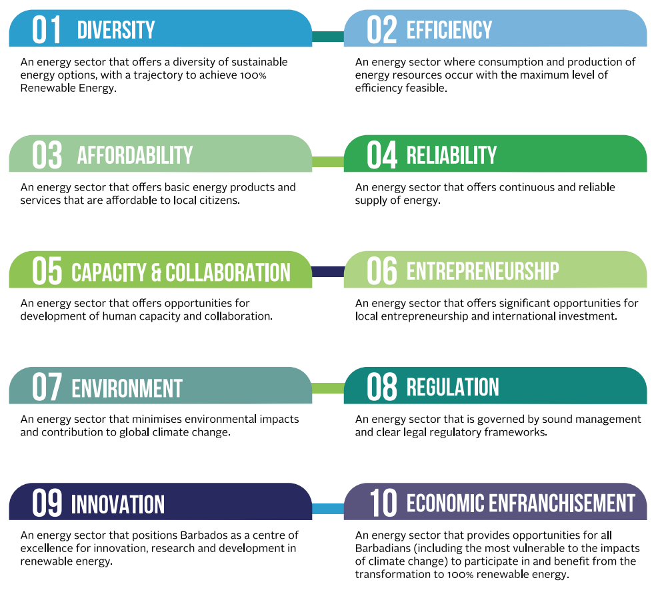

Barbados National Energy Policy - Goals
Source: Barbados National Energy Policy, 2019-2030, Summary
Notes:
Focus on a broader subset of these.
Affordability & the FCA. Clean energy hasn’t really impacted the consumer…yet. Modeling this actively to see the impact on the FCA and on customer impact on affordability. 100+ MW on the system. But as a percentage, it isn’t large yet.
Energy.gov.bb

Slide 3
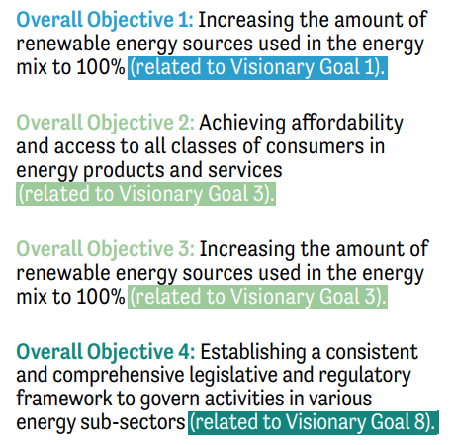
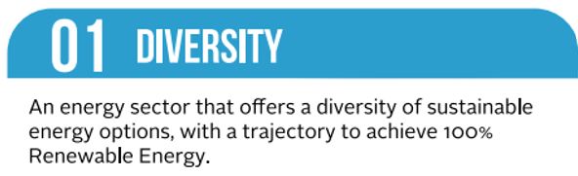
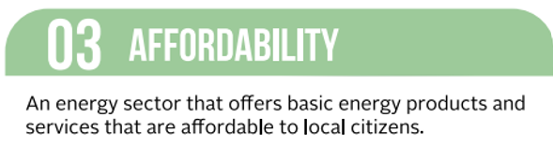
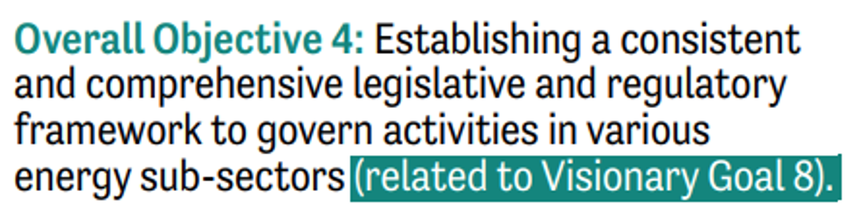
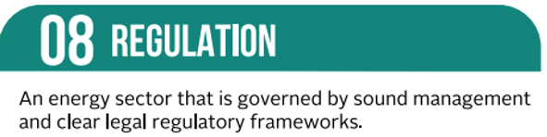
Barbados National Energy Policy - Objectives
Source: Barbados National Energy Policy, 2019-2030, Summary
Notes:
Diversity = Oil to solar to batteries. Wind to come. Level of interest in the Feed In Tariff lead to fast subscription. Lead to a pause in the issuance of new permits. FIT 1.0 2019-2022...FIT 2.0 was finalized in Dec 2022. Reprise evolution of FIT. Gently point out the FTC set a cap, wasn’t responsible for licensing, but the pace exceeded the cap anyway. Different jurisdictions handle differently.
Affordability = In RAP’s experience, if this suffers…if costs go up too quickly…then this crowds out all other potential policy options. Regulators have fewer choices…both in terms of the investments that they can make and the policies that they can consider. Affordability first.
- Assessment of non participating customer impact.
Regulation = The legal framework is clear and current. ESA puts planning back with the utility and procurement with the Ministry. The regulator’s role is______________________. Suggest IRRP involvement without prejudice.

Slide 4
Focus: Unpacking Five Strategies
1. Model Existing Mechanisms in the IRRP
2. Move Toward Performance Based Regulation
3. Accelerate Customer Facing Programs
4. Increase Stakeholder Education & Engagement
5. Build Up Skills & Capacity
Notes:
Barbados is well positioned to accelerate its progress toward a 100% renewable energy sector.
But there are difficulties along the way, a pause in solar development due to the pace of FIT investment, that RAP was brought in to help advise the FTC about how to regulate the energy transition..

Slide 5
Model Existing Mechanisms in the IRRP
Quantify rate & bill impacts.
Develop a scorecard.
Include customer facing programs.
Expand resilience planning.
Document IRRP approval & cost recovery in the ESA regulations.
Move toward comprehensive grid planning.
Notes:
Why Integrated Resource and Resilience Plan: It’s the first step in most jurisdictions.
NPV is helpful, but it doesn’t tell you when, who or how much.
Rate and bill impacts fill in these questions.
Scorecard is similar to report card but its ranked.

Slide 6
Move Toward Performance Based Regulation
Increase rate case frequency.
Benchmark rate case duration.
Adopt a future test year.
Develop a report card (as a precursor to a scorecard).
Connect & align the cost recovery processes.
Notes:
PBR is a suite of policies plus decoupling.
List of policy tools: MultiYear Rate Plans, Performance Incentive Mechanisms, decoupling, scorecard.
Decoupling is distinct because the other tools are effective on their own and can be implemented more quickly.
Theory of Change = Measurement + Transparency = Accountability (often without a financial incentive or PIM).

Slide 7
Accelerate Customer Programs
Consider a time-based rate pilot.
Consider adopting an energy efficiency resource standard.
Design programs for the major end uses.
Notes:
Anecdotes:
#1 recommendation from the IRRP. “DSM has the most powerful impact on costs…”
Also, the more efficiency reduces total kWh, the national renewable goal is less in absolute MWs.
So the question became, “How can the commission support faster adoption of demand side technology?”
The answer is to compliment the Ministry’s DSM programs with time-based rates and motivate action by consumer/citizens.
Lessons:
The literature on Time-based rates is strong. TBR works.
The challenge is in motivating customers to value the control and opportunity to save TBR gives them. While avoiding concerns and seeking solutions to them.

Slide 8
Increase Stakeholder Education & Engagement
Address known barriers to engagement.
Increase public education and outreach.
Consider creating advisory councils and holding listening sessions.
Increase public engagement as a responsibility of the regulator.
Notes:
Access to the Process
Meeting time, location, notice & publicity, language… Used Hawaii as the source and inspiration.
Anecdotes:
The transition gets harder as it progresses, not only technologically and economically, but with people and permitting. Hawaii protests…
Lessons:
The barriers are common sense, but still not often managed well.
Citizens have legitimate questions (not always well-articulated) that merit respectful consideration

Slide 9
Build Up the FTC’s Skills & Capacity
Invest in professional development.
Increase operations management capacity.
Increase the number of specialized positions.
Increase investment in specialized communications & reporting.
Consider adjustments to the organizational structure.
Notes:
Anecdotes:
There are a lot of free resources out there from NARUC, CEER and others
Many opportunities for training.
Annual reporting is a specialist competency.
Observing the typical org chart revealed specialization.
Hearing officers or ALJs Division.
COO, Deputy Exec. Director or just an empowered legal department.
Analytical specialization in rates/cost recovery, engineering, economics, even DSM.
Lessons:
Annual reports have many uses. Advocacy within government (for more money and FTE’s), accountability, customer education. Frame emerging issues.

Slide 10
Our Journey and Next Steps
Stakeholder Engagement
1. Ministry of Energy
Prioritize the Options
1. IRRP
Technical Assistance
- In 2026
2. Utility
3. RE Association
4. Other Stakeholders
2. PBR
3. Customer Facing Programs
4. Stakeholder Engagement
5. Skills & Capacity
Rollout Plans
Agency Resource Assessments and Gap Analyses
Self-assessment practices
Nimbleness
Addressing emerging demands

