Slide 1


Public–Private Partnerships and Innovative Funding Mechanisms
Case Study: Can‑Cara Jamaica and the Greater Bernard Lodge Development
October 2025

Slide 2
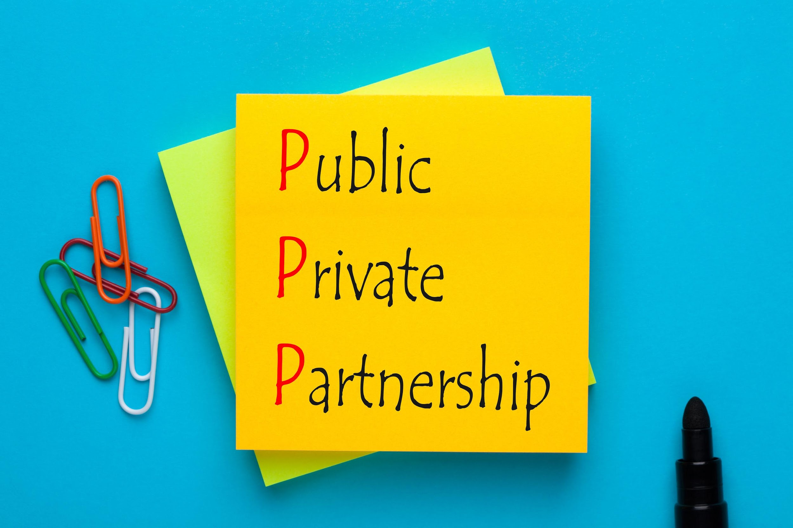
Introduction
This presentation examines the role of public–private partnerships (PPPs) and innovative funding mechanisms in Jamaica’s water and housing sectors. It highlights Can‑Cara Jamaica’s partnerships with government agencies such as the National Water Commission (NWC), the National Housing Trust (NHT), and its role in the Greater Bernard Lodge (GBL) development.
Key themes: PPP frameworks, stakeholder roles, case highlights, funding mechanisms, risk allocation, and an implementation roadmap.

Slide 3
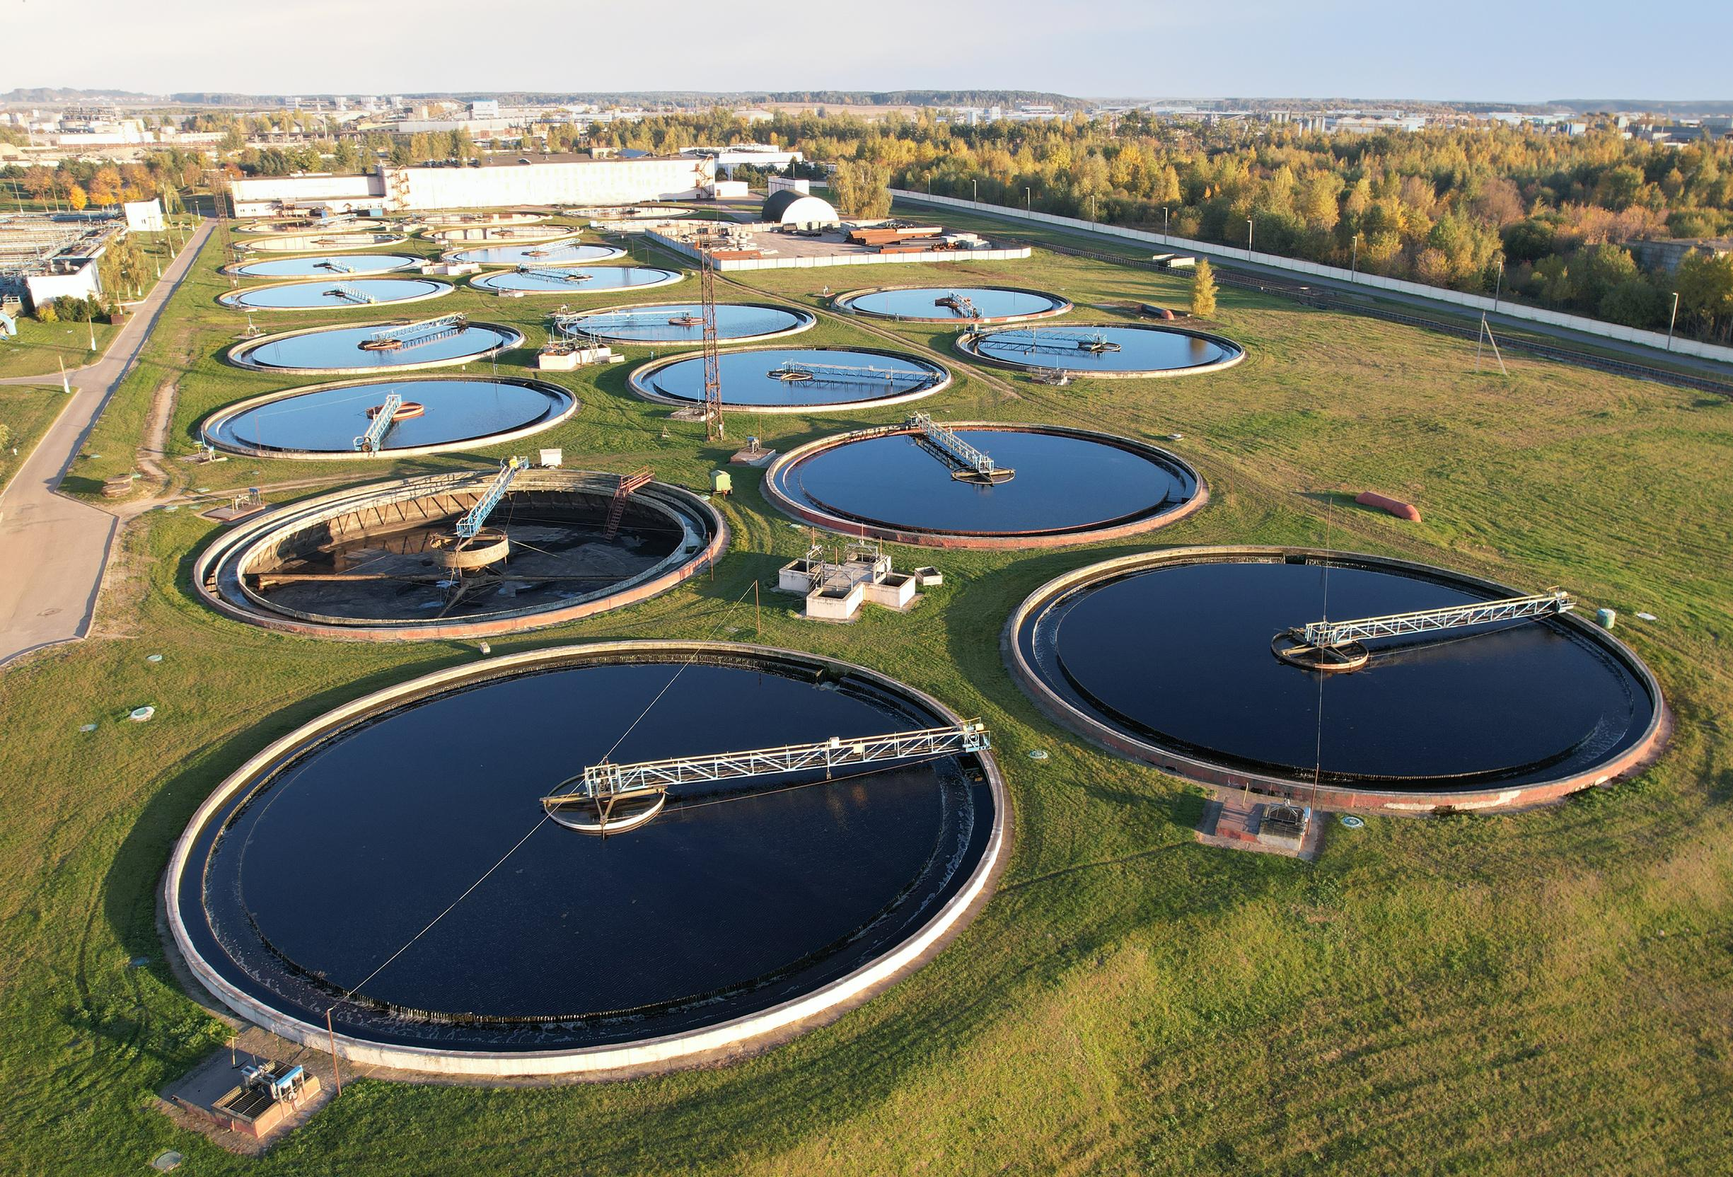
PPP Overview
A public–private partnership is a long‑term contract between a public sector entity and a private party. The private party finances, designs, builds, and operates infrastructure or services, while the public sector ensures regulatory oversight and often supports financial viability.
Why PPPs for water & wastewater?
  Mobilisation of private capital for capital‑intensive projects.
  Lifecycle operation and maintenance discipline.
  Performance‑based service delivery that improves resilience.
PPPs within the local context are guided by the Development Bank of Jamaica’s PPP policy and overseen by regulators ; Office of Utilities Regulation (OUR), the National Environment and Planning Agency (NEPA), and the Water Resources Authority (WRA).

Slide 4

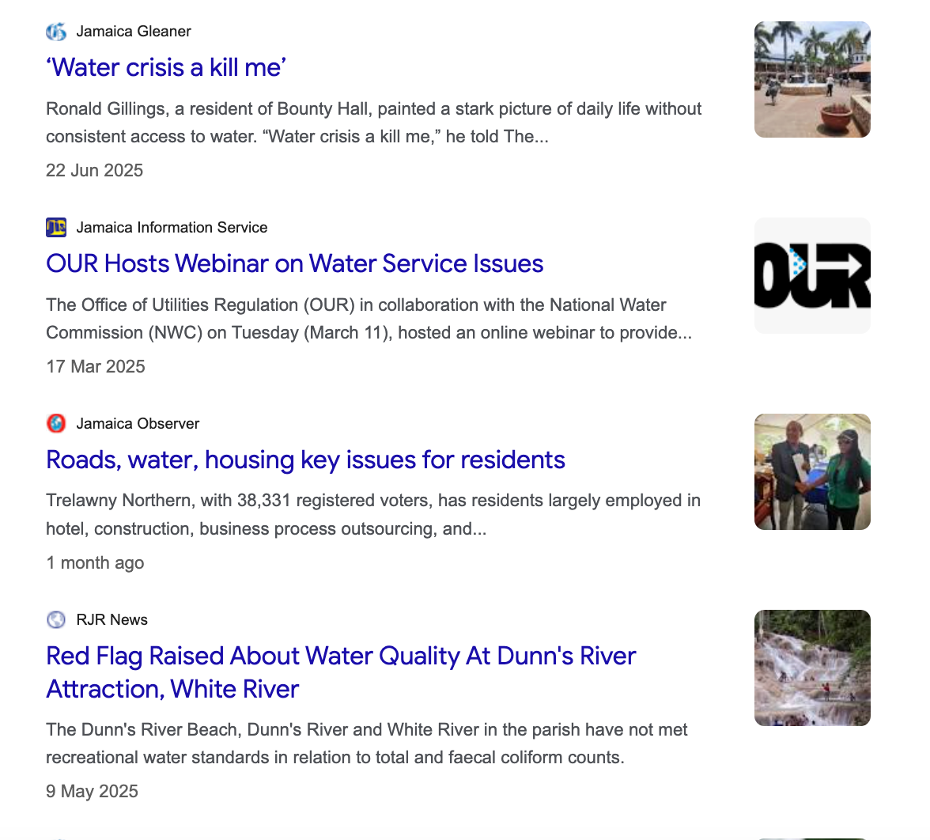
Jamaican Context
Rapid urbanisation and housing expansion in the Saint Catherine corridor, especially around Spanish Town, Portmore, and the GBL area, place pressure on water and wastewater infrastructure. Coverage gaps in central sewerage systems and the need for bulk potable water supply make PPPs an essential tool.
Policy and institutions
  Development Bank of Jamaica (DBJ): PPP unit and project preparation facility.
  OUR: Approves tariffs and ensures service standards.
  NEPA/WRA: Environmental and water abstraction permits.
  NWC: National water utility, bulk supply, and retail distribution.

Slide 5

Key Stakeholders
  3
  1
  2
  4
  3
The National Water Commission (NWC):
National Housing Trust (NHT):
SCJ Holdings / GBL Secretariat
Regulators (OUR, NEPA, WRA)
Bulk water supply and public utility role.
Financing for housing, joint ventures with developers, and mortgage support.
Master planning for the 5,400‑acre GBL township and trunk infrastructure coordination.
Oversight of tariffs, service quality, and environmental compliance.

Slide 6
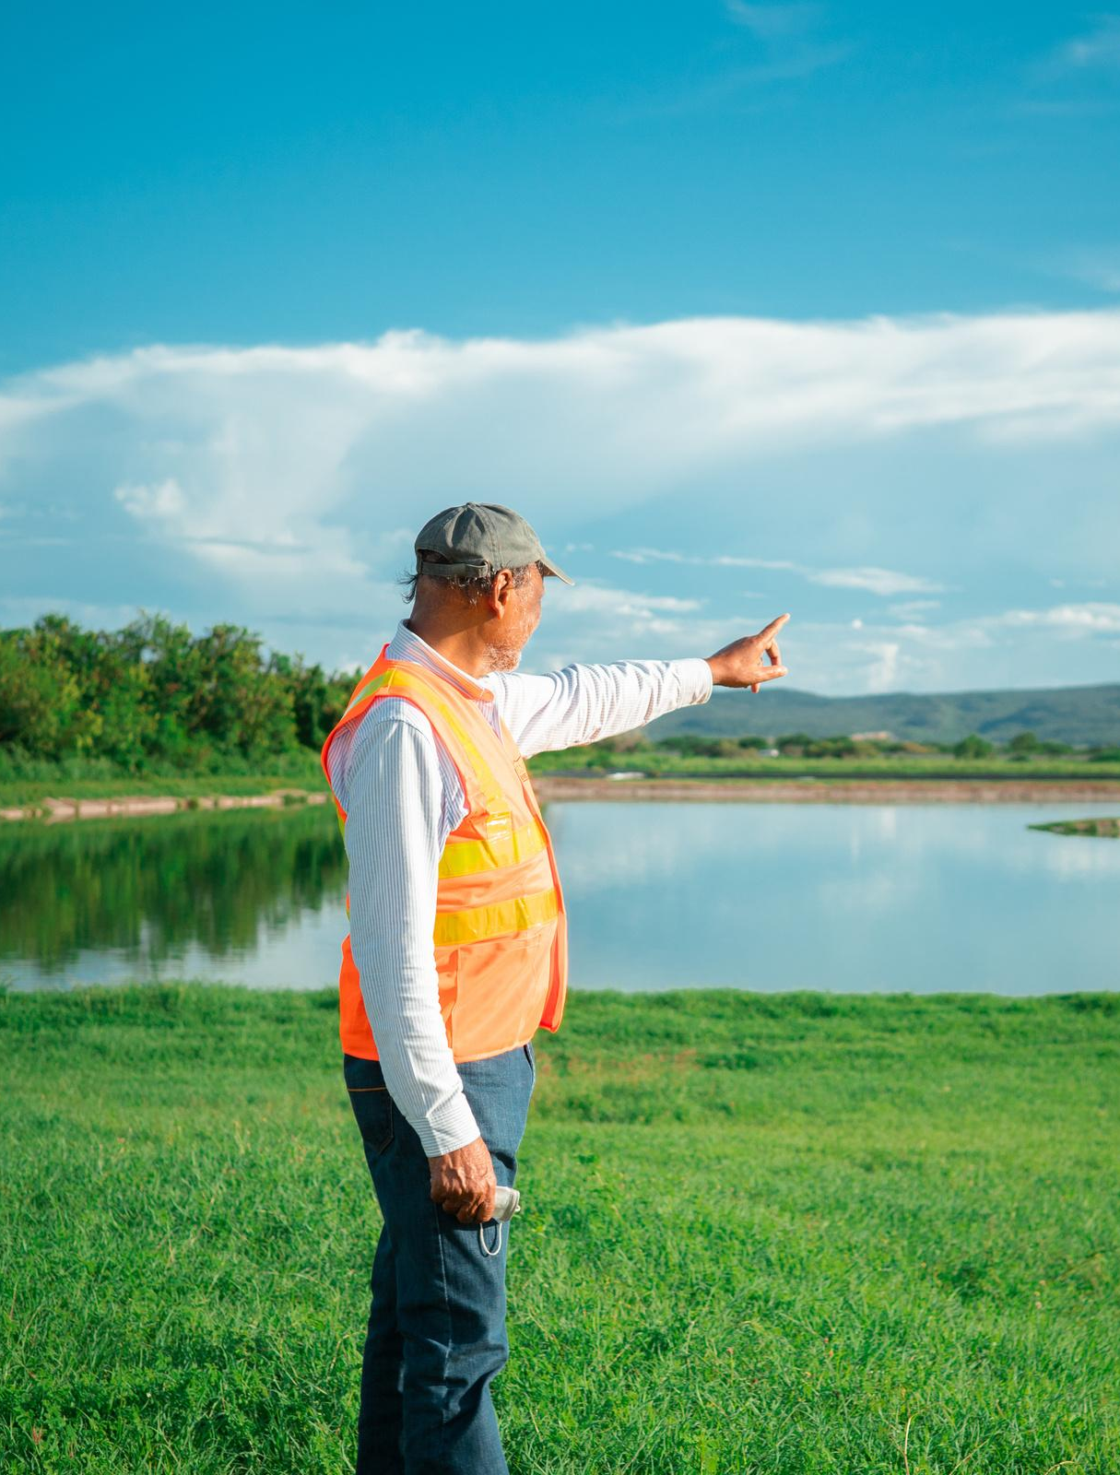
Can‑Cara Jamaica
Snapshot
Can‑Cara is a licensed private provider of potable water and wastewater services. It operates in St. Catherine and St. James, serving residential developments and communities. It is the first and largest private operator of its kind in Jamaica, with experience in both supply and treatment services.

Slide 7
Case Study 1: Can‑Cara × NWC MOU (2023)
In April 2023, Can‑Cara signed a Memorandum of Understanding with the NWC to provide bulk water, sewerage, and irrigation services to South‑East St. Catherine.
Scope
  Conveyance of sewage from NWC customers to Can‑Cara’s CDL treatment plant.
  Three‑phase roll‑out of bulk and retail services.
  Cabinet approval for Can‑Cara (CDL) to serve GBL with potable water and sewage disposal.
Significance
  First Cabinet‑endorsed role for a private utility in Jamaica’s master‑planned development.
  Model for public–private bulk supply agreements.

Slide 8
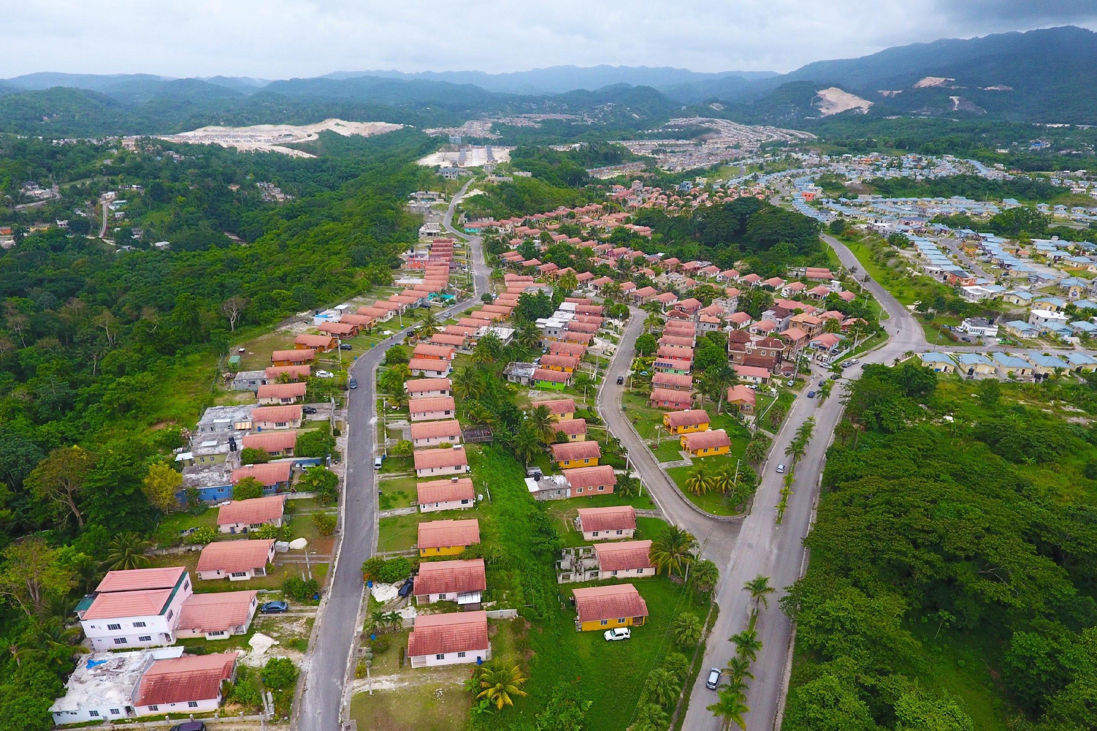
Case Study 2: Can‑Cara × NHT Housing JVs
The NHT has a history of partnering with developers. For example, at Union Acres in St James, NHT and the Jamaica Civil Service Association collaborated on a 144‑unit subdivision. NHT provided financing support through the Employee Benefits Programme and standard mortgage schemes.
Relevance to Can‑Cara
  Coordinated delivery of housing alongside compliant water and wastewater services.
  Demonstrates how NHT‑linked demand creates bankable utility projects.

Slide 9

Case Study 3: Greater Bernard Lodge (GBL)
The GBL project is a master‑planned township covering 5,400 acres in St. Catherine. It involves trunk infrastructure for water, sewerage, drainage, and roads.
Can‑Cara’s Role
  Cabinet approval to provide potable water and sewage disposal services.
  Interface with NWC for bulk supply and distribution.
  Enable private developers to access serviced lots.
Strategic Importance
  Supports national housing goals.
  Introduces a replicable model for utility provision in new townships.

Slide 10

Innovative Funding Mechanisms
PPP projects in Jamaica can draw on a range of innovative financing approaches:
  Development/Infrastructure Impact Fees: Lot‑based fees to finance trunk infrastructure.
  Bulk Supply & Take‑or‑Pay Contracts: NWC bulk off‑take provides revenue certainty for lenders.
  Tariff‑Backed Revenue: OUR‑approved tariffs guarantee predictable cash flows.
  Blended Finance with NHT Support: NHT mortgages and joint ventures stimulate demand.
  Pooled/Project Bonds: Special Purpose Vehicles (SPVs) can securitise receivables from tariffs and development charges.
  Public Equity: Can Cara’s planned fund raise via the major markets (JSE) slated for first quarter 2026.

Slide 11
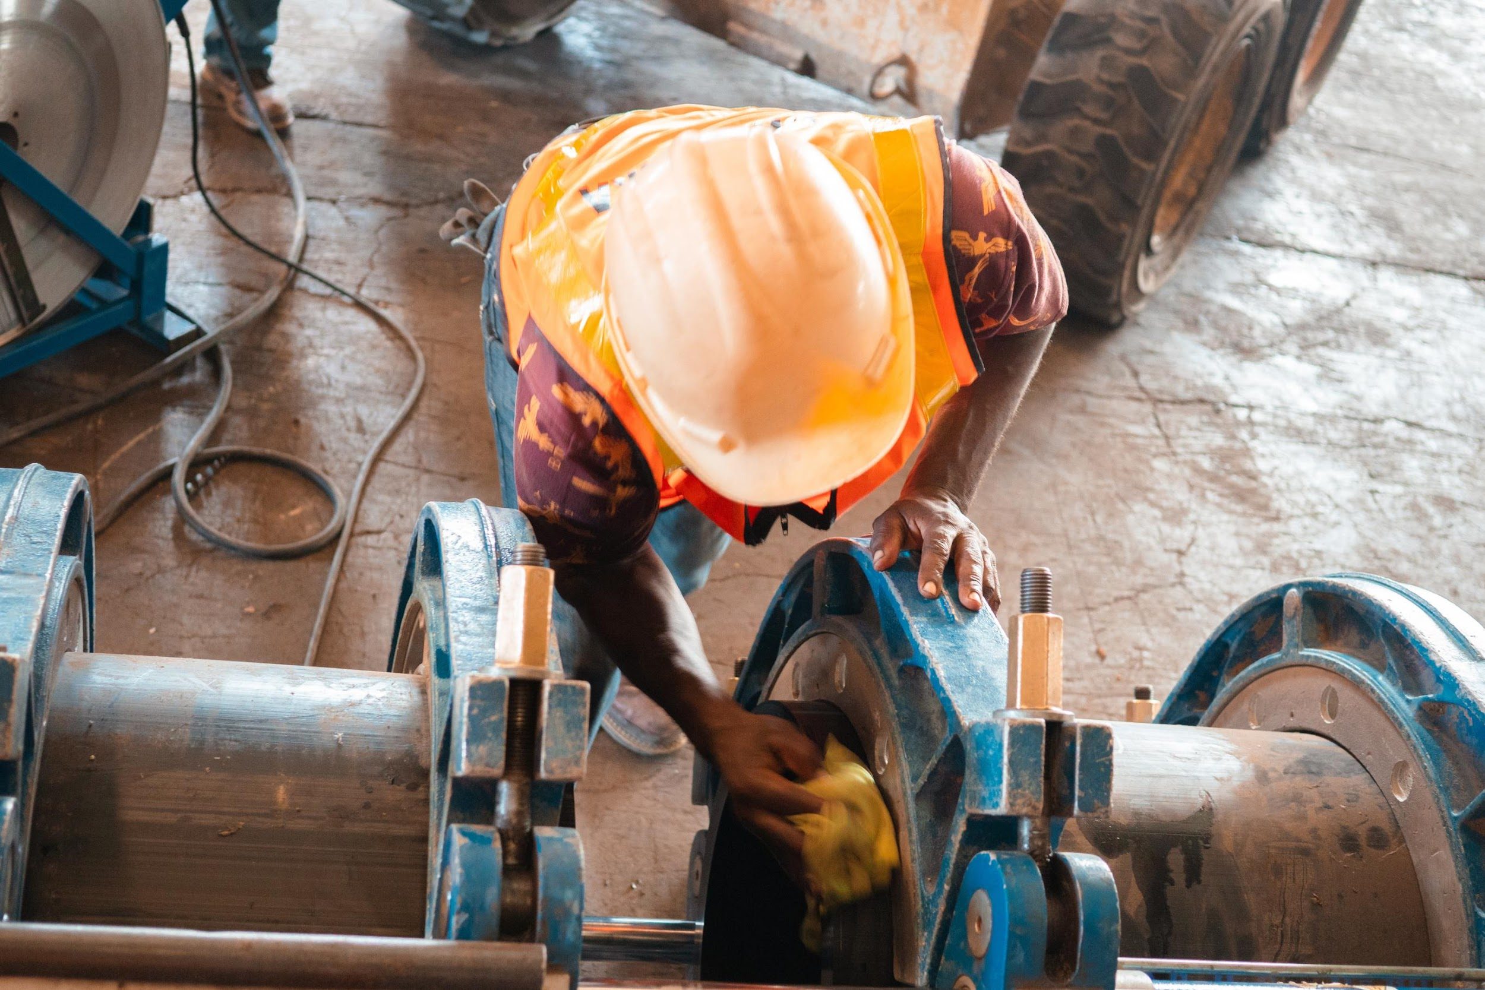

Risk Allocation
  Effective PPPs allocate risks to the party best able to manage them.
  Public sector (GoJ/NWC/SCJ): Land, right‑of‑way, regulatory support, and payment security for bulk off‑take.
  Private sector (Can‑Cara/SPV): Design, build, finance, operate responsibilities; funding via internally generated cash flows, private and publc equity – multilateral funding.
  Shared: Demand risk, force majeure, and change in law.

Slide 12

Delivery Roadmap (18–36 months)
Phase 2:
Construction (trunk mains, wells, wastewater plant upgrades).
Phase 1:
Financing (development charges, bulk off‑take, debt/equity structuring).
Phase 0:
Feasibility and structuring (demand assessment, technical design, tariff frameworks).
Phase 3:
Operations (KPIs include uptime, non‑revenue water, effluent compliance).

Slide 13

KPIs and Impact
  Service: 24/7 potable water supply; compliant effluent standards.
  Financial: Debt service coverage ratio (DSCR) above 1.2x; capex within ±10% of budget.
  Development: Connections delivered, housing completions, tariff affordability.

Slide 14
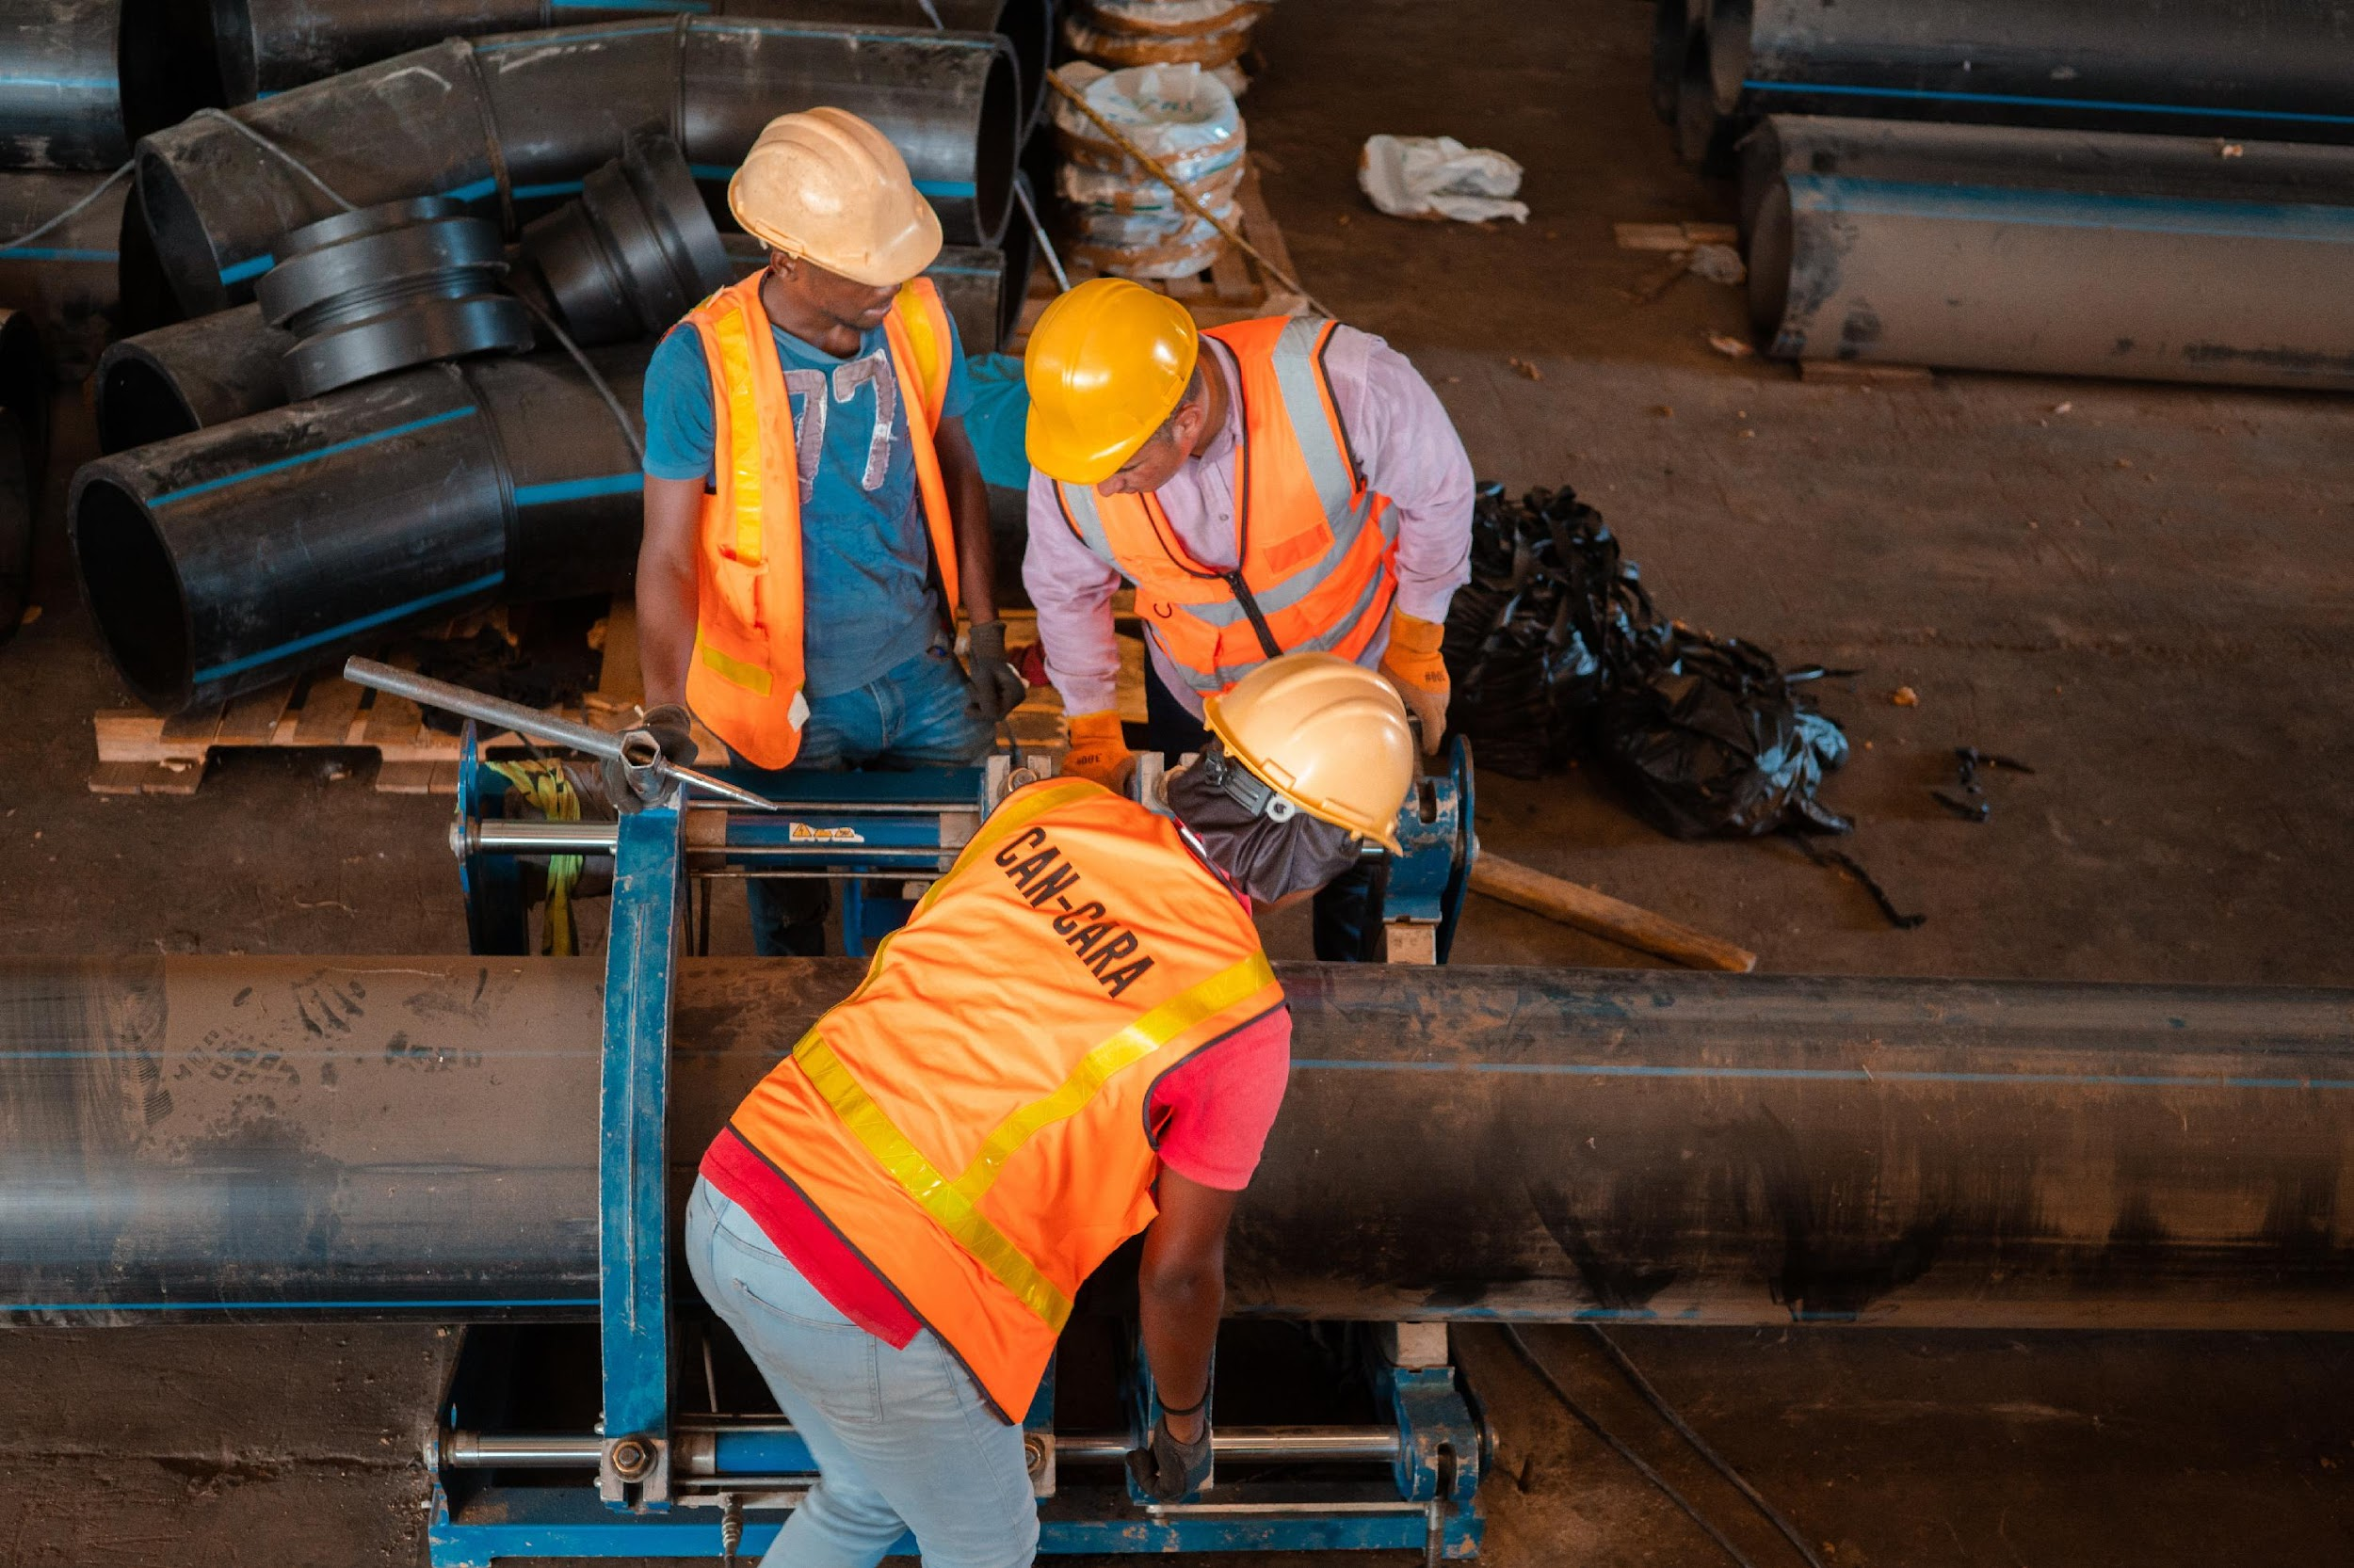
Next Steps
  Confirm demand from GBL developers.
  Agree on development fee structure.
  Advance OUR tariff application and NWC bulk contracts.
  Align NHT developer pipeline with utility build‑out.
  Conduct market soundings with lenders (domestic banks, DFIs, pension funds).

Slide 15

Conclusion
The Can‑Cara case demonstrates how PPPs and innovative finance can expand water and wastewater services to support Jamaica’s housing development.
By leveraging development charges, bulk off‑take contracts, and NHT demand, the model at GBL can be replicated across other housing growth areas, strengthening infrastructure delivery and national development.

Slide 16


Join Can-Cara’s Eco Revolution Today!
www.can-cara.com

