Slide 1



UNPLUGGED
Challenges and Opportunities of Distributed Energy Resources in the Caribbean
L. Nigel Burgess, Director of Utility Regulation
Supported by

Slide 2


Background
Islands and the Caribbean region face unique challenges in the electricity sector and its decarbonization.
  Isolation
  Land scarcity
  High and volatile prices
  Smaller scale -> Diseconomies of scale
Distributed Energy Resources (DER)
  Can help offset high electricity bills
  Can support decarbonization
  Improves energy security

Slide 3

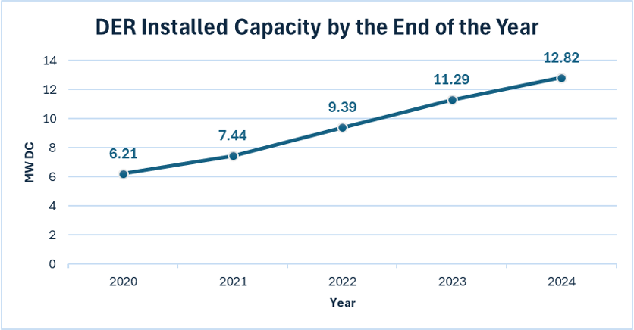
Bermuda’s Journey with DER
In Bermuda, any generation asset below 500kW is considered DER.
Why has DER increased?
What technical challenges have been observed?
Since 2020, Bermuda’s distributed solar capacity has increased from 6.21MW to 12.82MW -> more than double.

Slide 4


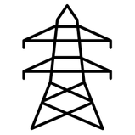


Bermuda’s Feed-in Tariff (FiT) Pre 2023
In 2018, Bermuda introduced a FiT scheme which compensates DER for excess electricity exported to the grid. The FiT aims to compensate DER for excess electricity based on utility’s avoided cost of generation.
FiT based on ex-ante calculation of avoided cost of generation using historical values
Updated every three years
Incentivises growth in renewables
Three-year review period provides stability
Misalignment between the trends of FiT and marginal cost of thermal generation

Slide 5
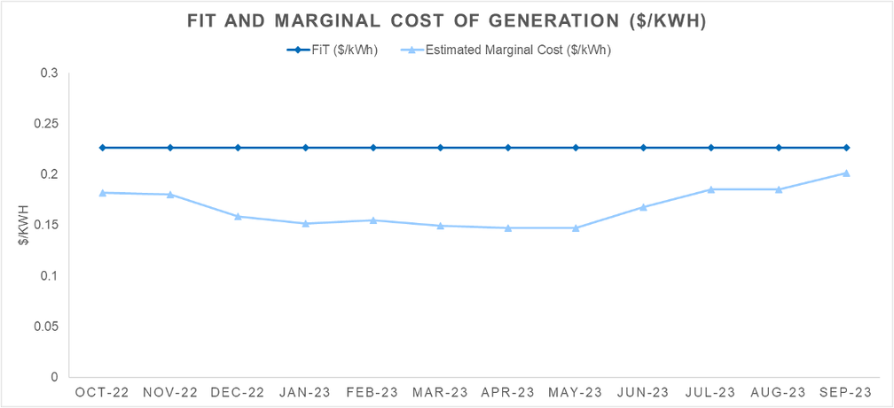
Bermuda’s Feed-in Tariff (FiT) Pre 2023
Between late 2022 and Q3 2023, there was a misalignment between the FiT and marginal cost trends
Where the FiT does not decrease in line with the benefits incurred by DG, it essentially amounts to other customers paying for an implicit subsidy towards DER users
This could result in oversizing of assets, which could impact the total cost of supply

Slide 6
Bermuda’s Feed-in Tariff (FiT) From 2023
In 2022, the RA began its review of the methodology to reassess the balance between decarbonization and fair pricing.
FiT based on ex-ante calculation of the avoided cost of generation using forecasted values
Updated every quarter
Incentivises growth in renewables
Better alignment between FiT and the marginal cost of thermal generation trends
Minimize non-DER subsidizing DER
Increased administrative burden
Rate volatility

Slide 7
Technical Challenges Posed by DER
As DER becomes more prominent in power systems, the uptake has the potential to risk grid stability and reliability if not managed and regulated properly. To do so, the RA uses two approaches:
1
Enforcing system reliability through targets
2
Power system planning constraints

Slide 8
1
Enforcing system reliability through targets
  Every Price Control, the RA sets annual performance targets, with a deadband, which at present include:
    System Average Interruption Duration Index (SAIDI)
    System Average Interruption Frequency Index (SAIFI)
    Heat Rate
  If the utility overperforms and its performance is positively out of the deadband, it receives a reward
  If the utility underperforms and its performance is negatively out of the deadband, it receives a penalty
  The targets set by the RA clarify performance expectations in the context of the changing nature of supply and demand resources, including but not limited to DER.

Slide 9
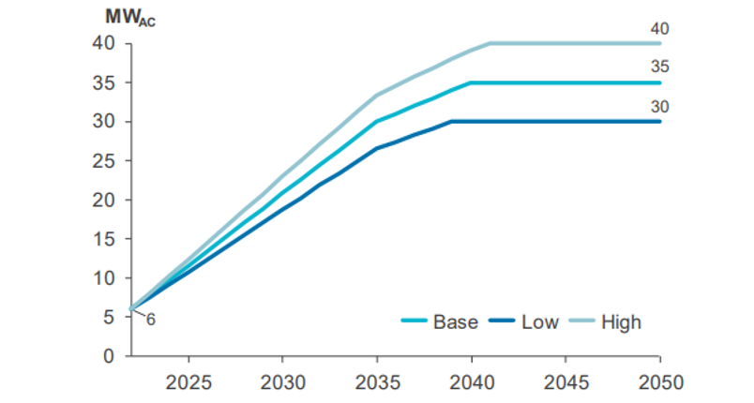
2
Power System Planning Constraints
  At least every five years, the RA must request an Integrated Resource Plan (IRP) proposal from the utility
  In addition to including a resource plan that includes expected demand and a procurement plan to meet the demand, legislation requires the IRP to “include proposed limits for total distributed generation capacity over the planning period”
  The utility can assess its power system and continuously monitor and amend the limit based on the system’s stability, reliability, and grid congestion
  Any new entry of DER cannot put the utility beyond the limit of DER capacity stated in the approved IRP

Slide 10
Managing increasingly blurred lines between DER and utility-scale solar
Historically, Bermuda has had three classes of assets.
DER < 500kW
Bulk Generation > 500kW
DER > 500kW
  DER in Bermuda is an asset below 500kW
  Receives a Standard Contract
  Benefits from the FiT for exporting to the grid
  IRP caps the level allowed in Bermuda
  Bulk Generation is an asset above 500kW that generates and sells all electricity to the utility
  Requires a Bulk Generation Licence
  Cannot access the FiT
  An asset with capacity above 500kW used to generate electricity and self-consume
  Assets cannot export excess electricity to the grid
  Requires a Large-Scale Self Supply Licence
  Cannot access the FiT

Slide 11
Managing increasingly blurred lines between DER and utility-scale solar
Historically, Bermuda has had three classes of assets.
BGSUI > 500kW
  The framework left a gap for large electricity consumers, which had two choices:
    Choice 1: Install an asset with a capacity lower than 500kW and export the excess electricity to the grid.
    Choice 2: Install an asset with a capacity above the threshold, self-consume, and curtail the excess electricity (or deploy a battery to shift the excess generation).
  Regardless of the choice, the customer and system would suffer
  BGSUI is a renewable asset that is above 500kW and uses or stores electricity at its principle location
  Must apply for the BGSUI Licence
  Benefits from a FiT for exports to the grid
  Only compensated for a maximum level of exports

Slide 12
Managing increasingly blurred lines between DER and utility-scale solar
Historically, Bermuda has had three classes of assets.
BGSUI > 500kW
Fair pricing
  BGSUI is a renewable asset that is above 500kW and uses or stores electricity at its principle location
  Must apply for the BGSUI Licence
  Benefits from a FiT for exports to the grid
  Only compensated for a maximum level of exports
  It was important for the RA to consider whether these assets should have the same FiT and FiT methodology as DER
  The RA settled on a methodology that balances costs and benefits to the TD&R Licensee, to minimize the impact on customers and the utility

Slide 13
Managing increasingly blurred lines between DER and utility-scale solar
Historically, Bermuda has had three classes of assets.
BGSUI > 500kW
Technical Constraints
  BGSUI is a renewable asset that is above 500kW and uses or stores electricity at its principle location
  Must apply for the BGSUI Licence
  Benefits from a FiT for exports to the grid
  Only compensated for a maximum level of exports
  Electricity Act caps the level of compensation:
    Compensation can be provided for exports up to 30% of the monthly generation
  However, RA can also select a lower value if appropriate
  This can help avoid customers trying to oversize the system and view the licence as a way to make a profit

Slide 14

Takeaways…
When considering creating a scheme to encourage DER uptake, it is important to balance conflicting priorities, such as fair pricing and decarbonization.
When using buy-back schemes to encourage DER uptake, it is vital to ensure that buy-back rates continue to be relevant with evolving markets.
Bermuda uses two approaches to monitor and maintain reliability: setting network reliability targets and power system planning constraints.
Introducing new types of licences requires careful design to ensure that they are not observed as an activity to make profit.

Slide 15


Thank-You
We will now open the presentation to any questions you may have.

