Slide 1

FROM DATA SILOS TO SMART REGULATION:
DATA GOVERNANCE AS A TOOL FOR DIGITAL INCLUSION
OOCUR 20TH CONFERENCE MONTEGO BAY, JAMAICA
APRIL 27-30, 2026
Mavis Johnson Collie, DGIMA Utility Regulation and Competition Authority

Slide 2

The problem: Data silos threaten effective regulation
Data silos: data stored in multiple unconnected systems
Fragmented Data
Limited Integration
Low visibility

Slide 3

The riskS
Weak insight and poor tracking of universal service
Inability to effectively measure inclusion gaps
Reactive decision making
Blind spots in underserved population
WHAT YOU HAVE
FRAGMENTED DATA
WEAK INSIGHT
DELAYED DECISIONS
BLIND SPOTS, PARTICULARLY IN UNDERSERVED POPULATION

Slide 4

Data governance: the new currency
“Without a shift in Data Governance Mind-sets, entities will likely find it challenging to leverage all the business benefits of next-generation platforms and successfully manage risks”

Slide 5
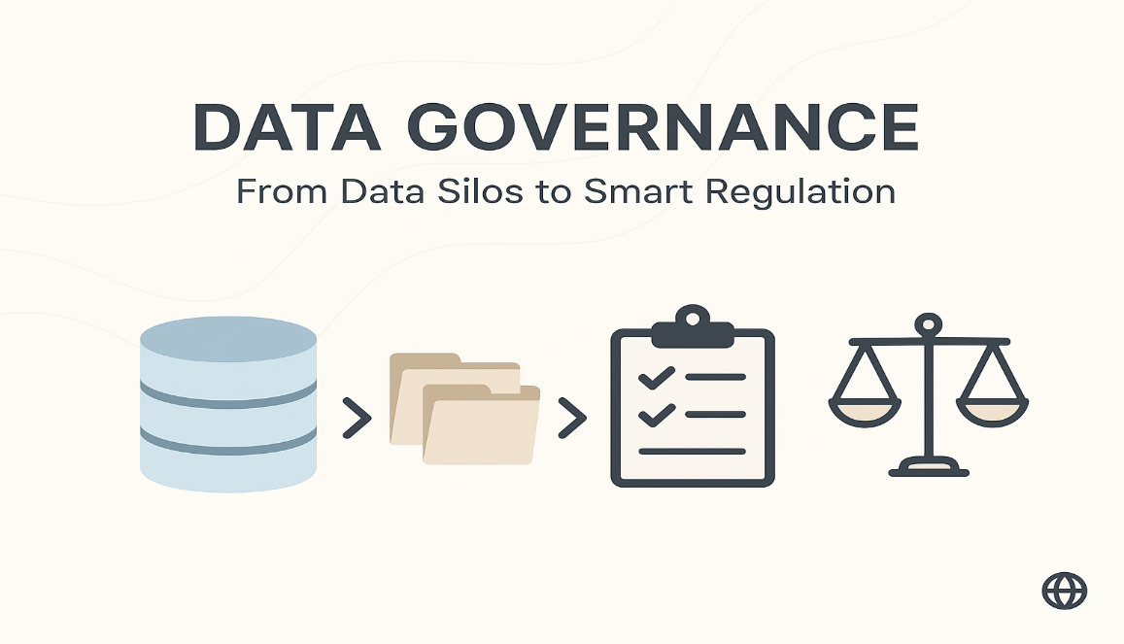
Smart regulation
Finds underserved areas
Monitors operators for consistency
Data driven/evidence base policy decisions

Slide 6

THE ENABLER
DATA INTEGRATION
ACCOUNTABILITY
BUSINESS SYSTEMS ALIGNMENT
DATA QUALITY
Notes:
Key elements of an effective data governance programme

Slide 7

Delivering with confidence
Coverage
Stronger Consumer Protection
More accurate and reliable data
Improved Policy Outcomes
The regulatory impact
T

Slide 8

DIGITAL INCLUSION: the goal
Bridging the digital divide
Bridging the gender gap
Supporting Universal service obligations
Reaching underserved and population

Slide 9

Delivering EFFECTIVE UTILITY REGULATION REQUIRES A SHIFT IN OUR DATA GOVERNANCE MINDSET

Slide 10

Thank YOU

