Slide 1


Beyond the Signal: Reimagining AI, Privacy & Regulatory Integrity in the Caribbean’s Telecommunications Future
OOCUR 20TH CONFERENCE
Navigating Caribbean Regulatory Challenges: Opportunities, Innovations and Collaborations
Najuequa Barnes, BSc., LL.B., MSc., CIPM
Chief Privacy Officer & Managing Director
United Consulting International Limited

Slide 2
01
Telecom as the Nervous System of the Caribbean

Slide 3

In the Caribbean, telecommunications is no longer just infrastructure, it is the architecture of governance, identity, and economic survival.

Slide 4
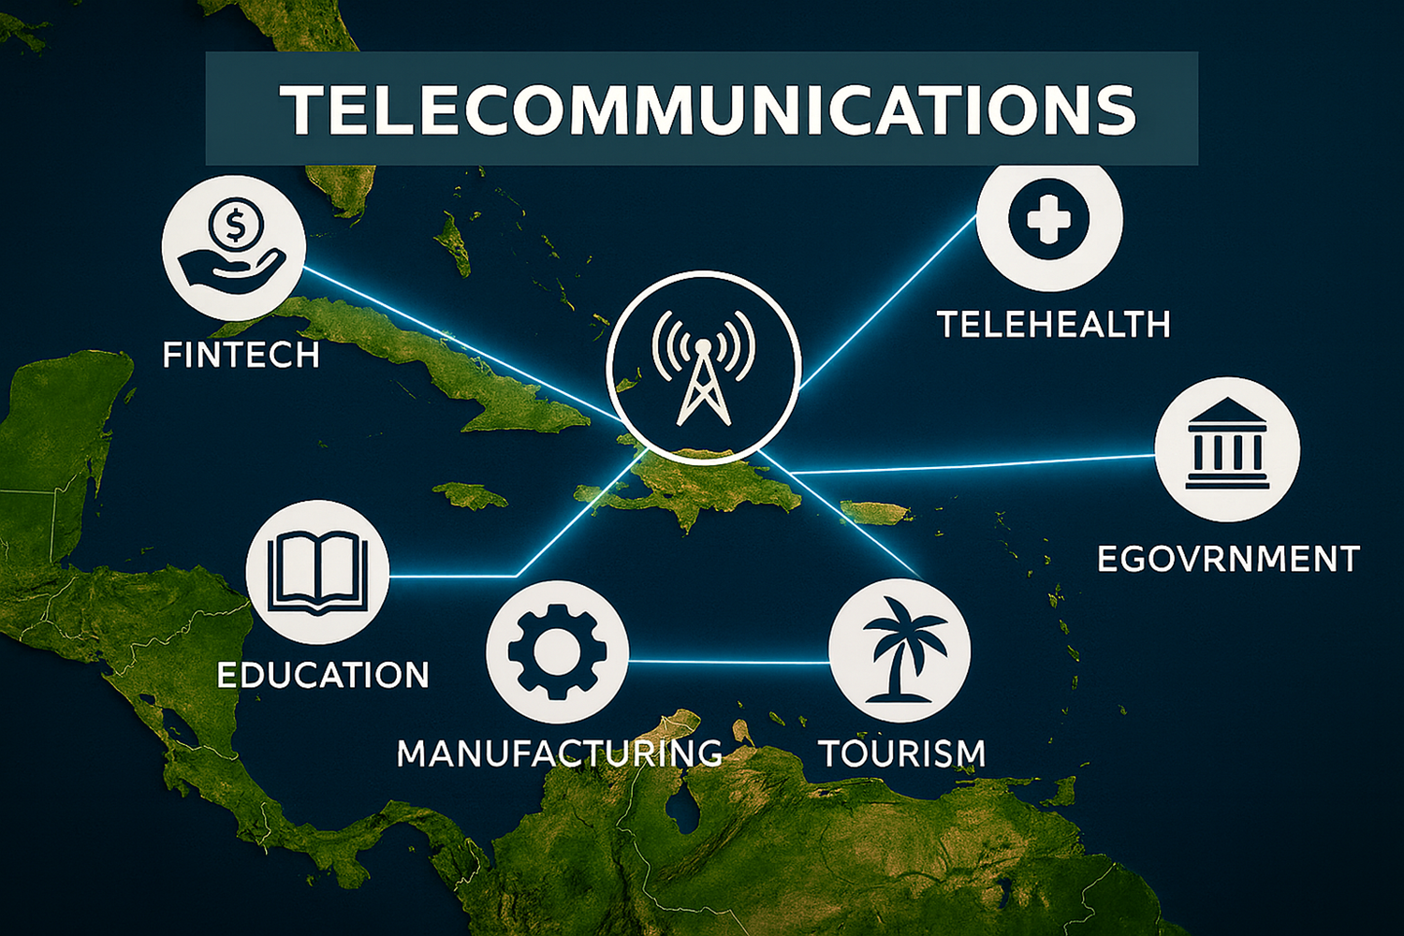


Slide 5

Telecom as the Nervous System of the Caribbean
Connectivity → Growth → Resilience → Integration
Telecom powers education, telehealth, manufacturing, fintech, e-gov, tourism
What role does telecom play in daily life?

Slide 6
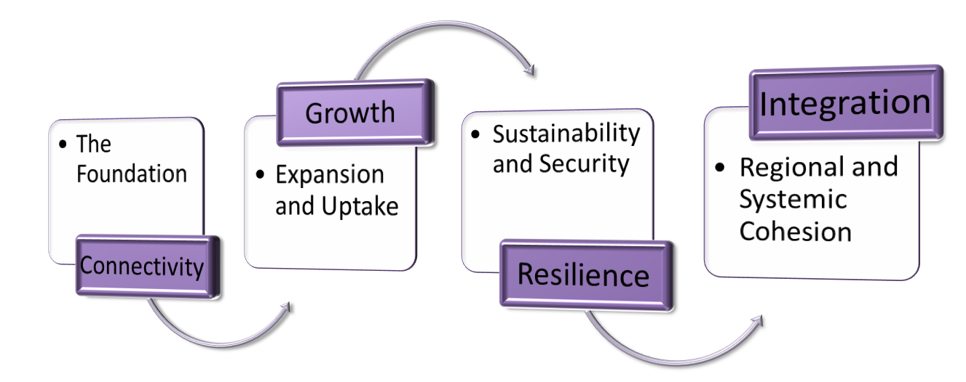
From Connectivity to Integration

Slide 7
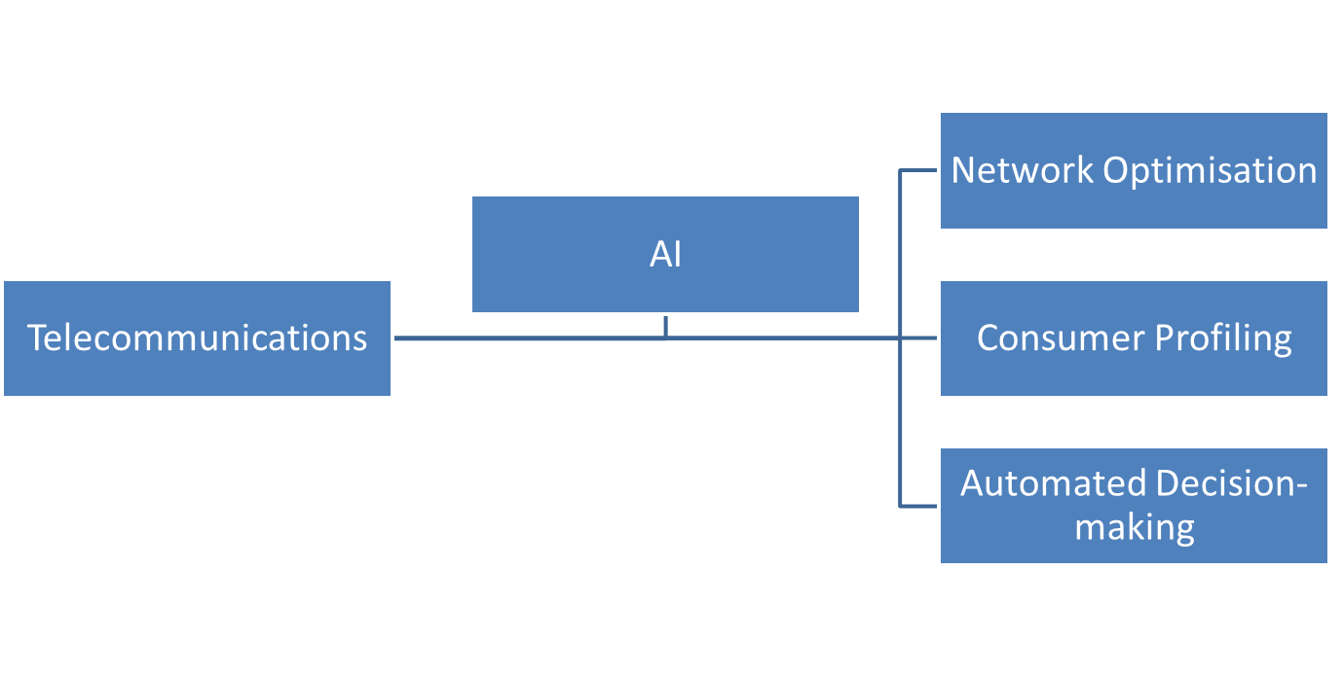
The AI Disruption
AI in Telecom: Network optimization, profiling, automation, predictive maintenance, fraud detection, customer scoring
Risk → automated profiling without consent
Efficiency vs Privacy: where’s the balance?

Slide 8
02
Theme 1: Algorithmic Infrastructure & Power

Slide 9
Theme 1: Algorithmic Infrastructure & Power
Before AI | With AI
Manual operations | Algorithmic optimisation
Strong human oversight | Reduced transparency
As decision-making shifts from human judgment to algorithmic systems, accountability becomes increasingly diffused and harder to enforce.
AI reshaping telecom networks
Consumer agency shrinking?

Slide 10
03
Theme 2: Cross-Border Data Flows & Sovereignty

Slide 11
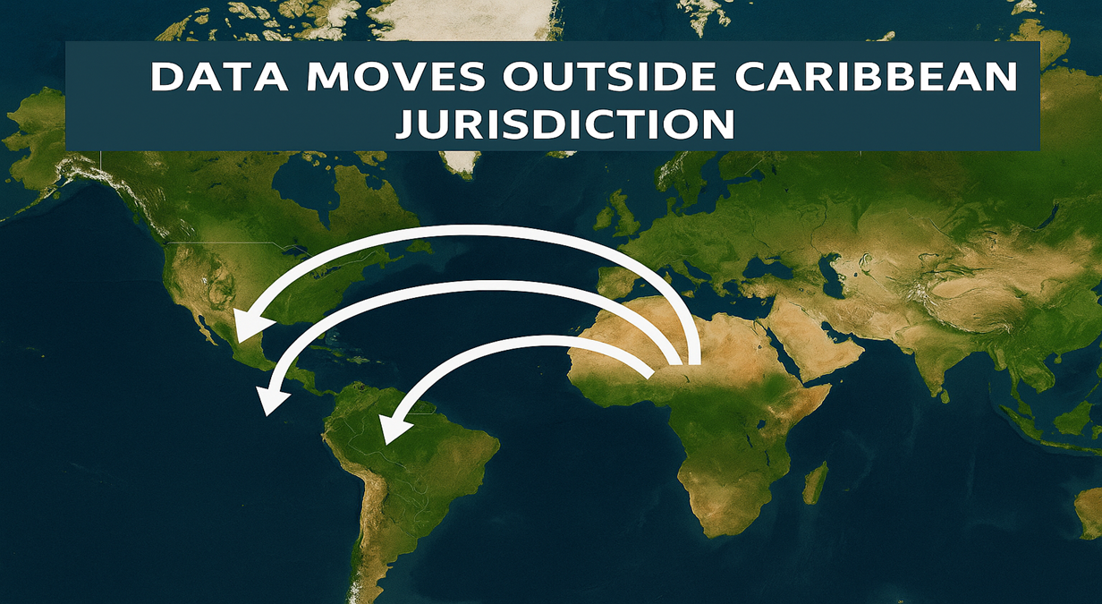
Theme 2: Cross-Border Data Flows & Sovereignty
Whose rules apply to Caribbean citizen data?
Data leaving Caribbean → stored in US/EU cloud
Conflict of laws (e.g. GDPR vs local laws)
Risk: regulatory dependency
The Caribbean risks becoming a data exporter without regulatory control over how that data is used.

Slide 12
04
Theme 3: Regulatory Dexterity

Slide 13
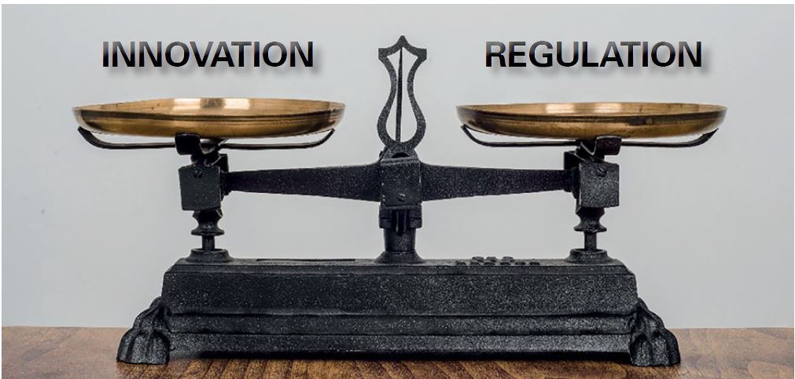
Theme 3: Regulatory Dexterity
Jamaica’s Data Protection Act, 2020
Gaps: AI bias, accountability, enforcement
Quick checklist: gaps → AI bias, algorithmic accountability, cross-border enforcement.
The DPA was not designed for AI-driven decision-making systems
Regulators must move from reactive compliance to proactive governance

Slide 14
05
Theme 4: Small Societies, Big Risks

Slide 15
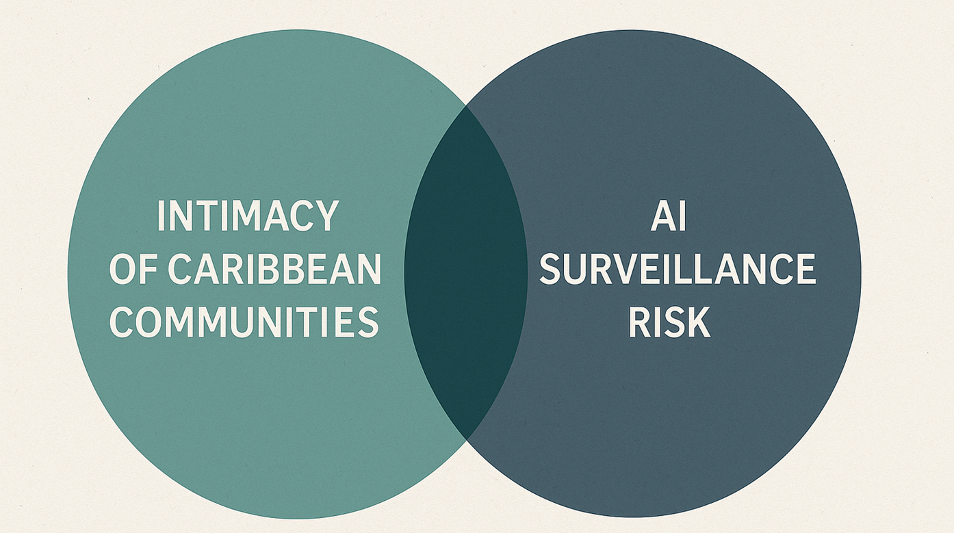
Theme 4: Small Societies, Big Risks
In small societies, privacy breaches are not just technical failures, they are social events.
Examples: reputational harm, limited watchdog capacity.
Prompt: Do our size and culture make us more vulnerable?

Slide 16
06
Theme 5: Ethics of Scale

Slide 17
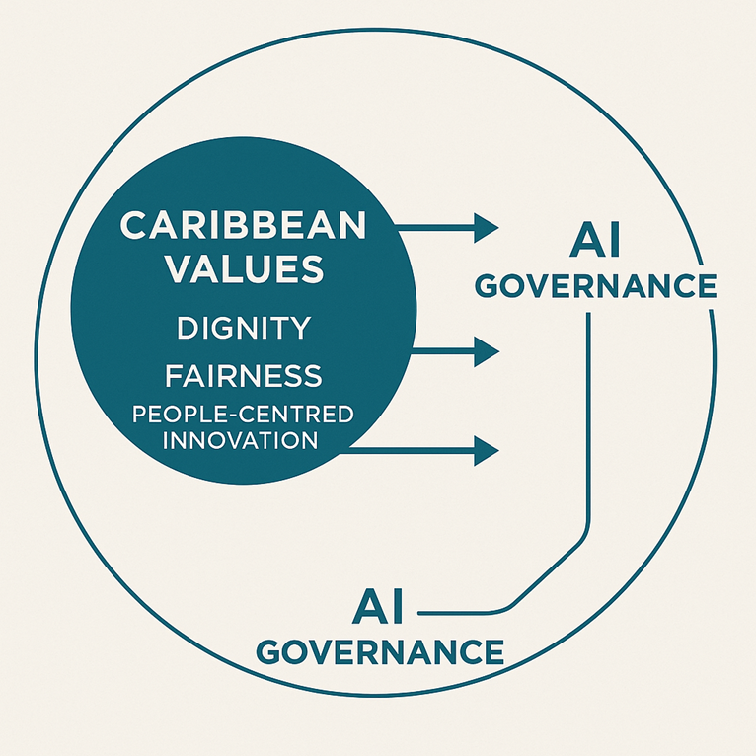
Theme 5: Ethics of Scale
Can we scale without losing who we are?

Slide 18
06
Case Examples

Slide 19
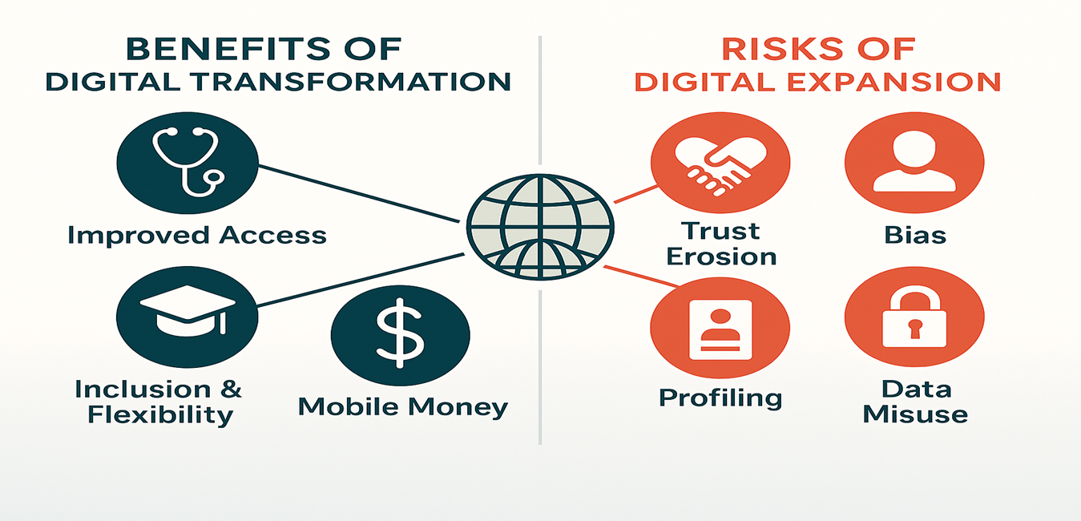
Case Examples
Telecom using AI to segment customers → leads to unfair pricing or exclusion
Maximize benefits: access, inclusion, mobile money
Contain risks: trust erosion, bias, profiling, data misuse
Operationalize governance: privacy-by-design, audits, redress

Slide 20
Roadmap for Reginal Action
Regional AI governance framework
Harmonised data protection standards and telecom laws
Telecom regulatory sandboxes
Cross-border enforcement mechanisms/Cross-Caribbean regulatory collaboration
Embed Caribbean values in governance
Capacity building for regulators

Slide 21

Beyond the Signal
The Caribbean’s digital future must not only be innovative, it must be sovereign, ethical, and built on trust.

Slide 22

DISCUSSION

Slide 23

Discussion Question
How can we design Caribbean telecoms that are both innovative and rooted in trust?

Slide 24




Thanks!
@UCI.CORPORATE

Slide 25

Subscribe to our Privacy Pulse Newsletter
Subscribe to receive important updates, tips, and alerts on data privacy protection. We share practical insights to help individuals and businesses keep their information secure

