Slide 1
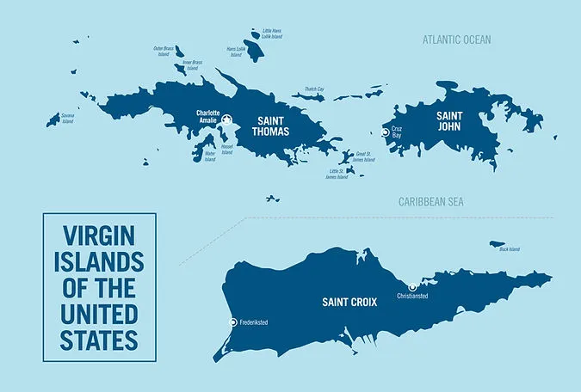
Wastewater Regulation in the U.S. Virgin Islands

Slide 2
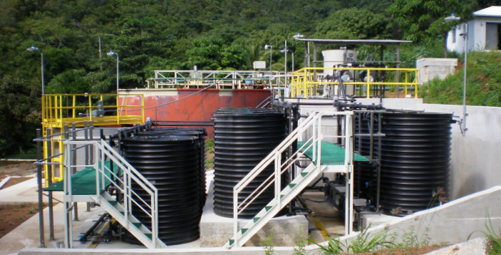
Introduction
Insights and Best practices
Regulatory Implementations
Wastewater Management, Usage, and Treatment

Slide 3
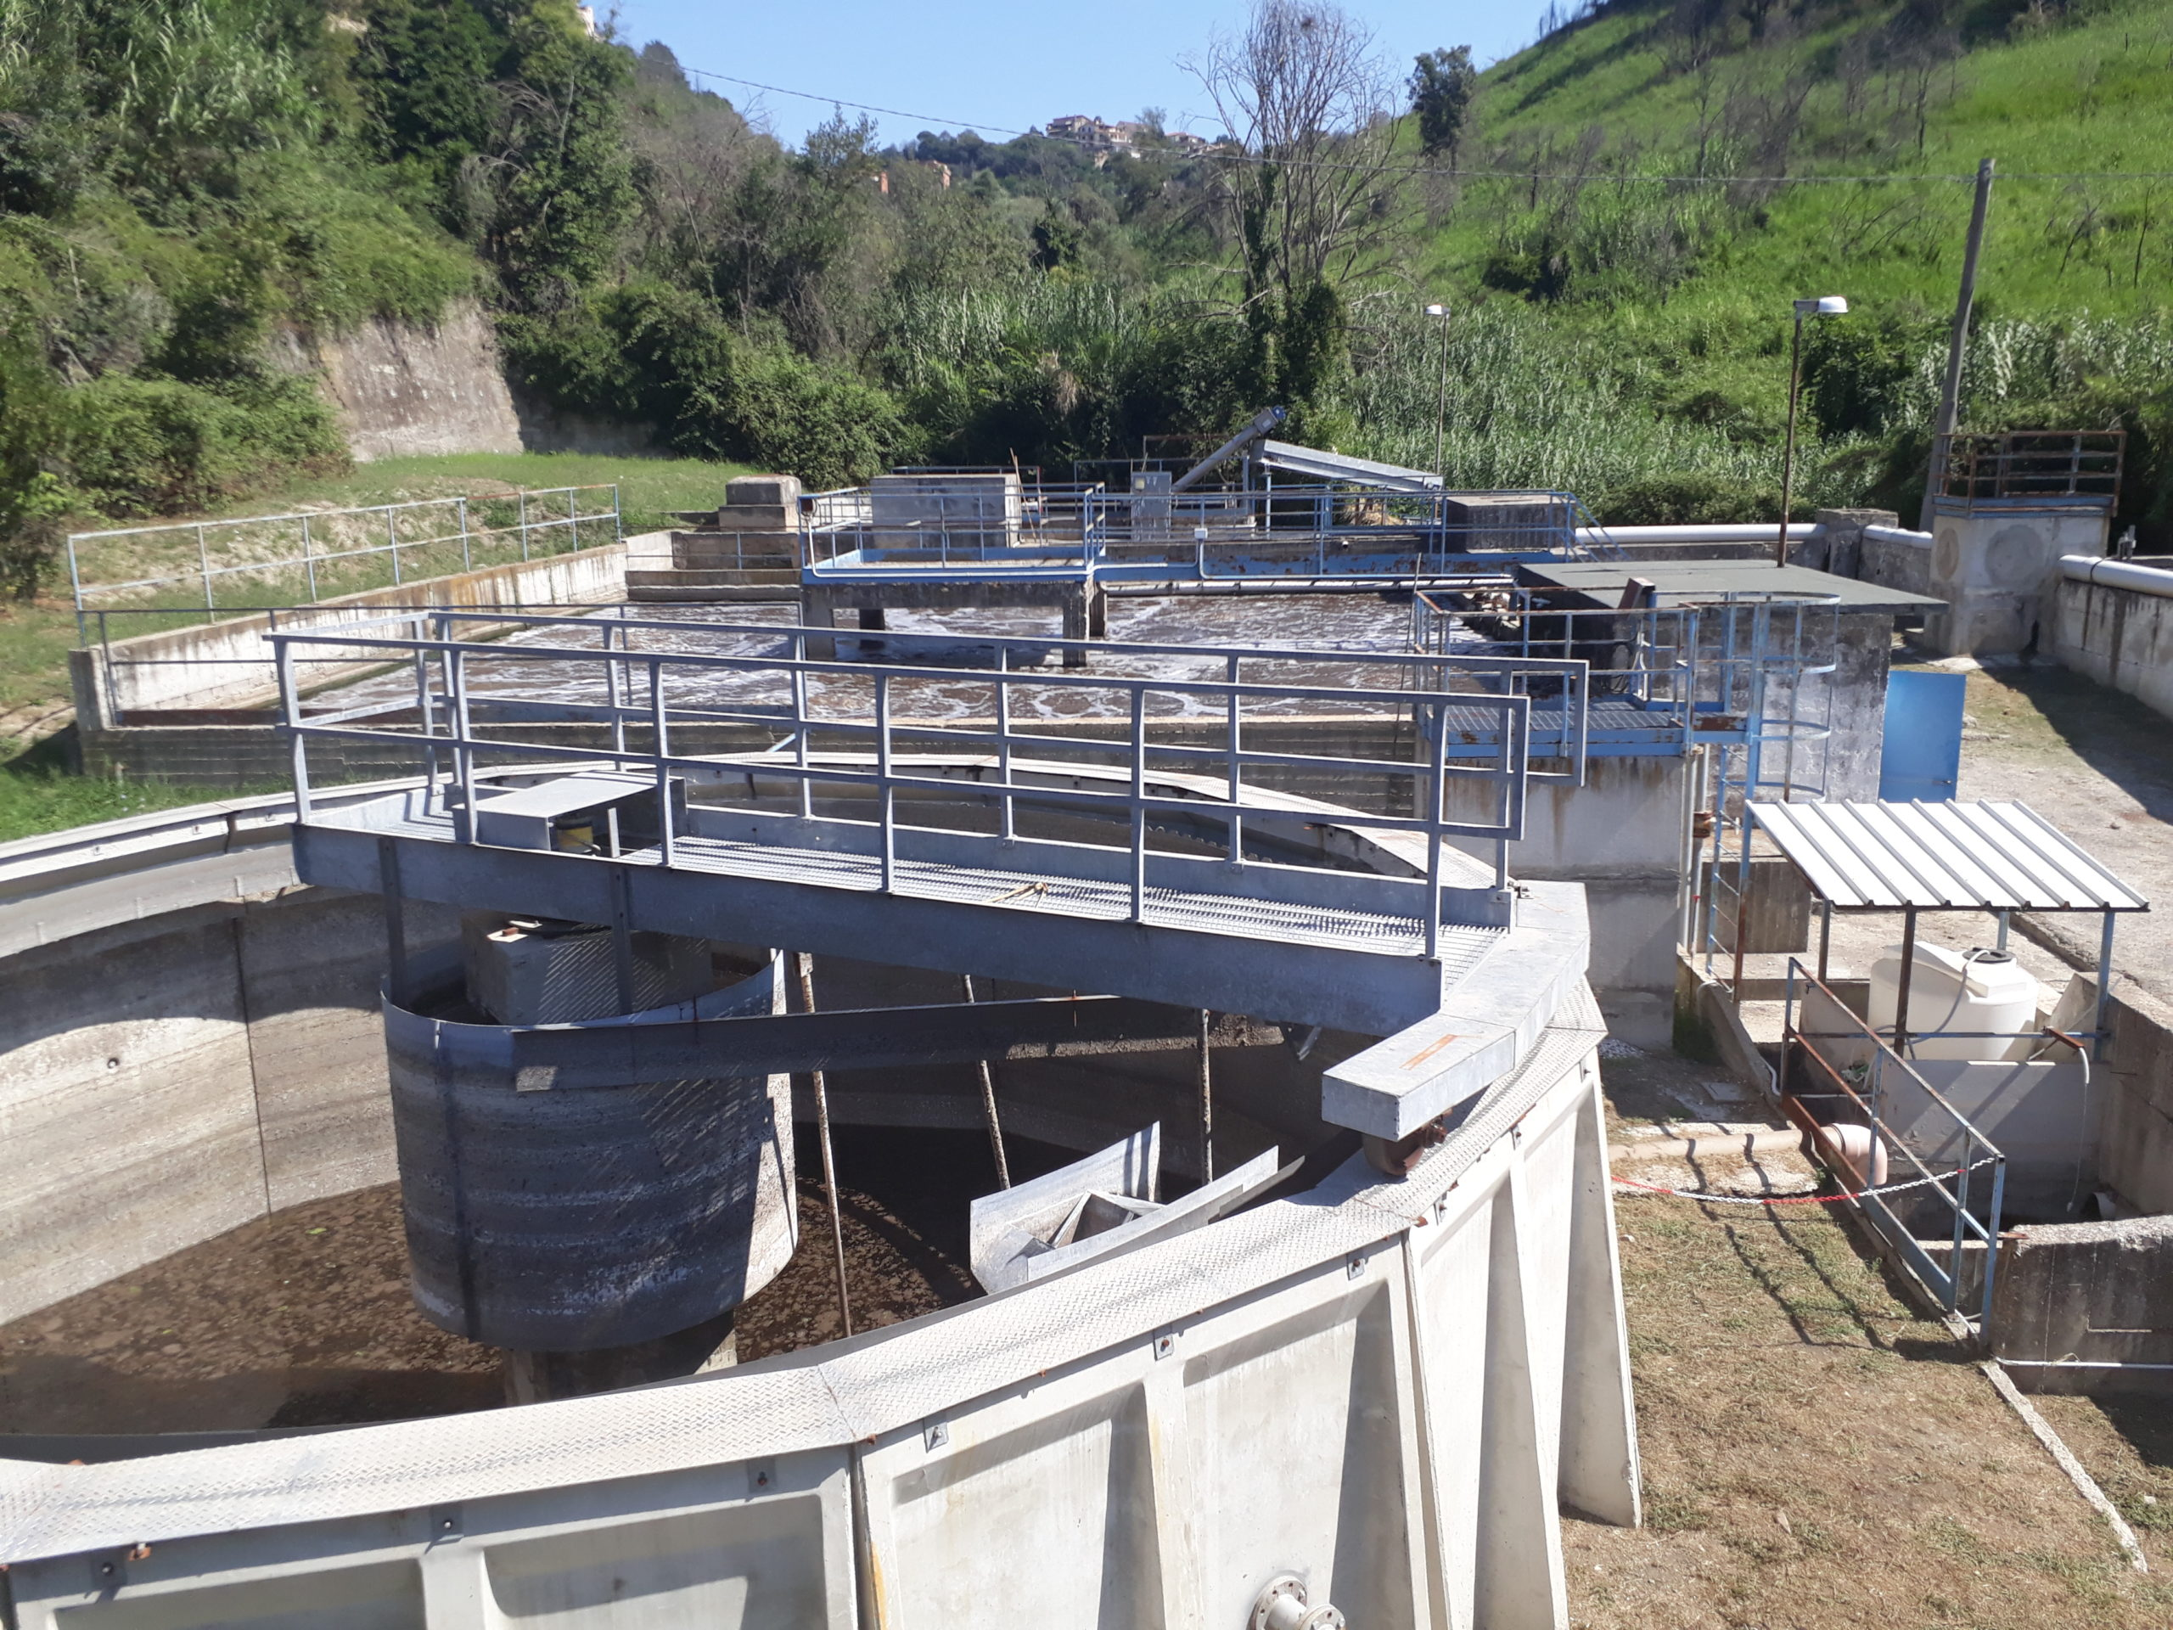
Evolution of Wastewater Management in the U.S. Virgin Islands
Early System: Department of Public Works (pre – 2004)
Infrastructure availability
Residential septic systems
Wastewater Treatment
Pressure for Reform: (1980’s – early 2000’s)
U.S. Clean Water Act of 1972
Virgin Islands Waste Management Authority (est. 2004)

Slide 4
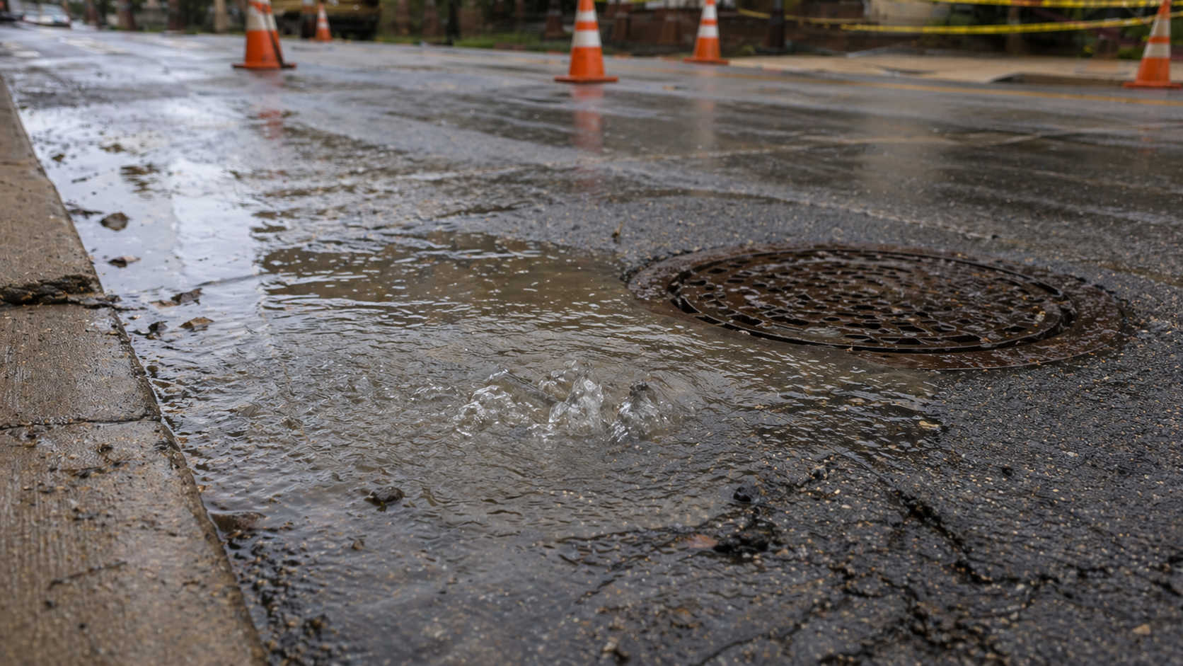
Wastewater Utility Regulation and Governance
VI Public Service Commission given regulatory authority
Oversees wastewater and solid waste services
VI Waste Management Authority Municipality
Manages operating sewer system and pump stations
Manages Treatment Plant
Regulate discharges

Slide 5
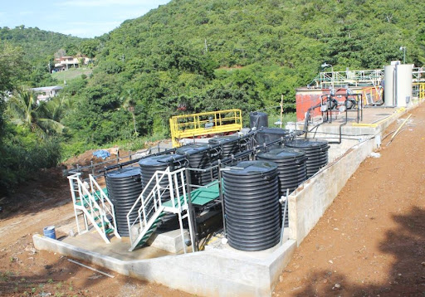
Value of Wastewater Services: Why Investment and User Fees Mater
Costly operations for safe and reliable services
Ensures systems are properly operated and maintained
Helps prevent pollution and preserves natural resources
Creates dedicated funding source
Essential for compliance with environmental laws, local, and federal regulations

Slide 6
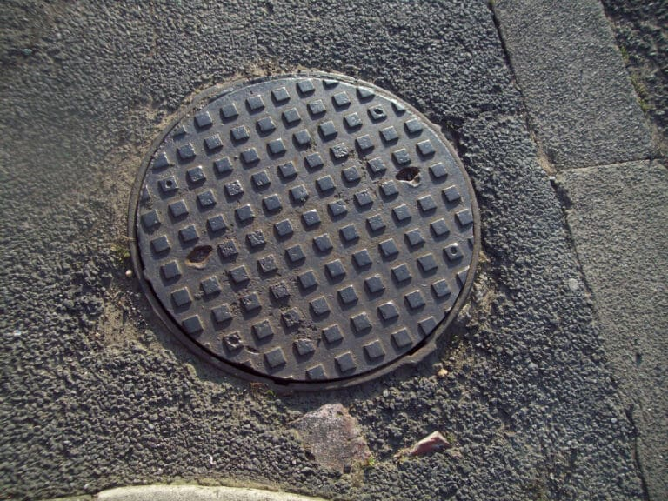
Modern Systems, Persistent Challenges: The Case for Local Regulation
Aging Infrastructure
Storm vulnerability
Compliance Issues
Financial Instability
Affordability

Slide 7
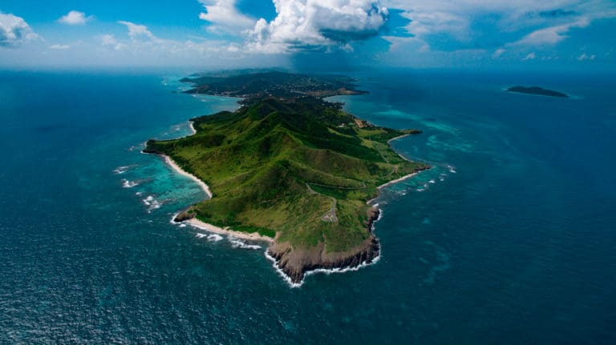
Questions?

