Slide 1
Strengthening Regulatory Confidence through Arbitration
DISPUTE RESOLUTION MECHANISMS IN CARIBBEAN UTILITY SECTORS
PRESENTER: SHAN M. GREER, CEO, BVI INTERNATIONAL ARBITRATION CENTRE

Slide 2
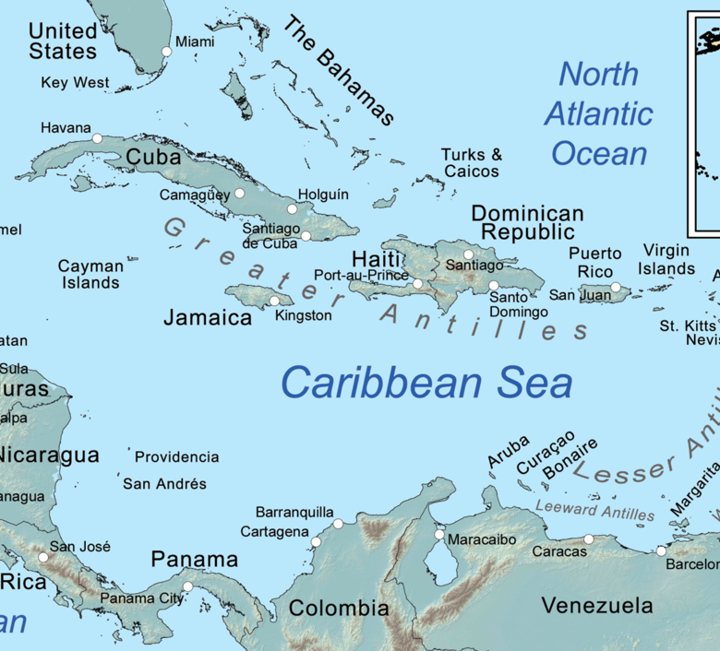
Evolving Utilities Landscape in the Caribbean
Aging and underfunded infrastructure
Heightened climate risks (hurricanes, droughts)
Small markets, limited legal & regulatory capacity
Regulatory reform in progress across the region
Complexities of foreign & cross-border investment

Slide 3


Why are disputes ignored?
Avoided as Confrontational
Seen as a sign of failure or breakdown
Discomfort with legal processes and adversarial settings
Fear of reputational damage or political fallout
Cultural hesitation to “rock the boat” or escalate conflict
Focus Elsewhere
Prioritisation of operations, compliance and service delivery
Resource constraints limit strategic legal planning
Limited legal expertise in regulatory and utility agencies
False assumption: “It won’t happen to us”
Lack of preparedness for dispute escalation

Slide 4


Why does this matter to Small Island Developing States?
Disproportionate Impact
Weaker bargaining power in negotiations
Limited access to legal and technical expertise
Overloaded and under-resourced court systems
High Risk, High Cost
One dispute can drain years of public resources
Financial exposure and legal expenses
Chilling effect on investor confidence
Risk of politicising regulatory decisions
Erosion of public trust in institutions

Slide 5

The Cost of Being Unprepared
Delays and access issues can escalate quickly
Weak contract terms increase risk
Major financial and reputational fallout is possible
Poor planning complicates resolution pathways

Slide 6
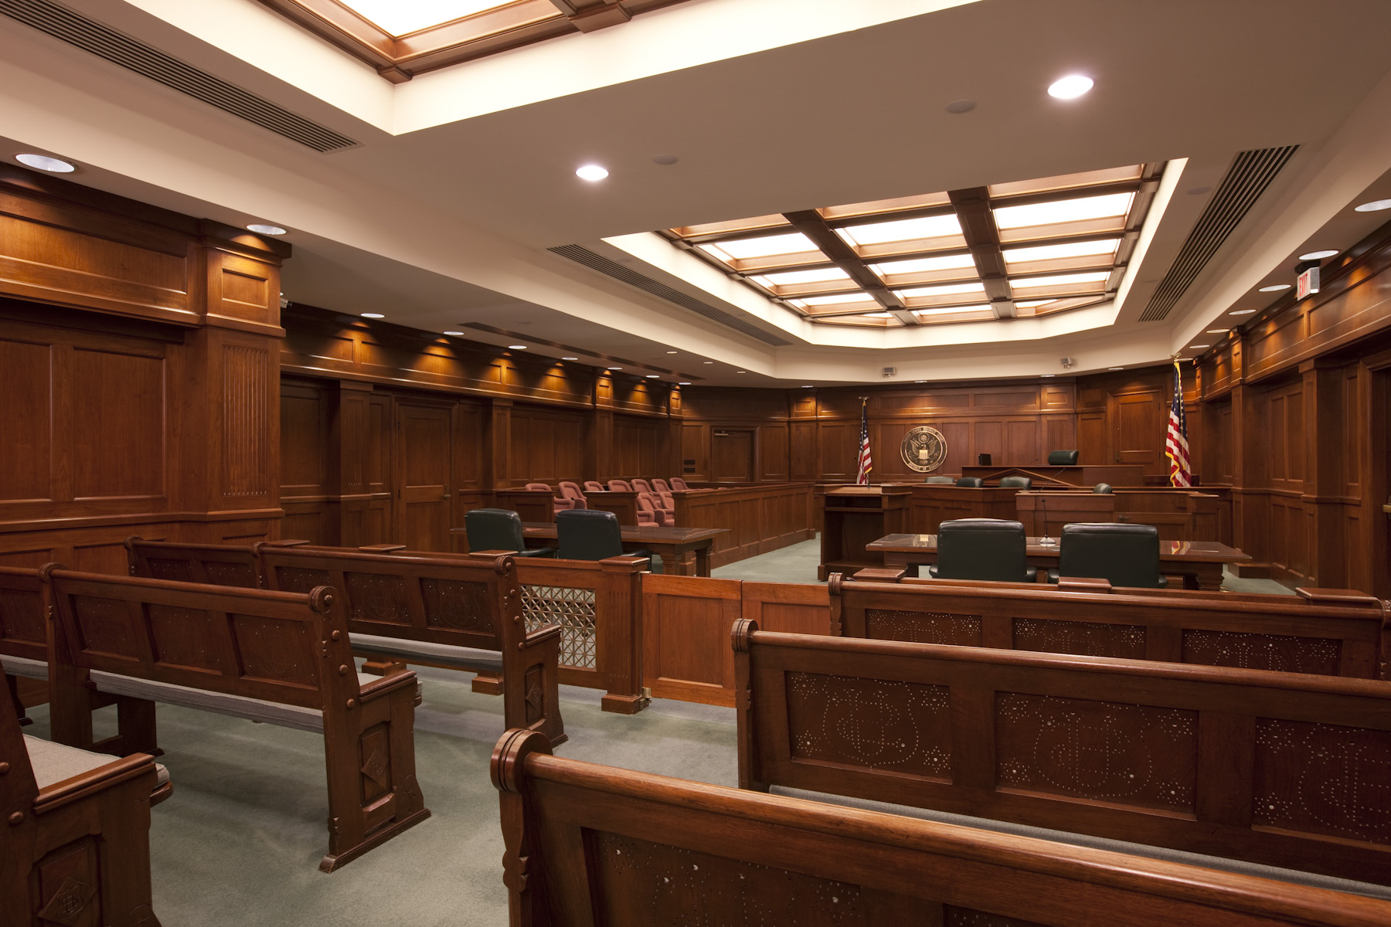

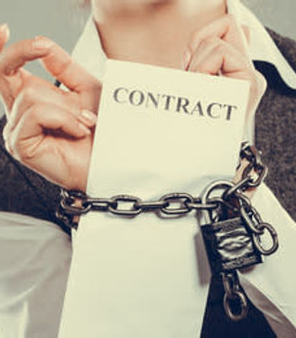
Arbitration as a Strategic Solution
NEUTRAL FORUM
SPEED AND EXPERTISE
ENFORCEABILITY
Arbitration administered by ICC in Washington, D.C.
Neutral ground for both parties
Builds trust—avoids local court bias
Contractor likely has foreign assets
Enforceable in 170+ countries under New York Convention
Easier cross-border recovery than national court judgments
Handled by technical and legal experts in EPC contracts
Faster timeline than national courts
Minimizes delays and disruption

Slide 7

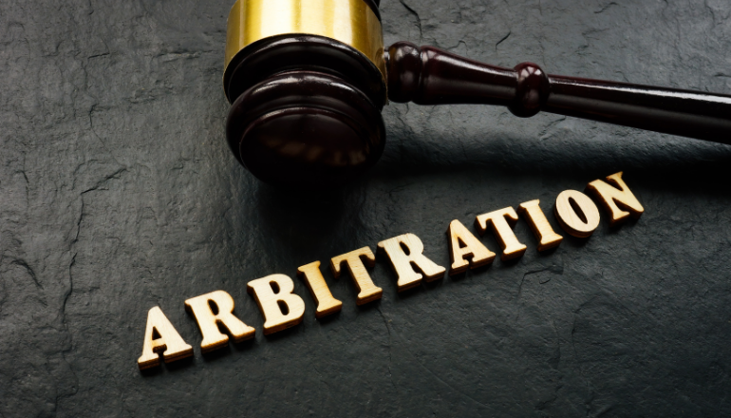
Drafting Effective Arbitration Clauses
Why it Matters
Essential Elements
Scope of disputes
Seat of arbitration
Number of arbitrators
Institutional rules
Language of proceedings
Avoids procedural uncertainty
Speeds up dispute resolution
Reinforces fairness and neutrality
Reduces legal risk

Slide 8
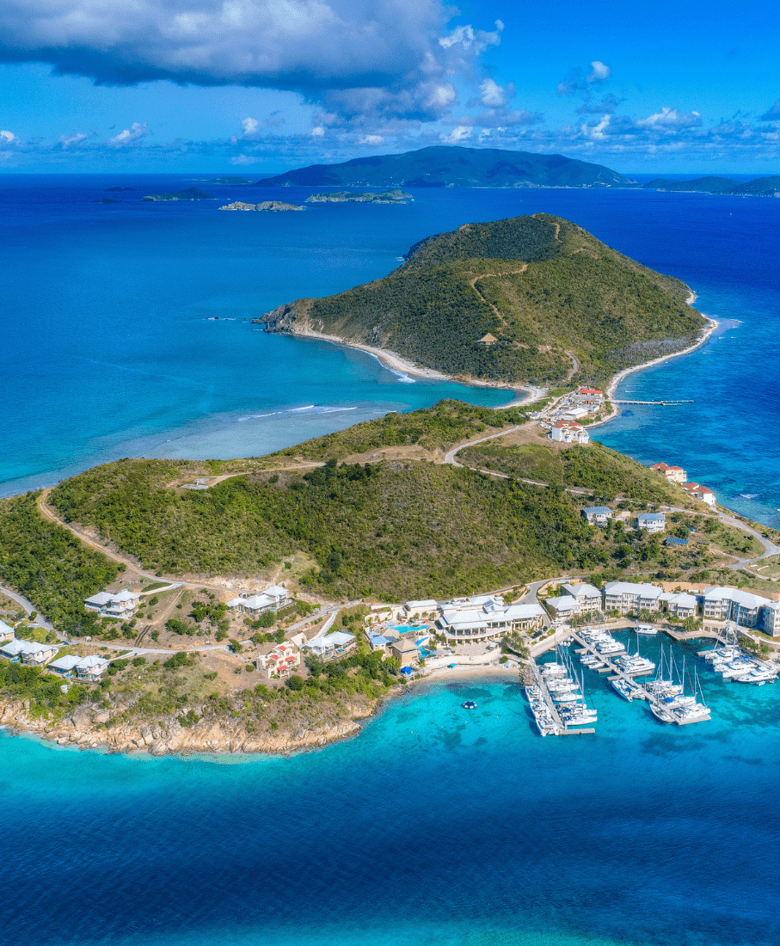
The BVI Advantage
Neutral & Stable: Politically independent, legally secure
Model Law Jurisdiction: Aligned with UNCITRAL international standards
Globally Recognised: Reputable and trusted worldwide
Cost-Effective & Accessible: Practical for regional actors
Supported by BVI IAC: Expert-led arbitration services and infrastructure

Slide 9

Building Regional Capacity Through the BVI IAC
🎓 Free training for public and private sectors
📄 Support with clause drafting and contract review
🌎 Promotion of Caribbean arbitrators and professionals
🛠️ Integrating arbitration into project planning

