Slide 1

Electricity Demand Forecast
Adjusting Medium-Term
In Response to External Shocks: A Methodological Framework
Odian Moore | OUR | Jamaica
Notes:
Good morning, everyone. My name is Odian Moore, and I’m from the Office of Utilities Regulation here in Jamaica.
Today, I’ll be sharing a methodological framework we apply to improve electricity demand forecasting—particularly when economies are hit by external shocks.
Recent events like COVID‑19, economic slowdowns, and extreme weather have shown us that traditional forecasting methods, while useful, can struggle when conditions change abruptly. This presentation is about how we can make forecasts more resilient, flexible, and defensible in those situations.

Slide 2

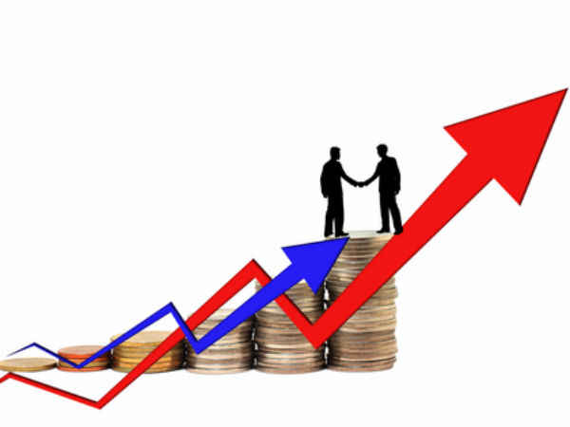
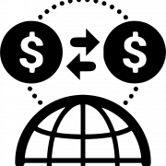
Introduction & Rationale
Why demand forecasting matters?
Electricity demand forecasting is crucial for ensuring the reliability, efficiency, and affordability of power systems. Accurate forecasts support key decisions in areas such as:
Power Systems Planning
Investment Strategies
Tariff Design
Regulation
Notes:
First, we are going to look at why Demand Forecasting Matters.
Electricity demand forecasting sits at the heart of power system decision‑making. It affects how we plan generation, approve investments, design tariffs, and regulate the sector.
When forecasts are accurate, utilities invest efficiently, customers pay fair prices, and systems remain reliable.
When they’re wrong, the consequences can be costly, resulting in over‑investment, stranded assets, reliability risks, or tariffs that don’t reflect reality.
That’s why improving forecasting accuracy should be a policy and regulatory priority.

Slide 3

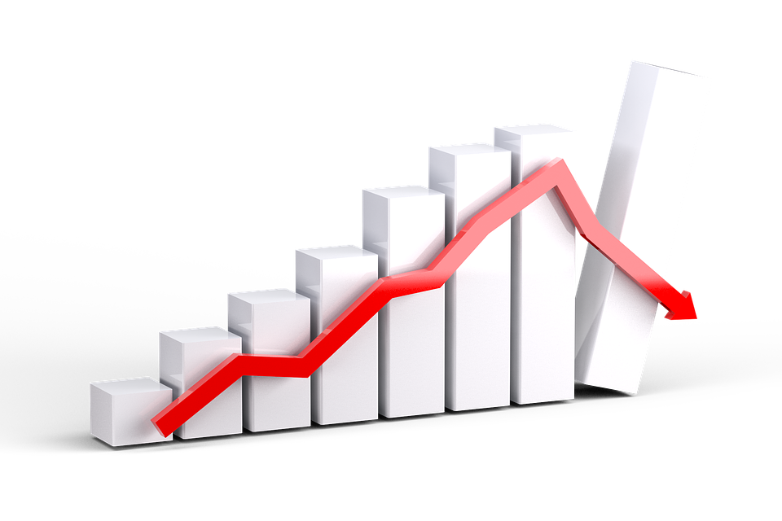

Introduction & Rationale
Why do forecasts break down?
The reliability of these forecasts is often compromised by external shocks such as:
Hurricanes
Pandemic
Economic Downturn
Policy Change
These events introduce significant uncertainty, frequently rendering original demand projections inaccurate.
Notes:
But the challenge here is that forecasts rely on assumptions and external shocks—like pandemics, hurricanes, economic downturns, or sudden policy changes—can quickly undermine those assumptions
COVID‑19 is the clearest example of this. Demand patterns changed sharply, and many forecasts quickly became obsolete.
So the key question becomes: how do we design a forecasting Framework that is grounded in fundamentals but flexible enough to adapt when reality shifts?
That question is what this framework aims to answer.

Slide 4




Introduction & Rationale
Why use Traditional Econometric Models as a Base?
Y_{t}​ = β₀​+ β₁​X_{1,t}​ + β₂​X_{2,t}​ +⋯+ β_{k​}X_{k,t}​ + ε_{t}​
Econometric models provide a robust forecasting foundation by linking electricity demand to:
GDP
Population
Prices
Weather
These models are anchored in economic theory, capturing elasticities, utility behavior, and structural drivers of demand.
Notes:
We will begin with traditional econometric models as the baseline, given their strong theoretical foundation.
These models explicitly link electricity demand to underlying drivers such as GDP, population growth, prices, and weather.
In normal conditions, econometric models perform well, especially for medium‑ to long‑term forecasting.
However, while they’re strong in stable periods, they’re less effective when sudden shocks disrupt historical relationships.

Slide 5
Introduction & Rationale
External Shocks Disrupt Forecasts
External events such as a pandemic, a natural disaster, and an economic downturn introduce significant uncertainty, making the original demand forecast by these econometric models inaccurate or obsolete.
A flexible framework is needed to combine fundamentals, short-term adjustments, and expert insights.
Notes:
External shocks, like a Pandemic or Natural disasters, can fundamentally disrupt demand trajectories, causing sudden collapses or surges that traditional econometric models are not designed to handle.
That’s why we need a flexible framework; one that blends economic fundamentals with short‑term responsiveness and professional judgment.
I want to emphasize that this framework is not about replacing econometric models, but it’s about enhancing them.

Slide 6
Introduction & Rationale
Short-term Adjustment tool: ARIMA models:
SARIMA(p,d,q)(P,D,Q)​
ARIMA is a type of time series forecasting model that predicts future values based on past data.
Why are ARIMA models useful?
01
Works well with univariate time series (e.g, Electricity Demand)
Can capture trends, cycles, and shocks in the data.
Flexible when combined with expert judgement to handle unusual events.
02
03
Notes:
After an external shock, we use the ARIMA model as the short-term adjustment tool.
ARIMA models are time‑series tools that rely purely on historical patterns in the data. They’re particularly effective at capturing short‑term dynamics, including sudden drops or rebounds.
And when combined with expert judgment, ARIMA becomes a powerful shock‑response mechanism.

Slide 7
Objectives of the Framework
01
02
Incorporate shock-responsive modeling with ARIMA
Enhance forecasts with expert judgment
03
Build a reliable baseline forecast using demographic and econometric models
Notes:
The framework has three clear objectives.
First, is to build a reliable baseline using econometric and demographic models.
Second,is to introduce a shock‑responsive adjustments using ARIMA models.
And third is to enhance forecasts with expert judgment.

Slide 8
Conceptual Basis
Econometric Models :
Capture Structural, Medium, and Long-Term relationships
ARIMA Models :
Capture Short-Term dynamics during shocks
Expert Judgement:
Brings qualitative insights
Notes:
Conceptually, each component plays a distinct role.
Econometric models explain long‑term demand behavior.
ARIMA models captures short‑term volatility during periods of disruption.
And, expert judgment adds qualitative insight to account for factors not captured in the data
Together, these elements produce a framework that is both transparent and adaptable.

Slide 9
Framework Overview
Build a baseline forecast using demographic or Econometric Forecasting models
Step 1
Shock Identification
Step 2
Adjustments using ARIMA models
Step 3
Expert Judgement Integration
Step 4
Final Adjusted Forecast
Step 5
Notes:
Before we get into the case study, this slide summarizes the full framework:
Step 1 is your baseline forecast.
Next, we identify any external shocks.
Then we apply ARIMA adjustments to reflect short‑term impacts.
After that, we integrate expert judgment to validate and refine the results.
The final output is a forecast that is both data‑driven and transparent

Slide 10

Case Study: Jamaica
Notes:
To demonstrate how this works in practice, I’ll now walk through a case study using Jamaica’s electricity demand.
This example illustrates the application of the framework during COVID-19, when the electricity sector was subject to significant external shocks.

Slide 11
Summary of the Baseline Forecast
DATABASE
RATE CLASS
DEMOGRAPHIC FORECAST
Total Population
Population by Age
Number of Households
Residential Customers (Rate 10)
General Services (Rate 20) and Street Lighting (Rate 60)
ECONOMIC FORECAST
GDP Growth
GDP by Industry
Personal Income
Price of Energy Sources
Large Commercial and Industrial Customers (Rates 40, 50, 70)
Notes:
For the baseline forecast, we use different methods depending on customer type.
Residential customers rely mainly on demographic forecasting (i.e. population and household data).
Commercial and industrial customers are modeled using econometric techniques tied to GDP and sectoral activity.
And this segmentation ensures the baseline reflects the different drivers of demand across rate classes.

Slide 12
Total Energy Consumption (GWh)
The COVID-19 pandemic had a significant impact on Jamaica’s electricity sector:
Year | Sales (GWh) | Econometric Forecast (GWh) | Sales vs Forecast % Change Sales
2019 | 3,276 | 3,249 | 0.8%
2020 | 3,043 | 3,281 | -7.3%
2021 | 2,980 | 3,337 | -10.7%
2022 | 3,065 | 3,403 | -9.9%
2023 | 3,262 | 3,471 | -6.0%
Notes:
This table clearly shows the impact of COVID‑19.
In 2019, actual sales and forecasts were closely aligned.
However, In 2021, sales fell by more than 10.7%, while the forecast still expected growth.
And this divergence highlights the limitations of relying solely on traditional models during shocks, and why adjustments were necessary.

Slide 13
Total Energy Consumption (GWh)
-1.4%
-4.0%
-0.4%
-0.8%
Notes:
On this chart, the gap between the original forecast and actual sales becomes very clear during the pandemic years.
However, when we introduce ARIMA adjustments combined with expert judgment, the forecast tracks much closer to reality.

Slide 14

Residential Customers (Rate 10)
Original Forecast
Demographic Forecasting Model
$$Sales(MWh)=\# of Customers ∗Unit Consumption$$
𝑺𝒂𝒍𝒆𝒔(𝑴𝑾𝒉)=# 𝒐𝒇 𝑪𝒖𝒔𝒕𝒐𝒎𝒆𝒓𝒔 ∗𝑼𝒏𝒊𝒕 𝑪𝒐𝒏𝒔𝒖𝒎𝒑𝒕𝒊𝒐𝒏
$$Penetration Rate =\frac{\# of JPS Cust.}{\# of Households}$$
𝑷𝒆𝒏𝒆𝒕𝒓𝒂𝒕𝒊𝒐𝒏 𝑹𝒂𝒕𝒆 =(# 𝒐𝒇 𝑱𝑷𝑺 𝑪𝒖𝒔𝒕.)/(# 𝒐𝒇 𝑯𝒐𝒖𝒔𝒆𝒉𝒐𝒍𝒅𝒔)
External Shock Adjustment
ARIMA Model
SARIMA(2,0,0)(0,0,1)₁₂
Notes:
For residential customers, sales are driven mainly by the number of customers and unit consumption.
During COVID‑19, work‑from‑home arrangements pushed residential consumption higher than expected.
We adjusted the original demographic forecast using a Seasonal ARIMA model to better reflect these changes

Slide 15
Residential Consumption (GWh)
-0.9%
-1.5%
-3.3%
+1.2%
Notes:
Here we see that the ARIMA‑adjusted forecast (the green line) aligns much more closely with actual residential consumption (the blue line).

Slide 16

Commercial Customer (Rate 40)
Original Forecast
Econometric Forecasting Model
Sales (MWh) = 1586 + 0.0022*[Hotels & Restaurants] + 0.017*[Govt. Services] + 0.02577*[Elec. & Water Supply]
External Shock Adjustment
ARIMA Model
SARIMA(0,1,1)(0,1,1)₁₂
Notes:
Commercial demand was heavily affected by the collapse in tourism and reduced government activity.
The original econometric model linked demand to GDP components such as hotels and restaurants.
And again, during the pandemic, we applied ARIMA adjustments to reflect the abrupt sectoral shutdowns.

Slide 17
Rate 40 Consumption (GWh)
0.3%
-2.6%
-0.1%
0.4%
Notes:
Once again, the ARIMA‑adjusted forecast tracks actual demand much more closely than the original projection.

Slide 18

Strengths of the Framework
Grounded in Fundamentals 📊: Tied to economic drivers
2. Adaptive to Shock ⚡: Responds to disruptions
3. Practical Insights 👤: Expert input for unseen factors
4. Credible & defensible 🛡️: Transparent for Regulators, System Planner, and Utilities
Notes:
To summarize the strengths:
The framework is grounded in economic fundamentals, yet flexible enough to respond to shocks.
It incorporates expert insight, making it practical and realistic.
And importantly, it remains transparent and defensible, which is a key requirement for regulators and policymakers.

Slide 19

Policy Implications
How do Regulators, Utilities, and System Planners benefit?
Tariff Adjustments: Enables realistic rate setting based on demand expectations.
Investment Approvals: Justifies infrastructure investments with credible forecasts.
Emergency Response Planning: Models demand disruptions from external shocks.
Regulatory Transparency: Builds trust through defensible, adaptive methodology.
Notes:
How would Regulators, Utilities, and System Planners benefit from this framework?
From a policy perspective, this framework supports better tariff setting, more credible investment approvals, and stronger emergency planning.
It is also important to note that it will enhance regulatory transparency and build confidence among stakeholders by clearly explaining how forecasts are adjusted during uncertain periods.

Slide 20
Conclusion
02
01
03
04
Why should Regulators, Utilities, and System Planners adopt this Framework?
Improved Reliability
Stronger Planning
Fewer surprises in demand forecasts
Better alignment of investment and infrastructure
Reduced Risk
Informed Decisions
Less chance of over/underestimating demand
Supports tariff setting, policy, and long-term strategy
Notes:
Why should you adopt this Framework?
Well, adopting this framework will lead to stronger planning, improved reliability, and better‑informed decisions.
It reduces the likelihood of over‑ or under‑estimating demand and helps align infrastructure investments with real system needs.

Slide 21

Thank You!
Odian Moore, FRM®
Regulatory Economic Specialist, OUR, Jamaica
Email: odian.moore@our.org.jm

