Slide 1


UNIVERSAL CONNECTIVITY IN ACTION:
A Case Study of Saint Vincent and the Grenadines' Innovative Approach
Apollo Knights
Director,
National Telecommunications Regulatory Commission
St. Vincent and the Grenadines

Slide 2
AGENDA
  Country Overview
  Context
  Main Connectivity Issues
  Main Strategic Interventions
  Main Challenges
  Successes
  Conclusion

Slide 3


Slide 4
CONTEXT
First Fixed Broadband Competitor
2002
Establishment of the Universal Service Fund (USF)
2008
Domestic Subsea Fiber Commissioned
2019
2001
Market liberalised
2021
Terrestrial VHF Emergency Communications Network (ECN) installed
2003
First Mobile Competitor
2012
GMDSS Network operational. Funded and maintained by USF

Slide 5
MAIN CONNECTIVITY CONCERNS
Consistent connectivity to Mobile Broadband services
Affordable devices (Computer, Laptop, Tablet)
Affordable entry-level fixed broadband packages

Slide 6
MAIN STRATEGIC INTERVENTIONS
USF Initiative to offer fixed broadband to low-income households with students at a cost of US$4 per month.
Development of Digital Skills through Associate Degree programs and coding Summer Programs
Fixed Broadband with Wifi at all 107 Schools, Health centres and Police Stations
Have all inhabited islands experience similar QoS levels on connectivity

Slide 7
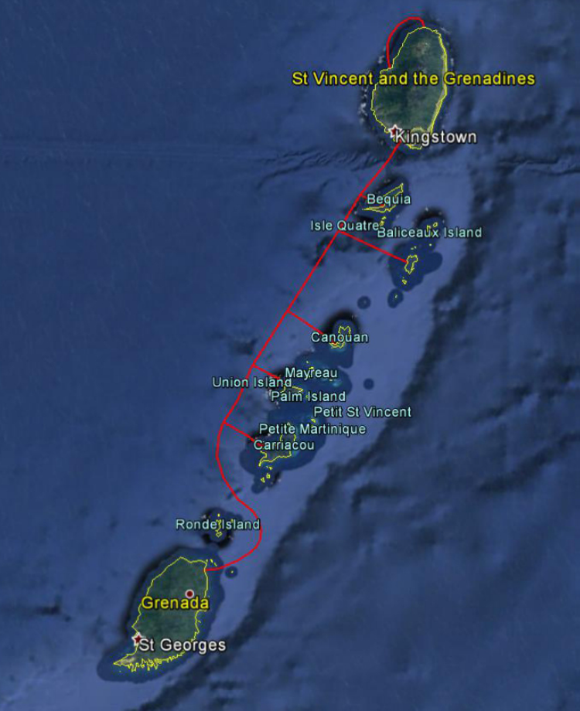
CARCIP Subsea Fiber

Slide 8


Slide 9
MAIN CHALLENGES
Computers into households
Wifi delivery in Schools
Innovative USF projects

Slide 10
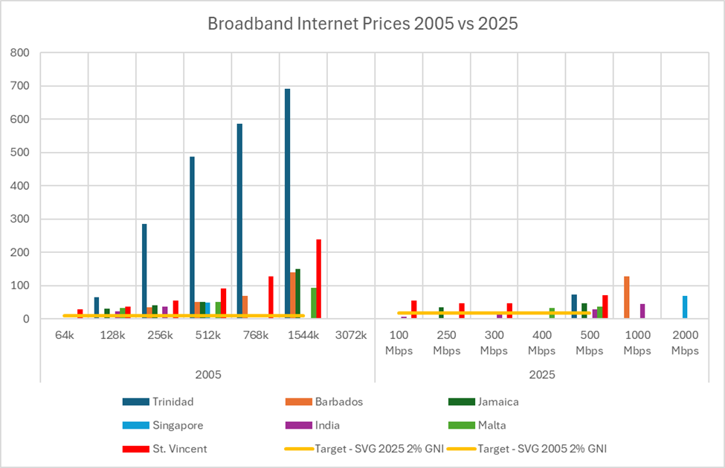
Comparison of entry level broadband prices in 2025 with those in 2005 along with the 2% GNI target.

Slide 11
SUCCESSES
  Private Partnership in getting devices to households
  Government procurement of devices for students.
  Deployment of CARCIP Subsea Fibre
  Fibre-based GWAN connecting all Government buildings and schools

Slide 12
SUCCESSES
  New USF regulations to facilitate grants for ICT entrepreneurs
  The first country in the OECS sub-region to grant a licence to a Satellite service provider to offer their services in our market

Slide 13

SPECIAL MENTION
Percent of Daily traffic in and out of SVG through USF Access Points
4%
11%

Slide 15
CONCLUSION
  New Electronic Communication Act
  New USF Project that provides 500 households with Subsidised internet, laptop and digital literacy training at US$7 per month.

Slide 16

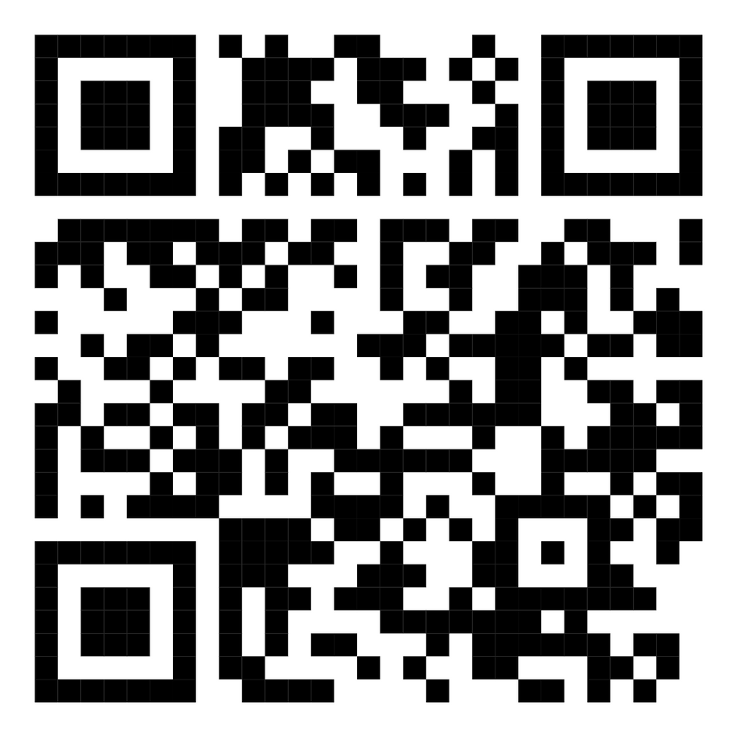
THANKS FOR YOUR ATTENTION!
ntrc@ntrc.vc
+1 784 457 2279
www.ntrc.vc
NTRCSVG
Scan to access paper.

