Slide 1
The Case for Strengthening Government Regulation of Wastewater Influent for Sustainable Municipal Treatment Systems
Dr. Richard Meggo
Rosehall Developments Limited

Slide 2
The Problem: Unregulated Influent Threatens Municipal Systems
Municipal Wastewater Systems are designed to handle domestic sewage not complex industrial effluents
Increasing volumes of untreated or poorly pre-treated industrial waste are overwhelming treatment systems, leading to:
Equipment corrosion and breakdown
Inefficient treatment and pollutant discharge
Higher operational costs and energy use
Public health risks from pathogens and toxins
potential for degraded water bodies and economic losses tied to tourism and fisheries

Slide 3
Sewage Sludge Regulations 2014
2.2.2 Discharge of Trade or Sewage Effluent into a Sewage Collection System or Treatment Plant (Regulations 8, 9 and 10) Facilities which discharge trade effluent or sewage effluent into a sewage collection system are required to provide the Authority with the written approval of the licensee prior to making the connection to the sewage collection system. In addition to submitting the written approval, facilities should submit documentation detailing the composition and volume of wastewater generated from the business, industry or manufacturing or trade facility that will be accepted by the licensee. Failure to provide this information constitutes an offence. Licensees who intend to receive wastewater from a business, industry or manufacturing must obtain written approval from the Authority prior to any agreement to accept such wastewater. The Authority should be informed of any proposed changes to the agreement relating to the composition or volume of the effluent and must give its consent to the amendments or any renewals to the agreement.

Slide 4
Sewage Sludge Regulations 2014
3.4 Discharge of Trade or Sewage Effluent into a Sewage Collection System or Treatment Plant (Regulations 8, 9 and 10) Treatment plants that intend to discharge trade effluent or sewage effluent into a collection system should provide the Authority with the following information: the name of facility; type of wastewater; characteristics of wastewater to be treated; layout of pre-treatment facility including geo-referenced sampling point (if applicable); treatment plant capacity; technology of treatment plant; and agreement between the licensee and the party that will be generating the wastewater.

Slide 5
NRCA Sewage Effluent Standards
Immediate Technology Based Sewage
Effluent Standards (applied to discharges from sewage treatment systems built prior to 1997)
Sewage Effluent Standards (applied to discharges from sewage treatment systems built after
1997)
PARAMETER | EFFLUENT LIMIT
BOD₅ TSS Nitrates (as Nitrogen) Phosphates COD pH Faecal Coliform Residual Chlorine | 20 mg/l 30 mg/l 30 mg/l 10 mg/l 100 mg/l 6-9 1000 MPN/100 ml 1.5 mg/l
PARAMETER | EFFLUENT LIMIT
BOD₅ TSS Total Nitrogen Phosphates COD pH Faecal Coliform Residual Chlorine | 20 mg/l 20 mg/l 10 mg/l 4 mg/l 100 mg/l 6-9 200 MPN/100 ml 1.5 mg/l

Slide 6
Measurable Impacts of Poor Influent Control
Studies show that systems receiving high-strength industrial waste influent with high chemical loads experience up to 40 % reduction in biological treatment efficiency and double the frequency of pump and pipe failures.
Municipalities incur millions in reactive repairs and energy overruns when grit, grease, and heavy metals foul aeration basins and clarifiers.
Coastal fisheries and tourism revenue decline where nutrient-laden effluent enters nearshore waters.

Slide 7
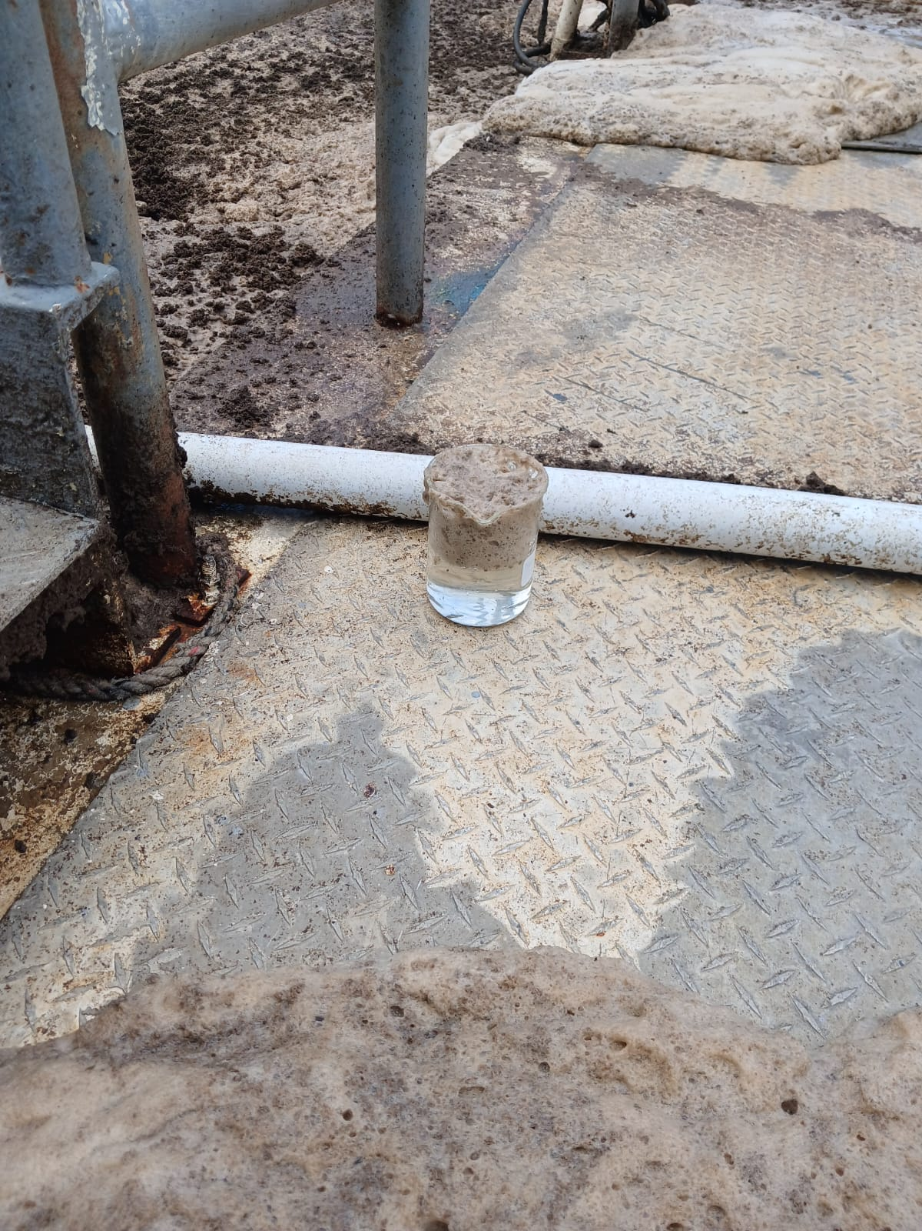
Evidence of Impact

Slide 8
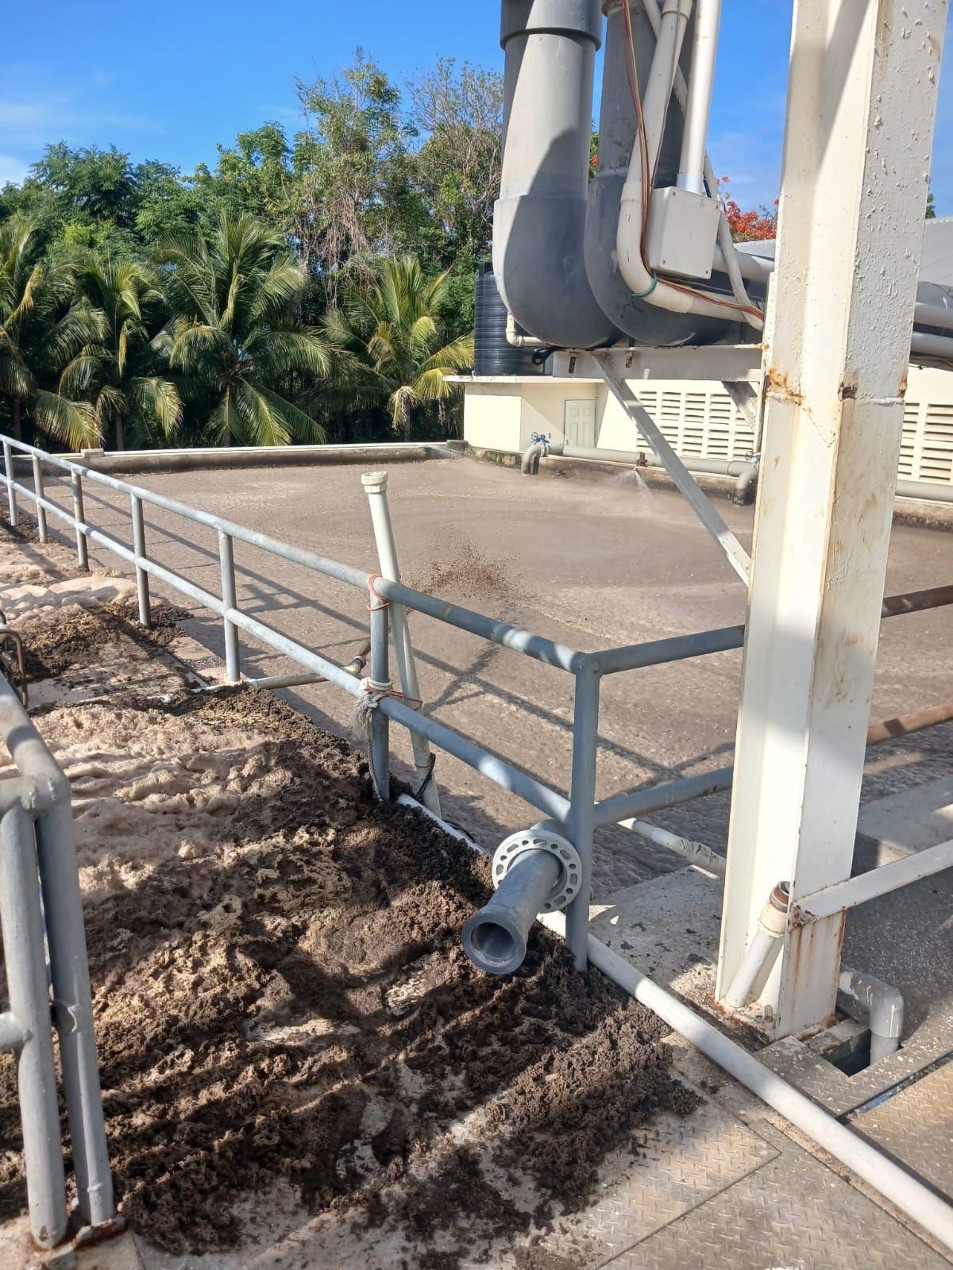
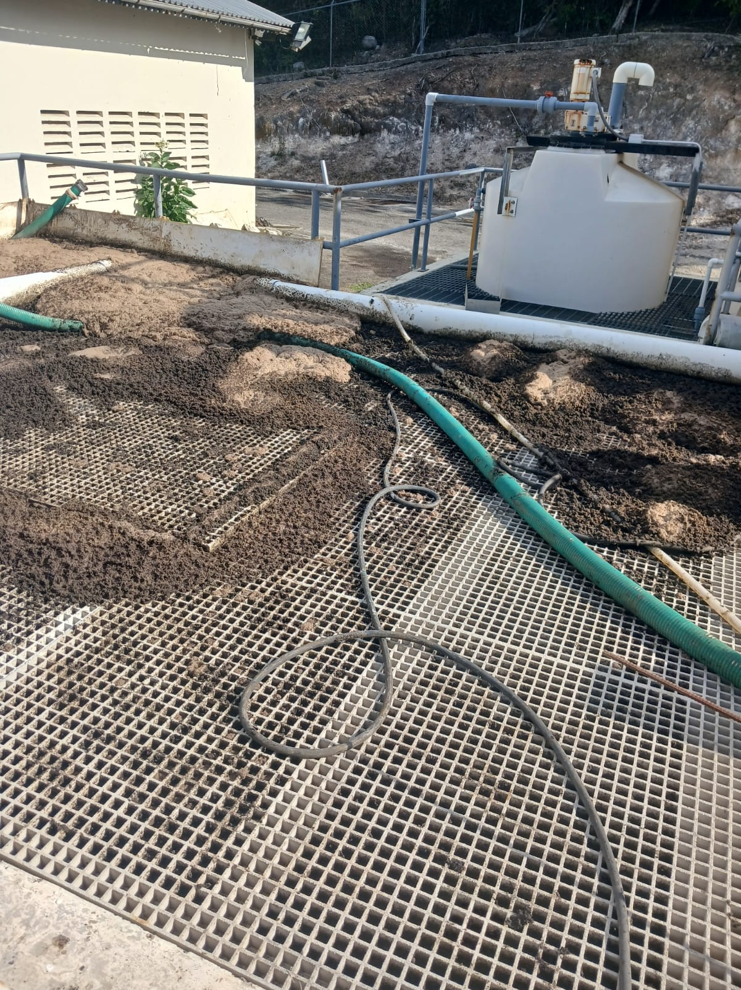
Evidence of Impact July 22 2025

Slide 9
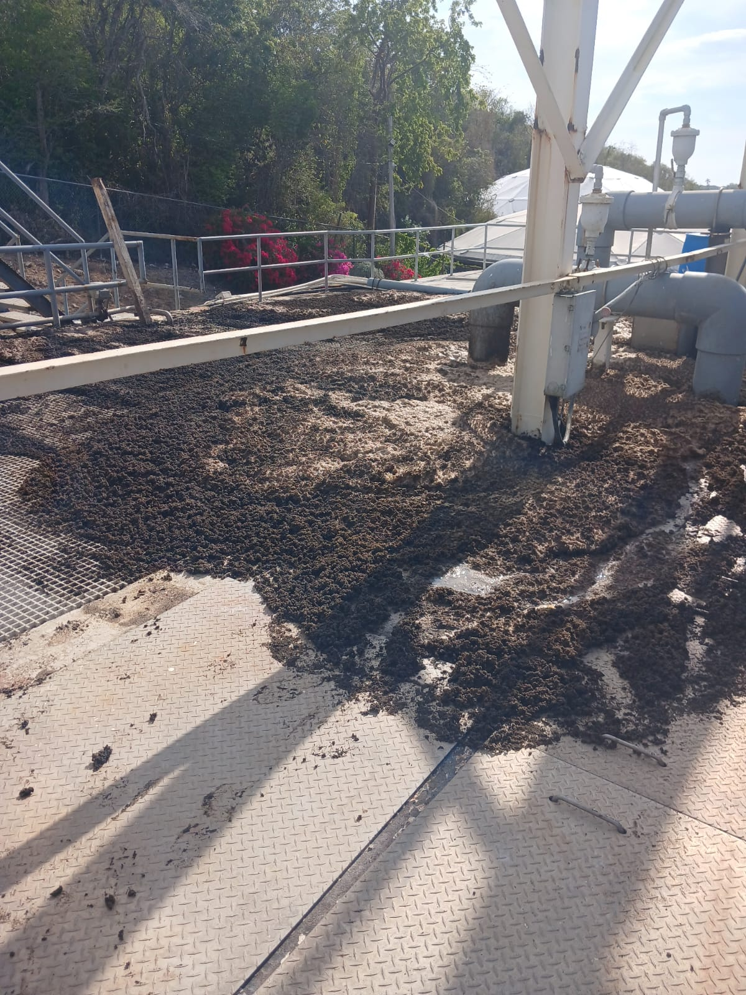
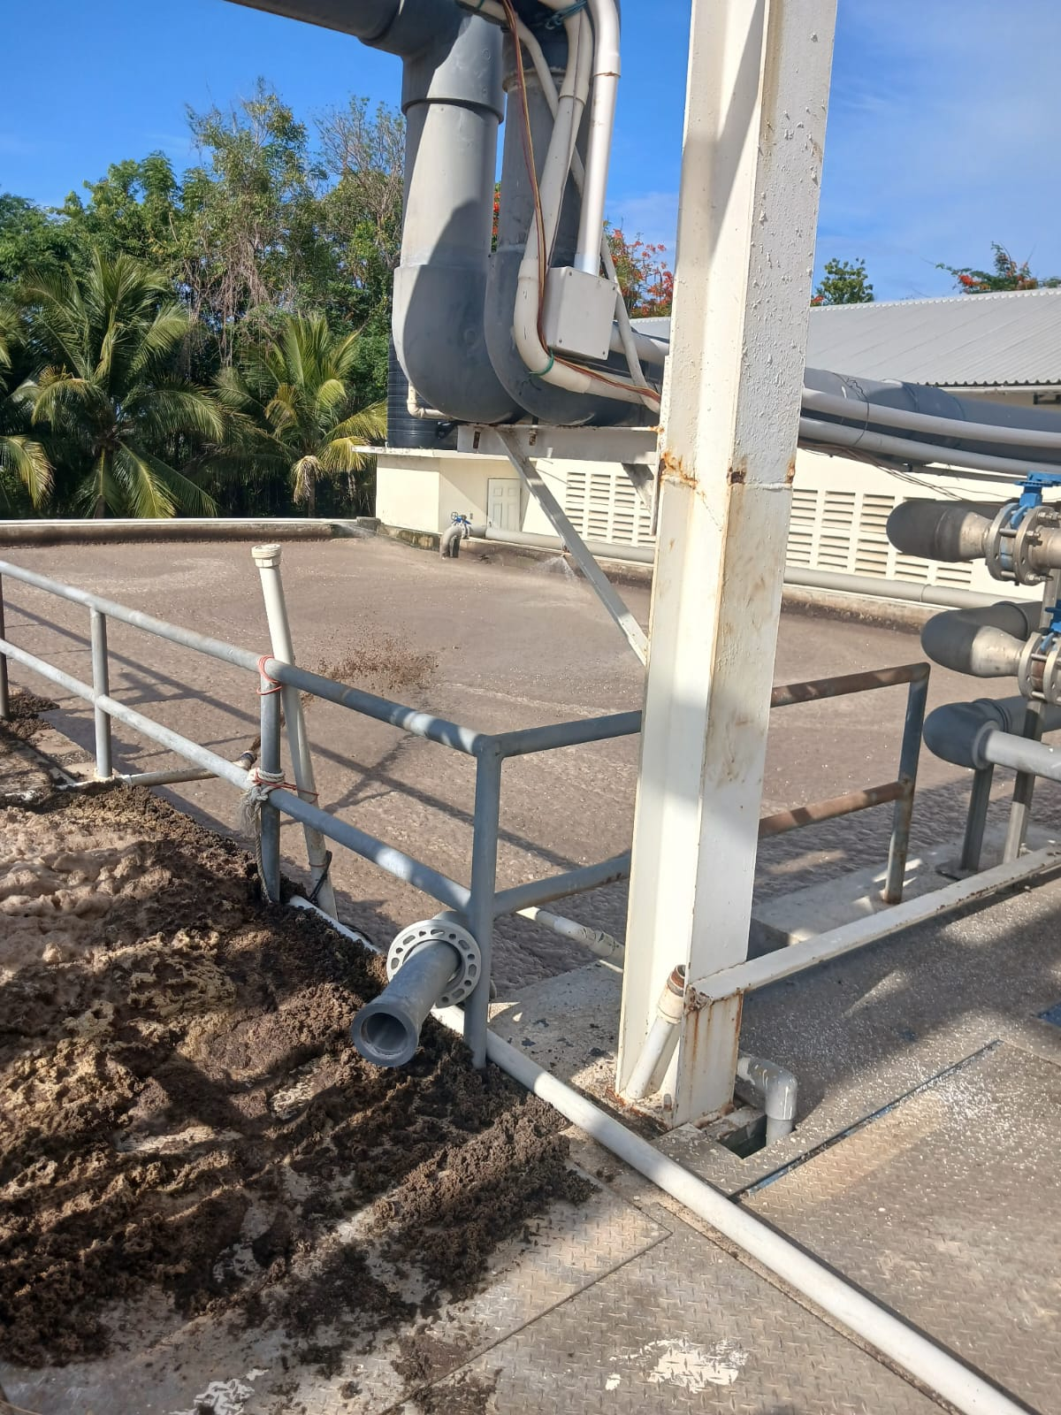
Evidence of Impact July 22 2025

Slide 10
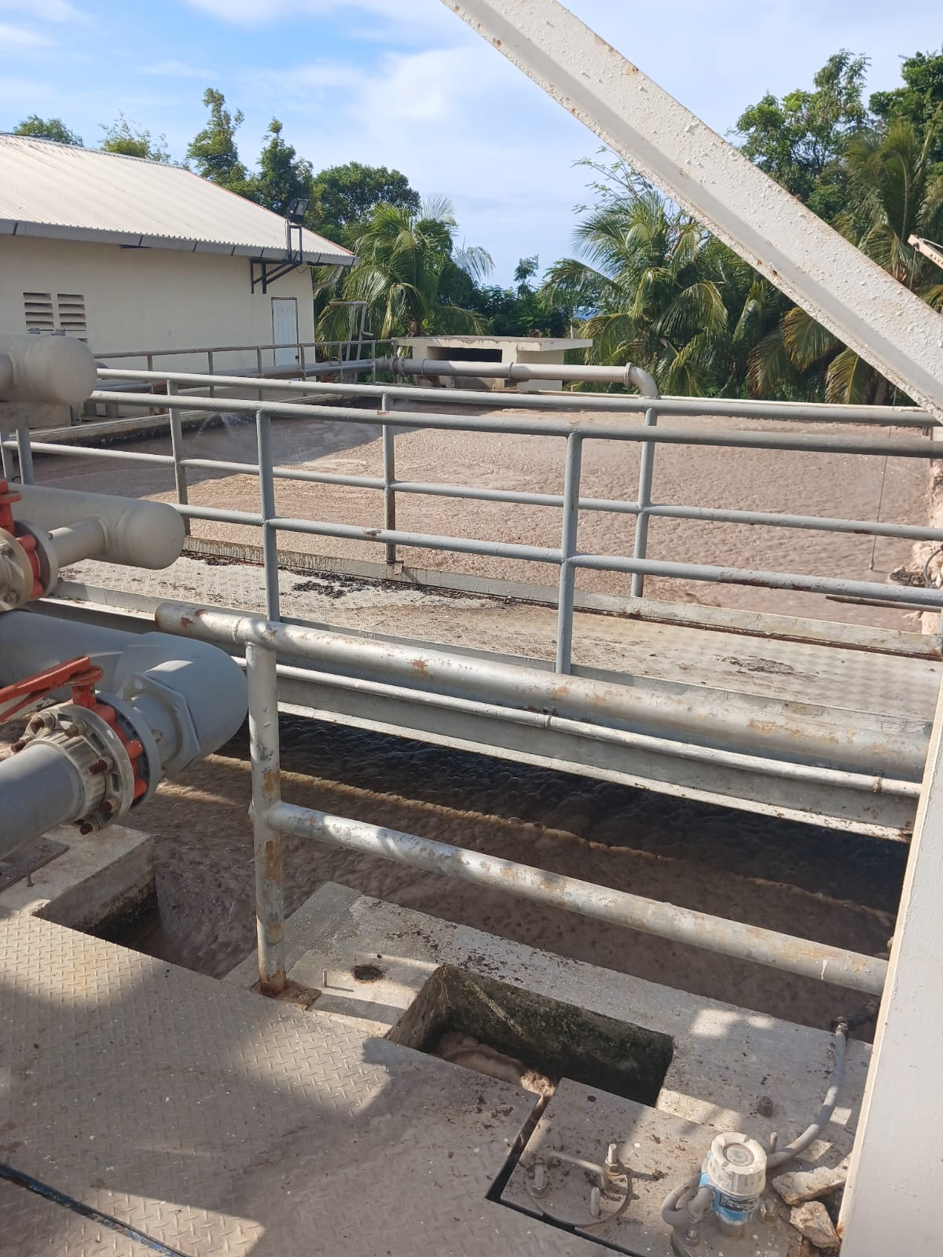
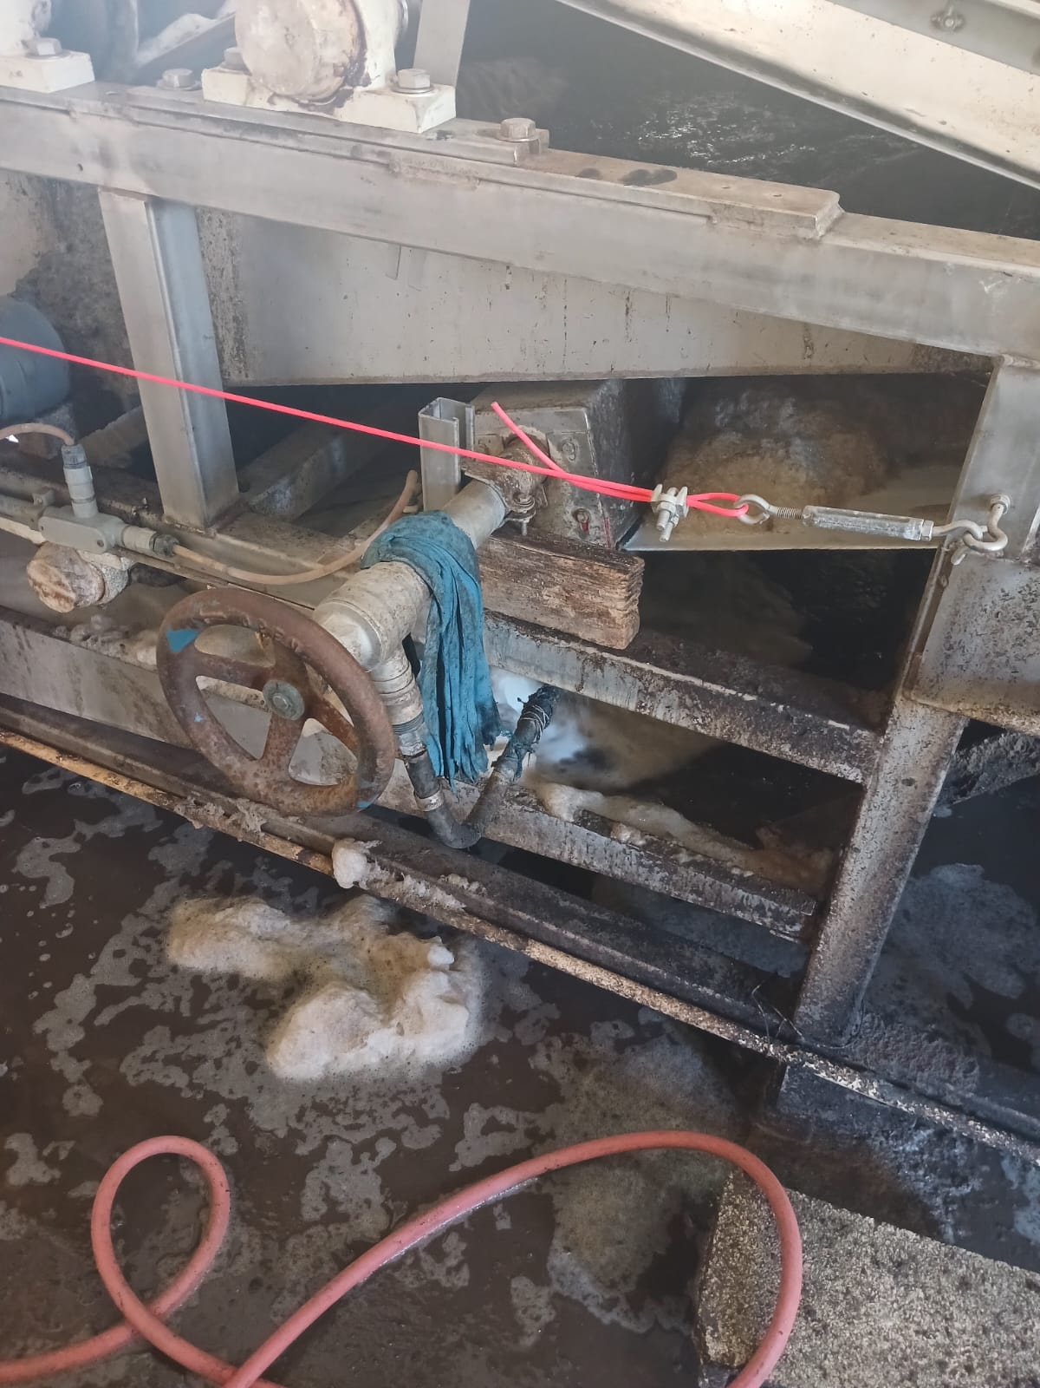
Evidence of Impact July 22 2025

Slide 11
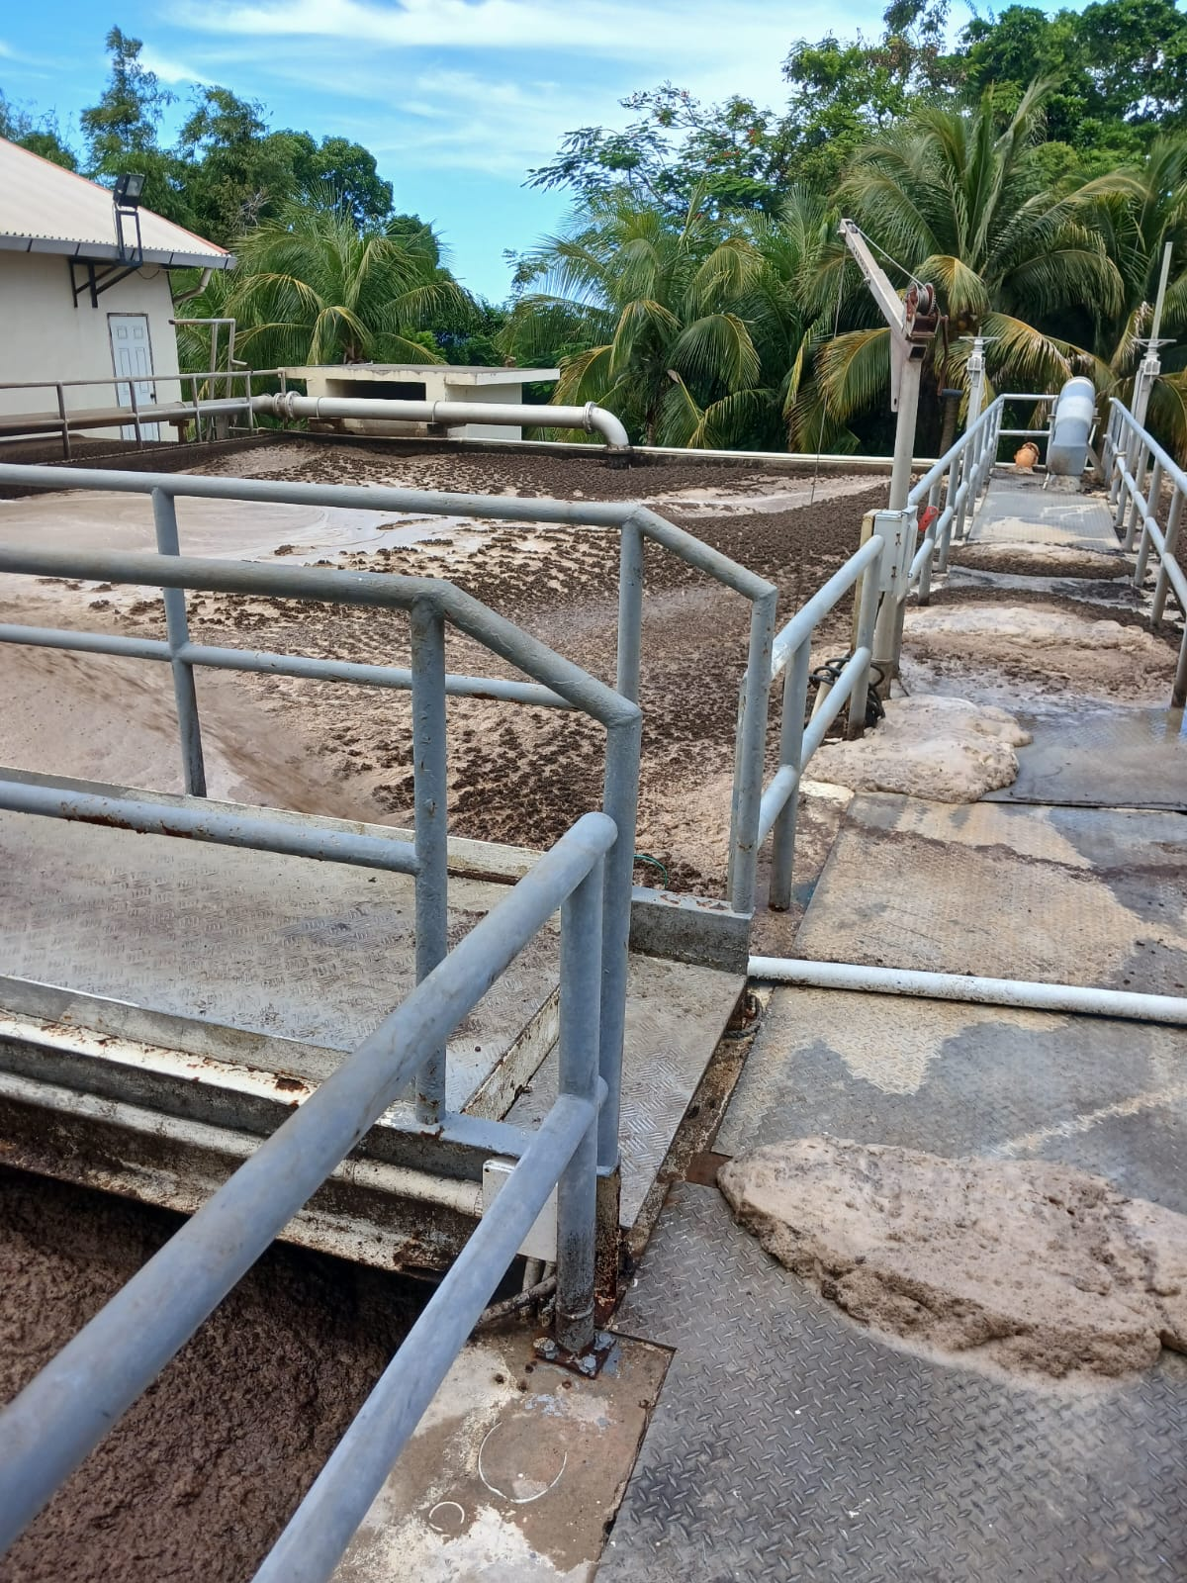
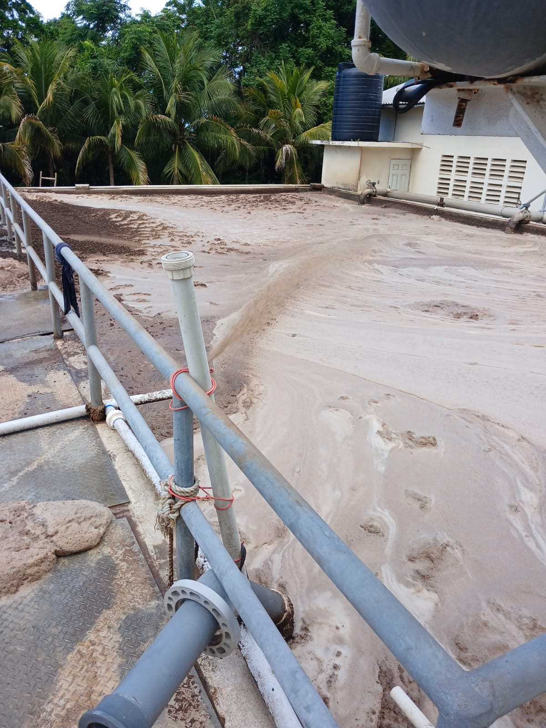
Evidence of impact Sept 24 2025

Slide 12
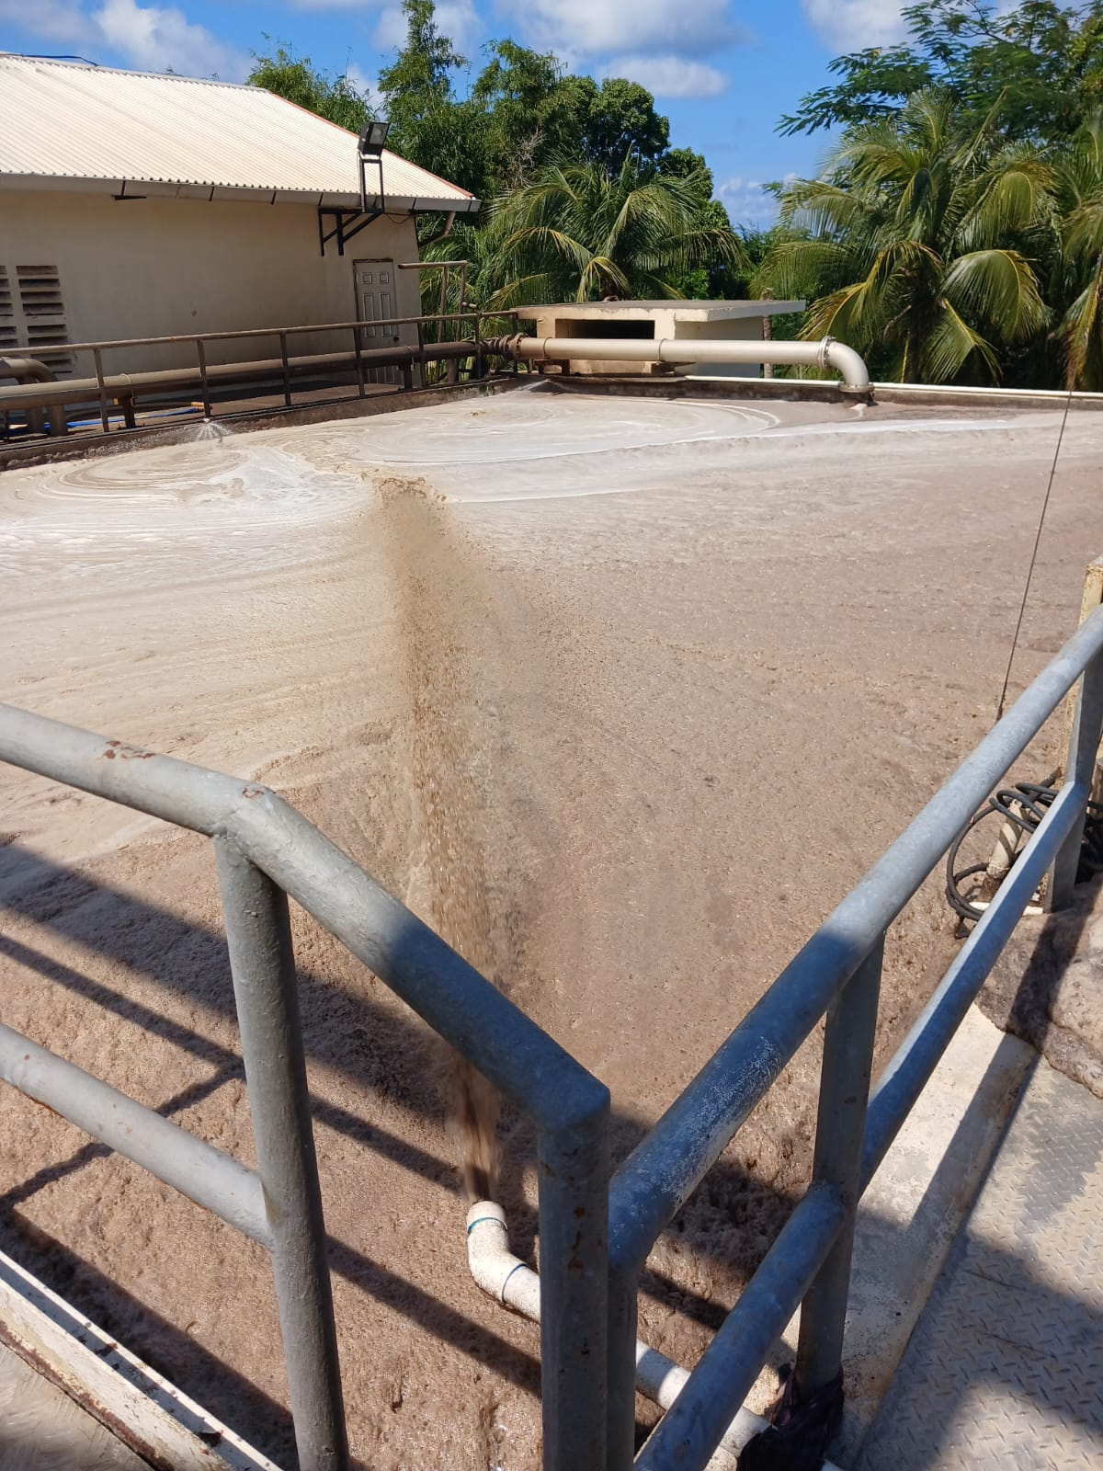
Evidence of impact October 21 2025

Slide 13
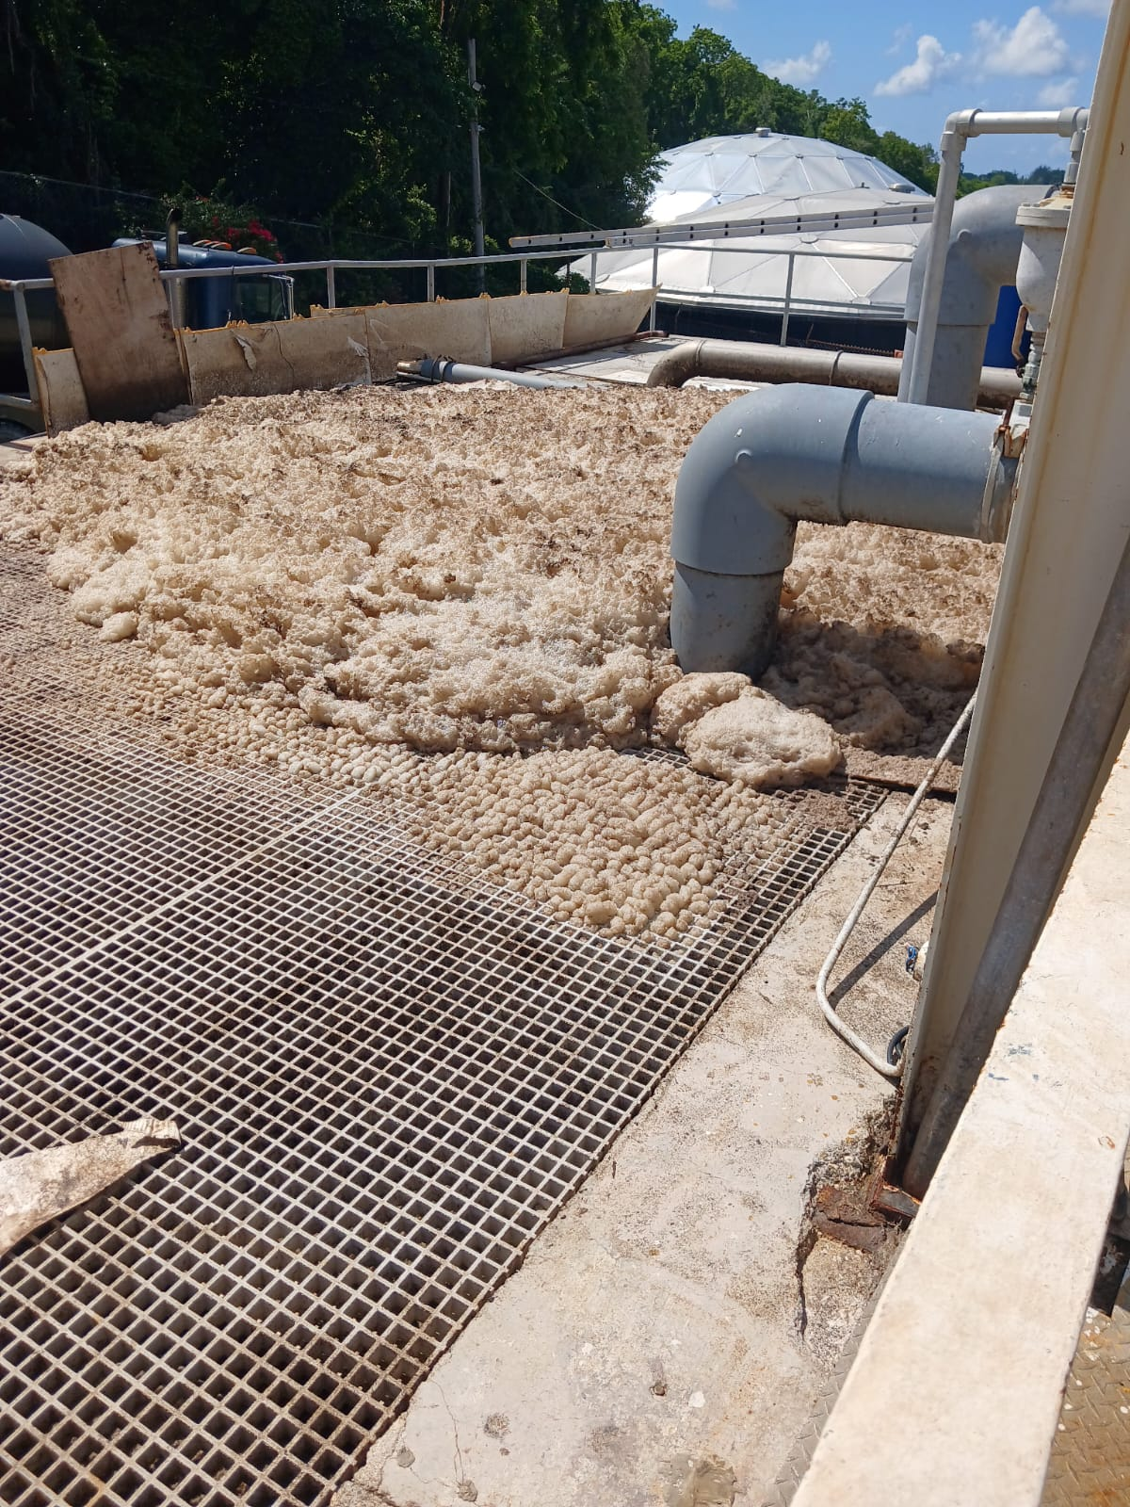
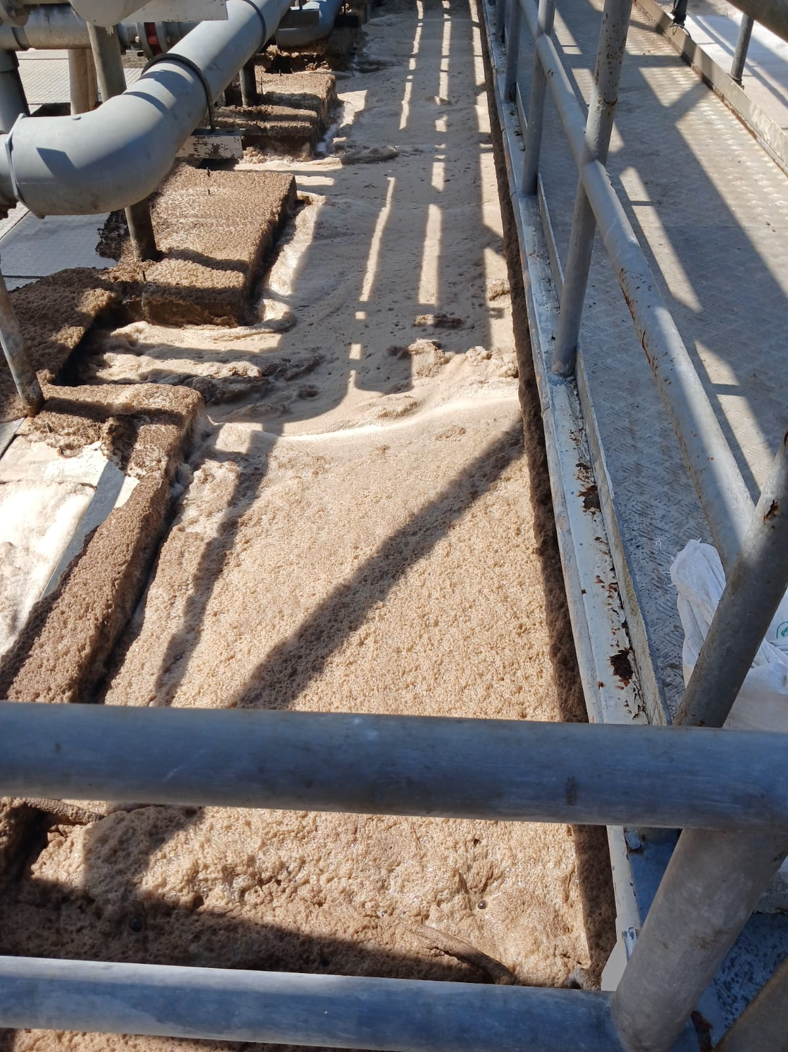
Evidence of impact October 21 2025

Slide 14
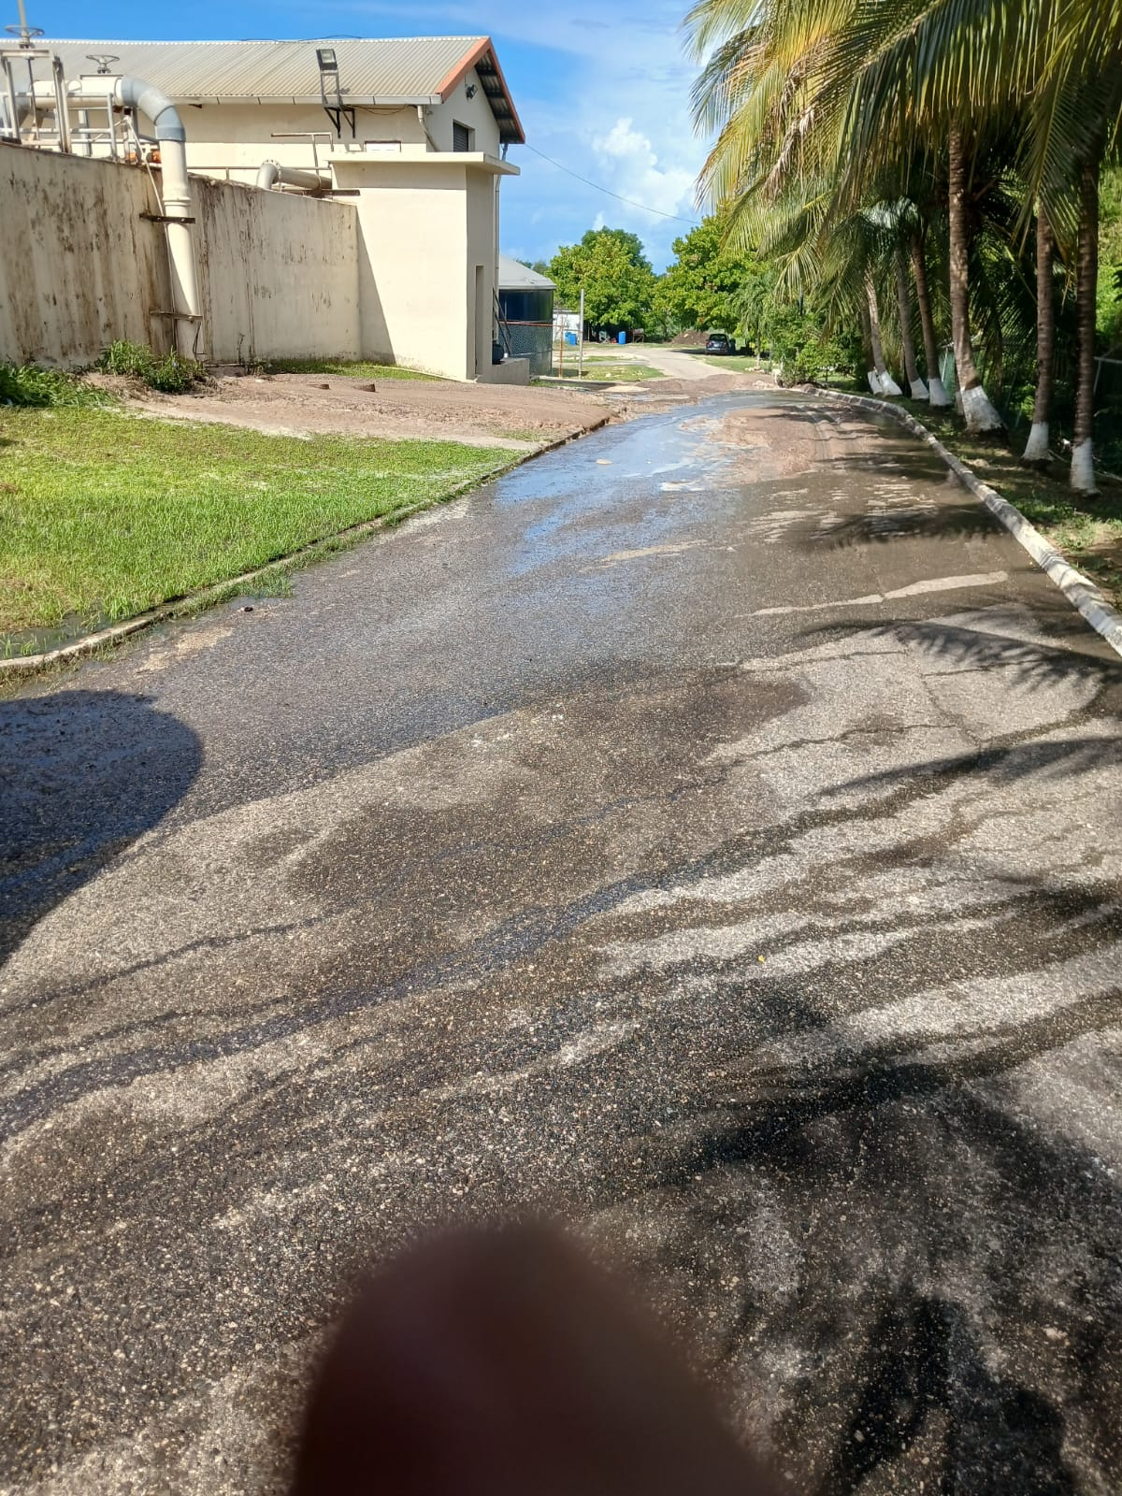
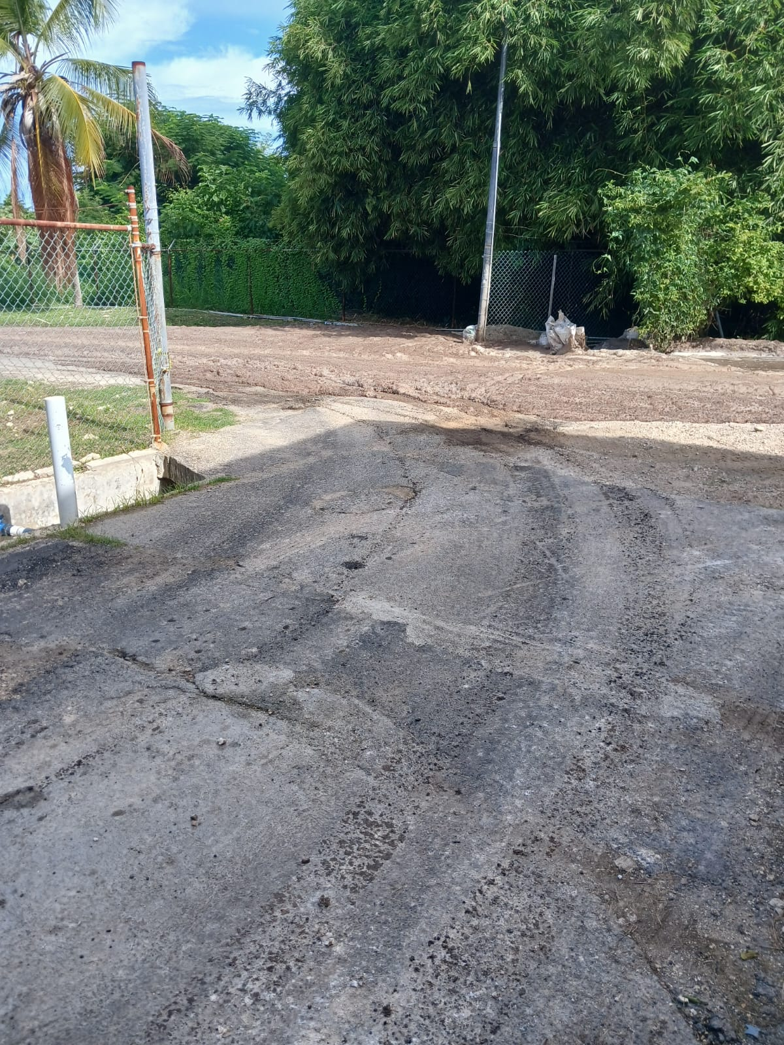
Evidence of impact October 22 2025

Slide 15
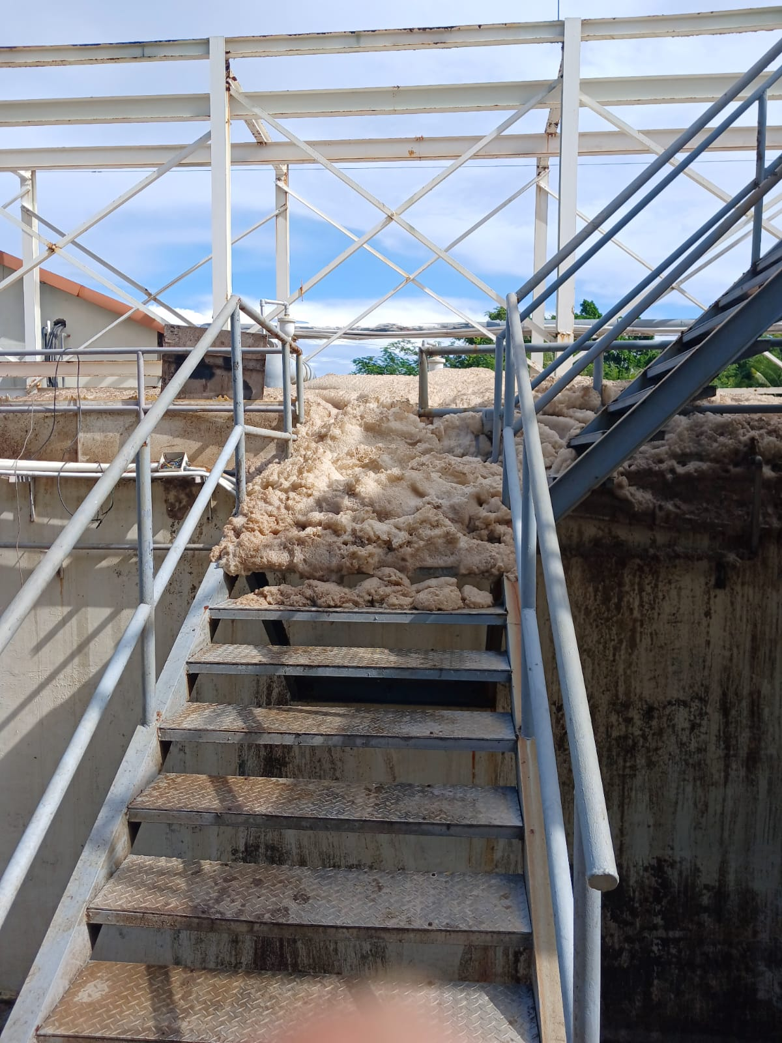
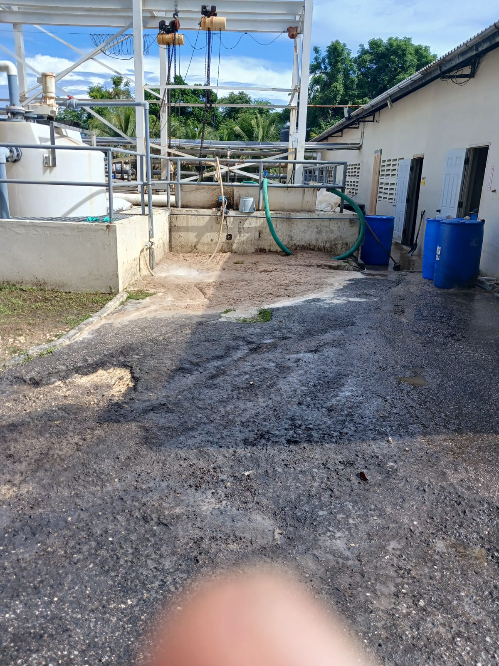
Evidence of impact October 22 2025

Slide 16
COD trend at offending party’s lift station

Slide 17
TSS trend at offending party’s lift station

Slide 18
PO4 trend at offending party’s lift station

Slide 19
NH4 trend at offending party’s lift station

Slide 20
Variability in key parameters at lift station

Slide 21
Why Regulation Works
Pre-treatment mandates for industrial and commercial entities reduce toxic loads before reaching municipal systems.
Monitoring and enforcement ensure compliance and accountability.
Licensing frameworks allow regulators to track and manage high-risk dischargers.

Slide 22
. Recommendations for Regulatory Strengthening: Proven Approaches
Update influent standards to address emerging contaminants—microplastics, pharmaceuticals, and endocrine disruptors—alongside traditional parameters.
Mandate on-line influent monitoring (flow, pH, turbidity, COD/BOD) with automated alerts to regulators and plant operators.
Enforce tiered pre-treatment requirements and discharge permits for all industrial and commercial users, backed by fines scaled to pollutant severity.
Harmonize regional protocols via CARICOM or OECS so that best practices at established plants can be replicated across other islands.

Slide 23
Sustainability and Economic Benefits
Benefit | Description
Infrastructure Longevity | Lower corrosion and fouling extend equipment life and reduce unplanned shutdowns
Operational Cost Savings | Fewer chemical overdoses and energy spikes cut utility bills by up to 20 %
Public Health Protection | Reduced pathogen and toxin loads decrease waterborne disease outbreaks
Reef and Fisheries Protection | Less nutrient and contaminant loading safeguards coral reefs and coastal fisheries

Slide 24
Call to Action
Utility regulators can hold the keys to transformative change. By tightening influent standards, investing in real-time monitoring, and enforcing pre-treatment across industry, regulators:
Shield communities from health risks
Ensure treatment plants operate at peak efficiency
Preserve the Caribbean’s invaluable coastal heritage
Strengthened influent regulation is not an optional extra; it is the foundation for resilient, sustainable municipal treatment systems across the Caribbean.

Slide 25
Closing Argument
Strengthening influent regulation is not just an environmental imperative—it’s a strategic investment in public health, economic resilience, and sustainable development. Regulators, have the power to shape a future where wastewater treatment is not a reactive burden, but a proactive pillar of national sustainability.

