Slide 1

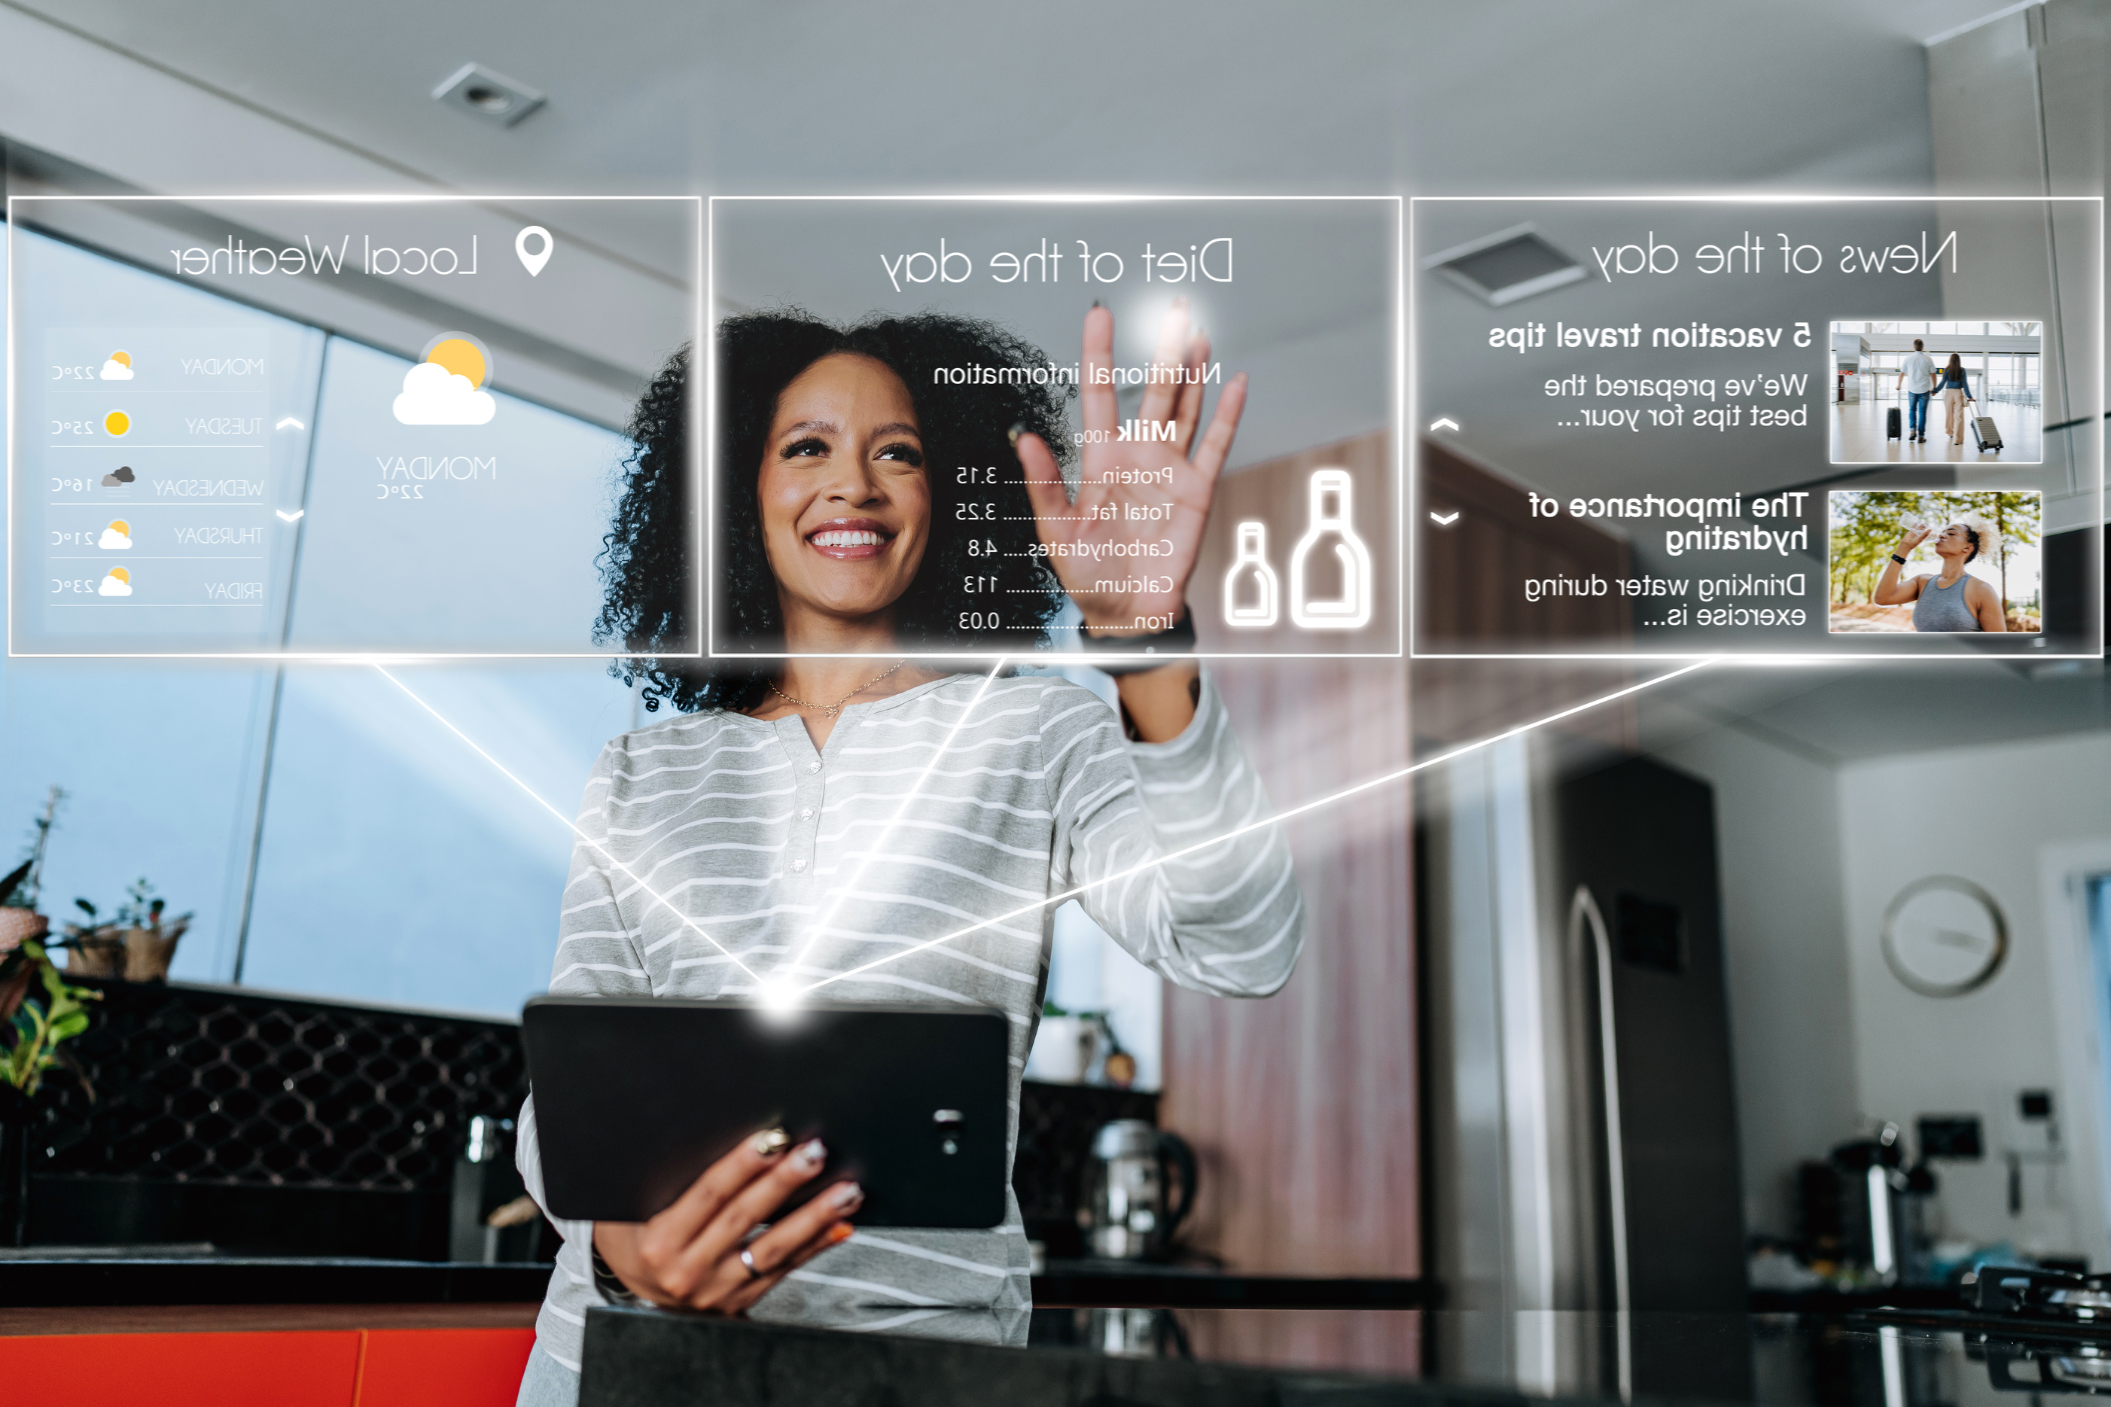
Harnessing Emotional Intelligence and Artificial Intelligence for workforce transformation in Public Utilities Commissions/Agencies:
Aligning People, Technology and Policy for Resilience.
SHANIQUE NUNES
Human Resource Manager - OUR

Slide 2



SETTING THE STAGE
Public Utilities = critical services under pressure (aging workforce, digital disruption, regulatory demands).
Workforce transformation is no longer optional—it’s survival.
Two key enablers: EI (human-centered skills) + AI (technology-driven insights).

Slide 3
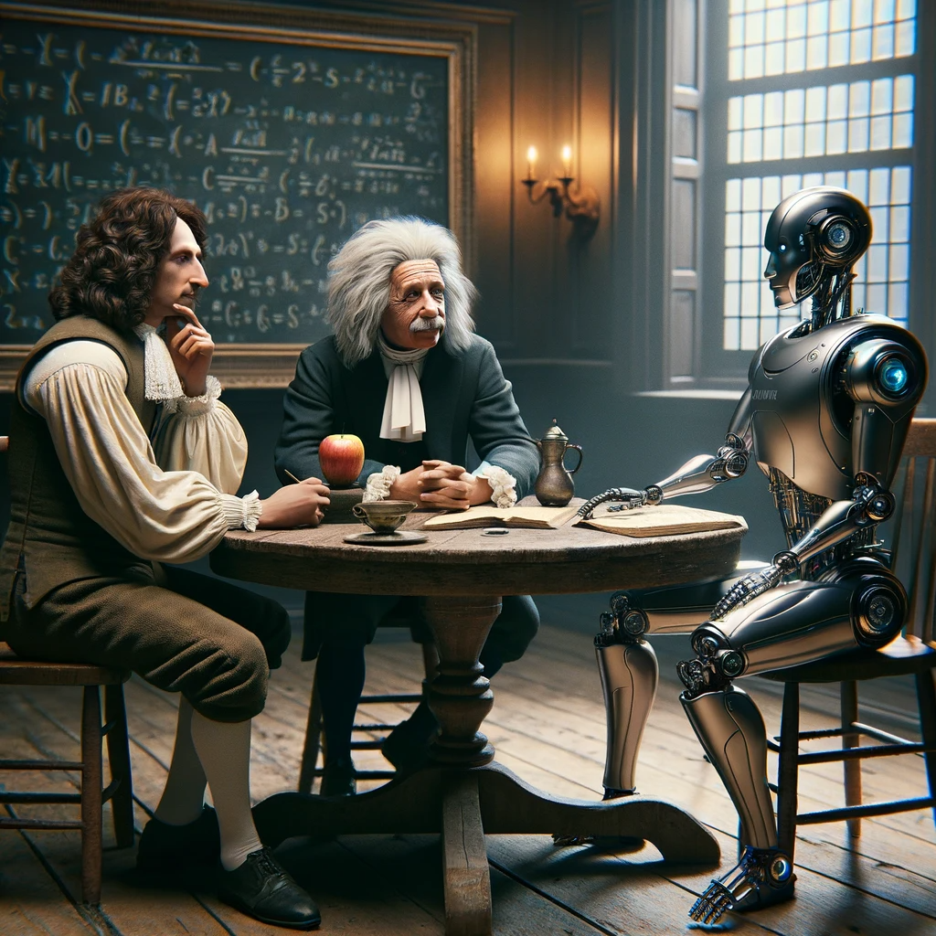

WHAT IS INTELLIGENCE
The ability to acquire and apply knowledge and skills.
  Learning
  Reasoning
  Adaptability
  Understanding
  Application

Slide 4


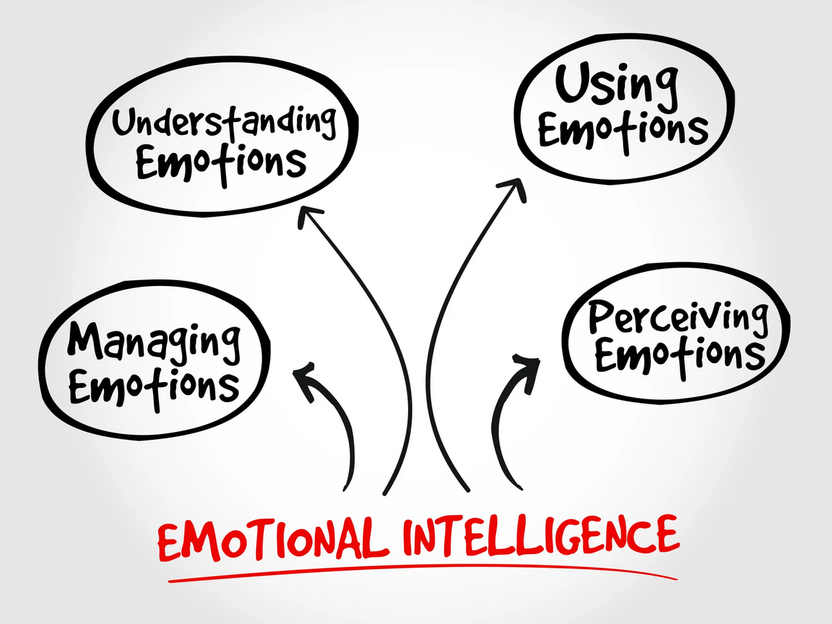
Emotional Inteligence (EI)
  self-awareness,
  self-regulation,
  empathy,
  social skills,
  motivation.

Slide 5

Emotional Intelligence (EI)
improves leadership & team collaboration.
supports change management
boosts employee engagement
E.g. Navigating resistance to automation through empathy

Slide 6
Workforce analytics & predictive modeling.
ARTIFICIAL INTELIGENCE AI
the simulation of human intelligence in machines to enable them to learn, reason, solve problems, perceive their environment, and make decisions
Example: Predictive maintenance of workforce scheduling in utilities.
Automating recruitment & onboarding.
AI chatbots for employee queries.

Slide 7
EFFECTS OF EI VS. AI IN HR :
Emotional Intelligence
Artificial Intelligence
  Human connection.
  Conflict resolution.
  Resilient leadership
  Efficiency & speed.
  Data-driven insights.
  Risk of bias/displacement.

Slide 8

SYNERGY - WHERE EI MEETS AI
  AI detects → EI responds.
  AI detects burnout risk → EI-driven managers provide support.
  Together: smarter, more human-centered workforce transformation.

Slide 9
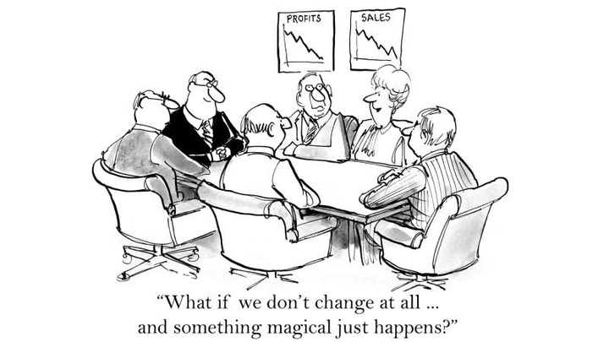
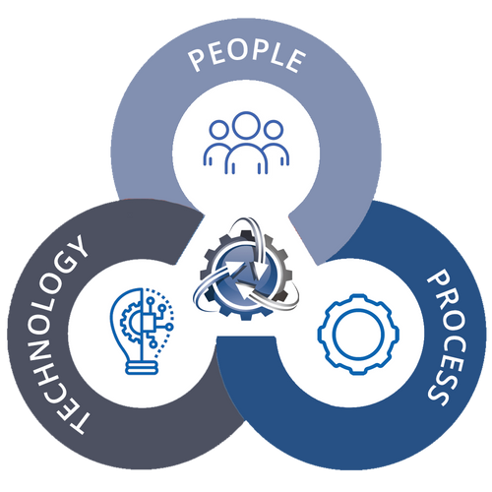
Aligning People, Technology & Policy
People
Technology
Policy
  Train leaders in EI.
  Upskill employees for digital future.
  Implement AI responsibly.
  Ensure transparency & fairness.
  Ethical use of AI in HR.
  Update regulations to support workforce resilience.

Slide 10
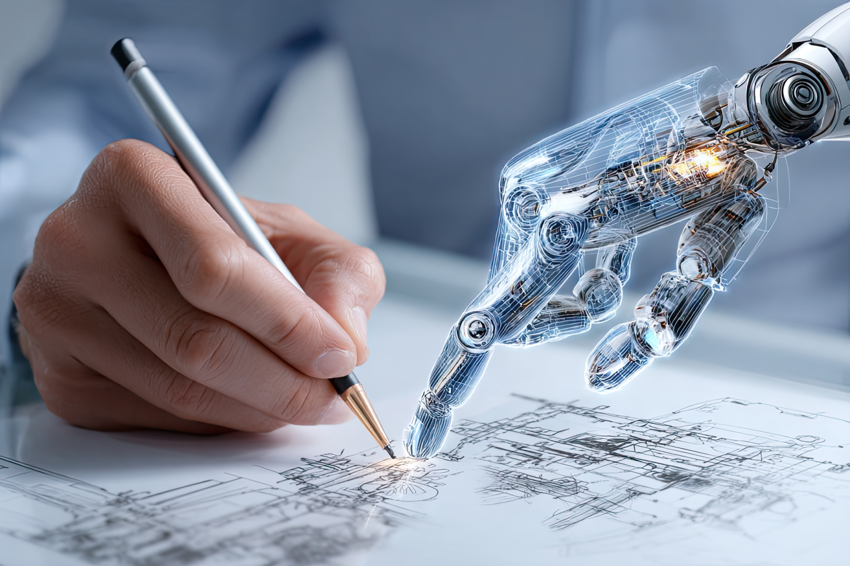
CAN EI & AI COEXIST?
  Not “EI vs. AI” but “EI + AI.”
  EI makes AI humane.
  AI makes EI scalable.
  Balance = resilience in public utilities.

Slide 11

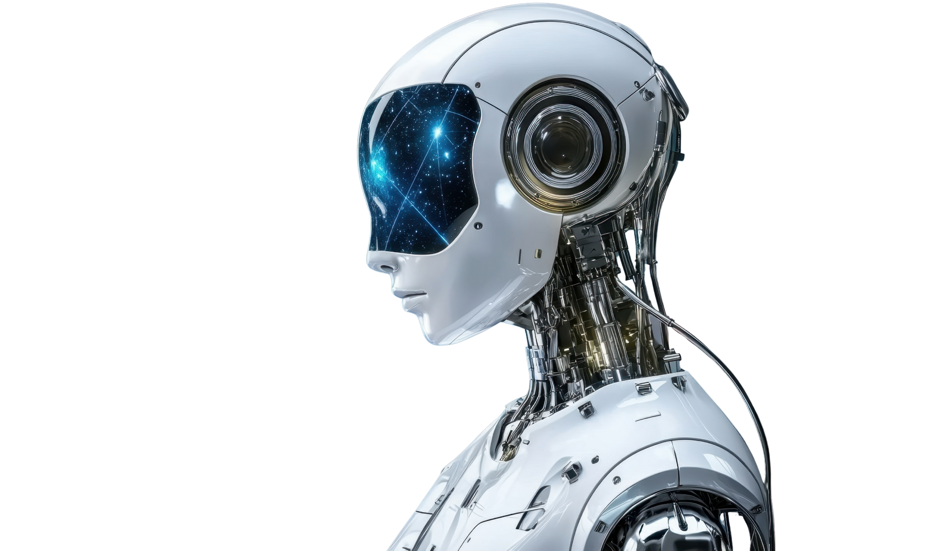
CLOSING THOUGHTS
  Future of workforce in utilities depends on human + machine collaboration.
  HR leaders must integrate EI & AI into strategy.
  Resilience = People + Technology + Policy working together.

Slide 12


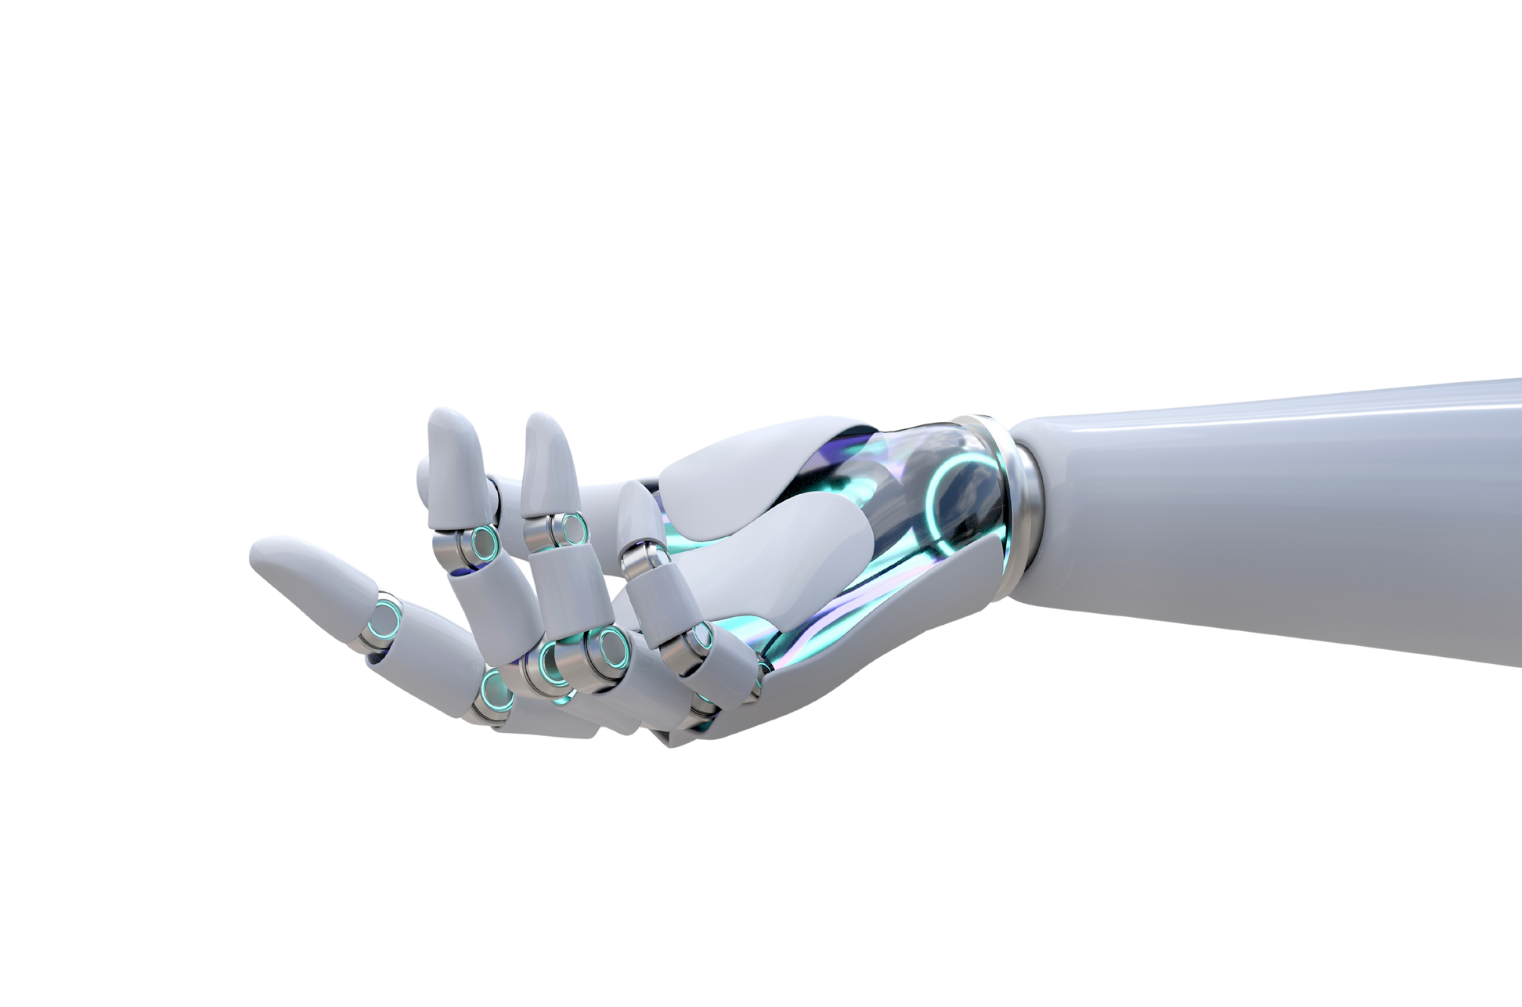

Call to Action / Quote
Technology without humanity lacks wisdom. Humanity without technology lacks speed. Together, they create resilience.”
THANK YOU!!!

