Slide 1
Bridging the Flow
Regulating the Water-Energy Nexus for a Sustainable Caribbean
INNOVATIVE SOLUTIONS FROM ISRATECH

Slide 2
WHY THE NEXUS MATTERS NOW
Three numbers explain why Caribbean water and energy policy can no longer be regulated in silos.
50%
40%
10%
Average water lost through leaks and aging pipes across the region
Share of utility operating costs that pumping and treatment can consume
Regionally, water sector accounts for 4-10% of national electricity consumption
Notes:
Of course, I brought goodies. I promise you, this is the easiest give-a-way you’ll participate in.
First question- How much of the human body is made up of water?
Is it 50%, 70%, or 90%?”
(Pause - answer: ~70%)
2. “Second question- Does the human body need energy to function, or can it survive on water alone?”
(Pause - answer: it needs both)
3. “And here’s the key one- what happens if the body has water, but no energy?”
(Pause - answer: it cannot function properly)
The human body is made up of approximately seventy percent water. ADDITIONALLY, the body requires energy to function.
So where am I going with this?
Neither of the two works in isolation. Water supports life, but without energy, the body cannot move, regulate, or sustain itself.
It’s the same with our infrastructure.
Water systems need energy for pumping, treatment, and distribution.
And energy systems, in many cases, depend on water for cooling, processing, and generation.
So just like the human body, these are not separate systems—they are interdependent, and they must be managed together.”
Now let’s bring that into the Caribbean context.
Every time we pump water, we consume electricity.
Every time we treat water, we use both energy and chemicals.
And every time we lose water through leaks, we are losing energy and money at the same time.
Add to that climate stress—droughts and storms—and both systems come under pressure simultaneously.
So when one system fails or becomes inefficient, the other is directly affected.
Now, these numbers tell us just how urgent this is.
Across the region, we are losing up to fifty percent of water through leaks and ageing infrastructure.
Up to forty percent of utility operating costs are tied to energy for pumping and treatment.
And the water sector accounts for roughly four to ten percent of national electricity consumption.
These are not separate issues.
They are one system problem—and they require one system response.”

Slide 3
THE IMPLICATION
Every cubic metre of water lost drains electricity, chemicals, operating cash, and the system’s drought resilience simultaneously.
The same islands that pay high energy costs also have strong distributed solar potential. That makes the nexus a regulatory opportunity, not just a systems problem
Notes:
“This brings us to the core implication.
Every cubic metre of water lost is not just water… it is wasted electricity, wasted chemicals, lost operating cash, and reduced drought resilience.
So when we talk about water loss, we are not talking about a maintenance issue.
We are talking about a compounded economic and resilience issue.
At the same time, the Caribbean faces high energy costs, but also has strong distributed solar potential.

Slide 4
HOW THE LOOP WORKS
Water Services
Abstraction
Treatment
Distribution
Energy Demand
Pumps
Wastewater
ONE SYSTEM
Water, power and resilience cannot be governed separately in island systems.
The Caribbean water-energy nexus is physical, financial and regulatory all at once.
Climate Stress
Drought
Storms
Salt Intrusion
Regulation
Tariffs
Standards
Planning
Notes:
“To understand this properly, we need to look at the system as a whole.
The water-energy nexus operates across four interconnected areas:
Water services: abstraction, treatment, and distribution.
Energy demand: particularly pumping and wastewater processing.
Climate stress: drought, storms, and salt intrusion.
And regulation: tariffs, standards, and planning.
These are not independent systems.
Water depends on energy.
Climate affects water availability and infrastructure.
And regulation shapes how both systems operate.
You cannot optimise one without affecting the others.
This is a closed-loop system and it must be managed as one system.

Slide 5
How can Isratech help?
Think of Isratech as the implementation layer between policy intent and field-level delivery.
Notes:
“So where does Isratech fit into all of this?
Think of Isratech as the circulatory system.
Just as the circulatory system moves water and delivers energy to keep the body functioning, Isratech connects water and energy systems to keep infrastructure working efficiently.
With over 35 years of regional experience across the water and energy sectors, we bridge the gap between strategy and execution across our four core divisions—agriculture, waterworks, energy, and chemicals.
We take ideas and turn them into working systems on the ground—from consultation and design through to implementation and maintenance.”

Slide 6
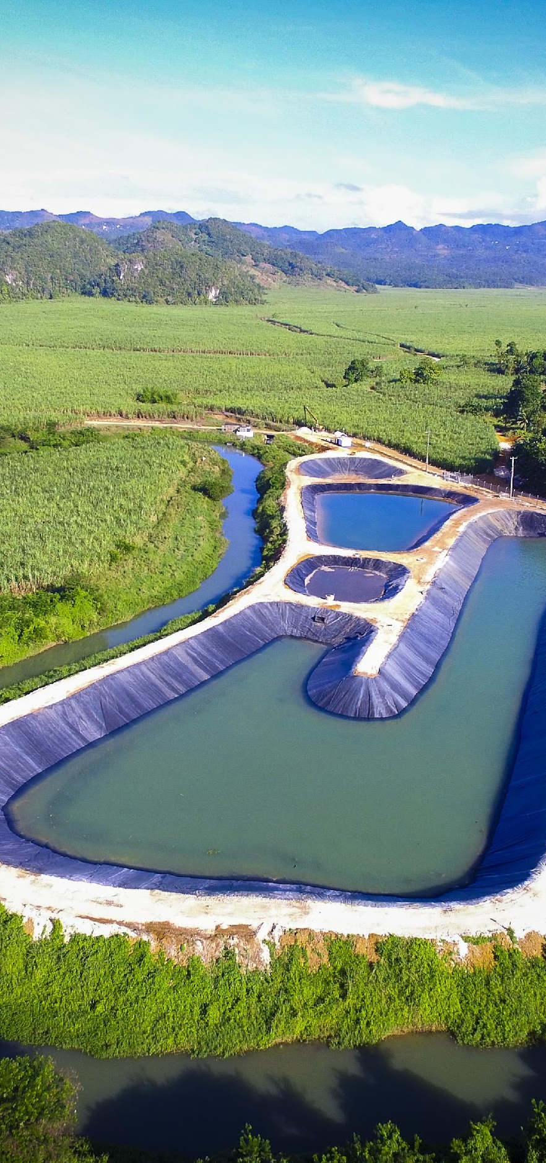
HOW ISRATECH CAN HELP
Treat advanced water and wastewater treatment
Notes:
“At our core, Isratech delivers four integrated solution areas.
Water and SCADA wastewater treatment. Supervisory Control and Data Acquisition system used to monitor, control, and optimise wastewater treatment and sewer operations in real time.

Slide 7
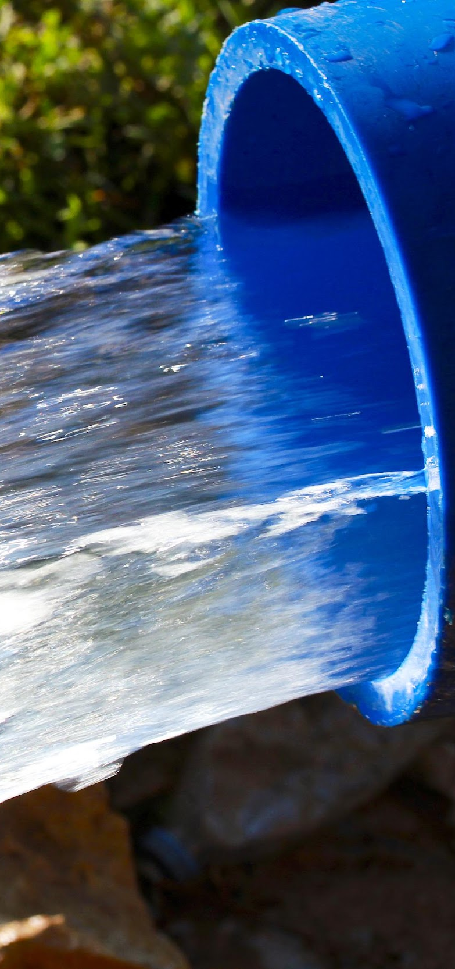
HOW ISRATECH CAN HELP
Move water infrastructure products and systems
Notes:
Water infrastructure systems- more durable high density polyethylene (HDPE) pipes, pumps, filtration and distribution networks.

Slide 8
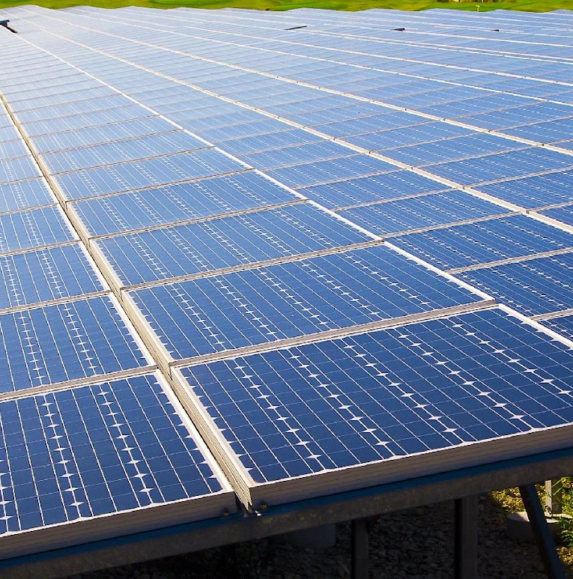
HOW ISRATECH CAN HELP
Deliver sustainable energy solutions for small or large projects
Notes:
Energy solutions, including solar applications.

Slide 9
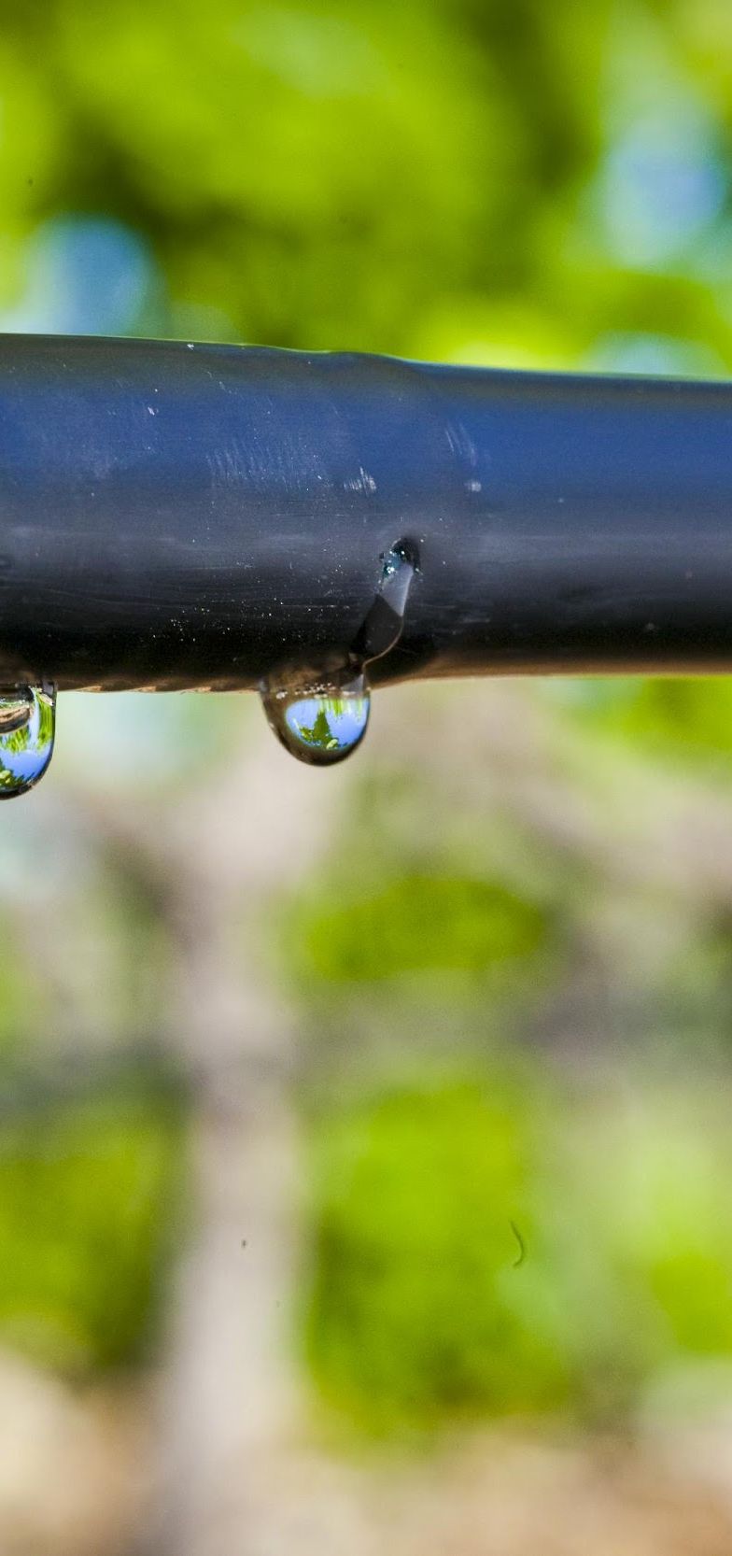
HOW ISRATECH CAN HELP
Conserve drip irrigation and demand-side efficiency
Notes:
And irrigation and demand-side efficiency systems.
What makes us different is that we do not operate in fragments.
We deliver integrated solutions… systems that work together… not isolated products.”

Slide 10
HOW ISRATECH CAN HELP
That combination allows integrated pilots such as solar-assisted pumping, modular treatment, reuse-ready systems, network upgrades and climate-smart irrigation rather than isolated equipment purchases.
Notes:
“This allows us to deliver integrated pilots such as:
Solar-assisted pumping systems,
Modular treatment plants,
Reuse-ready water systems,
And climate-smart water and energy solutions.
This is where real value is created, by combining technologies into working systems, not simply supplying equipment.”

Slide 11
Regional Proof Points
The building blocks already exist.
Regulation now must connect and scale them.
Notes:
“The key point here is that the solutions already exist.
The Caribbean is not lacking innovation.
What we are lacking is integration and scale, driven by the right frameworks.

Slide 12
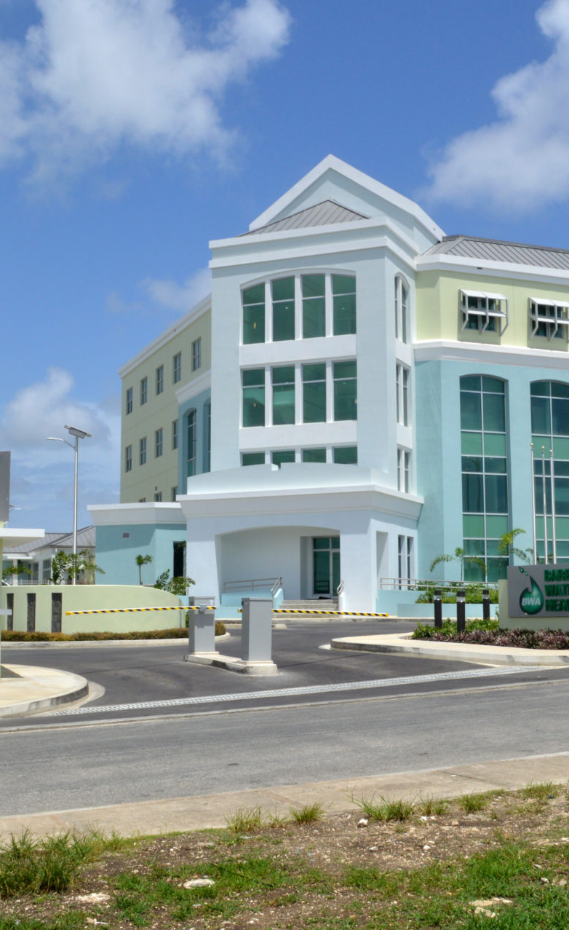
REGIONAL PROOF POINTS
Barbados Water Authority
~95%
SCADA implementation for the water production system plus smart metering across the customer base.
Notes:
“In Barbados, we see approximately ninety-five percent SCADA implementation, along with smart metering across the customer base.
This level of digital integration enables real-time monitoring, better control, and improved efficiency.”

Slide 13

REGIONAL PROOF POINTS
Across Caribbean Utilities
Renewable pumping
Back-up generators
Reservoir storage
Disaster support systems
ALREADY BEING DEPLOYED
Notes:
“Across the region, we are already seeing:
Renewable-powered pumping,
Backup generation systems,
Reservoir storage,
And disaster support infrastructure.
These are proven building blocks, not future concepts.”

Slide 14
The question is no longer, “Can this be done?”
It is, “How quickly can regulators turn these scattered successes into normal practice?”
Notes:
“So the question is no longer whether this can be done.
The real question is: how quickly can we turn these scattered successes into standard practice?

Slide 15
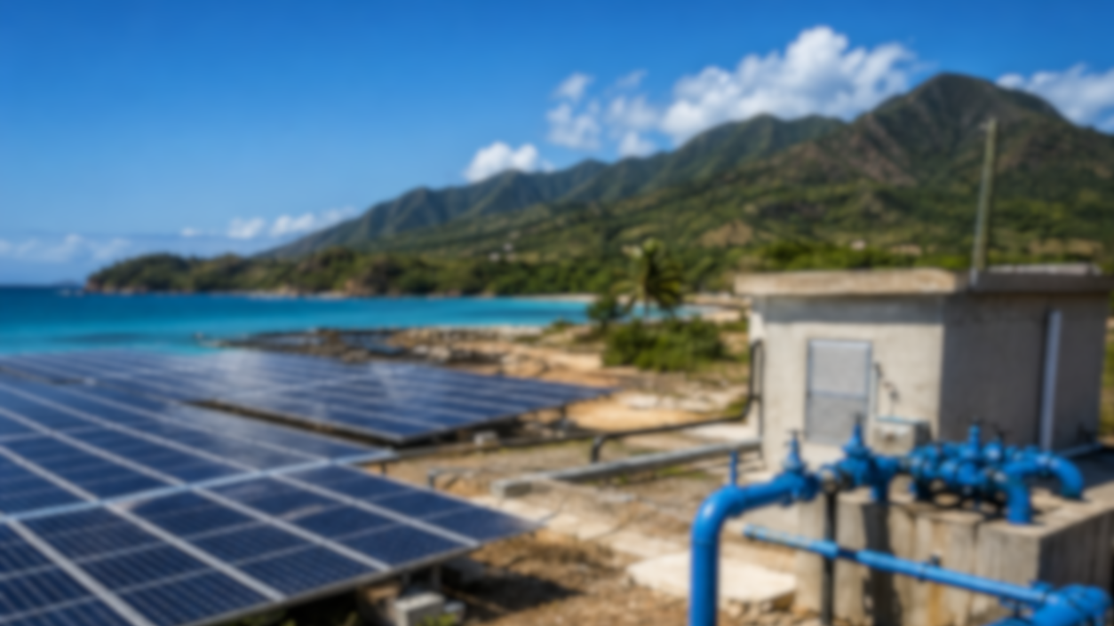
This is not about water.
It is not about energy.
It is about systems that must work together.
ISRATECH-bridging the flow between strategy and execution with everything agriculture, water, energy and chemicals.
Notes:
“Let me leave you with this.
This is not about water.
It is not about energy.
It is about systems that must work together.
And at ISRATECH, that is exactly what we do.
We connect water, energy, sustainability and resilience on the ground, in real systems, delivering real results. ISRATECH-bridging the flow between strategy and execution with everything agriculture, water, energy and chemicals. Ladies and gentlemen, thank you.
Our booth is on the outside. Should you have any questions, our chief engineer, Oreal is there to address them for you.

Slide 16


