Slide 1
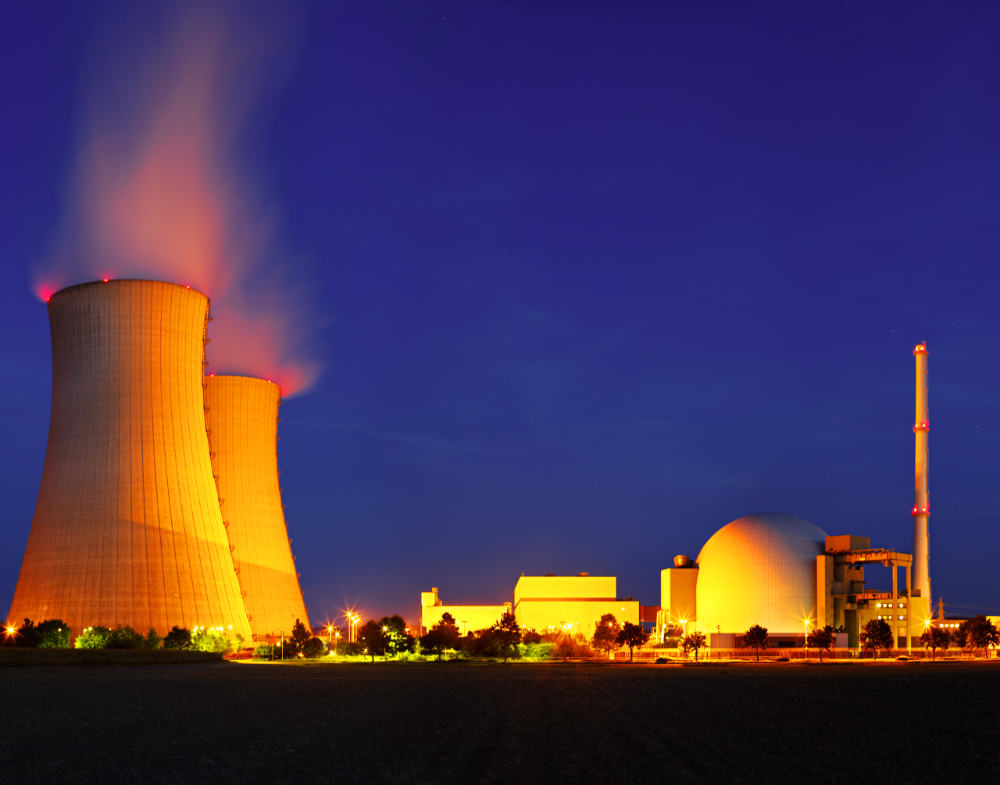
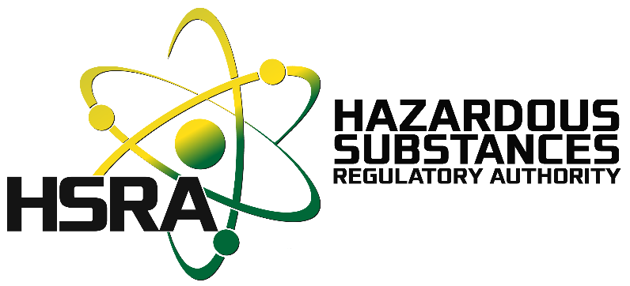

Exploring the Feasibility of Nuclear Power in Jamaica
LEGISLATIVE REALITIES, REGULATORY CAPACITY, AND THE PATH TOWARD SMALL MODULAR REACTORS
Cliff Riley, Ph.D. M.A.
Director General,
Hazardous Substances Regulatory Authority
an Agency of the Ministry of Industry, Investment and Commerce
Notes:
The presentation explores the legislative, regulatory, and social dimensions of Jamaica’s nuclear readiness and its potential regional implications.
This can be position as part of the Caribbean’s broader conversation on resilient, low-carbon, and affordable energy transitions — highlighting nuclear energy’s re-emergence as a viable pathway, especially for SIDS.

Slide 2

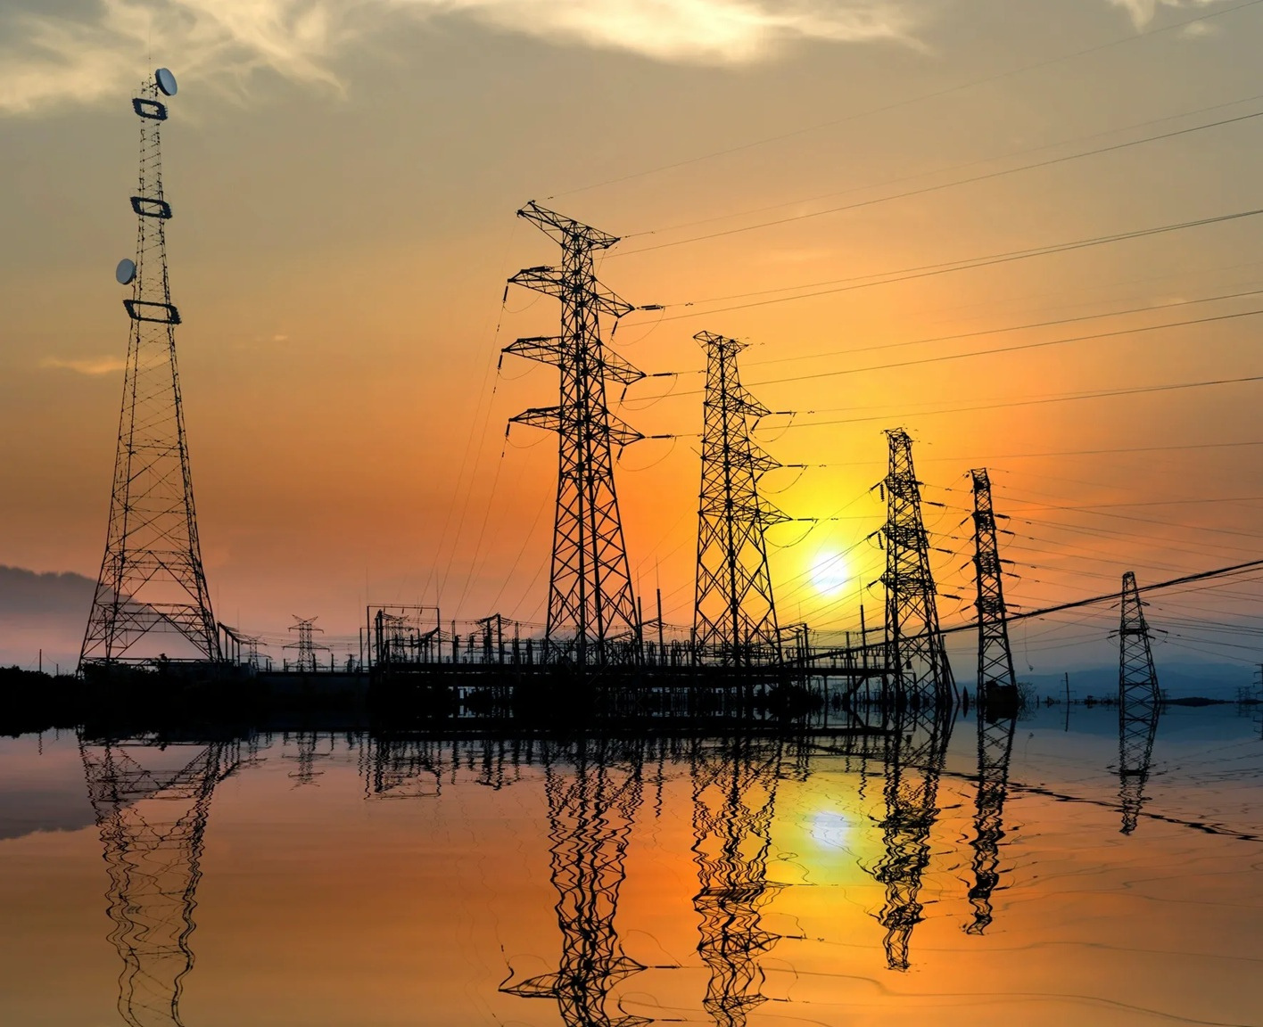

INTRODUCTION
Jamaica’s energy sector remains heavily dependent on imported fossil fuels—over 85% of its primary energy supply.
Electricity costs are among the highest in the Caribbean, influenced by oil price volatility and foreign exchange exposure.
Despite recent progress, renewable sources contribute only around 12–15% of total generation.
Energy insecurity, combined with climate vulnerability, drives the national ambition to diversify toward stable, low-carbon baseload options.
Notes:
This is Jamaica moving from interest to structured exploration. Stress that the discussion today is not about immediate construction but about readiness, governance, and learning from global best practices.
Point out that while renewables are growing, they require a stable baseload source — which nuclear energy could provide.

Slide 3
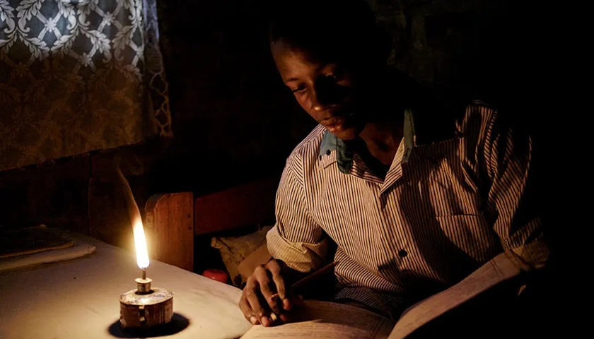
INTRODUCTION CONT’D
High energy costs affect every sector — manufacturing, tourism, digital services, and households.
Energy poverty persists, particularly in rural areas, limiting access to reliable electricity.
This dependence on imported fuel also undermines economic resilience and exposes the country to external shocks.
Sustainable development requires an energy system that is affordable, reliable, and low-carbon, capable of supporting industrial growth and social well-being.
Notes:
Stress that energy affordability is an equity issue. Nuclear power exploration must be seen through a developmental lens, not only technological feasibility.

Slide 4



Rationale for Exploring Nuclear Energy
Jamaica’s interest in nuclear energy stems from:
  The need for stable, low-cost baseload power to complement renewables.
  The goal to reduce import dependence and enhance energy security.
  The desire to meet emissions reduction commitments under the Paris Agreement.
  The opportunity to expand local expertise in advanced science and technology.
SMRs, in particular, are well-suited to Small Island Development States (SIDS) due to their scalability, modularity, and safety-by-design features.
Notes:
This is a pragmatic exploration — not replacing renewables but complementing them. Nuclear provides reliability; renewables provide sustainability.

Slide 5

Why SMRs?
SMRs represent the next generation of nuclear technology.
They are:
  Compact reactors (<300 MWe).
  Factory-built and transportable.
  Designed with passive safety systems (no external power required).
  Capable of flexible deployment — suitable for small grids like Jamaica’s.
  Their modular nature allows incremental investment and scalability as demand grows.
SMRs appeal to SIDS because of reduced land footprint, lower upfront risk, and compatibility with renewables.

Slide 6
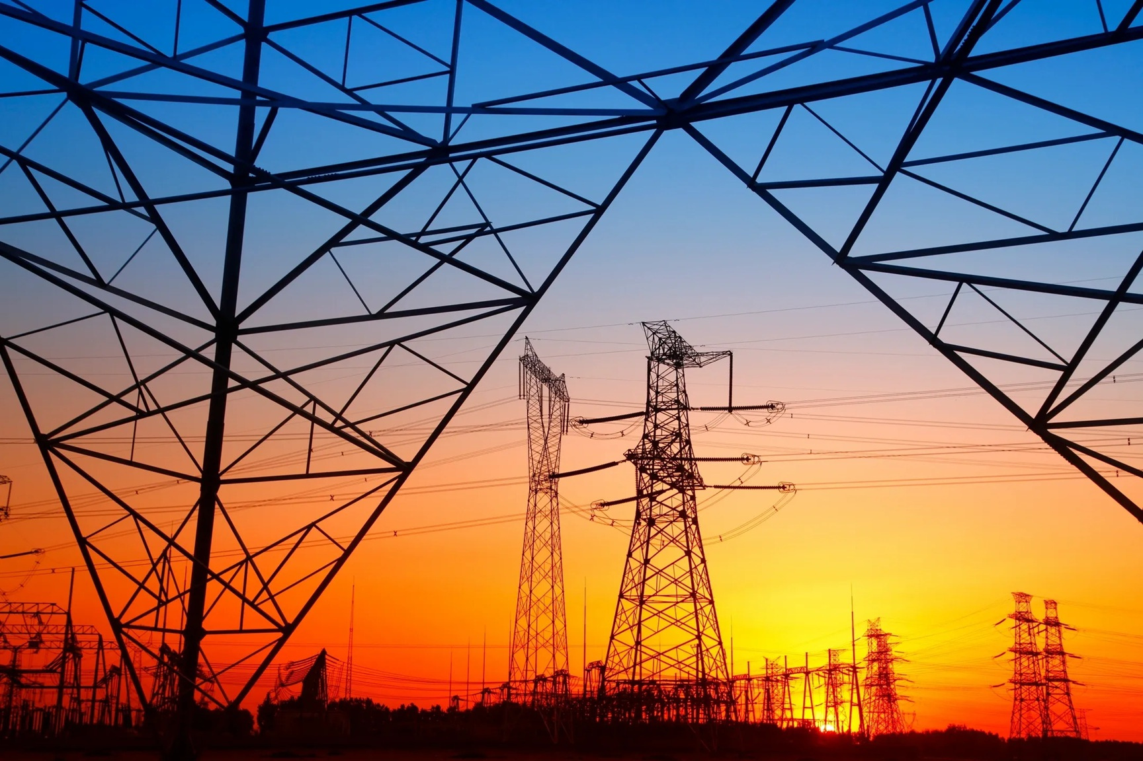
Potential Benefits for Jamaica
Adopting nuclear technology could deliver:
  Energy security: Stable baseload supply independent of oil imports.
  Economic resilience: Reduced exposure to fuel price fluctuations.
  Climate benefits: Near-zero emissions during operation.
  Technical growth: Expansion of high-skilled scientific jobs.
  Regional leadership: Establishing Jamaica as a model for safe nuclear integration in SIDS.
Others include education, research, and international standing.

Slide 7
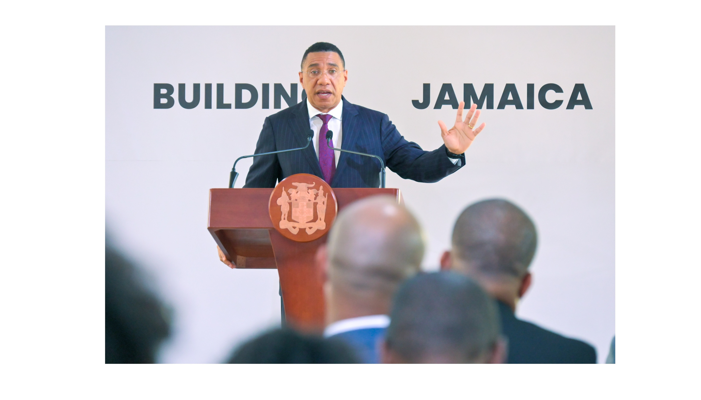
The 2024 MOU between Jamaica and Canada marks the first formal step toward evaluating nuclear feasibility. It establishes cooperation in:
  Technical assistance and knowledge transfer.
  Capacity-building and training.
  Feasibility studies on SMR deployment.
  Regulatory framework development.
This demonstrates high-level political will and recognition that long-term energy security requires exploring all viable low-carbon technologies.
Political Commitment
Notes:
Highlight that political commitment is critical for regulatory evolution and international confidence. The MOU opens doors for collaboration, but it does not mean commitment to immediate construction.

Slide 8

Legislative Barriers
NSRP Act, 2015 provide Jamaica’s core legal basis for regulating ionizing radiation and radiation sources.
Section 27 explicitly prohibits:
  Construction or operation of nuclear installations (power plants, enrichment or reprocessing facilities).
  Authorization by the Hazardous Substances Regulatory Authority (HSRA) for any such installations.
Notes:
Clarify that this legal prohibition must be addressed through either legislative amendment or a new act that supersedes the 2015 framework.

Slide 9
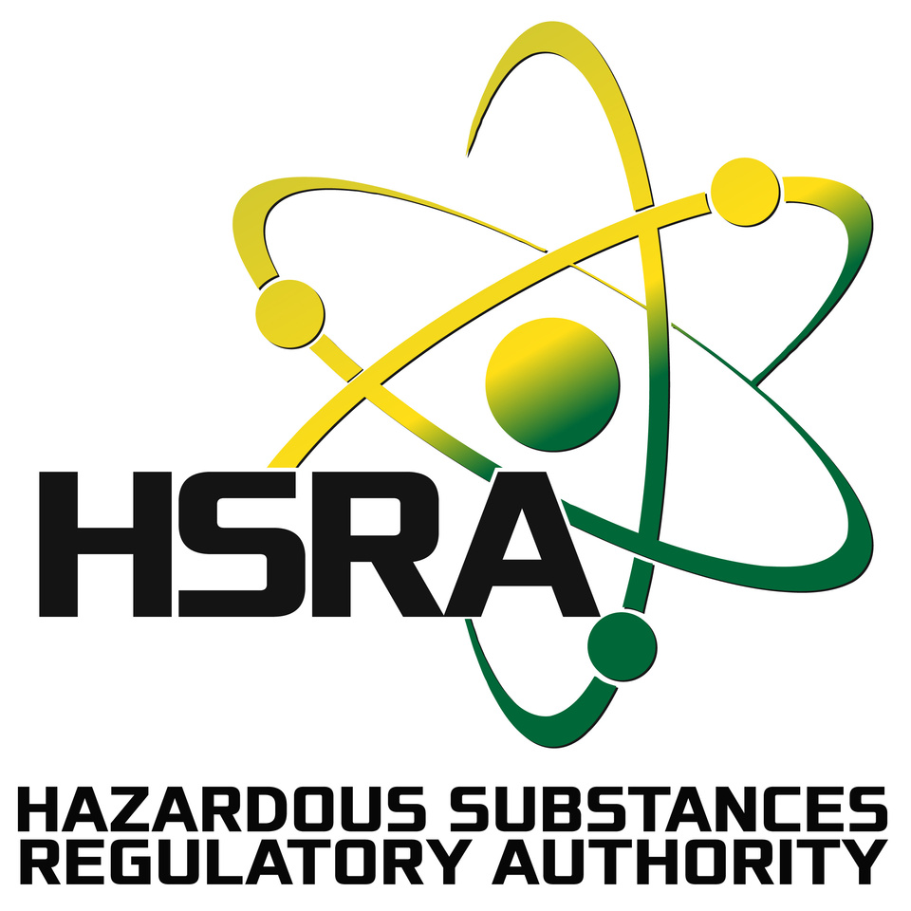
The HSRA is responsible for radiation protection, safety, and security.
  Regulatory oversight of facilities utilizing ionizing radiation across all sectors.
  High compliance is maintained among radioactive material users, research reactors, medical, industrial, and security facilities.
  The national compliance rate stands at 57%, driven by historically low but improving compliance within dental facilities through targeted regulatory engagement.
  Technical expertise and infrastructure mainly focused on non-nuclear applications.
For nuclear power readiness, HSRA , or a successor agency, would require expanded authority, specialized training, and operational independence.

Slide 10
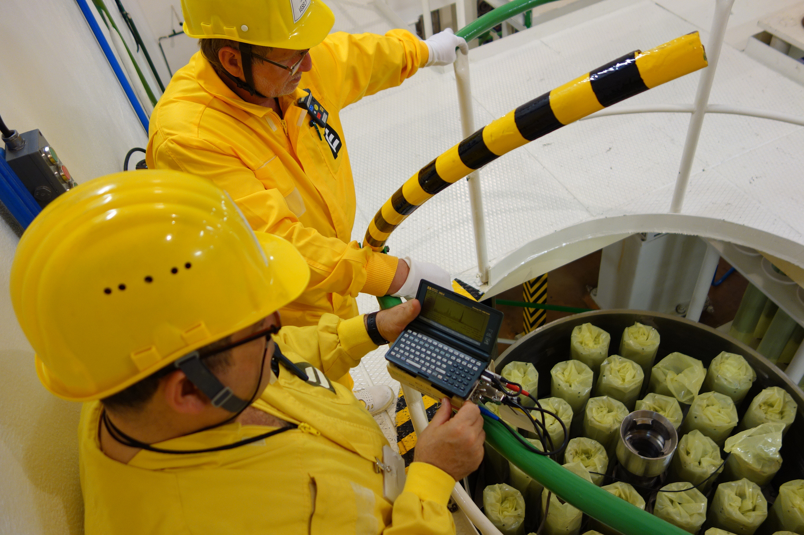
Jamaica’s Safeguards and Non-Proliferation Agreement
The Safeguards Agreement ensures nuclear materials and activities are used solely for peaceful purposes through international verification and oversight.
Jamaica is party to the IAEA Comprehensive Safeguards Agreement (1978) and the Additional Protocol (2003).
These instruments commit the country to:
  Peaceful use of nuclear technology.
  International verification of nuclear materials and activities.
  Transparent reporting and inspections by the IAEA.
Jamaica’s track record of compliance reinforces its credibility and positions it as a responsible partner in the global nuclear framework.
Notes:
Explain that safeguards ensure that nuclear material is not diverted for military use. Jamaica’s strong record here builds international trust—an essential foundation for nuclear expansion.

Slide 11
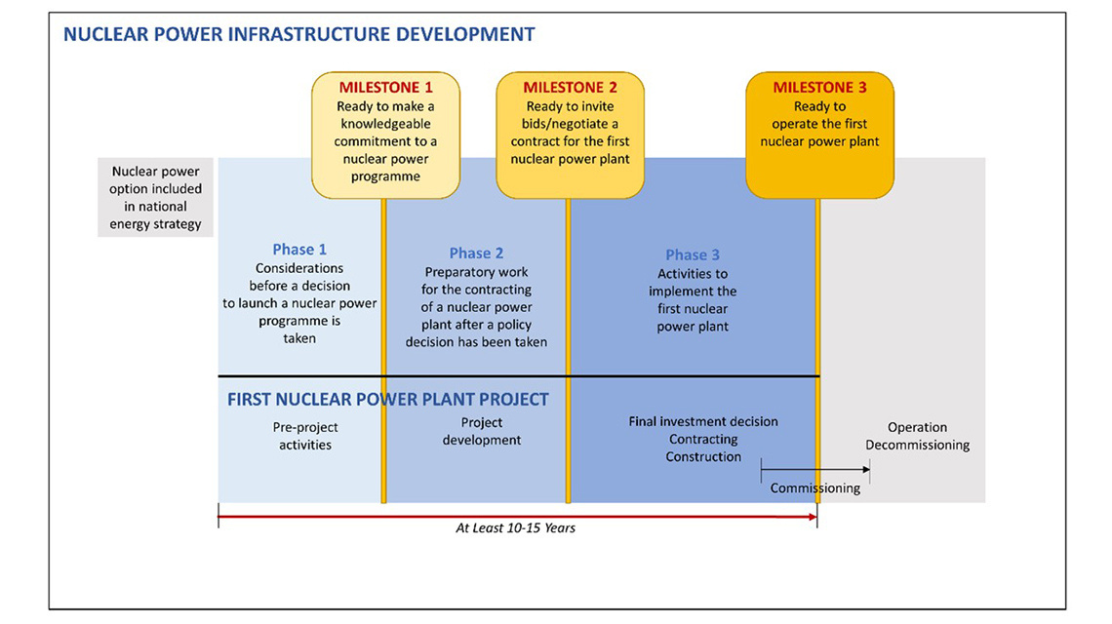
Jamaica adopted the IAEA Milestones Approach in 2023:.
19 infrastructure issues across 3 progressive phases:
  Consider:
    National position, legal framework, public engagement.
  Prepare:
    Regulatory framework, human capacity, financing, siting studies.
  Construct:
    Implementation and commissioning readiness.
Ensures systematic, transparent development aligned with international best practice.
The IAEA Milestones Approach
Notes:
Position the Milestones Approach as a map for safe, responsible progression — not a fast-track to construction.

Slide 12
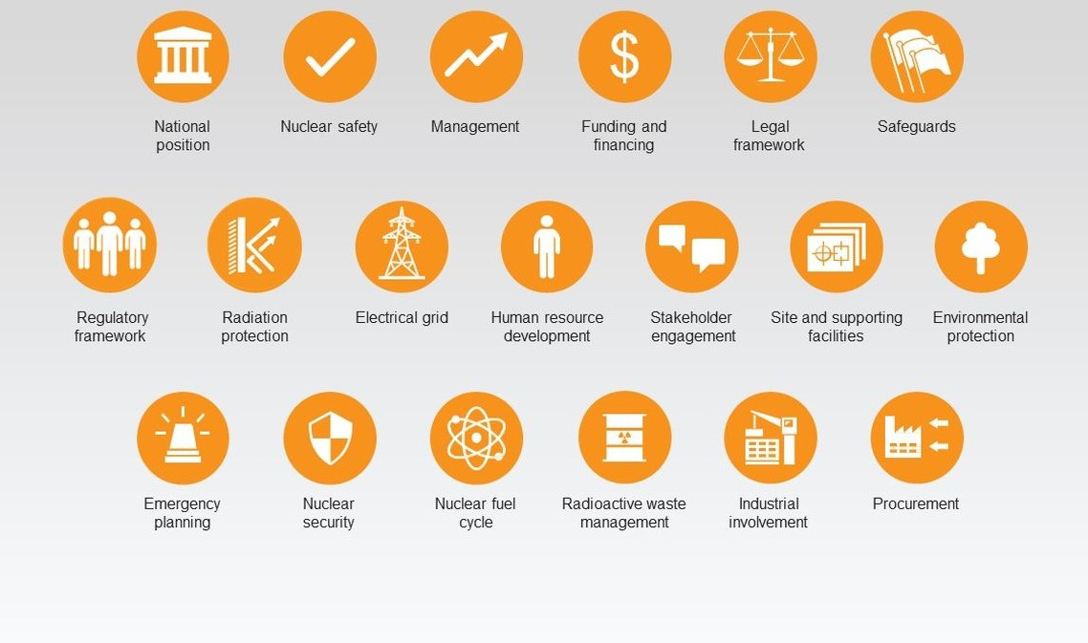
The IAEA Milestones Approach 19 infrastructure issues

Slide 13
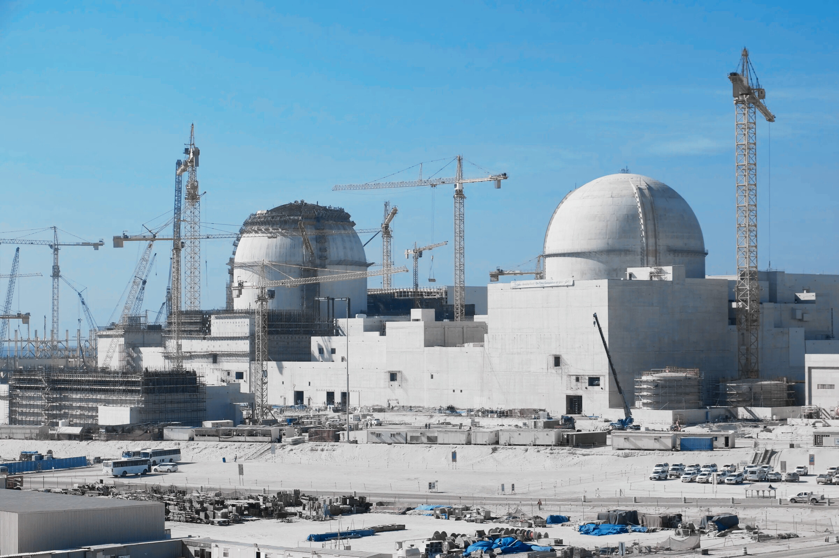
Jamaica’s 20 Year Roadmap
Approved by Cabinet in 2025-Roadmap translates policy interest into structured national action. It prioritizes:
    Comprehensive legislative reform -either amendment the NSRP Act, 2015 or enact a new Act
    Creation of an independent nuclear regulatory authority.
    Establishment of a Nuclear Energy Planning and Implementation Organization (NEIPO) - central coordination body for aligning ministries, academia, and international partners.
    Human resource and infrastructure development.
    International cooperation for knowledge and safety exchange.
Notes:
Explain that the NEPIO will serve as the central coordination body — aligning ministries, academia, and international partners.

Slide 14
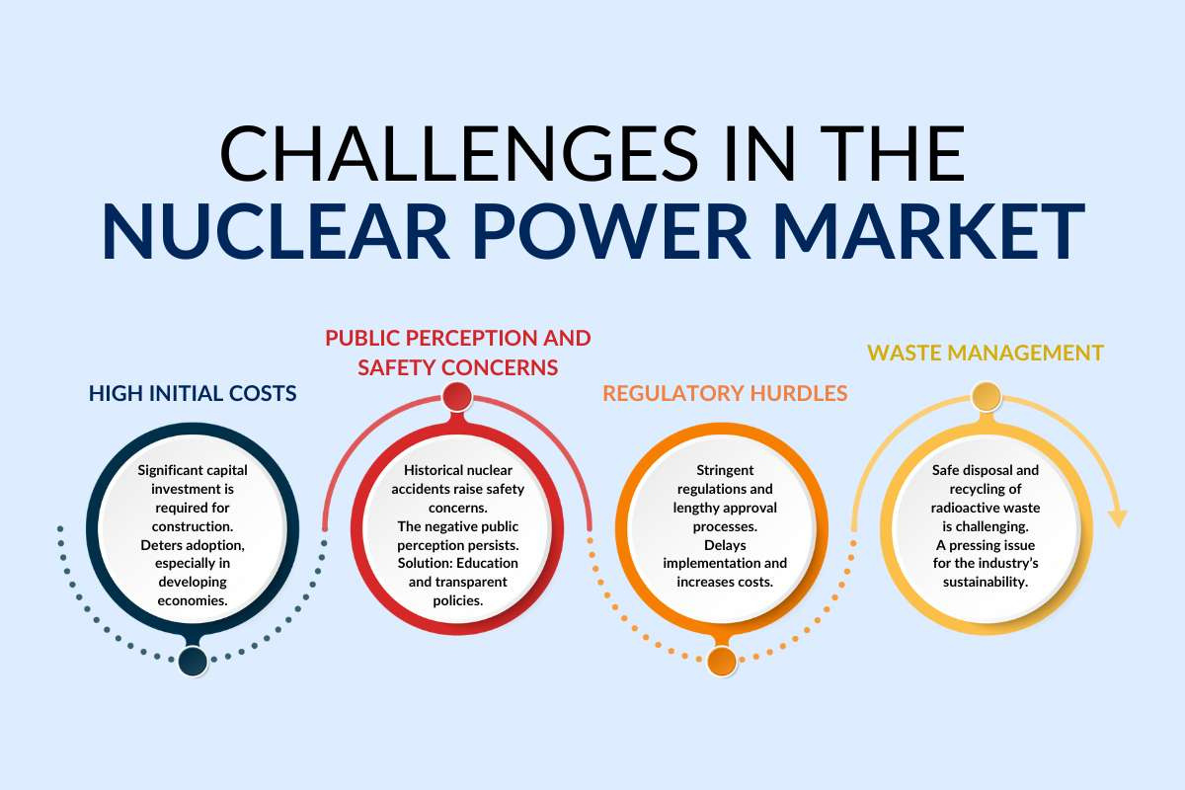
Transitioning to nuclear energy involves complex challenges:
  High upfront capital costs and financing uncertainties.
  Public skepticism about safety and waste management.
  Regulatory readiness and sustained political will.
  Long-term institutional capacity for waste disposal and decommissioning.
  Regional emergency preparedness and security measures.
Key Challenges and Risks
Notes:
Acknowledge that these challenges are manageable but require strategic planning, consistent policy, and public transparency.

Slide 15
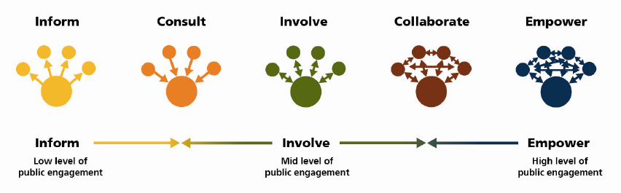
Public Perception & Engagement
Public perception is a decisive factor in nuclear success. Effective engagement should include:
    Clear communication on safety, cost, and environmental impact.
    Educational partnerships with schools and universities.
    Open town halls and digital platforms for public dialogue.
    Transparency in government decisions and risk management.
Public trust must be earned continuously, and transparency along with education are non-negotiable pillars.

Slide 16
01
Amending or replacing the NSRP Act, 2015
02
Strengthening or creating an independent nuclear regulator.
03
05
Formalizing NEPIO operations under the Roadmap
04
Executing feasibility and siting studies for SMRs
Expanding technical training programs
Path Forward for Jamaica
Moving from exploration to implementation requires a structured, phased approach — transitioning from policy intent to practical implementation, and enabling integration with renewable energy initiatives to achieve a balanced, resilient energy portfolio.
Notes:
Encourage regulators to view Jamaica’s pathway as a regional opportunity — not a national experiment.

Slide 17
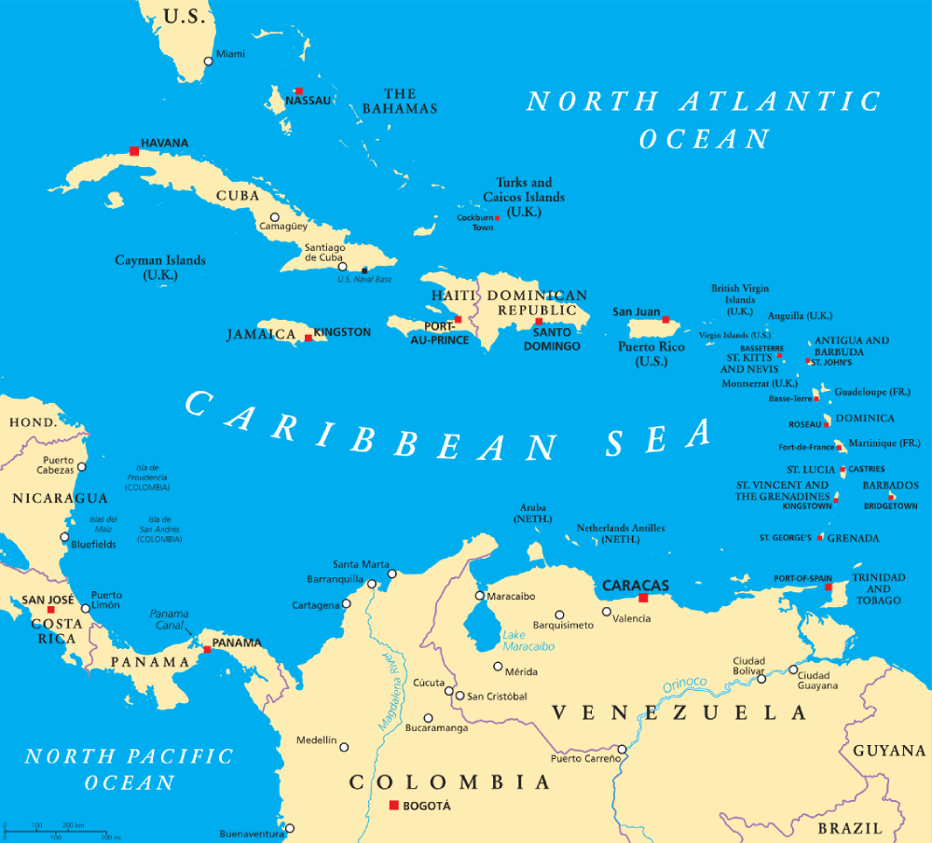
Regional Implications
Jamaica’s progress carries wider Caribbean significance.
Its experience will:
  Provide a blueprint for other CARICOM states.
  Facilitate regional collaboration in regulation, training, and emergency response.
  Promote a shared safety culture and collective technical advancement.
  Support regional climate commitments through diversified energy strategies.

Slide 18

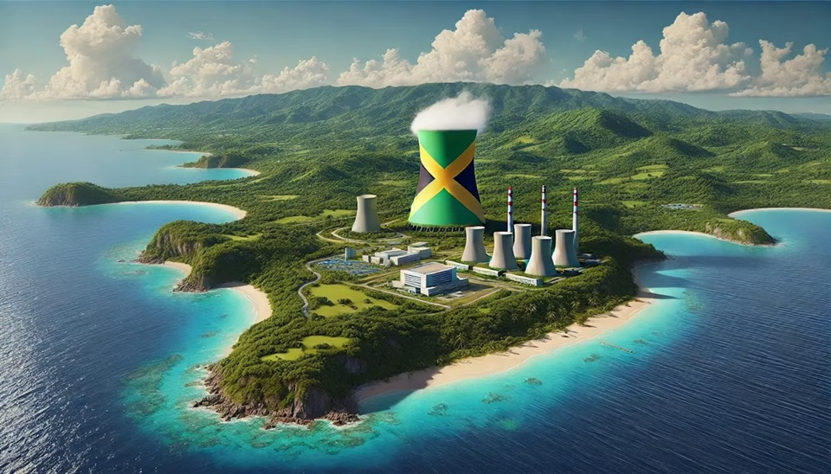
Conclusion
Jamaica’s exploration of SMRs represents a strategic opportunity for clean, secure, and resilient energy.
Success depends on:
  Legislative modernization.
  Regulatory capacity and independence.
  Human capital investment.
  Transparent public engagement.
  Strong international partnerships.
By pursuing this structured path, Jamaica could become the Caribbean’s pioneer in nuclear readiness—demonstrating safe, responsible innovation in energy transformation.

Slide 19
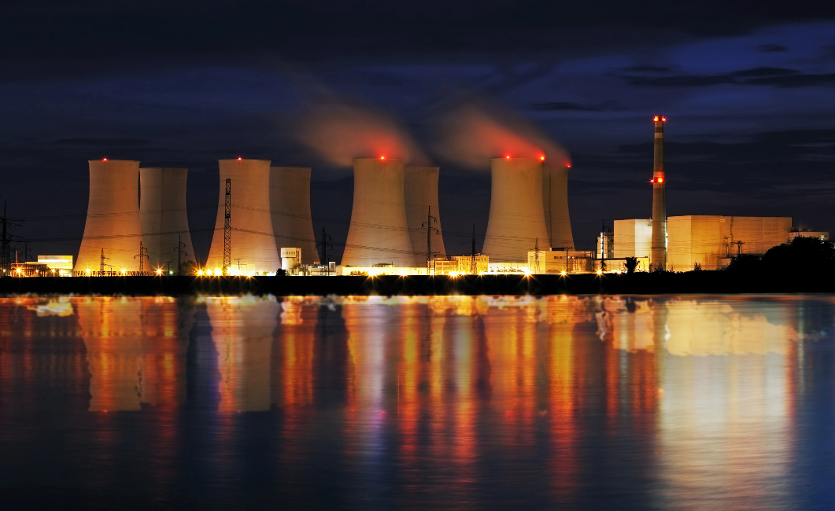


THANK YOU
1-876-618-5761
info@hsra.org.jm
www.hsra.gov.jm

