Slide 1

Navigating Caribbean Regulatory Challenges, Opportunities, Innovations, and Collaborations
Keynote Address – Caribbean Utility Regulators Conference
David Morton, Chair, ICER

Slide 2

Hurricane Melissa

Slide 3

New Technologies

Slide 4
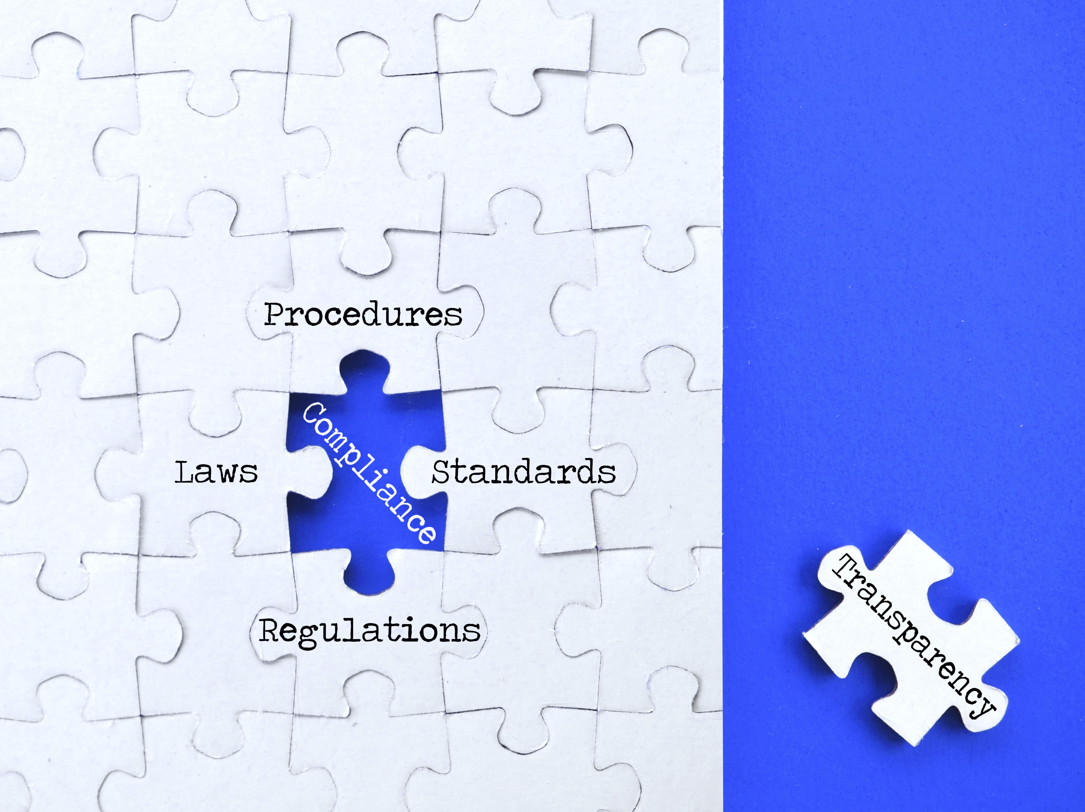
The Role of the Regulator

Slide 5
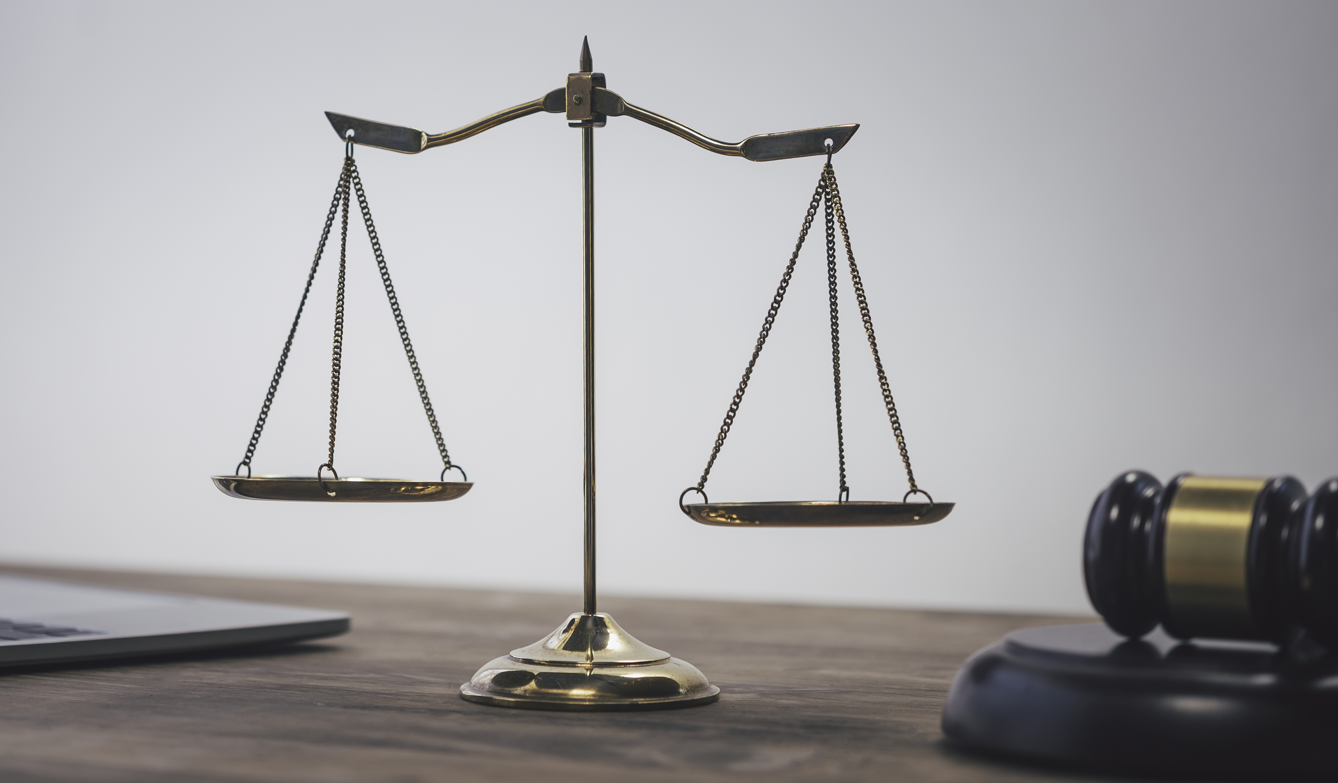
Regulatory Independence

Slide 6

Opportunities

Slide 7

Balancing Objectives

Slide 8

Leadership

Slide 9

Collaboration

Slide 10
Thank You

