Slide 1
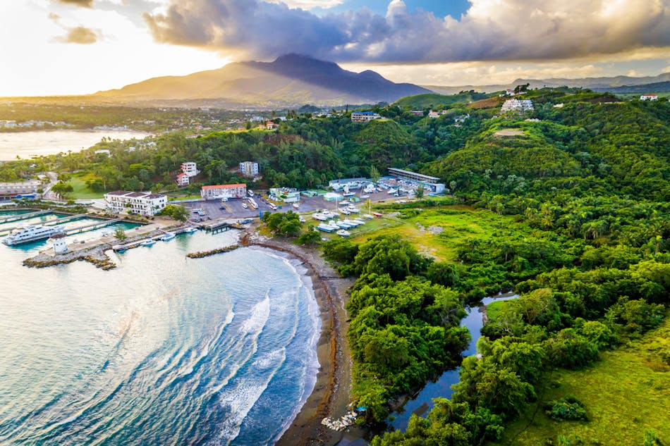
The Role of Microgrids in Enhancing Energy Access and Reliability:
.
Caribbean Perspective
Dr. Oswald Smiley, PE
OOCUR 2025 Annual Conference
April 27 –May 01,2026
Ocean Coral Spring & Ocean
Eden Resort Trelawney, Jamaica

Slide 2

Outline
The Caribbean Energy Landscape: Challenges and Vulnerabilities
What are Microgrids and Why They Matter in the Caribbean Context
Microgrids in Action: Regional Examples
Challenges to Address for implementation of Microgrids
Moving Forward: Steps to allow Microgrid Deployment in the Caribbean

Slide 3



Caribbean Energy Realities
Approximately, 190–220 million kWh/day consumed mostly from fossil fuels in the Caribbean
Rising emissions, declining sustainability
The Caribbean must pivot to systems that provide:
Energy Independence (Dependability), Accessibility, Availability, Speedy Recovery after Natural Disasters, (Reliability and Resiliency)
Notes:
Globally, over 320 billion kilowatt-hours of energy are consumed daily, largely from fossil
fuels.
Approximately, 190–220 million kWh/day consumed mostly from fossil fuels in the Caribbean
With growing environmental concerns, global warming, and declining sustainability of
these traditional energy sources, there is an urgent need to pivot towards greener alternatives.
This presentation talks about the Caribbean perspective on microgrid deployment, examining their
potential to enhance energy access, reliability, and sustainability Especially in times of Crisis.

Slide 4
The Caribbean Energy Landscape: Main Challenges and Vulnerabilities
High Costs: Over 90% of Caribbean energy is generated from imported petroleum products, which makes the system vulnerable to oil price shocks and leads to destabilization of national economies
Climate Vulnerability: Extreme weather events (hurricanes) frequently cause widespread power outages.
Aging Infrastructure: Outdated grids are susceptible to damage and frequent outages
Limited Access: Remote or underserved communities often lack reliable electricity.
Notes:
The Caribbean’s energy sector is expensive, fossil-fuel dependent, and highly climate-vulnerable, with aging infrastructure, fragmented regulation, and limited technical capacity.
High Costs: Dependence on imported fossil fuels leads to some of the world’s highest electricity cost.
Climate Vulnerability: The Caribbean is in the hurricane belt; storms like Maria (2017,Puerto Rico), Dorian (2019, The Bahamas), Beryl (2024) devastated entire power systems in the Caribbean.
Centralized grids can take weeks to months to restore after hurricanes.
Rising sea levels and saltwater intrusion also threaten coastal plants and substations.
Aging Infrastructure: Many generation and distribution assets are 30+ years old, leading to frequent outages and inefficiencies
Grid systems are often centralized and lack redundancy.
Maintenance backlogs and high replacement costs worsen vulnerabilities.
These vulnerabilities highlight the urgent need for resilient, decentralized solutions like microgrids.

Slide 5
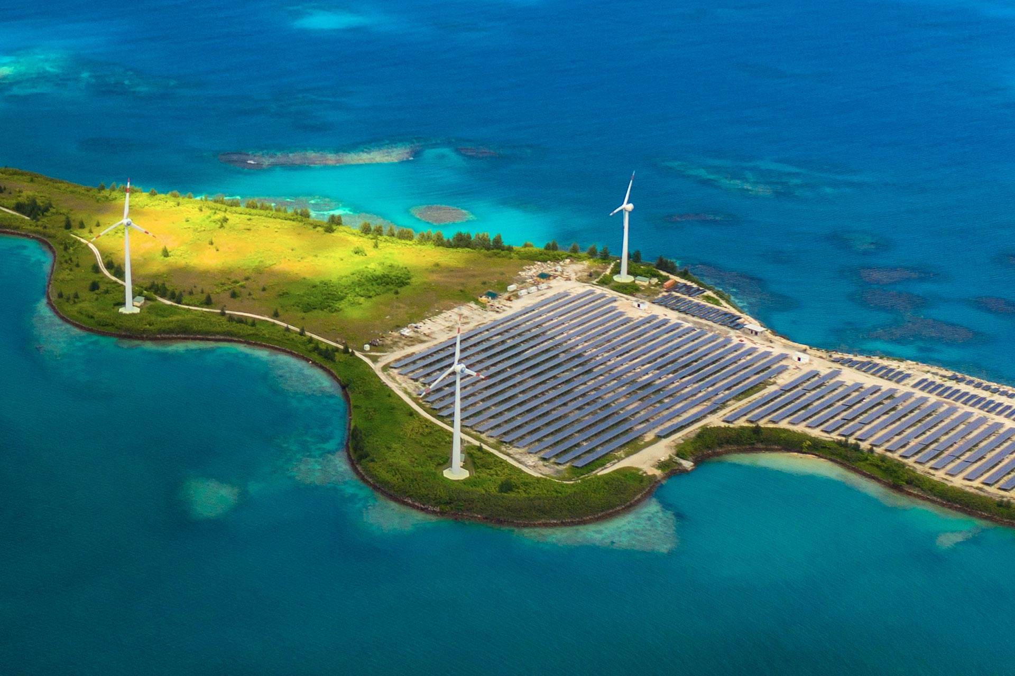
What is a Microgrid?
• A localized power system (e.g. solar, wind, battery storage)
• Operates connected or isolated from local grid
• Includes renewables, storage, controls, and smart distribution
Notes:
Definition: A localized group of energy resources (e.g., solar, wind, battery storage)
and interconnected loads that can operate independently or connected to the main
grid.
Flexibility: Can disconnect (island) from the main grid during outages and continue
supplying local loads.
Components: Include generation sources (often renewables), energy storage
(batteries), and intelligent controls.

Slide 6

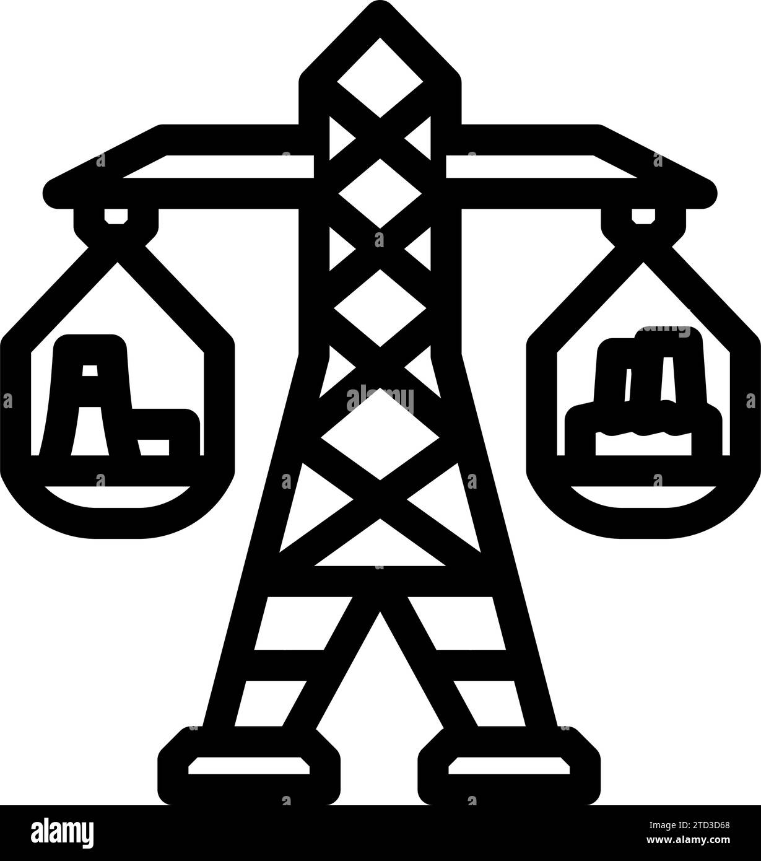
Why Microgrids?
Direct Benefits
🌪 Disaster Resilience: By forming localized, independent energy hubs, microgrids enable communities to separate from the main grid during crises, keeping critical services and households powered
Improved Access: Supports remote islands and underserved rural areas. This reduces reliance on long transmission lines and associated losses.
Grid Stability: Microgrids strengthen overall grid stability, lower peak demand pressures, and prolong the life of fuel-powered systems by enabling them to operate at higher, more efficient loads when required
⛽ Reduced Fuel Dependency: Microgrids can stabilize costs by relying less on imported fossil fuel.
Notes:
Microgrids are vital in the Caribbean to enhance energy resilience against hurricanes, reduce high fossil fuel dependency and costs, improve energy access and reliability, and support environmental sustainability by integrating renewables like solar power.
Disaster Resilience: One of the strongest arguments for microgrids in the Caribbean is disaster resilience. Centralized grids are highly vulnerable , in fact research shows over 80% of major global power outages are weather-related, and these outages have increased by 80% over the last decade (Microgrid Knowledge, 2023). After Hurricane Maria in 2017, Puerto Rico’s central grid collapsed for months, but solar & battery microgrids kept hospitals and community centers powered (DOE, 2019). For the Caribbean, where hurricanes are an annual reality, microgrids are not optional, they’re essential for survival and disaster preparedness
Reduce Fuel Dependency: In some islands, electricity prices exceed US $0.30 per kWh, among the highest globally, largely due to fuel dependency (CARICOM, 2020). Microgrids integrating renewables and storage cut that dependency significantly. Studies show they can reduce diesel consumption by up to 42% and annual energy usage by 56% in island systems (MDPI, 2022; OSTI, 2022). Beyond environmental benefits, this is an economic liberation strategy, stabilizing prices and reducing exposure to global oil volatility
Grid Stabilility: Microgrids strengthen national grids by lowering peak demand and optimizing efficiency. Instead of running fuel plants inefficiently during peaks, microgrids balance the load. For example, in Jamaica’s Munro Wind Farm microgrid, wind, solar & batteries provide 24.5 MW of hybrid power, ensuring stable supply during outages (JPS, 2023). This reduces stress on centralized assets, prolongs their lifespan, and lowers operational costs. For regulators, this means fewer outages and more reliable service for citizens
Improved Access: Finally, microgrids expand access. In Haiti, where rural electrification is often below 15%, community-owned microgrids launched in 2019 now power towns like Tiburon, providing affordable, reliable electricity to over 2,000 residents (REN21, 2023). Similarly, in Tanzania, microgrids achieved 98% reliability, compared to just 47% for the national grid (New America, 2021). For remote Caribbean islands, microgrids mean more than electricity — they mean access to education, healthcare, and business opportunities

Slide 7
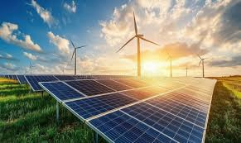
Why Microgrids?
Developmental Benefits
💰 Economic Impact: While upfront costs are high, operational costs of renewables & storage are lower than diesel generation. Studies show microgrids can cut energy costs by 20–30% over their lifecycle compared to fossil-fuel-only systems. (Maktinta, 2025; National Renewable Energy Laboratory [NREL], 2025; New Sun Road, 2023; ScienceDirect, 2025)
👥 Job Creation: Microgrids will require skilled laborers for operation and maintenance
👥 Collaboration: Caribbean Development Bank & CARICOM initiatives can lower barriers regionally.
Sustainable Development Goals- Caribbean nations have pledged under the Paris Agreement and Caribbean Sustainable Energy Roadmap (C-SERMS) to achieve 50% renewable generation by 2030. Microgrids directly support SDG 7 (Affordable & Clean Energy) and SDG 13 (Climate Action) by reducing greenhouse gas emissions. (Caribbean Centre for Renewable Energy and Energy Efficiency [CCREEE], 2015)
🌱
Notes:
Economic Impact
“Yes, upfront costs are higher—but over time, microgrids reduce energy costs by 20–30%.”
“For fuel-dependent economies, that’s a major stabilizer against price volatility.”
Job Creation
“They also create skilled jobs—installation, operations, and maintenance.”
“This builds local capacity and prepares our workforce for the energy transition.”
Collaboration
“Microgrids unlock regional collaboration.”
“With support from partners like CDB and CARICOM, we can scale faster and reduce barriers.”
Sustainability
“They directly support our 2030 renewable targets.”
“And align with SDG 7 and SDG 13—clean energy and climate action.”
Close
“So microgrids aren’t just an energy solution—they’re an economic, workforce, and resilience strategy.”

Slide 8
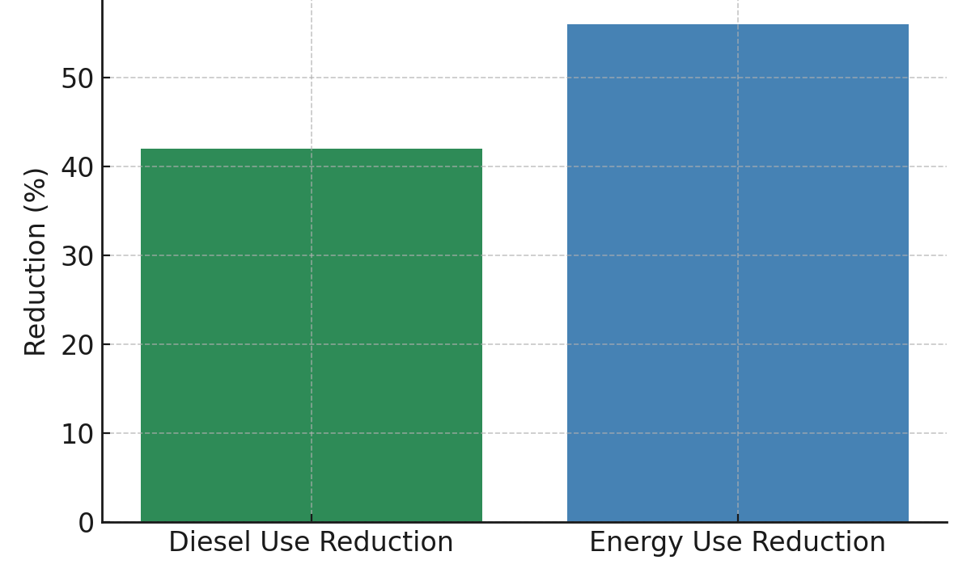
Caribbean Resiliency Impact: Energy savings (Puerto Rico)
Studies show that microgrids can cut diesel generator consumption by up to 42%. In fact, renewables and storage in island microgrids can replace as much as 56% of the electricity that would otherwise have been generated with diesel, meaning more clean power, lower costs, and less dependence on fuel imports (MDPI, 2022; OSTI, 2022).
Notes:
This example from Puerto Rico demonstrates the real, measurable impact of resilience-focused energy strategies.
Microgrids have delivered up to a 42% reduction in diesel consumption, significantly lowering fuel costs and exposure to supply disruptions. At the same time, they achieve up to a 56% reduction in overall energy use by integrating renewables and storage.
The key takeaway is that resilience and efficiency go hand in hand. By reducing dependence on diesel, these systems not only cut operational costs but also improve sustainability and energy security.
For island systems like ours in the Caribbean, this is particularly relevant—less reliance on imported fuel, greater system stability, and faster recovery after disruptions.
This is not theoretical—these are proven outcomes that reinforce why distributed energy resources and microgrids must be part of our forward strategy.
Study done at Vieques and Culebra, Puerto Rico after Hurricne Maria and Irma

Slide 9
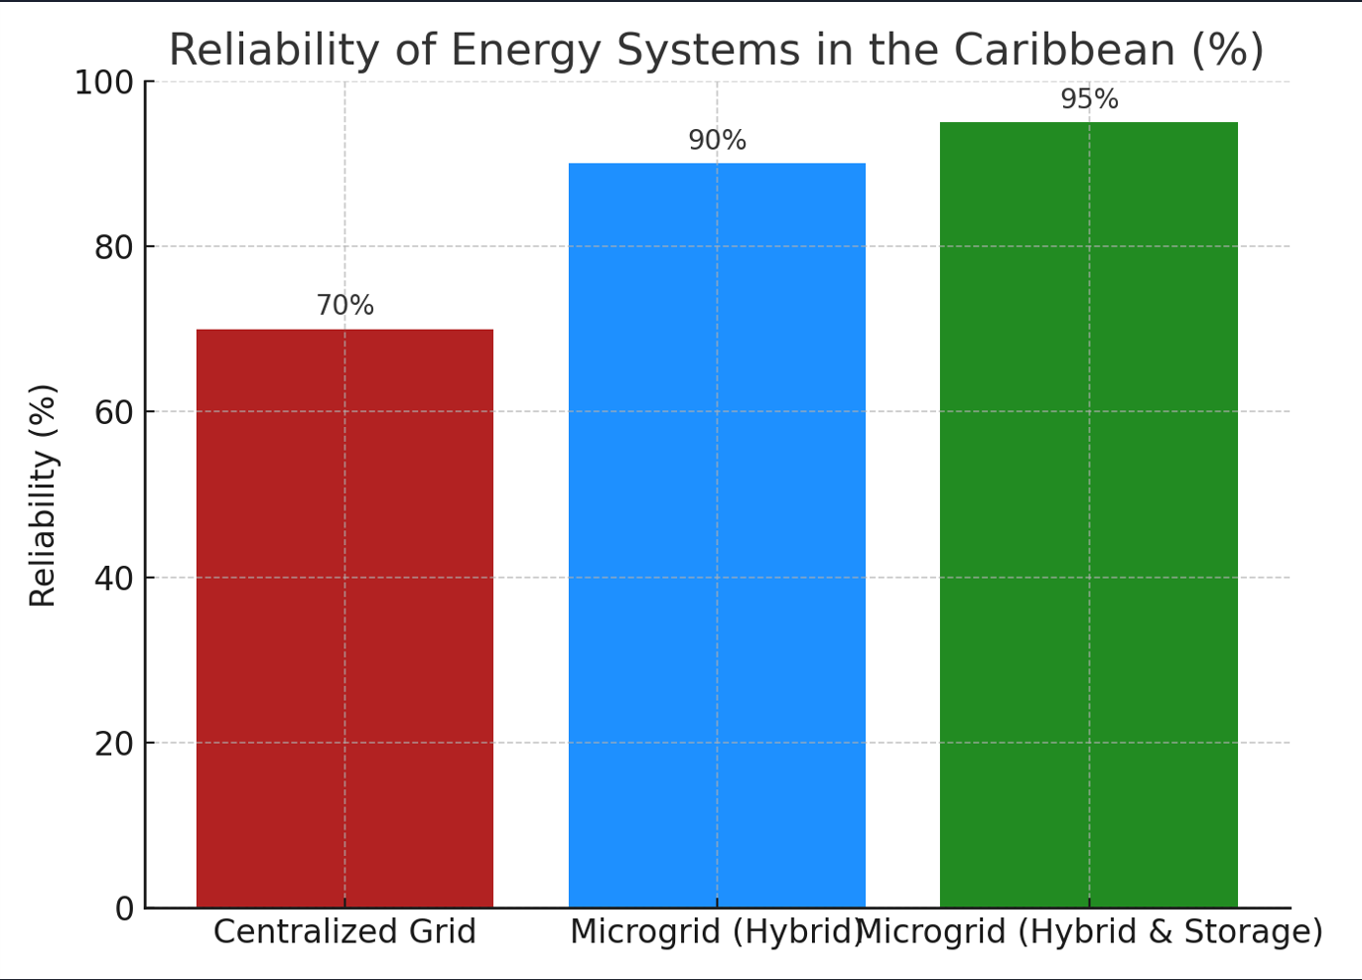
Microgrid Reliability/Resiliency Comparison
The microgrid pilot projects shows that a mix of solar and storage provided 95% resiliency in the Caribbean
Notes:
This comparison highlights a critical shift in how we think about energy reliability in the Caribbean.
Traditional centralized grids deliver around 70% reliability, which leaves significant exposure during extreme events.
When we introduce hybrid microgrids, reliability increases to approximately 90%, already a major improvement. But the real transformation occurs when we integrate solar with battery storage—driving reliability up to 95%.
This is a step change, not a marginal gain. It means fewer outages, faster recovery, and greater continuity for critical services and economic activity.
The implication is clear: resilience is no longer dependent solely on grid hardening—it must include distributed energy and storage solutions as core infrastructure.
For Caribbean utilities, this provides a practical and proven pathway to building a more resilient, future-ready energy system.
DOE (2019): Microgrids in Puerto Rico kept hospitals running post-Hurricane Maria.
REN21 (2023): Solar microgrids in Haiti ensured stable electricity in underserved towns.
New America (2021): Microgrids achieved 98% reliability vs 47% for national grid (Tanzania).

Slide 10
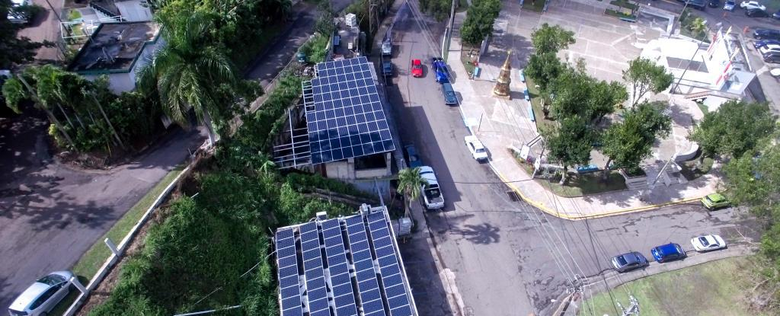
Real-World Examples in the Region: Adjuntas, Puerto Rico
☀ ️ Solar PV, battery storage & diesel backup
🏥 Restored power to hospitals, schools, water plants after Hurricane Maria (2017)
Faster recovery compared to centralized grid
👥 Community-owned systems improved local resilience
📍 Influenced Caribbean disaster preparedness policies
Notes:
Following Hurricane Maria in 2017, Puerto Rico deployed solar microgrids with battery storage and diesel backup to restore electricity to hospitals, water treatment plants, and other critical facilities.
The microgrids enabled faster recovery compared to the centralized grid, which remained down for months.
Community-owned systems like the Adjuntas solar microgrid played a vital role in maintaining essential services and supporting local businesses.
These projects demonstrated the value of decentralized, renewable-based power systems in disaster contexts, and shaped regional strategies for resilience across the Caribbean.
Other Microgrids in action in the region include:
Mayreau, Grenadines:
Ragged Island, Bahamas- providing over 90% renewable energy to a small fishing community

Slide 11
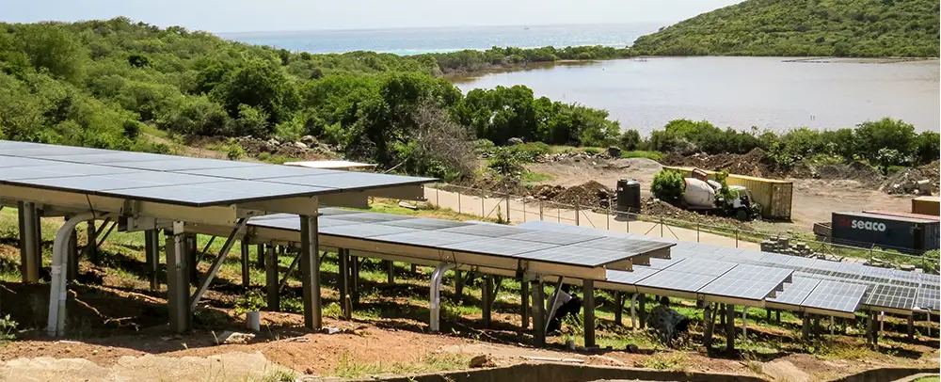
Real-World Examples in the Region: Mayreau, Grenadines
☀ ️ 100 kW solar PV & 216 kWh battery storage hybrid microgrid
⚡ Commissioned 2020-21 by VINLEC, RMI-CWR & ComAp
🔌 Built to integrate with diesel gensets, allowing 6-10 hours/day of diesel-off operation
🌱 Cuts fuel consumption, reduces emissions & noise, raises renewable share (~28%)
📍 Resilient model project for small island communities in the Grenadines
Notes:
Mayreau, Grenadines:
313 solar PV panels with a total capacity of 100kW, battery storage & diesel backup
System allowed for several hours of diesel free operation , significantly reducing the diesel fuel and provides a more environmentally friendly power generation model
Designed to withstand a category 5 hurricane winds, ensuring operation during severe weather events.

Slide 12
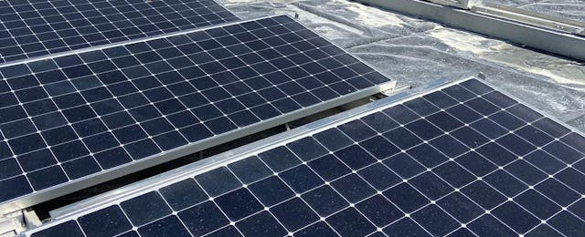
Real-World Examples in the Region: Ragged Island, Bahamas
☀ 390 kW solar PV & 1,260 kWh battery storage hybrid microgrid
⚡ Developed post-Hurricane Irma by Bahamas Power & Light with RMI & partners
🔌 Integrates with diesel gensets for backup; delivers up to 95% renewable penetration
🌱 Cuts fossil fuel imports, lowers costs, designed for hurricane resilience
📍 Flagship renewable microgrid for small island communities in The Bahamas
Notes:
Ragged Island, Bahamas
A 390kW solar microgrid system with a 1,260kWh battery storage system
The system now allows Ragged Island to displace as much as 90–95% of its diesel use, drastically reducing costs and emissions.
This project is especially important because it is designed with hurricane resilience in mind. The solar arrays are rated for extreme wind loads, making it a model for other hurricane-prone Caribbean islands

Slide 13
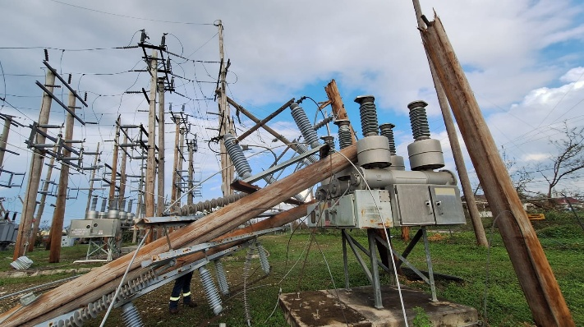
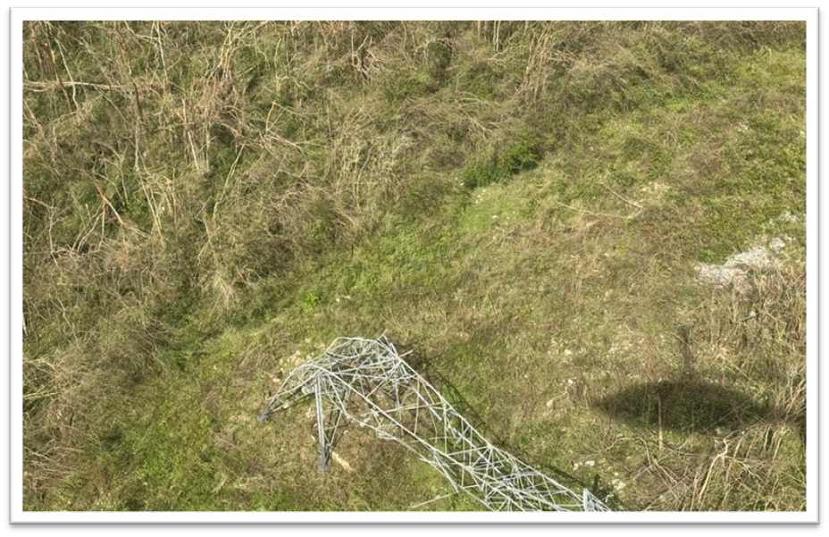
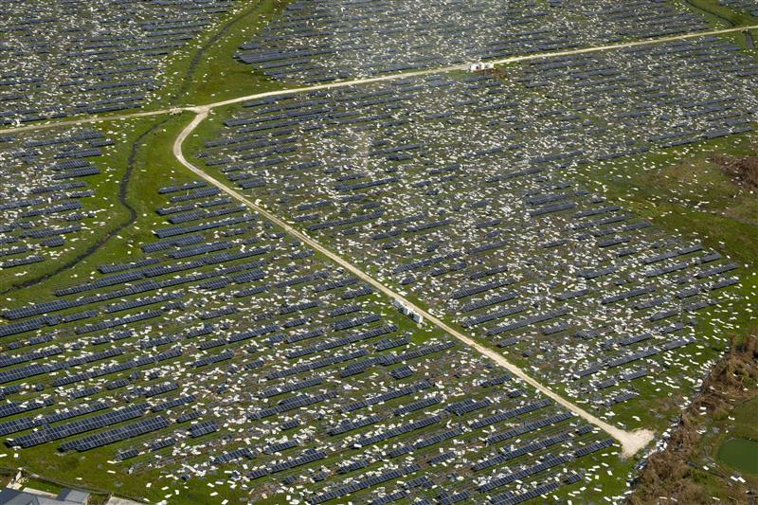
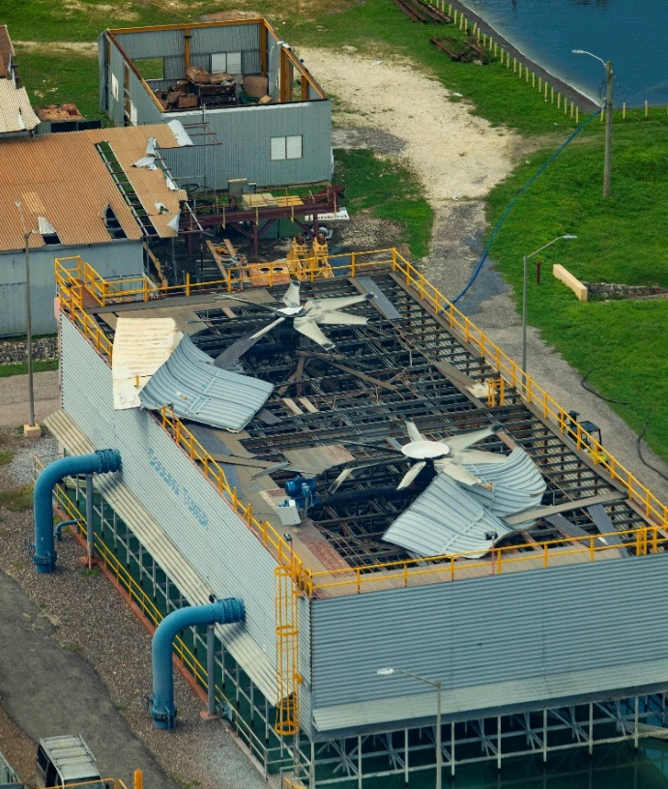
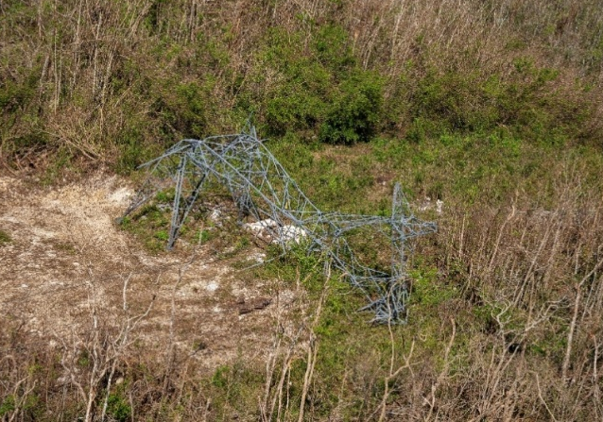
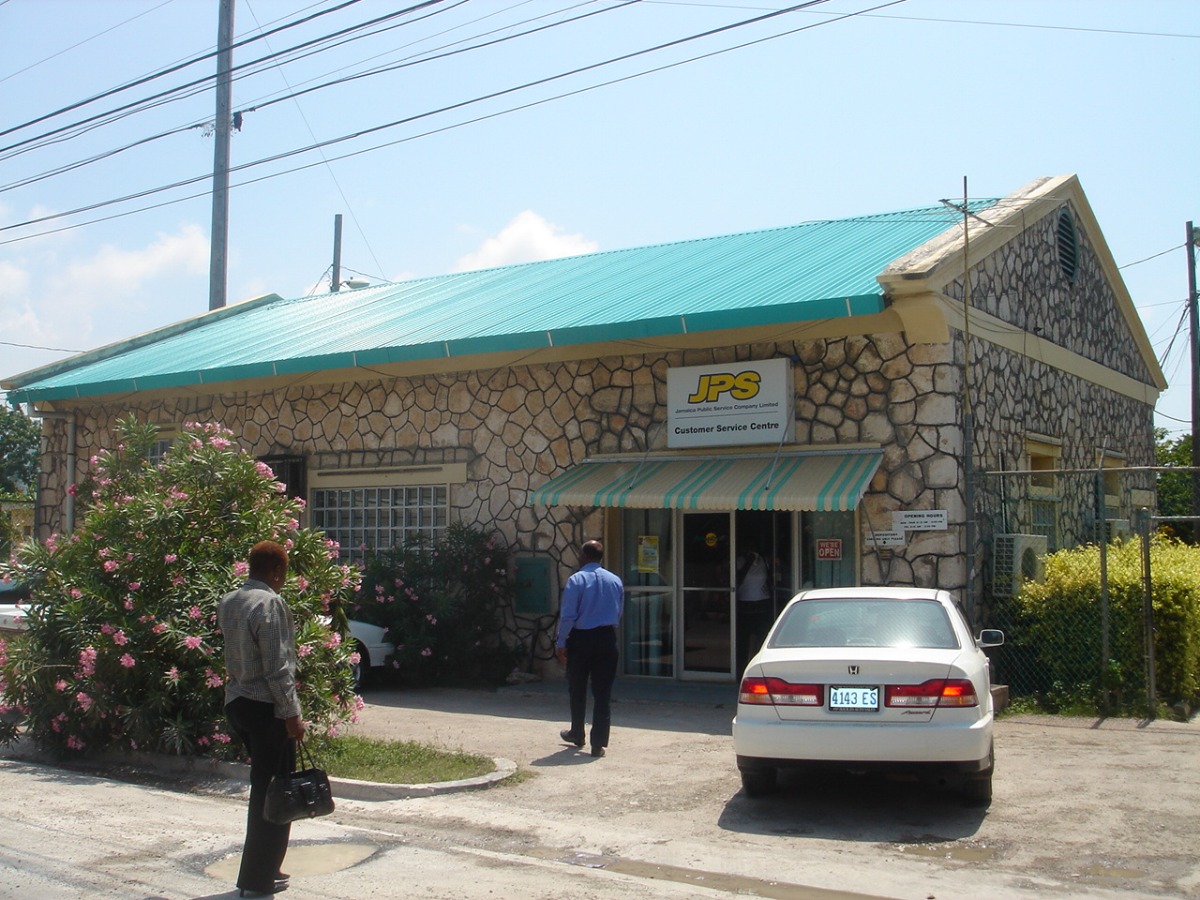
HURRICANE MELISSA'S IMPACT
Extensive Damage to Substations
Transmission and Distribution Network Impact:
Approximately 85,000 occurrences of hurricane damage recorded.
  Approximately 40,000 poles were damaged.
  Approximately 1,400 miles of power lines were damaged.
Transmission Towers After Hurricane Melissa
Bogue Power Plant Infrastructure Damage
Paradise Solar Park (Westmoreland)

Slide 14
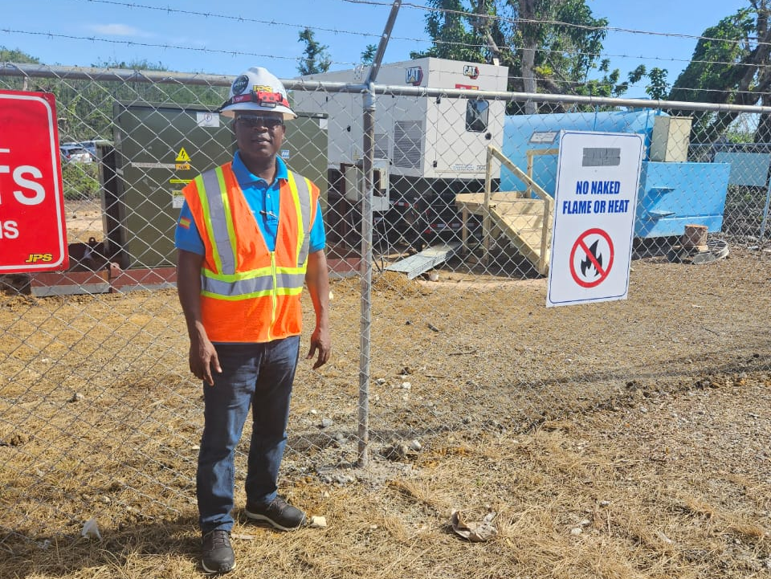
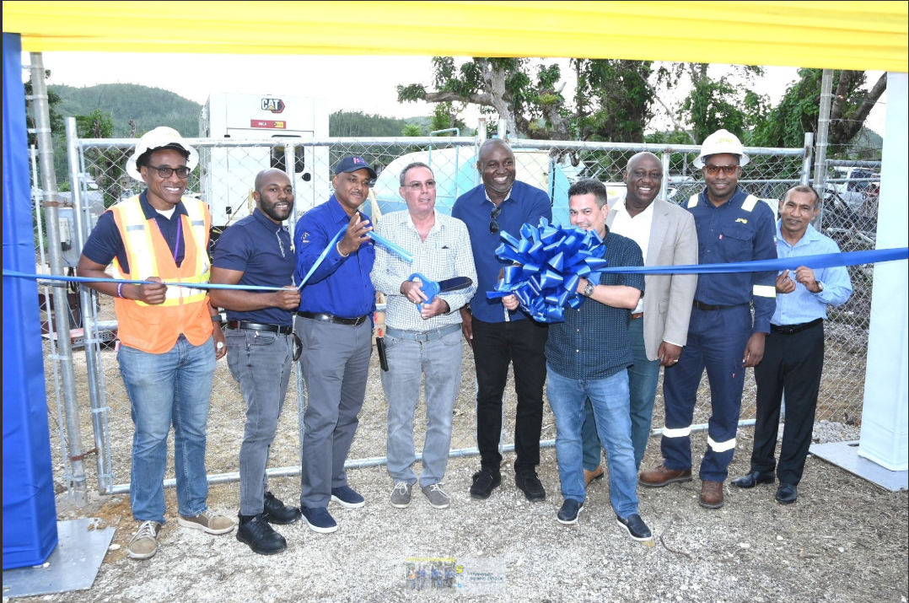
EMPG Solutions Employed in Hurricane Melissa
500kw Emergency mobile power generation unit in Darliston, Westmoreland Jan 25, 2026
Emergency mobile power generation unit to supply over 850 customers in Bethel Town, Westmoreland commissioned Feb 20, 2026
Notes:
This slide highlights practical EMPG solutions deployed during Hurricane Melissa to restore and stabilize power in affected communities.
On the left, we see a 500kW emergency mobile generation unit deployed in Darliston. This provided immediate, localized power support—critical for maintaining essential services while permanent repairs were underway.
On the right is the commissioning of another mobile generation unit in Bethel Town, restoring supply to over 850 customers. This demonstrates speed of execution—from disruption to restoration in a controlled, strategic manner.
The key point here is agility. These mobile and distributed solutions allow us to bypass damaged infrastructure, reduce downtime, and bring power directly to communities when they need it most.
It reinforces a broader lesson: resilience is not only about hardening the grid—it’s about having deployable, flexible energy solutions that can respond in real time to disruptions.

Slide 15
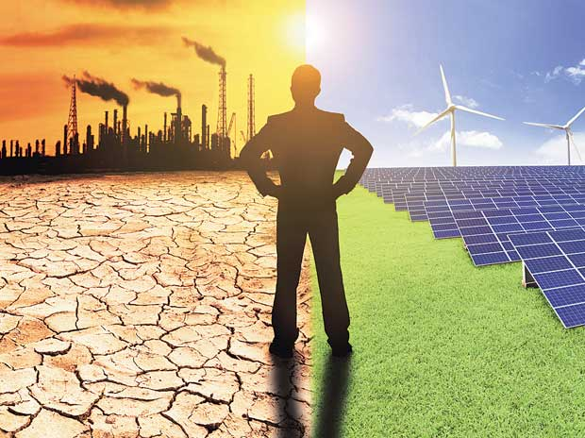
Challenges for implementation of Microgrids
Financial and Investment Barriers: Microgrids seen as high risk. Also lack of tailored financial instruments
Technical Capacity and Skill Gaps
Fragmented Policies and Regulations
Natural Disaster Vulnerability
Social Acceptance and Awareness
Notes:
While the benefits of microgrids are clear, implementation across the Caribbean is not without challenges.
First, financial and investment barriers—microgrids are often perceived as high-risk, and there is a lack of tailored financing mechanisms to support deployment at scale.
Second, technical capacity gaps—there is still a shortage of specialized skills required to design, integrate, and maintain these systems effectively.
Third, fragmented policies and regulatory frameworks—inconsistent standards and approval processes slow down adoption and create uncertainty for investors.
We also face natural disaster vulnerability, which, while driving the need for microgrids, can simultaneously disrupt deployment and infrastructure.
Finally, social acceptance and awareness—stakeholders must understand and trust these solutions for widespread adoption to occur.
The key message is that advancing microgrids is not just a technical issue—it requires coordinated progress across finance, policy, capacity, and public engagement.

Slide 16

Catalyzing Microgrid Deployment in the Caribbean
Policy and Regulatory Frameworks: Standardized technical requirements & stable incentives like tax breaks, net metering or feed-in tariffs help attract investors and reduce uncertainty for developers
Financial Mechanisms: Public- Private Partnerships (PPPs), climate grants, blended finance help to de-risk projects (e.g. CREDP)
Capacity Building: Investing in local training for engineers, technicians and regulators ensure microgirds and sustainable local systems
Regional Collaboration: CARICOM Energy Policy and international partnerships needed. Regional procurement and standards to be implemented (e.g. CDB,RMI, CREDP, Green Climate Fund)
Notes:
To scale microgrids, the region needs clear, consistent policies, financial mechanisms and opportunities to opportunity building and regional collaboration
Microgrids can be capital-intensive upfront.
Financial Mechanisms: e.g Caribbean Regional Energy Development Programme (CREDP) Funded Projects in Dominica, St. Lucia, Grenada
Regional Collab: CDB, RMI, and the Green Climate Fund provide shared knowledge, harmonized standards, and regional leverage for financing. Collaboration makes deployment faster and more cost-effective. (e.
If the Caribbean aligns policy, financing, skills, and collaboration, microgrids can become the backbone of a cleaner, more resilient, and affordable energy future.

Slide 17

Conclusion
By integrating renewable energy, energy storage, and digital technologies, microgrid systems can:
  improve resilience to natural disasters,
  Provide accessibility to remote areas,
  reduce dependence on imported fossil fuels,
  support economic and social development.
Time for action is now to:
  Build Policy frameworks
  Create financial blends that works
  Train our people
  Collaborate on regional projects
Microgrids are now more affordable and support sustainable development. The Caribbean cannot afford to wait
Notes:
Microgrids present a strategic and practical solution for enhancing energy access, reliability, and sustainability in the Caribbean

Slide 18
References
Microgrid Knowledge (2023). Island Microgrids & Hurricane Resilience Report
.U.S. Department of Energy (DOE) (2019). Puerto Rico Case Study: Microgrids in Disaster Recovery
.MDPI (2022). Design and Performance of Island Microgrids
.OSTI (2022). Battery Storage and PV for Island Resilience
.Jamaica Public Service Company (JPS) (2023). Munro Wind Farm Microgrid Pilot Report
.CARICOM Energy Unit (2020). Caribbean Renewable Energy Development Programme
.REN21 (2023). Global Status Report – Haiti Snapshot
.New America (2021). Microgrids and Universal Access.
Caribbean Centre for Renewable Energy and Energy Efficiency. (2015). Caribbean Sustainable Energy Roadmap and Strategy (C-SERMS) baseline assessment report. CCREEE. https://cekh.ccreee.org/wp-content/uploads/2021/04/C-SERMS_Baseline_10.29.2015.pdf

Slide 19

Thank You!
Dr. Oswald Smiley, PE
Author of Removing the Barriers for Engineers Entering Business
osmiley@jpsco.com
876-878-3304
Let’s build a resilient energy future together.

