Slide 1

Powering Resilience AND PRODUCTIVITY:
Lessons for Business and Utility Recovery From Recent Disasters
Author: Dr. Sarah Buckland-Reynolds, Senior Research Analyst (former)
Coauthor, presenter: Steven Alexander Smith, Research Officer
Jamaica Productivity Centre
OOCUR Conference, April 2026

Slide 2






The JPC promotes and facilitates productivity improvement in Jamaica and the region
  Technical services
Productivity assessments
Workshops & training
Consultations
  Ask about toolkits at our booth!
Notes:
Drop logo, vision, mission; Consider prioritising core service offering and breadth of expertise here rather than Tripartite character
Talking point (don't prioritise but keep in mind) – recent interventions (e.g. TASU work w/ BSJ, energy cap; RMU research into productivity measures)
FIND THAT SLIDE WITH QUALITY CIRCLE + BULLET POINTS W/ TECHNICAL SERVICE OFFERING
If adding toolkit here, loop back to core services and say something like, "for more details, check the booth"
Our interest is in entities under OUR to be more efficient
Stress that (unlike JA Recovery & Collections + Isratech)

Slide 3

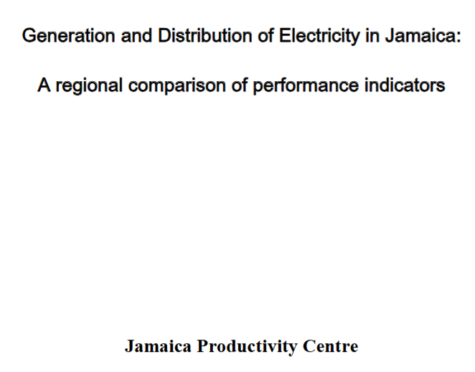


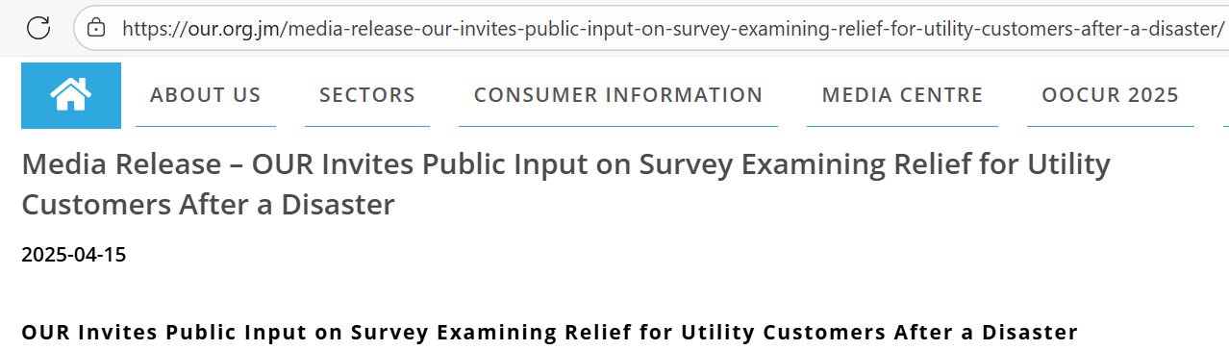

The JPC and OUR: An Intersecting Mandate
(2010)
(2024)
(2025)
(2025)
Notes:
Swap out SBR's benchmarking presentation with Alrick's 2010 paper (to show that
Ensure audience knows that JPC and OUR both have intervened

Slide 4
Relevance to national development
Jamaica needs resilient and productive utilities
Jamaica a top 3 exposed country to natural hazards (Global Facility for Disaster Reduction and Recovery [GFDRR], 2010)
Utilities are the backbone for emergency response, so their rapid recovery and continuity are essential
Resilient utilities can reduce secondary disasters (such as supply chain disruptions, disease outbreaks)
They not only allow for better adaptation to crises but are also central to enabling the future of work that will be more remote, telecoms-dependent

Slide 5
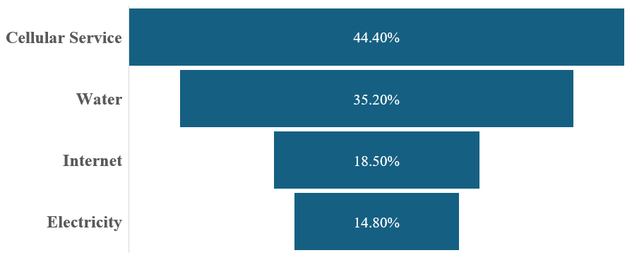
Lesson 1: What are the most resilient utilities?
Resilience Hierarchy of Jamaica’s Utility Services from Beryl Case Study
Proportion of respondents with no disruption
Increased resilience

Slide 6
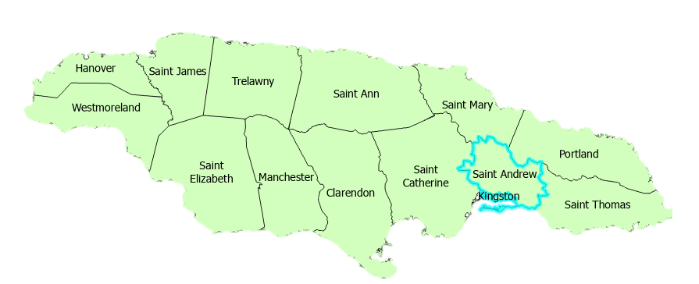
Lesson 2: Where needs most focus?
Non-KSA
KSA
38.1%: Experienced 5 or more days of internet disruptions
27.3%: No internet disruptions.
33%: Electricity disruptions >5 days.
24.2%: No electricity disruptions.
61.9%: Experienced 2 or more days of water disruptions
51.5%: No water disruptions.
52.4%: Experienced 2 or more days of cellular disruptions
60.5%: No cellphone disruptions.
Internet was the utility that had the highest relative proportion of respondents who indicated not having received restoration for 5 days or over of all utilities.
Notes:
This slide attempts to quantify disruption

Slide 7
Lesson 3: How long before productivity declines significantly?
The number of work hours lost drastically increased among respondents experiencing utility disruptions beyond:
.
>4 days disruption significantly increased work hour losses
Water
Electricity
Internet
>2 days disruption significantly increased work hour losses
Cellphone service
Key Takeaway: Utility operators can be supporters of productivity resilience by setting a standard restoration time below the thresholds of restoration within 2 days or less for cellphone service and 4 days for water, electricity, and internet.
.
Notes:
Be careful about characterising utilities as being "least" or "most" resilient
This impact study identified a critical threshold limit for utility disruption required for maintaining productive outcomes, beyond which a component of labour productivity rapidly declined. Utility losses have been documented to impact workers’ ability to prepare adequately for work, hindering the performance of basic hygienic and preparation duties. In this case study, internet outage was strongly and significantly correlated with electricity outage (R=0.841, p=0.000). Internet and electricity disruption may impede basic use of electrical equipment such as irons, electric stoves and also impede work-related communication via internet.

Slide 8
Through our benchmarking, we found...
Global inflation pushed electricity prices upward during onset of COVID-19
Small businesses had slower rebound
OFI: Improve efficiency by undoing increasing trend of total/unaccounted energy losses
Notes:
Unclear what purpose of benchmarking analysis was
Bring home concept of productivity in energy (and how it impacts provision/relationship to customers)
Find a way to show what productivity/resilience are and how they're important/related without spending time to define each dictionary-style
What about geopolitical environment? (USA/ISR-IRN, etc.) Other shocks (C19, floods, landslides, etc.)
Find a way to highlight impact on MSMEs (which make up majority of enterprises in JAM, CARICOM)

Slide 9
Situation since the passage of hurricane melissa
J$ 78.8 B
Infrastructure damage
J$ 37 B
Infrastructure LOSSES
(PIOJ DaLA team)
2 to 4 Days post-impact...
58%
Power outages
(78% peak)
9 parishes
with turbid water;
Scarcity in WML/ST. E
(OCHA Melissa sitrep #2)
~30%
Telecom
outages
Emergency telecoms intermittent during impact, immediate relief period
(ODPEM NEOC Situation reports #4, #5)
Notes:
Ensure attribution is clear
What about geopolitical environment? (USA/ISR-IRN+AOR, etc.) Other shocks (C19, floods, landslides, etc.)

Slide 10
P.R.E.P.: Preparedness, Resilience, equitabilty and Productivity
Preparation:
  Modernise infrastructure - Reduce infrastructure-based disruptions to less than 20% (JPC, 2010).
  Channel resources on the improving electricity and internet
Resilience: Aim for maximum restoration times post-disaster (within 2 days cellphone service; 4 days for water, electricity, and internet)
Equitability: Decentralise utility restoration efforts, particularly in rural areas in Southern Jamaica
Partnership: Ensure utility providers, customers, regulators and other stakeholders cohere and collaborate
Notes:
Consideration for "Resilience": Someone could interpret this as being integrated into SLA, or simply not want to be told what to do; stress that these recommendations come from the data
Consideration for "Equitability": Maybe add SLAs and then explain meaning

Slide 11
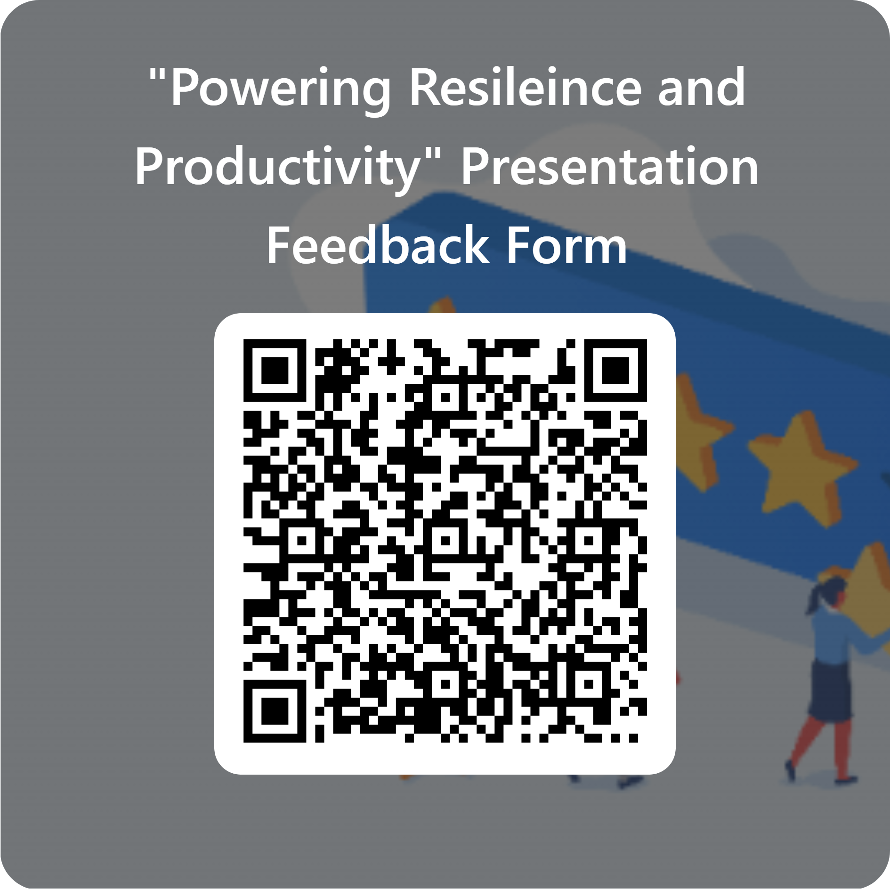



Scan to give feedback on our presentation
Email jpc@mlss.gov.jm
@jamaicaproductivity
Jamaica Productivity Centre
@productivityja
Call +1 (876) 676-5739-40
Go to mlss.gov.jm/jpc
Notes:
QR code/service offering together (consider dropping service offering)
Contact info (more distinct, in own slide?)
Drop QPS

