Slide 1

Strengthening Ties
Spectrum Management Authority of Jamaica & Telecommunications Regulatory Commission (TRC) of the British Virgin Islands

Slide 2
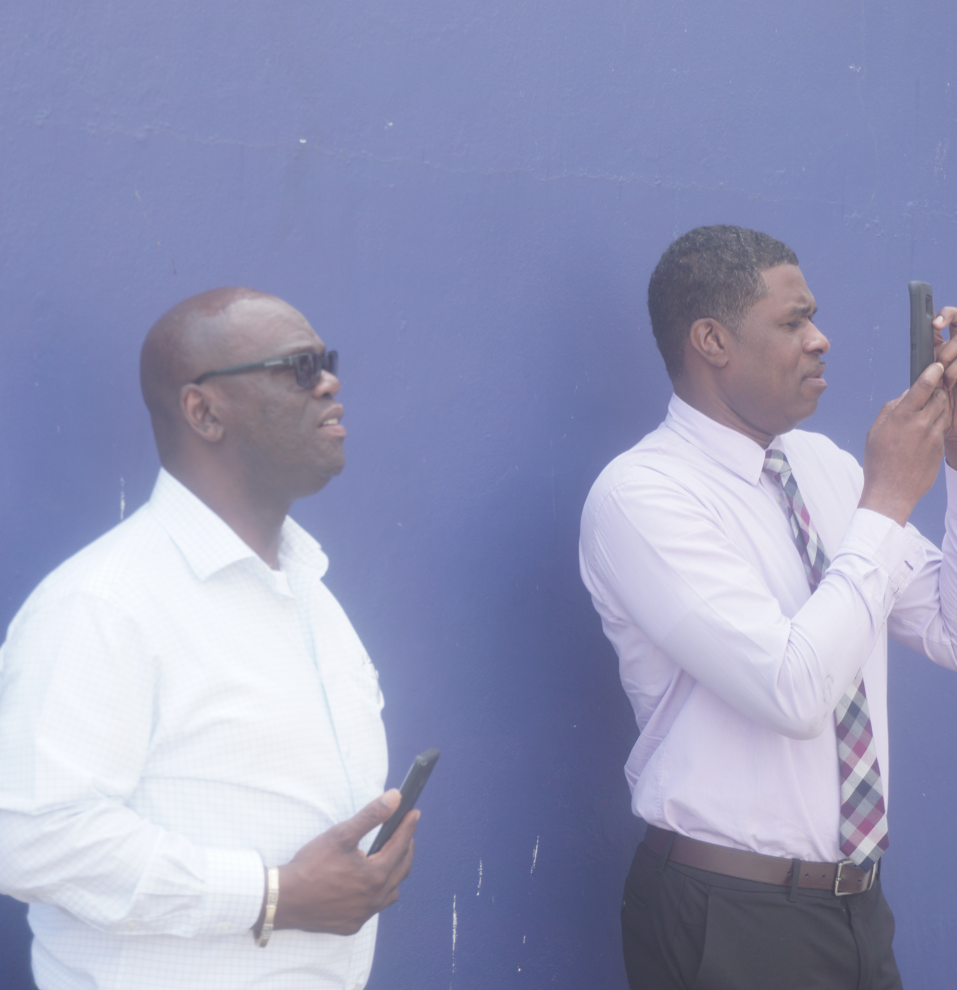
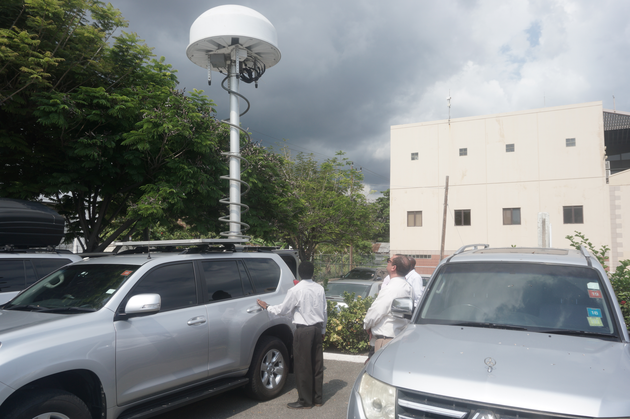

Regulator Collaboration Employee Secondment Initiative
Spectrum Management Authority Jamaica
Telecommunications Regulatory Commission
British Virgin Islands
Leading spectrum regulation and monitoring across the island, bringing world-class engineering expertise to the Caribbean region.
Governing telecommunications and spectrum use across the BVI, committed to building robust regulatory capacity for the future.

Slide 3

Our Discussion
Phase 1: Foundation
Background
Strategic Partnership
Secondment Agreements
Secondee Arrival in the BVI
Phase 2: Implementation
Phase 3: Review
Objectives of the Secondment
Terms of Reference
Workplan
Expected Deliverables
Additional Considerations
Reports
Conclusion
AGENDA

Slide 4
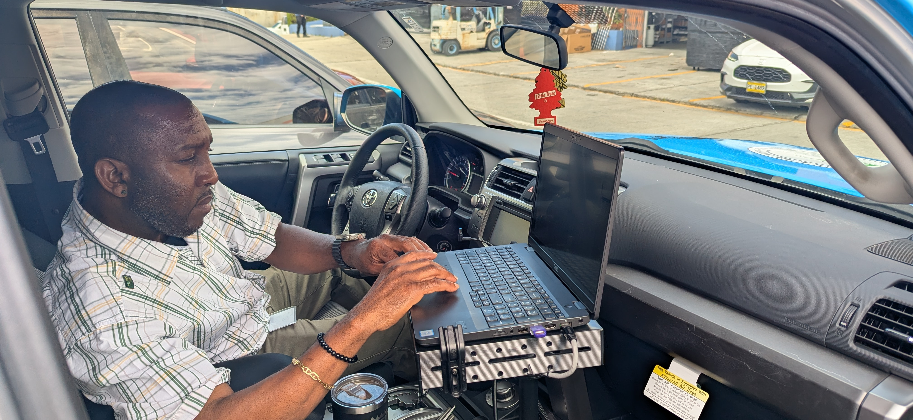
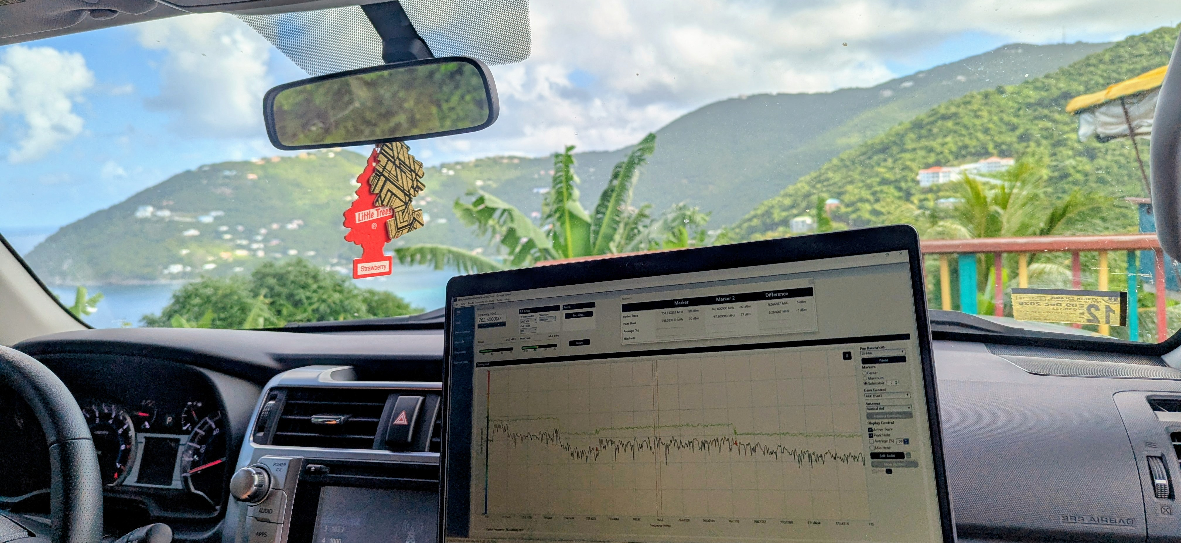
In the Beginning
We spoke. We planned. We acted.
What started as a conversation between two regulatory bodies became a landmark initiative for Caribbean telecommunications cooperation — a story of vision, commitment, and decisive action.

Slide 5


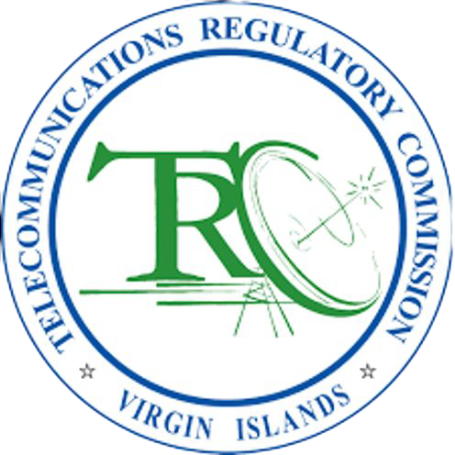
Employers Secondment Engagement
Spectrum Management Authority
Jamaica
Providing world-class telecommunications engineering expertise and spectrum monitoring capabilities to support regional partners.
Telecommunications Regulatory Commission
British Virgin Islands
Strengthening its spectrum management function through strategic talent sharing and inter-agency collaboration.

Slide 6

Background
2022
TRC team visited SMA in Jamaica and subsequently benchmarked and acquired similar monitoring equipment in
the BVI.
1
COVID-19 Pause
TRC and SMA commenced talent-sharing discussions, which were halted due to the COVID-19 pandemic.
2
February 2025
Discussions resumed with heads of entities along with critical members representing engineering and human resources.
3
Working Groups
Divisional heads and teams from both entities formed two working groups to formulate and finalise the technical terms of reference, work plan, and HR terms.
4
Agreement Finalised
Governance criteria were ascertained; secondment agreements were crafted and reviewed by legal representatives from both entities for approval by the HOEs.
5

Slide 7







Objectives of the Partnership
Temporary Secondment
Temporary secondment of two telecommunications engineers from SMA to TRC to provide hands-on technical
expertise.
Support Spectrum Operations
Support TRC's spectrum operations in the BVI, ensuring effective management of the radio frequency environment.
01
02
03
04
Enhance Capacity Enhance capacity in spectrum management, equipping the TRC with the skills and tools needed for modern regulatory
oversight.
Knowledge Transfer Enable knowledge transfer and further collaboration between the two regulatory bodies for long-term regional benefit.

Slide 8


Strategic Partnership
Partnership Agreement
The TRC (BVI) and SMA (Jamaica) signed an agreement to share talents to bolster individual, organizational, national, and regional capacity.
Engineering Secondment
Two SMA telecommunications engineers were seconded to the TRC for twelve months to strengthen radio frequency monitoring and inspection capabilities.
Technical Support & Training
SMA engineers assist with building out monitoring functions, training staff on techniques, and using specialized monitoring equipment.

Slide 9
The Secondment Agreement
01
The Secondment Agreements outline the scope and objectives of technical assistance sought by the TRC from the SMA.
02
Under this collaborative agreement, an SMA telecommunications engineer would be seconded to the TRC’s Spectrum Management Department, with a specific focus on enhancing spectrum monitoring capabilities.
03
This secondment would support the Commission’s strategic objective to strengthen its capacity to monitor the radio frequency environment, a vital function amid rising demand from wireless technologies.
04
The initiative represents a critical step toward fostering inter-agency collaboration, optimizing national spectrum resources, and ensuring regulatory readiness.

Slide 10
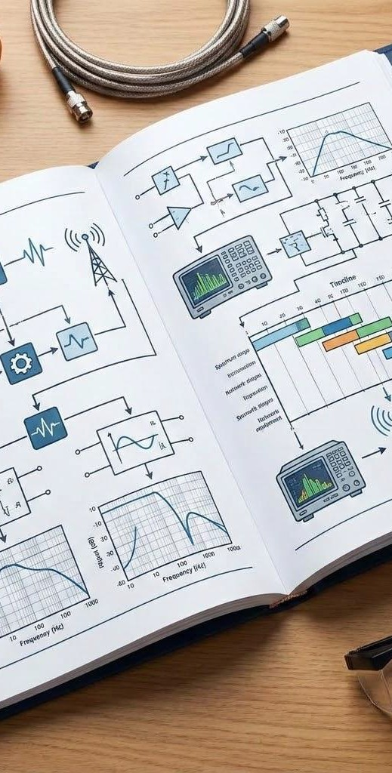



The Agreement Structure
Two agreements. One secondment. Clear roles, defined terms, and shared accountability.
Part 1 – Employers (Principal Agreement)
Part 2 – Employee (Secondary Agreement)
Two six-month agreements were separately signed by each of the selected telecommunications engineers between the SMA and the TRC, without negatively affecting their substantive employment contract with the SMA.
Schedules A and B
The technical Terms of Reference and Workplan attached to each agreement outline the Secondee’s RF technician activities to be carried out by the telecommunications engineers and monitoring engineers over the period of their assignment to the TRC.
One twelve-month agreement was signed by the TRC and the SMA for the secondment of two telecommunications engineers from SMA, Jamaica, to TRC, British Virgin Island.

Slide 11
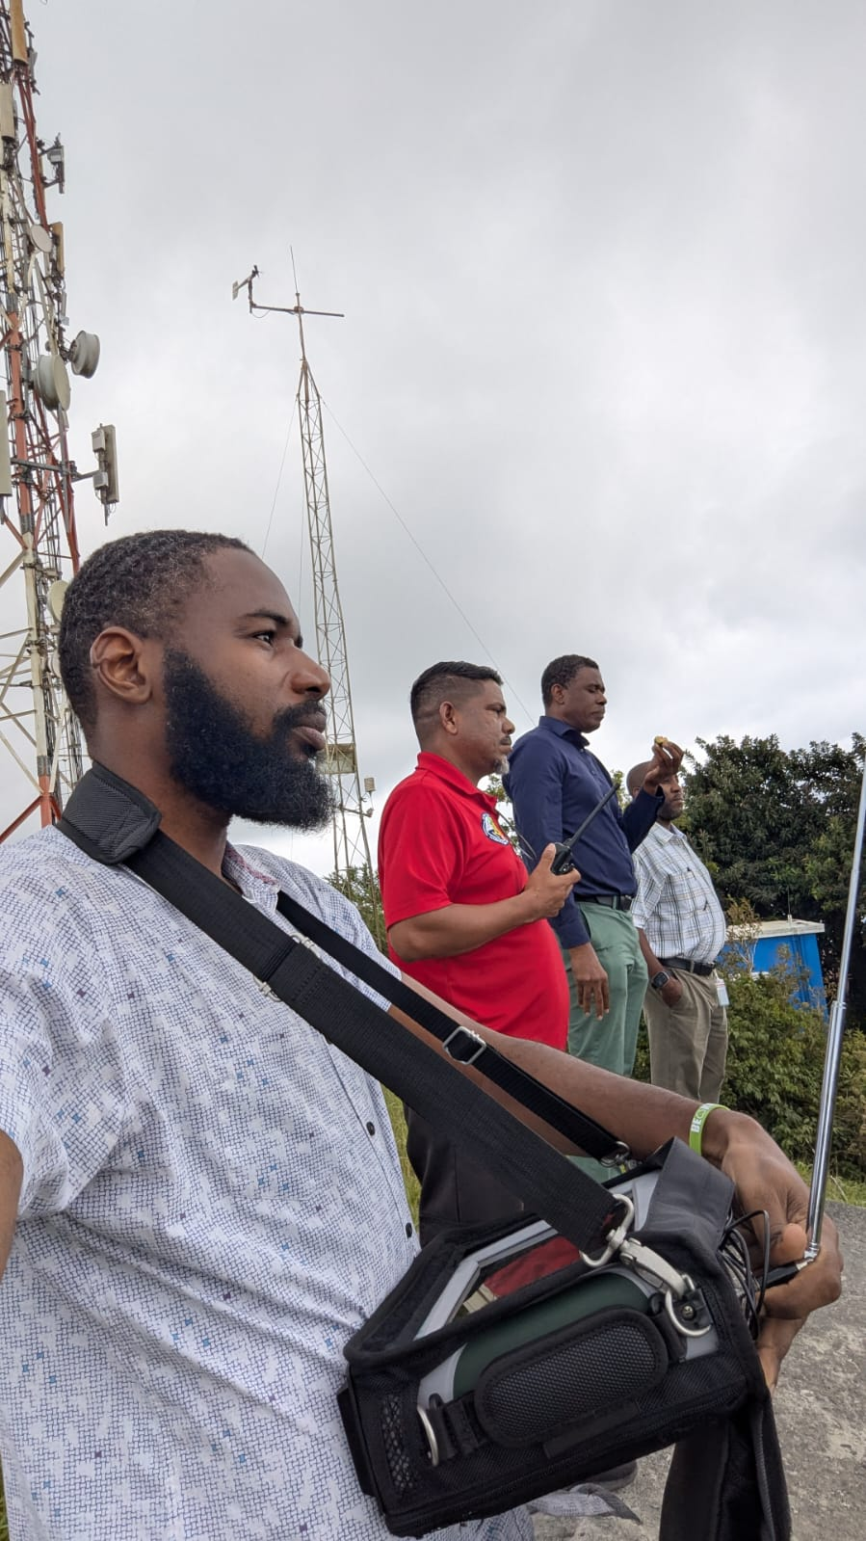
Peter's Arrival in the BVI
Mr. Peter Bartley, Telecommunications Engineer (Monitoring and Inspection), arrived in the BVI on Sunday, October 12, 2025.
Peter was warmly welcomed and cared for by the TRC team:
Welcome Team
Mrs. Denise Stoutt-Johnney
Human Resources Manager
Department Lead
Mr. Gregory Nelson
Manager, Spectrum Department



Slide 12

Key Performance Indicator
01
Temporary deployment strengthens TRC’s spectrum management capacity
02
Secondees maintain SMA employment status throughout
03
Defined roles promote operational support and knowledge
04
Agreement promotes cooperation and regulatory effectiveness in the BVI.

Slide 13

The primary objective of this initiative is to strengthen the Commission's national spectrum monitoring capabilities. This collaboration with the SMA aims to enhance technical oversight of the radio frequency environment and ensure more effective management of the spectrum resource in the Virgin Islands.
Objectives
Detect unauthorised Use
Identify and document unauthorised spectrum use across all BVI islands.
Assess Current Usage
Assess current spectrum usage and coverage in a structured, data-driven manner.
Prepare for 5G
Prepare for future spectrum allocations, including 5G and emerging wireless technologies.

Slide 14

Terms of Reference
TRC shared details of its current spectrum monitoring landscape, citing the objectives, scope, and expected outcomes of the technical assistance to be provided. The SMA would provide the support in accordance with the following:
Current Spectrum Monitoring Landscape
Objectives of the Secondment
Expected Deliverables
Implementation Plan and Timelines

Slide 15

Implementation Plan & Timelines
Q1 (Months 1–3)
In Progress
Develop General Guidelines for Spectrum Monitoring
Orientation with Commission staff & Review tools
Begin development of guidelines
Field assessments on Tortola
Q2 (Months 4–6)
Upcoming
Measurements on Virgin Gorda, Anegada, & Jost Van Dyke
Identify unauthorized use & Refine guidelines
Start drive tests
Conduct Field Spectrum Measurements
Q3 (Months 7–9)
Planned
Assess Spectrum Availability for 5G Deployment
Complete 5G readiness assessment (low/mid-band)
Deliver internal training & QoS analysis
Draft interim findings
Q4 (Months 10–12)
Planned
Evaluate Mobile Network Coverage and Service Quality
Finalize Guidelines & Submit final reports
Deliver recommendations
Knowledge transfer wrap-up session

Slide 16
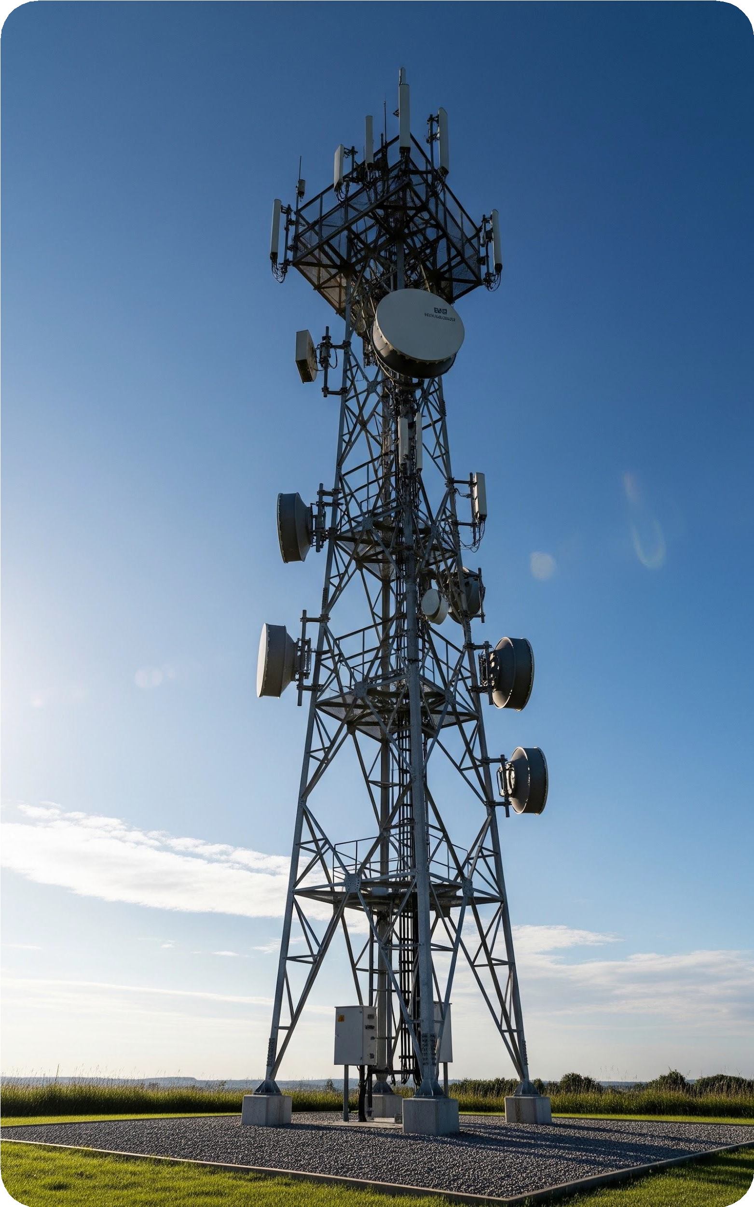
Workplan, Milestones and Timelines
The Telecommunications Engineer (SMA Secondee) will serve as RF Technician at the TRC to support delivery in six (6) phases:
PHASE 01
Initial Assessment and Research
Months 1-2
PHASE 02
Equipment and Technology Evaluation
Months 3-4
PHASE 03
Standardizing Procedures and Reports
Months 5-6
PHASE 04
Monitoring – IMT Band & 5G Readiness
Months 7-8
PHASE 05
Training and Knowledge Transfer
Months 9-10
PHASE 06
Final Review and Recommendations Months 10-12

Slide 17
Expected Deliverables

ONE
Spectrum Monitoring Guidelines

TWO
Field Measurement Reports

THREE
5G Readiness Assessment

FOUR
Mobile Network Coverage & QoS

FIVE
Training and Knowledge Transfer

SIX
Final Recommendations Report

Slide 18
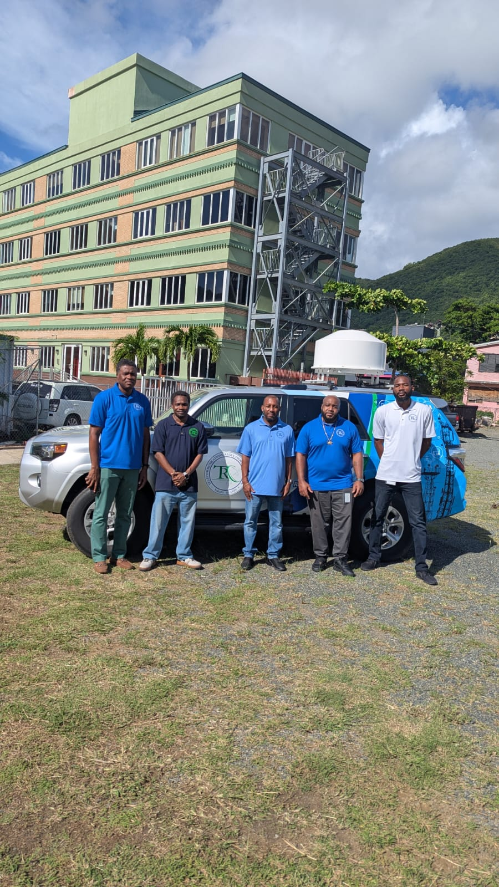
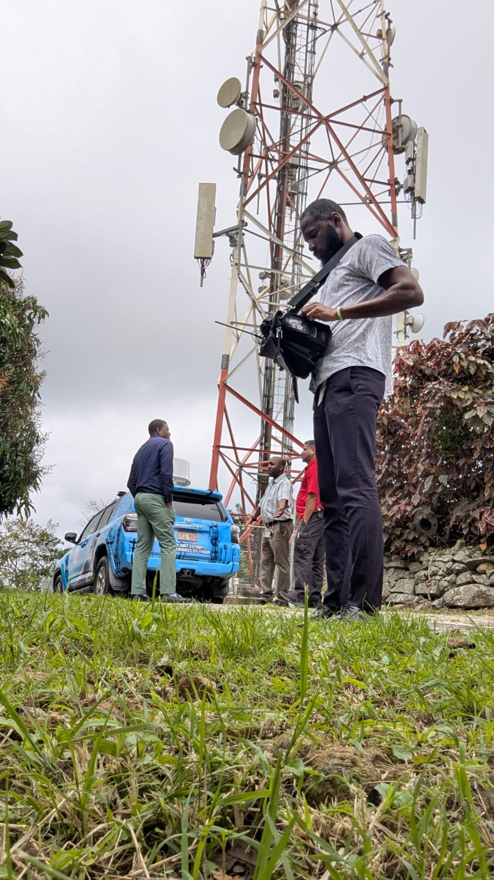
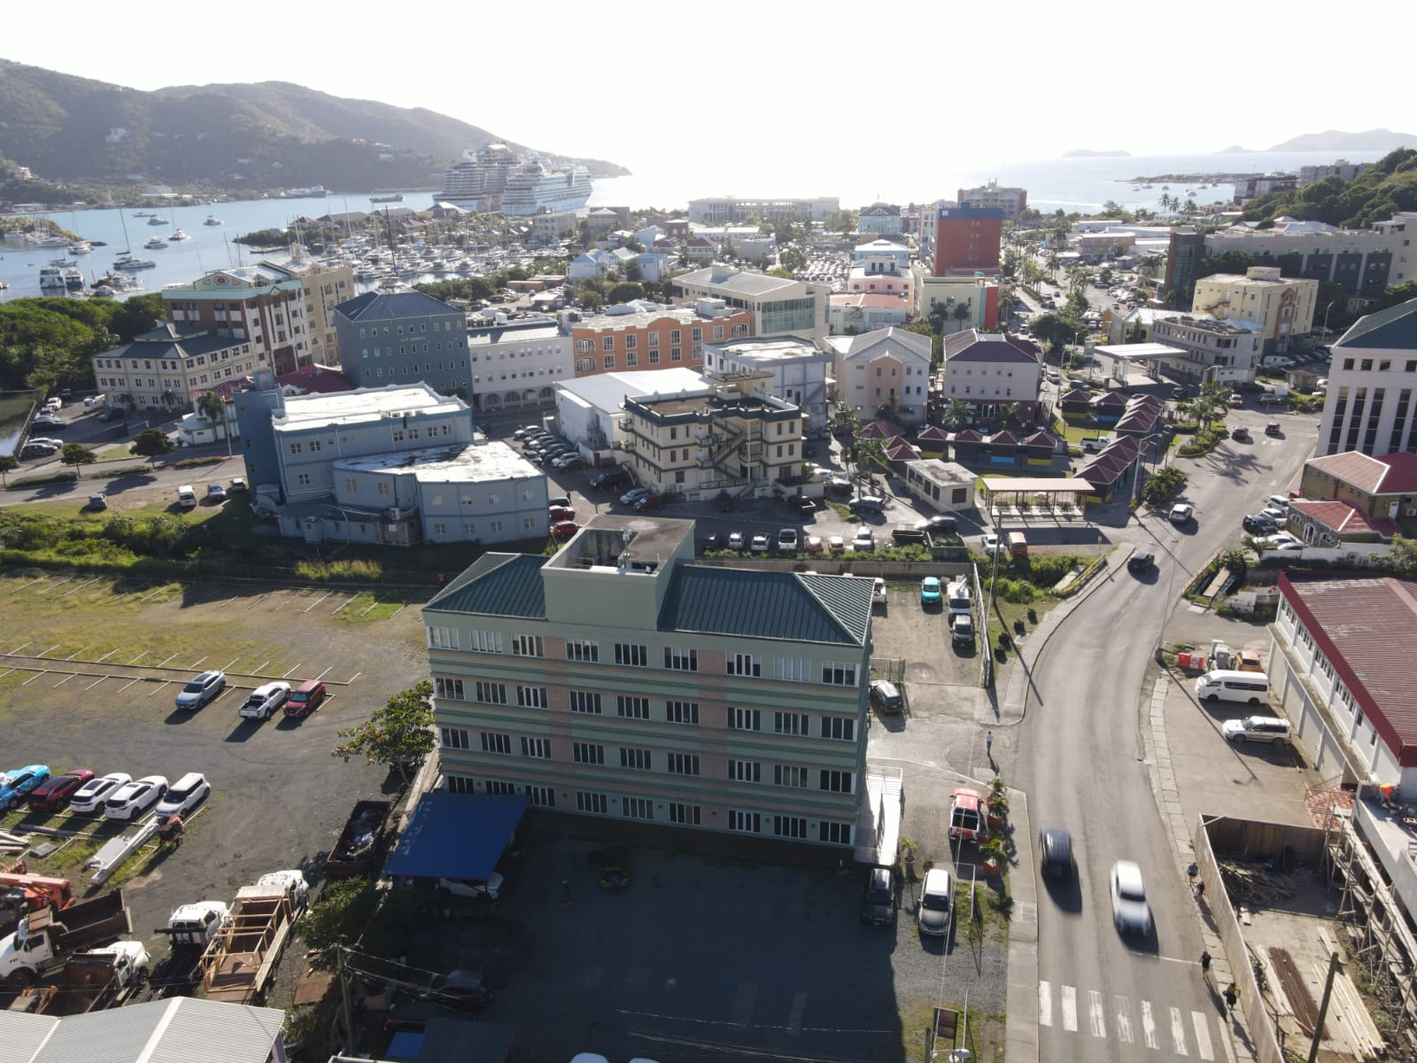
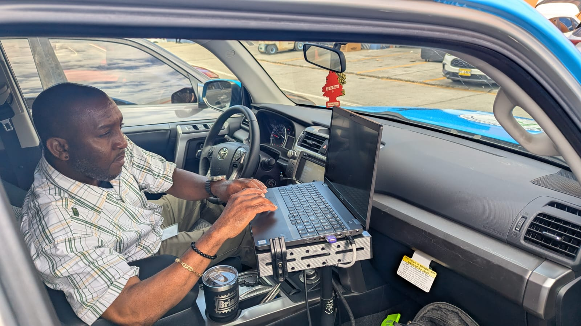
Weekly/Monthly Reports
ONGOING UPDATES
Peter’s participation in weekly Spectrum Engineering Division meetings (Jamaica) to provide an update on the work plan.

Slide 19


Key Benefits
Spectrum Capacity
Deployment strengthens management capacity.
Regional Cooperation Promotes regulatory eﬀectiveness in both BVI and Jamaica


Employment Status
Secondees maintain SMA status throughout.

Operational Support
Defined roles promote knowledge transfer.

Equipment Optimization
Increased functionality using a spectrum analyzer.

Timeline Efficiency
Interference resolution timeline reduced.

Slide 20
Strategic Outcomes

Regional Collaboration
Secondment Agreement as a catalyst for strengthening regional regulatory capacity and trailblazing initiative in the Caribbean.

Human Capital Growth
Talent sharing resulting in organizational adaptability and strategic workforce planning aligned with CSME principles.

Global Sustainability
Aligning regional activities with global sustainable development goals through transformative priorities and shared actions.

Digital Transformation
Shifting towards shared services, remote/hybrid working models, and the integration of Artificial Intelligence.
01
02
03
04
These outcomes represent a strategic evolution from resource preservation to dynamic, technology-driven regional cooperation.

Slide 21


Thank you.
Questions and Discussion
“Success is achieved through action, perseverance, and a positive mindset, often requiring hard work, collaboration, and the ability to overcome challenges.

