Slide 1
Balancing Access and Stability
Jamaica’s Evolving Power Wheeling Framework
28 April 2026
Stanley G. Smellie, C.E.M.
Regulatory Policy Specialist
OOCUR 20th Annual Conference
Falmouth, Jamaica | 27 April – 1 May 2026
Notes:
Good morning/afternoon. [pause]
It’s a privilege to join you here at OOCUR’s 20th Annual Conference in Falmouth, Trelawny, Jamaica.
Today I’ll share Jamaica’s evolving approach to power wheeling—[pause]
how we are balancing expanded access with system stability, financial viability, and fairness. [beat]
All within a small island context. [pause]

Slide 2
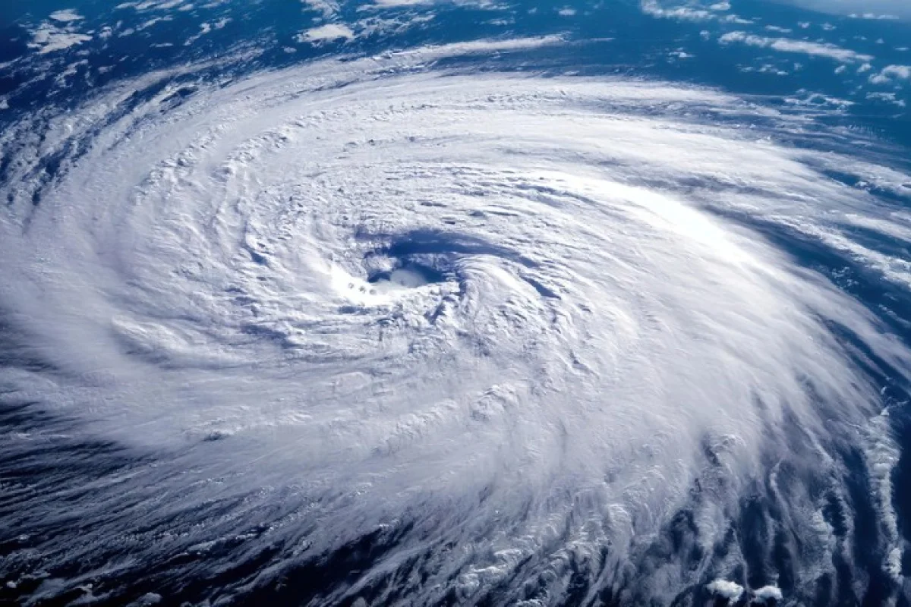
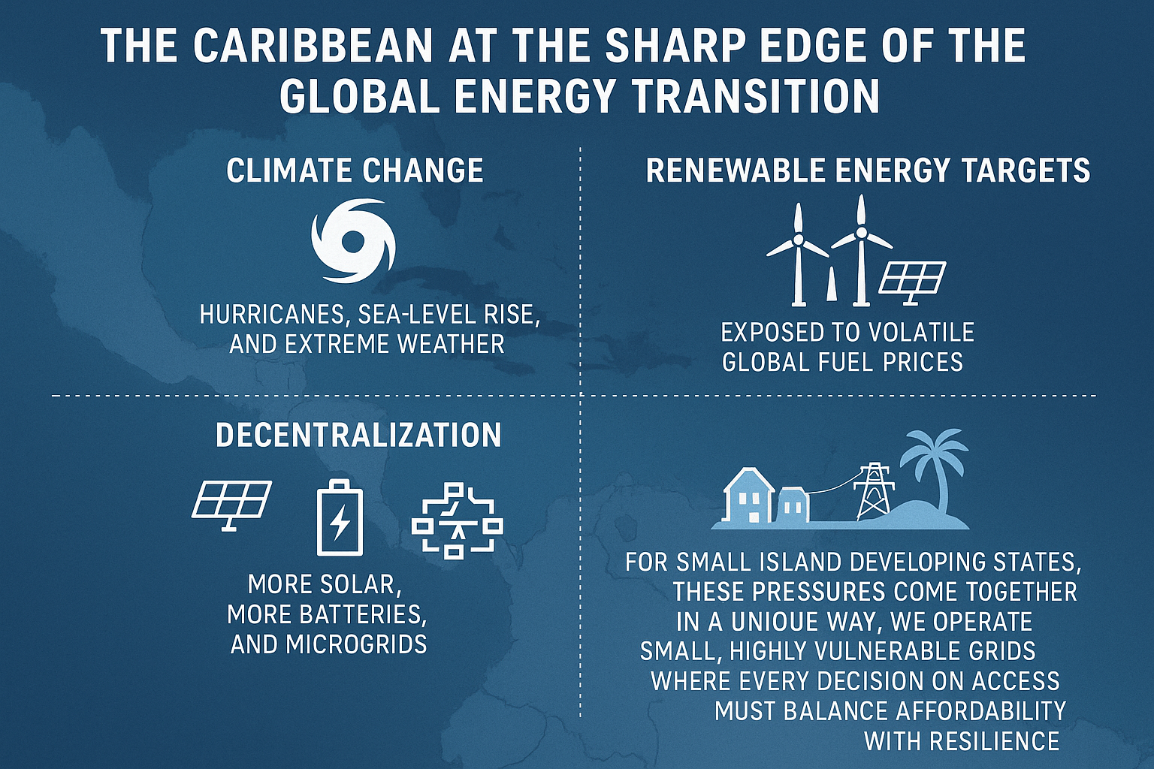
Energy Transition in the Caribbean
Modernizing grid access in a vulnerable region
Drivers of change
  Climate change impacts
  Renewable energy targets
  Fuel price volatility
  Decentralization (solar, batteries, microgrids)
Core challenge for SIDS
  Small grids, high vulnerability
  Balancing affordability, resilience, and access
How do we modernize grid access in this environment of constraint and opportunity?
Notes:
The Caribbean sits at the sharp edge of the energy transition.
We face climate exposure, fuel dependence, and a rapid shift toward decentralized energy. [pause]
For small island systems, these pressures converge sharply.
Our grids are small and more vulnerable—limited margin for error. [pause]
So the challenge is not simply whether to modernize grid access. [pause]
The real challenge is how to modernize grid access in a way that preserves reliability, supports affordability, and strengthens resilience. [beat]
That is the broader regional context in which Jamaica’s wheeling framework has been evolving.
Which leads to the real question: [slight pause]
How do we expand access… [pause]
without compromising affordability or reliability? [beat]

Slide 3

What is Power Wheeling?
Definition:
Transportation of electricity generated by a licensed self-generator across the National Grid for use at specified locations.
Why it matters:
  Unlocks self-generation
  Optimizes investment in renewables
  Diversifies electricity supply
Context in Jamaica:
  Electricity Act, 2015
  JPS Licence 2016 (Condition 12)
  Electricity (Wheeling) Regulations, 2025
  Transition from concept → implementation
Continuous movement of electricity across the grid
Notes:
Let’s now get practical—what is power wheeling? [pause]
At its simplest, it is the transportation of electricity generated by a licensed self-generator across the national grid for use at another location. [pause]
Think of it as movement across a defined pathway—the grid.
Electricity generated in one place, delivered to another. [pause]
So the grid becomes not just a supply system—but a platform for energy transfer. [pause]
Why does that matter? [pause]
It unlocks investment, supports renewables, and diversifies supply. [pause]
In Jamaica, we’ve moved from concept… [pause] to implementation. [beat]
For government, this is not just technical—it enables investment, lowers costs, and strengthens resilience.
For utilities, it’s a structured way to integrate new generation while keeping the grid stable.

Slide 4

Jamaica’s Regulatory Journey
Tri-partite contractual framework
OUR’s role:
  Exploratory – structured implementation
  Principle-based, phased approach
Tri-partite contractual framework
Legal anchors:
  Electricity Act (2015) – grid access rules
  JPS Licence (2016) – wheeling obligations, non-discrimination, interconnection rights
  Electricity (Wheeling) Regulations, (2025) – licensing, access, and system charges
Key tension: balancing JPS’s exclusive transmission, distribution, and sale rights with evolving market access and participation
Access
Wheeling Contract
Backup
Sale
Top-Up & Standby Contract
Excess Energy Contract
(Developed to operationalize wheeling within the regulatory framework)
Notes:
Let’s take a closer look at Jamaica’s regulatory journey. [pause]
Our approach has been deliberate. [pause]
We moved from exploration to structured implementation—[pause]
anchored in law, licence obligations, and regulation.
Then we operationalized through a tri-partite contractual framework. [pause]
This includes:
a Wheeling Contract governing access and transportation across the grid,
an Excess Energy Contract addressing surplus generation, and
Top-Up and Standby arrangements to ensure reliability of supply. [pause]
These are separate but interlinked contracts, operating within the statutory and regulatory framework. [pause]
And this brings us to a key tension: [beat]
How do we expand market access… [pause]
while maintaining system stability and respecting existing utility rights? [beat]

Slide 5
Insights from Stakeholder Engagement
Equity & Cost Neutrality
Wheeling must not burden non-participants
Fair Access
Non-discriminatory access reinforced by Licence
Financial Viability
Safeguard utility revenue stability
The OUR-determined system charges
Operational Integrity
Real-time metering & *DERMS
Curtailment protocols & firm capacity
No cross-subsidization across customer classes
Access governed by regulatory conditions
*Distributed Energy Resource Management Systems (DERMS)
Notes:
Stakeholder engagement revealed four foundational principles. [pause]
First—equity and cost neutrality. [pause]
No cross-subsidization from non-participating customers.
Second—fair access. [pause]
Non-discriminatory and rules-based.
Third—financial viability. [pause]
Cost-reflective charges.
And fourth—operational integrity. [pause]
Discipline, visibility, and control. [beat]
These principles now anchor the framework. [pause]

Slide 6
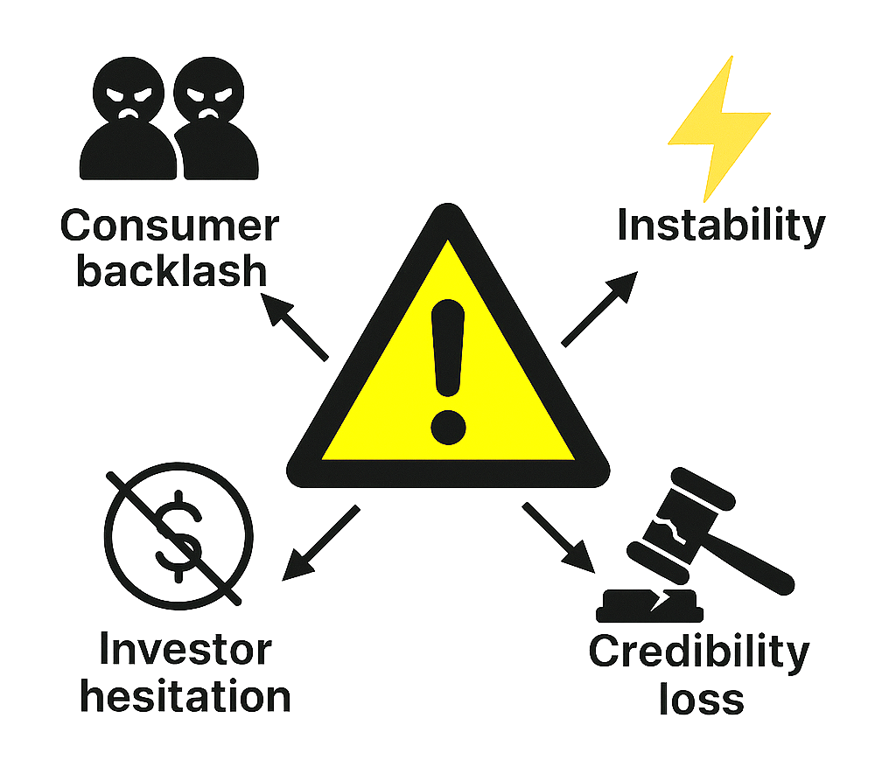
Risks of Poorly Designed Wheeling:
Why a phased approach is essential
Hidden subsidies → consumer backlash
Grid instability→ reliability threats
Investor hesitation → stalled self-generation growth
Regulatory credibility loss → reduced public trust
Notes:
If wheeling is poorly designed, the risks are immediate. [pause]
Hidden subsidies… [pause]
Grid instability… [pause]
Investor hesitation… [pause]
And loss of regulatory credibility. [beat]
That is why Jamaica adopted a phased approach. [pause]
To manage risk while building confidence. [beat]

Slide 7
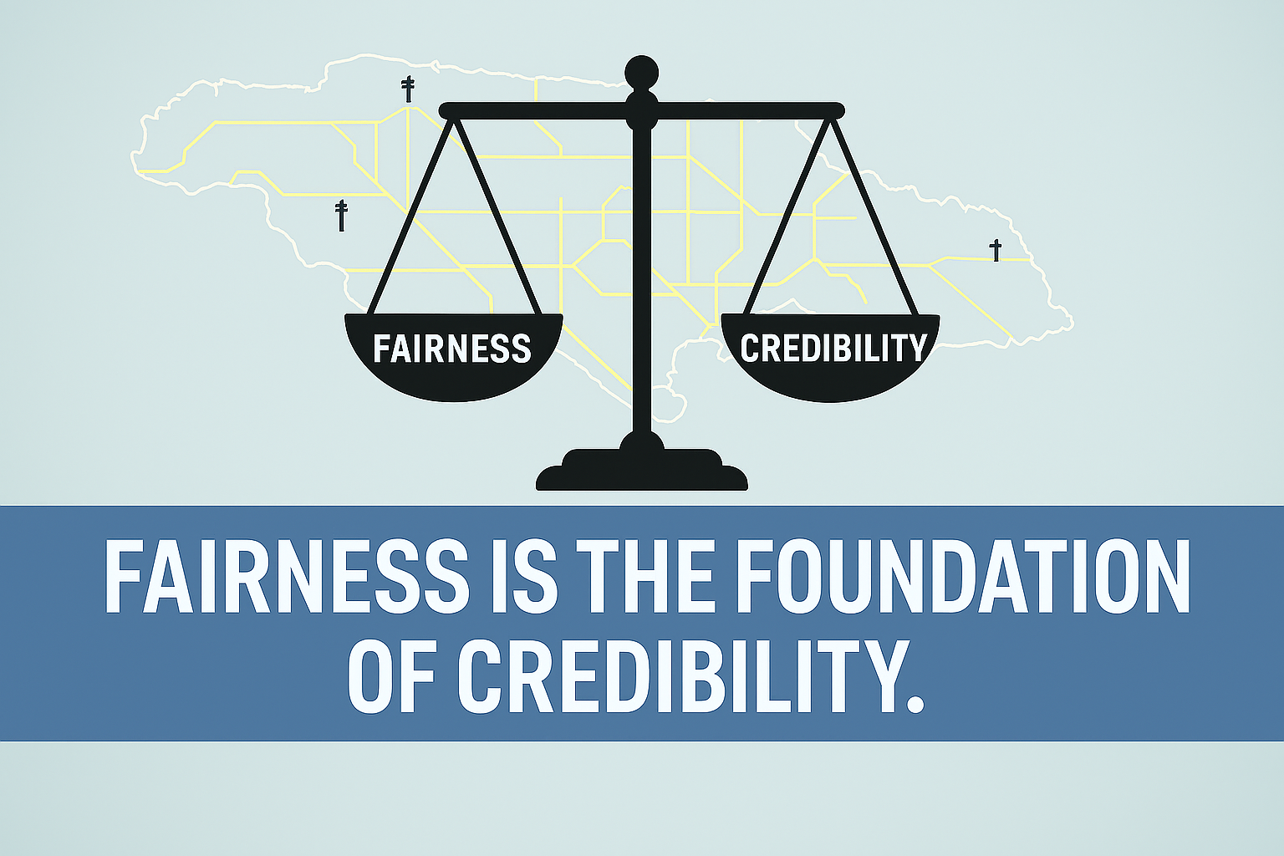
Regulatory Fairness & Credibility
Trust anchors reform
Fairness is a core principle of the OUR’s mandate, and is directly linked to credibility:
  Transparent process → legitimacy
  Engagement → fairness & trust
Fairness builds credibility; credibility sustains reform
“Regulating Utilities for the Benefit of All”,
is used as the OUR’s tagline
Notes:
A successful wheeling framework depends not just on technical design—but on trust in the rules that govern it. [pause]
Fairness is not abstract. [pause]
It is foundational. [beat]
Transparent processes build legitimacy. [pause]
Engagement builds trust.
And importantly—[pause]
fairness builds credibility… [pause]
and credibility sustains reform. [beat]
For regulators, wheeling tests how we safeguard fairness while enabling innovation.

Slide 8
From Phases to Convergence:
An Iterative Pathway
Phased implementation
Controlled rollout to manage risk and test assumptions
Early-stage reliance on structured contractual arrangements
Iterative refinement
Continuous improvement of pricing, access conditions, and operations
Regulatory framework evolves while contracts provide stability
Convergence
Mature, stable, and scalable framework
Full alignment between:
Regulations
Contracts
Grid operations
Contracts anchor trust, while regulation refines performance.
Notes:
Up to this point, we’ve explored the risks, the principles, and the importance of fairness and credibility. [pause]
The question then becomes—how does a system like this actually develop? [pause]
Our approach is iterative. [pause]
We start with phased implementation—[pause] controlled, careful rollout.
Then refine—[pause] improving pricing, access, and operations.
And ultimately, we converge—[pause]
toward a stable, scalable framework. [beat]
In simple terms: [pause]
Contracts anchor trust… [pause]
while the regulatory framework evolves over time, [pause]
and regulation improves performance. [beat]
At that point, wheeling becomes an integrated and scalable component of the electricity market.

Slide 9
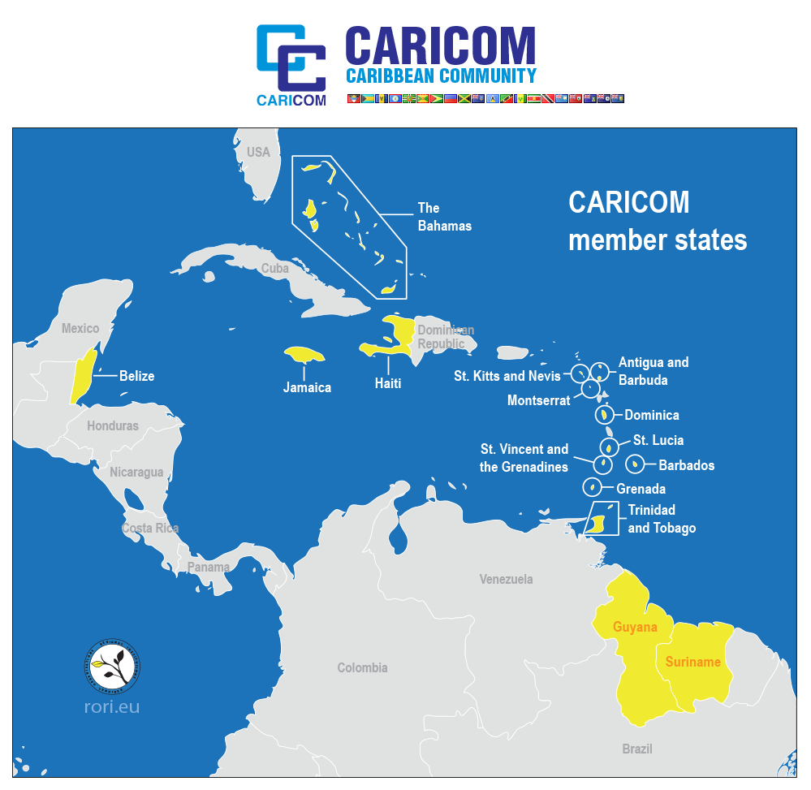
Sharing Lessons, Not Prescriptions
Regional & Global Relevance
Not a blueprint, an illustration:
Jamaica’s framework reflects its specific system and constraints
Transferable lessons:
Inclusive stakeholder engagement builds legitimacy
Cost neutrality protects non-participating customers
SIDS as innovation laboratories:
Agility enables rapid policy experimentation
Lessons from small systems can inform larger markets
Phased approach manages risk & supports learning
Notes:
This is not a blueprint. [pause]
It is an illustration. [beat]
But there are transferable lessons:
Engagement builds legitimacy. [pause]
Cost neutrality protects consumers. [pause]
Phasing manages risk. [pause]
And importantly—[pause]
small island systems can act as innovation laboratories. [beat]
While we may lack scale, we benefit from agility—the ability to test, adapt, and implement reforms more quickly.

Slide 10
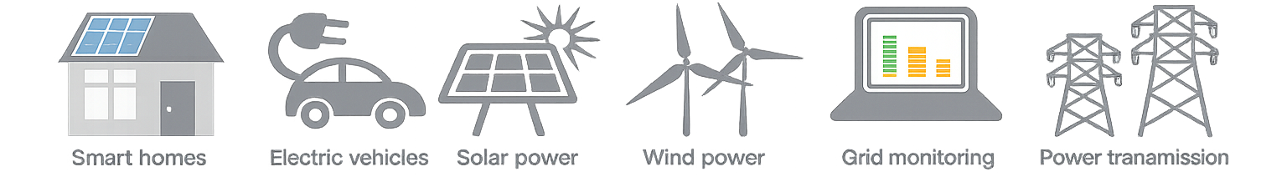
The Future of Utilities
Evolving Beyond the Traditional Monopoly
Evolving system dynamics
Increasing instances of bi-directional power flows
Expanding system complexity
More participants interacting with the grid
Evolving role of utilities
Growth in distributed energy resources
Greater coordination required to maintain stability
From sole supplier → system operator and facilitator
Maintaining reliability in a more dynamic environment
Resilience as a priority (SIDS context)
Diversified supply reduces exposure to shocks
Stronger systems enable faster recovery
Source of the icons: http://www.news.gatech.edu/2014/01/31/applying-lessons-learned-one-biggest-blackouts-history
Notes:
As we look ahead, power wheeling sits within a broader evolution of the electricity system. [pause]
Utilities are evolving. [pause]
From sole suppliers… [pause]
to system operators and facilitators.
We are seeing more distributed energy, [pause]
more participants, [pause]
and greater system complexity. [beat]
Which means coordination becomes critical—[pause]
and resilience becomes central. [pause]
A more diversified and flexible system improves resilience and recovery after shocks. [pause]
This is not about replacing the system—but strengthening and adapting it.

Slide 11

The Future of Utilities
Role of the Regulator: Making the Framework Work & Ensuring Fairness
Operationalising the framework
  Access, pricing, participation
Ensuring fairness
  Non-discrimination & enforcement
Safeguarding the system
  Stability, sustainability, credibility
Enabling innovation
  Within clear regulatory boundaries
Power wheeling enables:
🌞
Distributed Generation
👥
Consumer Participation
🌍
Energy Resilience
Notes:
So what is the regulator’s role? [pause]
To make the framework work in practice. [pause]
That means:
Enabling access… [pause]
Ensuring fairness… [pause]
Safeguarding the system… [pause]
And enabling innovation—[pause] within clear boundaries. [beat]
This is where policy becomes operational reality. [pause]
Power wheeling sits within this broader context—
supporting distributed generation, enabling participation, and strengthening system resilience.

Slide 12
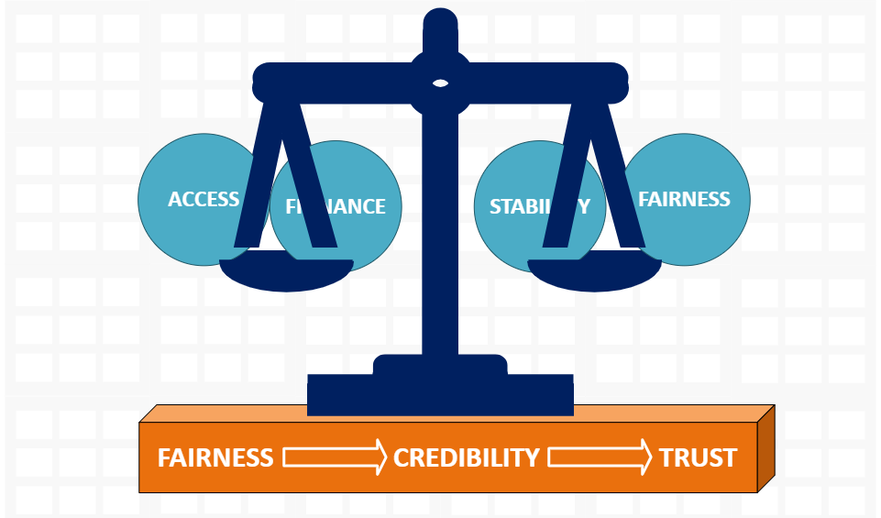
Conclusion & Call to Engagement
Balance: Access | Finance | Stability | Fairness
In wheeling, investing in trust sustains the system
Notes:
At its core, wheeling is about balance. [pause]
Access… [pause]
Finance… [pause]
Stability… [pause]
Fairness. [beat]
And underpinning all of it—[pause]
is trust. [pause]
Because in a shared grid, [slow]
trust is not optional – it is what sustains the system. [beat]
This is a model of disciplined regulatory innovation under constraint.

Slide 13
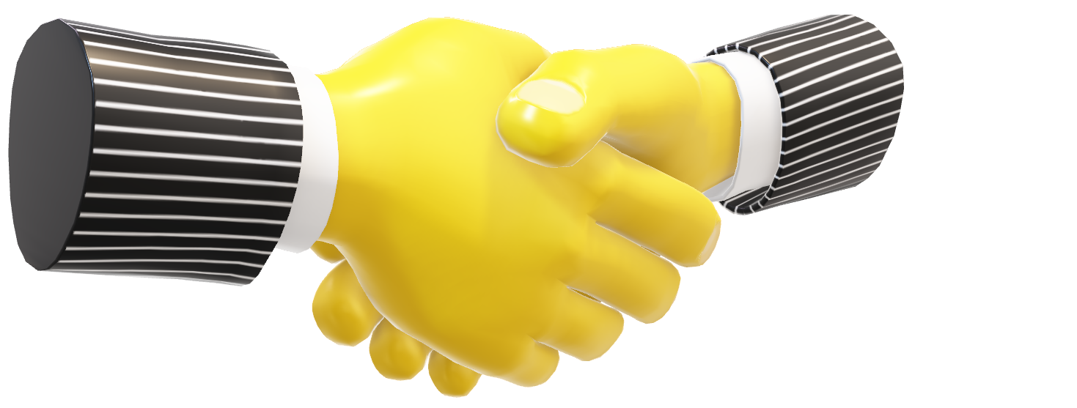
Thank You
Invitation: Let’s continue regional dialogue
Questions
Notes:
Thank you. [pause]
I look forward to your questions—[pause]
and to continuing the regional dialogue. [beat]

Slide 14
Thank You!
Stanley G. Smellie, C.E.M.
stanley.smellie@our.org.jm

